Slide 1


Slide 2


Project Title
First Year Project Synopsis
Submitted by
ROLL | NAME
2401730030 | Shreeya Ghai
2401730003 | Khyati Sharma
2401730008 | Nayan Goswami
2401730025 | Ojasvi Singh
Industry Mentor: Mr. Anuj Malik
Faculty Mentor: Ms. Suman
Notes:
New Courses replaced with New Programmes

Slide 3
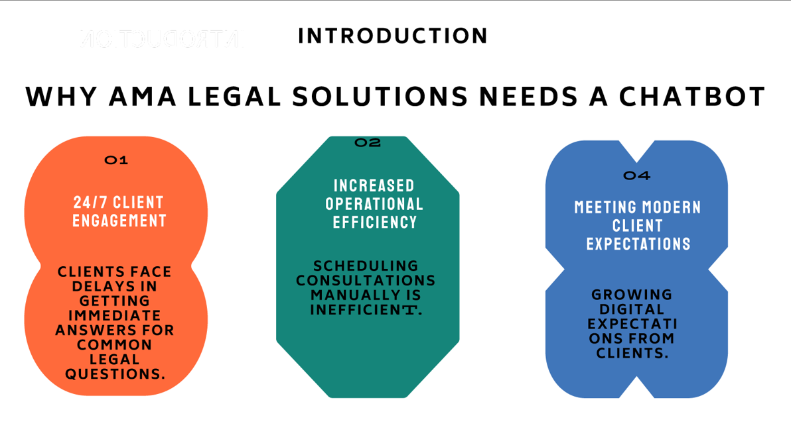

Project Overview
03
Notes:
New Courses replaced with New Programmes

Slide 4


ABOUT AMA LEGAL SOLUTIONS ​:-
AMA Legal Solutions is a well-known law of 650 cases and 300 closures were undertaken.
Established by Anuj Anand Malik, AMA Legal Solutions has established a great reputation for trust and client satisfaction.
The range of industries, including banking and law, intellectual property rights, real estate, civil laws, and loan settlements.​
Client engagement plans include past cases having prominent companies as BillCut, Saga Communications and Velocity Tours.​

Slide 5
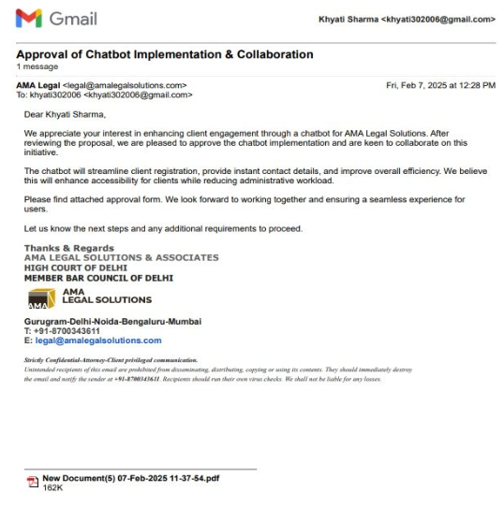
Our collaboration with AMA Legal Solutions :-

Slide 6
Problem Statement
Many legal firms, including AMA Legal Solutions, experience delays and inconsistencies in handling client queries.
This is important because delays and inconsistencies in handling client queries can lead to several negative outcomes like Client Dissatisfaction, Reputation Damage, Inefficiency, Missed Opportunities etc.
Solving this problem with the help of our chatbot will lead to faster responses, improved client satisfaction, and enhanced operational efficiency. It will reduce costs, provide a competitive edge, and ensure accessibility with 24/7 availability.
Notes:
New Courses replaced with New Programmes

Slide 7
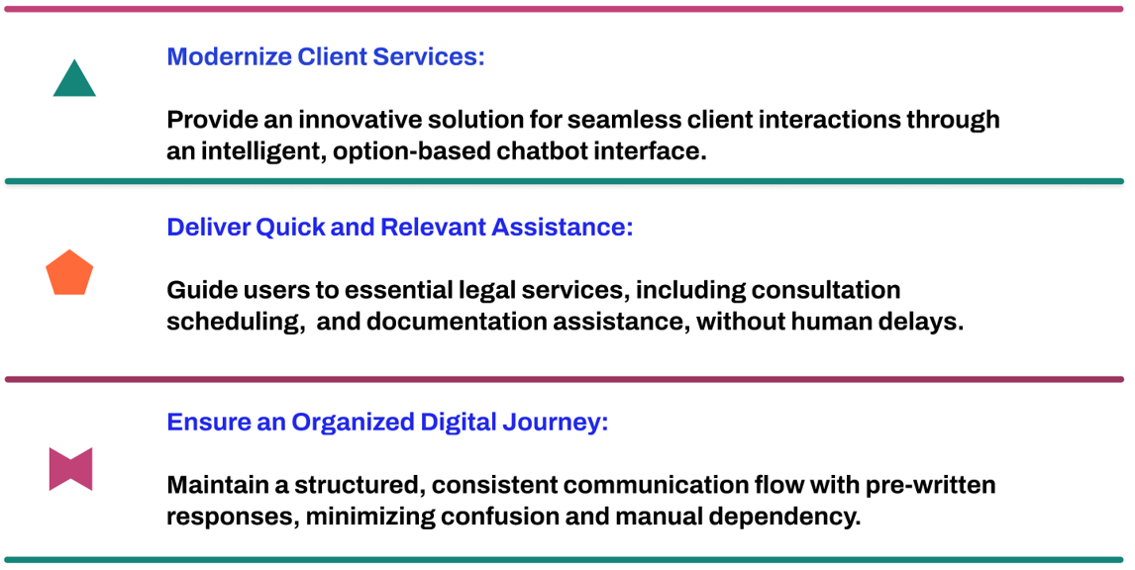
Objectives
Main goal of the project
Note: Specific objectives (3-4 key points - Not lengthy). No key words including Like, E.g., etc.
Notes:
New Courses replaced with New Programmes

Slide 8

Methodology, Tools, and Techniques
▪️ Create a frontend rule-based chatbot using HTML,CSS and Javascript.
▪️ Using backend to make our website based chatbot more advanced.
▪️To enhance client engagement, a database according to the firm’s requirement may be integrated.
▪️Deployment.
Notes:
New Courses replaced with New Programmes

Slide 9
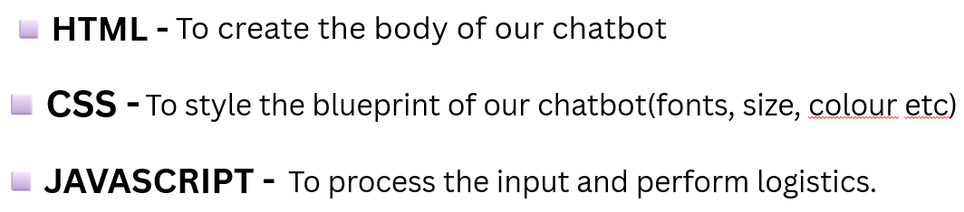
💡TOOLS and TECHNIQUES
▪️FRONTEND - TO MAKE VISUAL INTERFACE THROUGH USER INTERACTION.
Components to be used in frontend :-

Slide 10
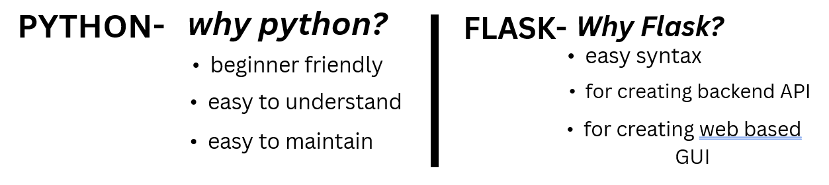
Backend-
To equip our chatbot with the ability to be responsive, storing information and fetching accurate outputs to the frontend.
Components to be used in backend:

Slide 11
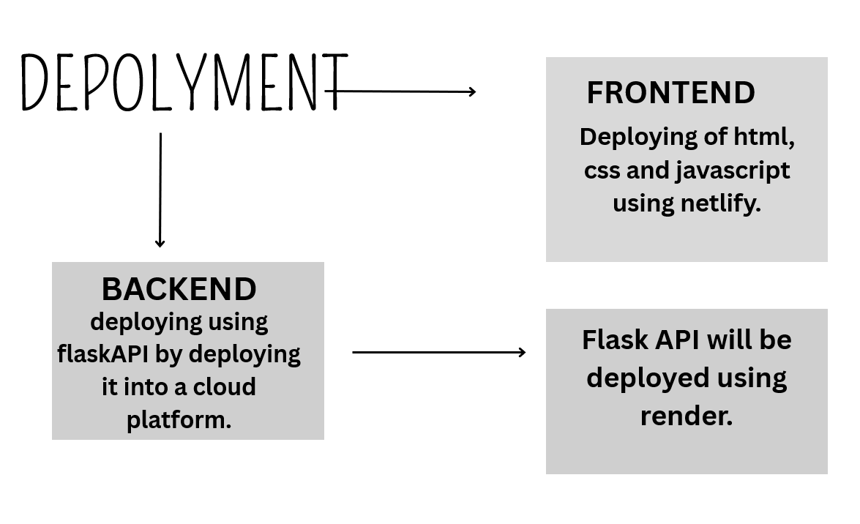
Depolyment Flowchart

Slide 12
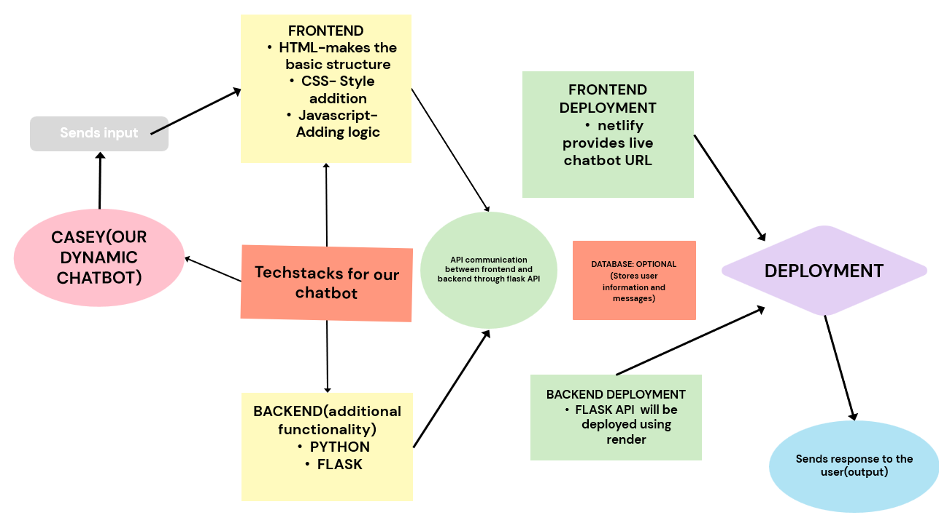
Methodology Flowchart
Notes:
New Courses replaced with New Programmes

Slide 13
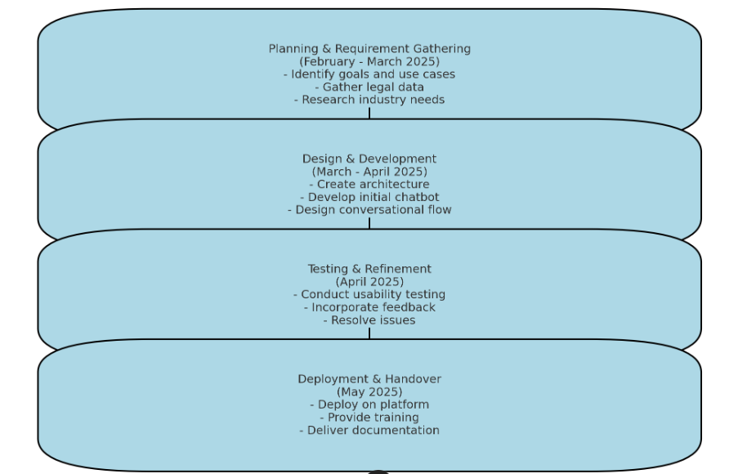
Project Timeline
Notes:
New Courses replaced with New Programmes

Slide 14
References
1. AMA Legal Solutions :-
WebsiteURL :- www.amalegalsolutions.com
Purpose :- Information about the firm's services, history, and expertise.
2. Online Webinar :-
Mr. K. Suresh, "Artificially Intelligent Chatbot," presented at the “Building an Artificially Intelligent Chatbot Workshop”, Webinar, 18th Jan. 2025.
Notes:
New Courses replaced with New Programmes

Slide 15
THANK YOU

