Slide 1
GENDER DETECTION
USING GENERATIVE AI
NAYAN KUMAR : 2105473
RAJASHREE DEB : 2105564 HARSHIT NAYAN : 2105820

Slide 2
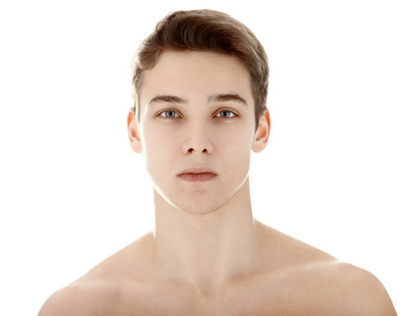
Need of gender detection project
Gender Detection Project is a real-time system designed to predict an individual's age range and gender based on facial features. It utilizes pre-trained deep learning models for classification and OpenCV for face detection.
Our objective is to develop a lightweight, efficient, and accurate system that can classify gender categories for applications in retail, security, and personalized user experiences.
The project focuses on live detection using a webcam feed or video input, making it suitable for real-time applications.

Slide 3

Generative AI
Generative AI refers to machine learning models that are capable of creating new content, such as images, text, music, or even code, based on patterns learned from existing data.
Generative AI typically uses deep learning techniques such as Generative Adversarial Networks (GANs) or Variational Autoencoders (VAEs) that learn the statistical properties of input data and use them to generate new, similar data.
Generative AI is set to revolutionize industries, enabling creators and businesses to explore new levels of innovation and creativity.

Slide 4
Applications of Gender Detection in Gen AI
Personalized Content Creation: Generative AI models can tailor content based on gender preferences to create targeted advertisements, videos, and user experiences.
Character Design and Gaming: AI-assisted character creation in video games and virtual environments can use gender detection to design characters that align with user preferences.
Healthcare Applications: Generative AI models using gender detection can create personalized health recommendations, such as diet plans or exercise routines. Improves inclusivity and gender-specific responses in AI-driven healthcare tools.
Research and Development: Facilitates data-driven studies in sociological, psychological, and marketing fields by synthesizing diverse content aligned with gender data.

Slide 5
Applications of Gender Detection in Gen AI
Bias in Training Data: AI models may inherit biases from datasets that lack diversity, leading to inaccuracies, particularly for non-binary individuals.
Accuracy Across Demographics: Variations in ethnicity, age, and cultural expressions affect detection reliability.
Ethical Concerns: Gender detection raises privacy issues and risks of misuse, such as discrimination or profiling.
Real-Time Detection Challenges: Poor lighting, angles, or resolution reduce performance in real-time scenarios.
Dynamic Nature of Gender Presentation: Models struggle to adapt to changes in gender expression over time or context.
Cultural and Social Sensitivities: Perceptions of gender vary culturally, leading to potential biases in globally deployed systems.

Slide 6
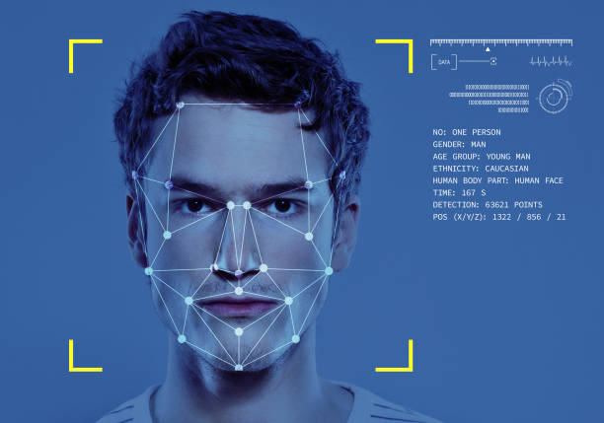
Advantage of multiple face detection
Real-Time Processing: Generative AI enables simultaneous detection of multiple faces in real-time, making it ideal for applications like crowd monitoring, surveillance, and live events.
Scalability and Efficiency: Efficiently processes large volumes of visual data, identifying multiple faces in crowded scenes without significant performance loss.
Enhanced Accuracy: Advanced AI models reduce false positives and improve accuracy by leveraging deep learning techniques, even in complex environments with overlapping or partially obscured faces.
Applications in Security and Authentication: Enhances multi-user security systems by identifying multiple faces for access control or threat detection in sensitive areas.

Slide 7
Technology Used
Python: Used for scripting and implementation of the detection system. Python's flexibility and extensive library support make it ideal for machine learning and computer vision tasks.
OpenCV:Provides tools for face detection and image processing.
Handles webcam or video input and overlays prediction results on the output feed.
Caffe:Deep learning framework used for the pre-trained age and gender classification models.
NumPy:Used for numerical computations, such as image normalization and data processing.

Slide 8

KEY FILES AND THEIR FUNCTIONS
2
gender_deploy.prototxt
1
age_deploy.prototxt
Defines the structure of the gender detection neural network.
Defines the structure of the age detection neural network.
4
gender_net.caffemodel
3
age_net.caffemodel
Pre-trained model weights for predicting gender.
Pre-trained model weights for predicting age ranges.
6
opencv_face_detector.pbtxt &
opencv_face_detector_uint8.pb
5
age_gender_detection_live.py
Python script for running the age and gender detection system in real-time using video input or webcam feed.
Configuration file for the OpenCV face detection model and Pre-trained weights for the face detection model respectively

Slide 9
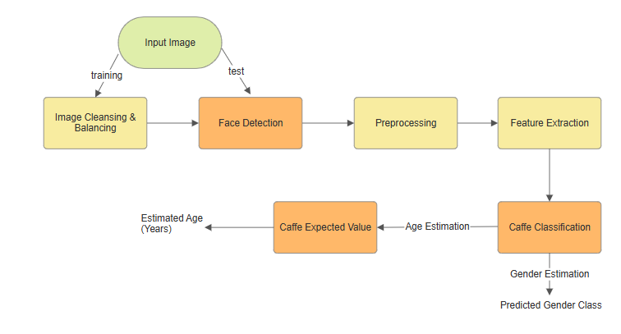
Project Working Model

Slide 10
STEP ONE
Load Pre-trained Models
The system loads the Caffe models (age_net.caffemodel and gender_net.caffemodel) along with their respective prototxt files (age_deploy.prototxt and gender_deploy.prototxt) to define the model architecture and weights.

Slide 11
STEP TWO
Face Detection
OpenCV's DNN module uses the face detection files (opencv_face_detector.pbtxt and opencv_face_detector_uint8.pb) to identify faces in the input image or video feed.

Slide 12
STEP THREE
Image Preprocessing
Detected face regions are cropped and resized to the input dimensions required by the models (e.g., 227x227 pixels).
Preprocessing includes normalization and scaling for accurate predictions.

Slide 13
STEP FOUR
Age and Gender Prediction
The cropped face is passed through the models:
Age Model: Predicts the age range (e.g., 0-2, 4-6, etc.).
Gender Model: Classifies the face as male or female.

Slide 14
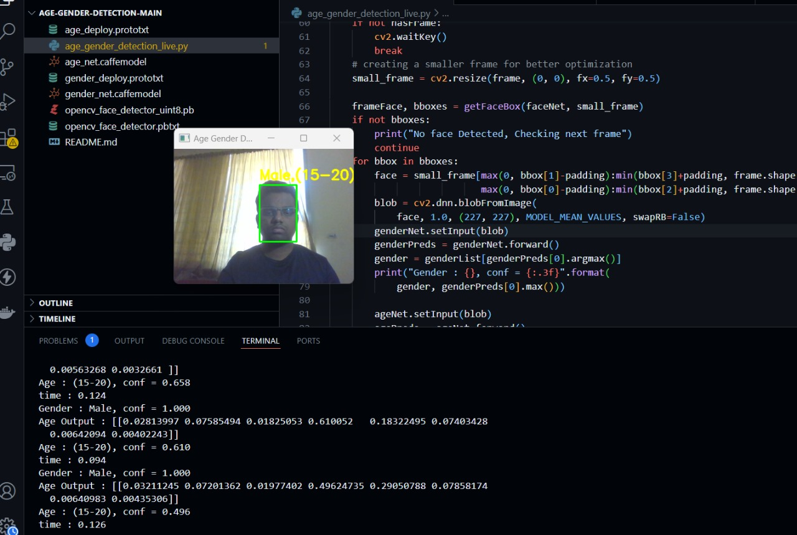
Experimental setup & Outcomes
Predicted age and gender labels are overlaid on the detected face in real-time with OpenCV. We collected results of 30 people to test the proper functioning of the application.

Slide 15

THANK YOU !

