Slide 1
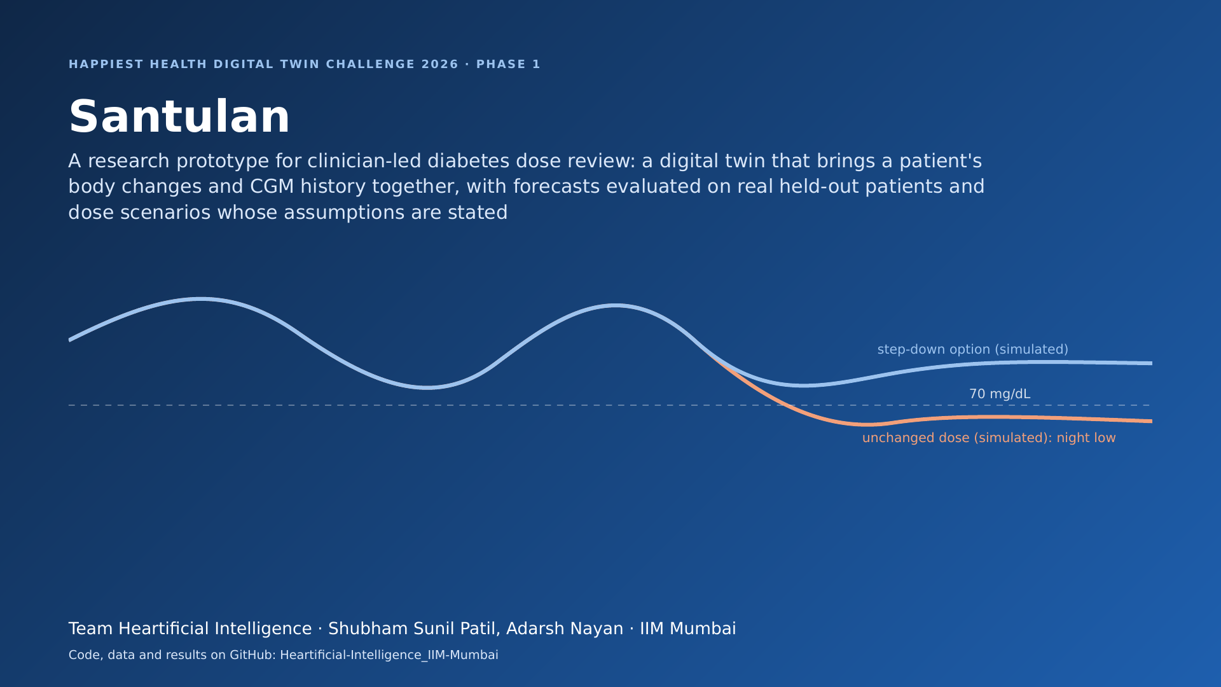
Notes:
Start about 0:00. Cover
Hello. We are team Heartificial Intelligence from IIM Mumbai: Shubham Patil and Adarsh Nayan. This is Santulan, our entry to the Happiest Health Digital Twin Challenge 2026.
Santulan means balance. It is a research prototype for one clinical job: the medication review for adults with Type 2 diabetes who take a sulfonylurea or insulin. The twin brings together a patient's body changes and their glucose sensor history, forecasts glucose for held-out real patients after a five-day personal calibration, and compares dose options under assumptions that are written down.

Slide 2
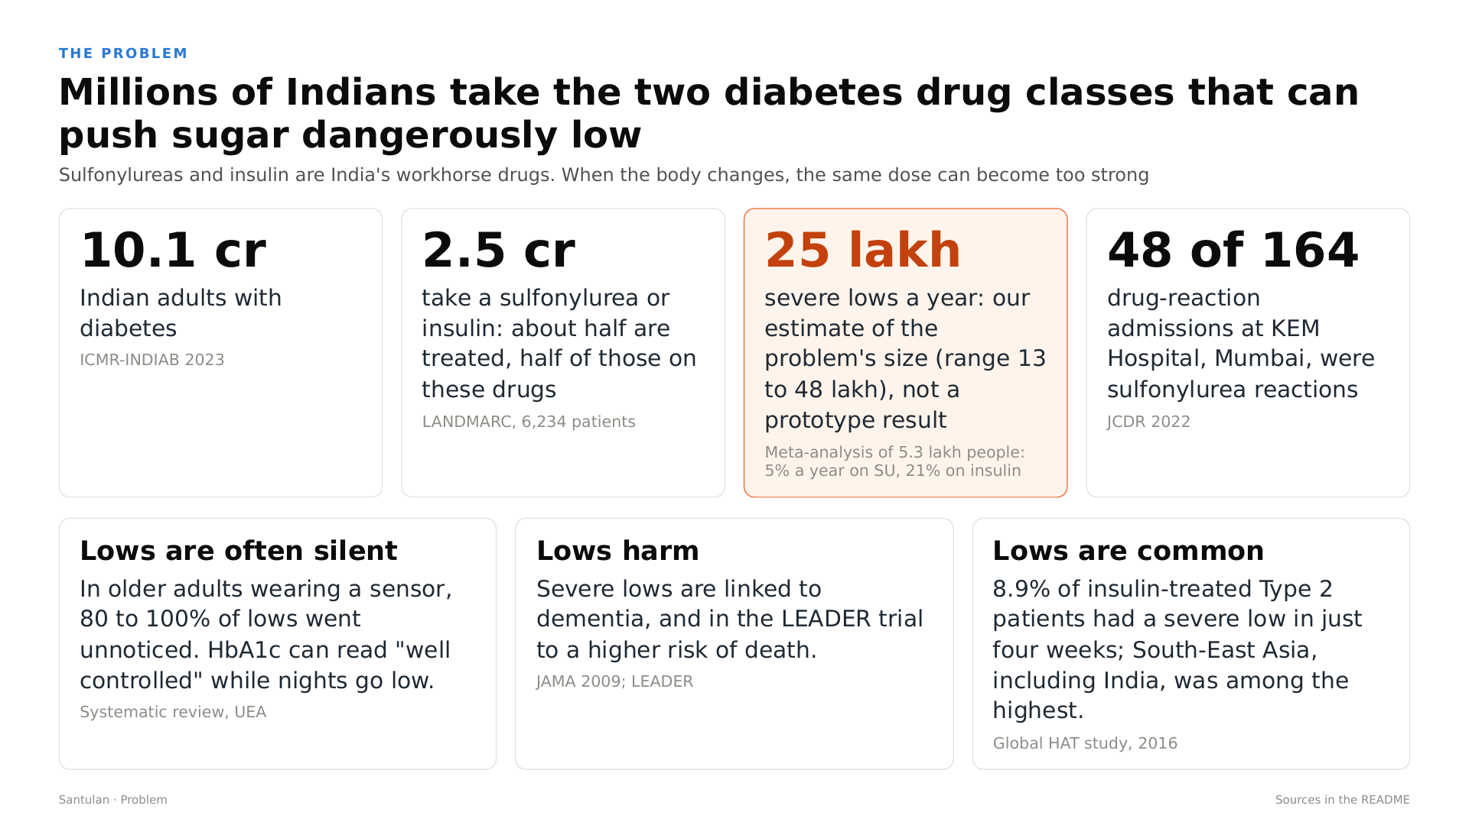
Notes:
Start about 0:39. The problem
India has about 10.1 crore adults with diabetes, according to the ICMR-INDIAB study. About half are treated, and about half of those take a sulfonylurea, such as glimepiride, or insulin. That is roughly 2.5 crore people on the two drug classes that can push blood sugar dangerously low.
How many severe lows is that? A meta-analysis of more than five lakh people found a severe low each year in about 5 percent of people on sulfonylureas, and 21 percent on insulin. Applied to India, that is our estimate of about 25 lakh severe lows a year, with a range of 13 to 48 lakh. That is a sizing of the problem, not a result of our prototype. And these lows reach hospitals: at KEM Hospital in Mumbai, sulfonylurea reactions were 48 of 164 drug-reaction admissions.

Slide 3
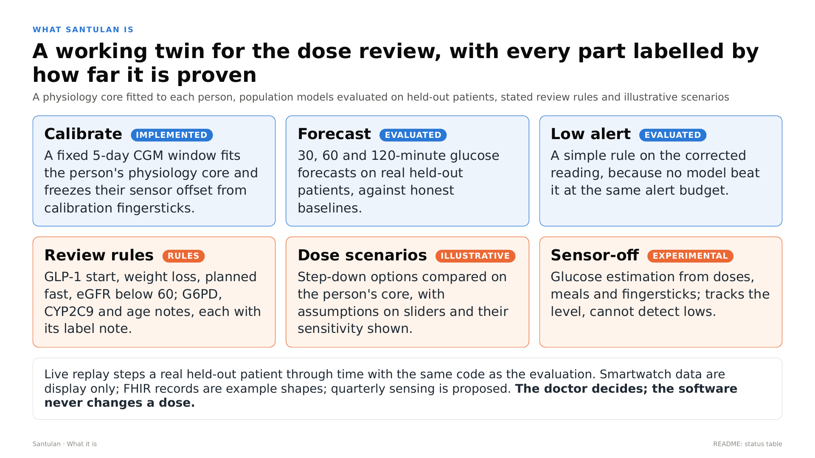
Notes:
Start about 1:38. What Santulan is
So what is Santulan? A working twin for the dose review, with every part labelled by how far it is proven.
It calibrates on a fixed five-day window of sensor data. It fits a physiology core to the person, and it freezes their sensor offset, learned from their fingersticks in those five days only. That part is implemented.
It forecasts glucose 30, 60 and 120 minutes ahead, and it raises a low alert. Both are evaluated on held-out real patients, with population models trained without them. As you will see, the alert we use is a simple rule on the corrected reading, because no model beat it at the same alert budget.
Three parts carry honest labels. Review rules flag a GLP-1 start, weight loss, a planned fast, kidney function below 60, and genetic and age notes, each with its label note. Dose scenarios compare step-down options on the person's core, under assumptions you can see and change. And sensor-off estimation is experimental: it tracks the level, but it cannot detect lows. Throughout, the doctor decides. The software never changes a dose.

Slide 4
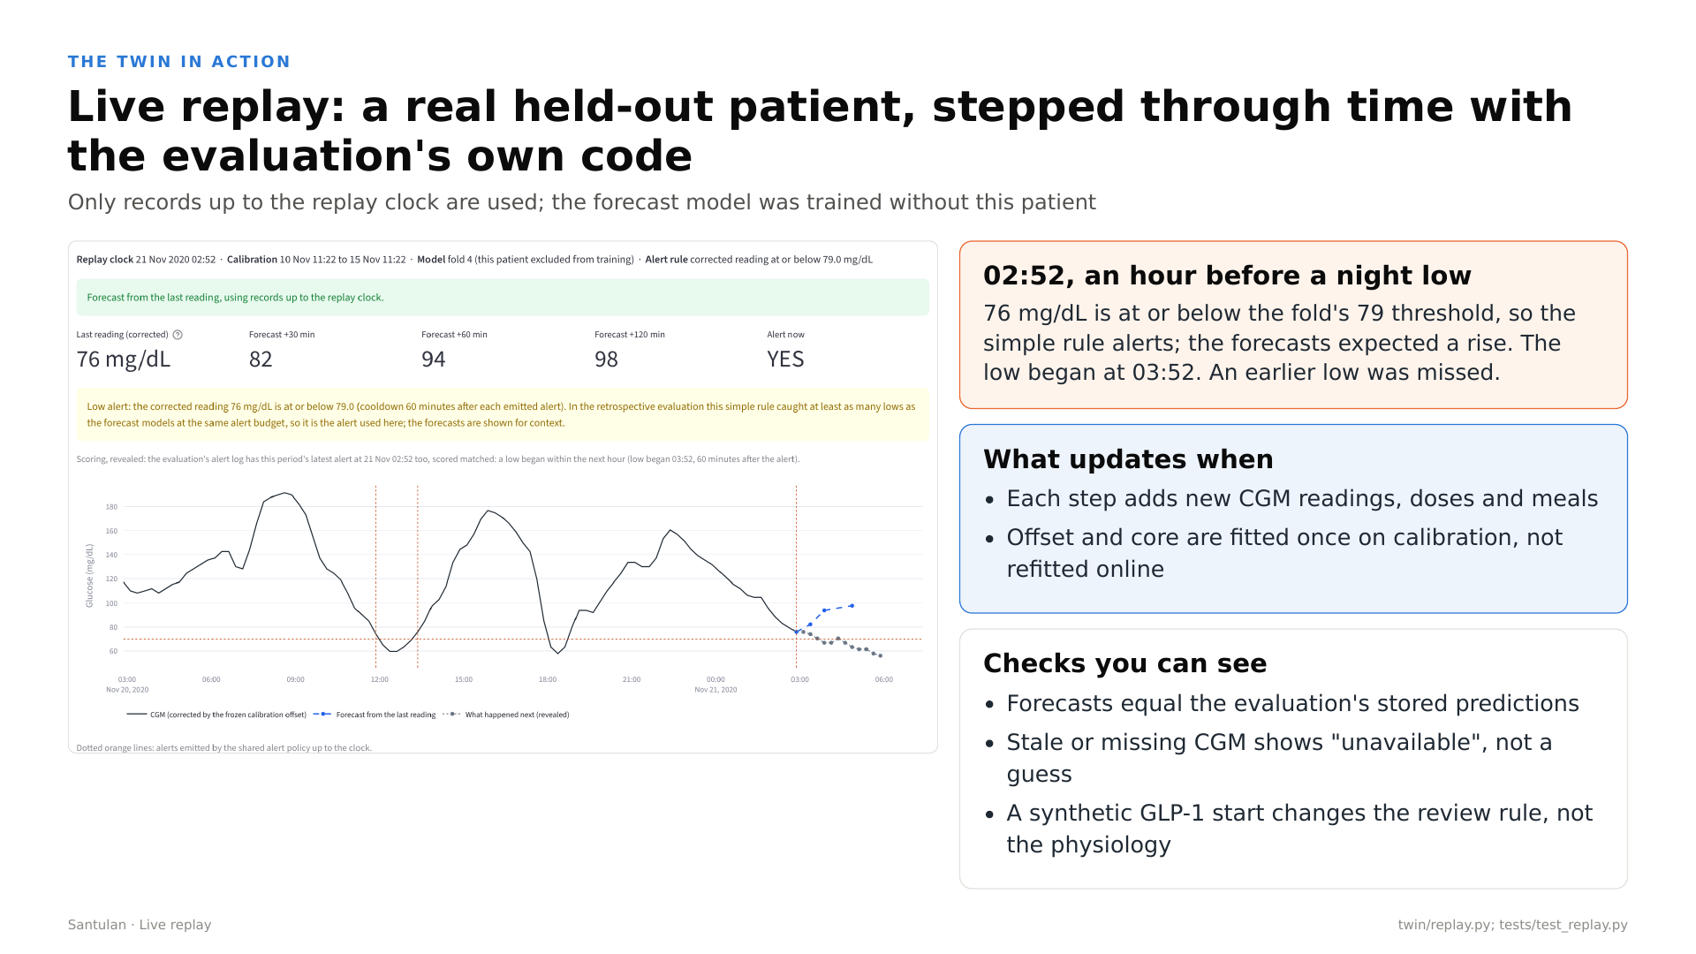
Notes:
Start about 2:57. Live replay (recording 1)
Here is the twin working. This is a live replay of a real patient from the ShanghaiT2DM dataset. The forecast model for this patient was trained without them, and at every step the dashboard uses only the records up to the replay clock. Let me play the recording.
[Start docs/demo_1_live_replay.mp4 now and talk over it. It runs 2 minutes 47 seconds. Start each paragraph when its caption appears.]
[Clip 1 at 0:02]
We start on a real sensor period, with the model that excluded this patient.
[Clip 1 at 0:12]
The clock starts 75 minutes before this period's first low.
[Clip 1 at 0:19]
Each click adds fifteen minutes of real readings, doses and meals, and recomputes the 30, 60 and 120-minute forecasts with exactly the code used in the evaluation.
[Clip 1 at 0:34]
At 8:22 the reading is 79.5, just above this fold's threshold of 79. No alert.
[Clip 1 at 0:43]
Fifteen minutes later it is 67, and the low has begun without a warning. The evaluation counts this one as missed. We show it because misses are part of the result.
[Clip 1 at 0:59]
Now we jump to 75 minutes before a night-time low in the same period. At 2:37 in the morning the reading is 79.5.
[Clip 1 at 1:08]
At 2:52 it is 76, at or below 79, so the rule alerts. Notice the forecasts: they expected glucose to rise.
[Clip 1 at 1:21]
Revealing what happened next, which the model never sees: the reading kept falling.
[Clip 1 at 1:29]
The low began at 3:52. The evaluation scored this alert as matched, one hour ahead.
[Clip 1 at 1:37]
This line is the parity check. The live forecast equals the prediction the evaluation stored for this exact moment. Same code, same numbers.
[Clip 1 at 1:49]
An hour later the low has begun. The rule stays quiet during a low, and for 60 minutes after each alert, so it does not nag.
[Clip 1 at 2:03]
If the sensor drops out, here for the last 45 minutes, the twin does not guess. It says the forecast is unavailable.
[Clip 1 at 2:20]
A clinical update, here a synthetic GLP-1 start added for the demo, fires the dose-review rule with its label note. It changes the review, not the fitted physiology.
[Clip 1 at 2:39]
Reset returns the clock to the end of calibration. Nothing carries over.
[If the recording ends before you finish, stay on slide 4 until you do.]

Slide 5
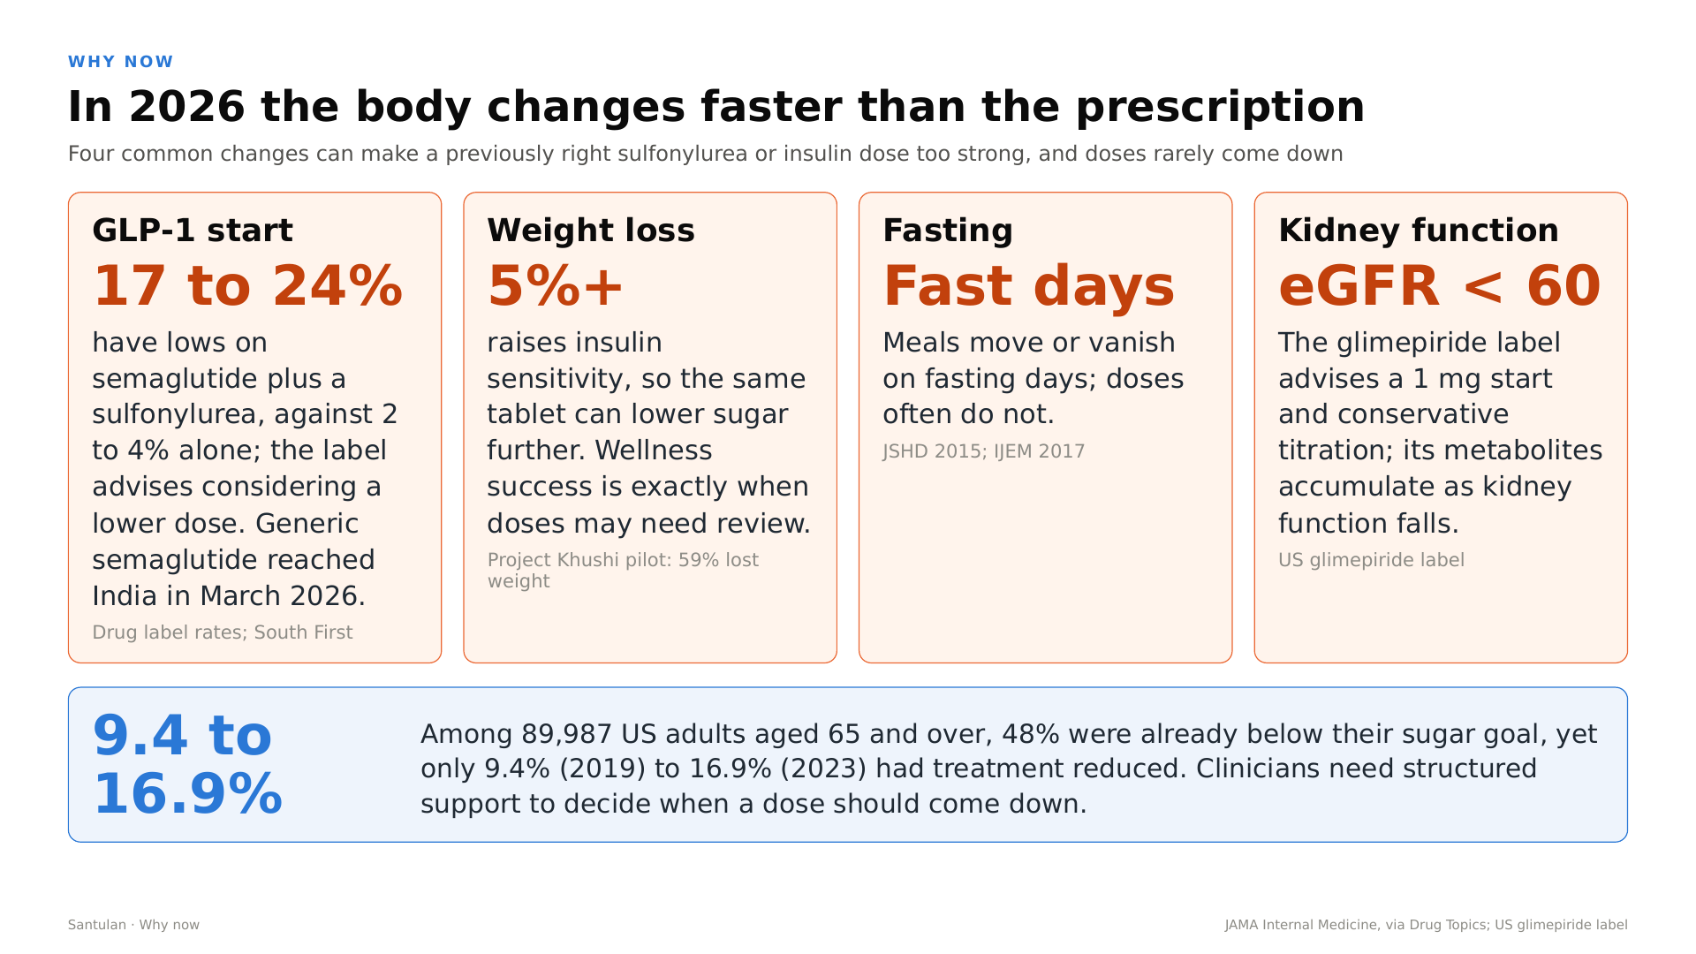
Notes:
Start about 6:09. Why now
Why does this matter now? Because in 2026 the body changes faster than the prescription. Four common changes can make a previously right dose too strong.
A GLP-1 start. With semaglutide plus a sulfonylurea, 17 to 24 percent of people have lows, against 2 to 4 percent on semaglutide alone, and the label advises considering a lower dose. Generic semaglutide reached India in March 2026.
Weight loss. Losing 5 percent or more raises insulin sensitivity, so the same tablet lowers sugar further. Wellness success is exactly when a dose may need review. In Happiest Health's Project Khushi pilot, 59 percent of participants lost weight.
And kidney function. Below an eGFR of 60, the glimepiride label advises a 1 milligram start and careful titration, because its metabolites accumulate.
Doses rarely come down. Among 89,987 American adults aged 65 and over, 48 percent were already below their sugar goal, yet only 9.4 percent in 2019, and 16.9 percent in 2023, had their treatment reduced. Clinicians need structured support to decide when a dose should come down.

Slide 6
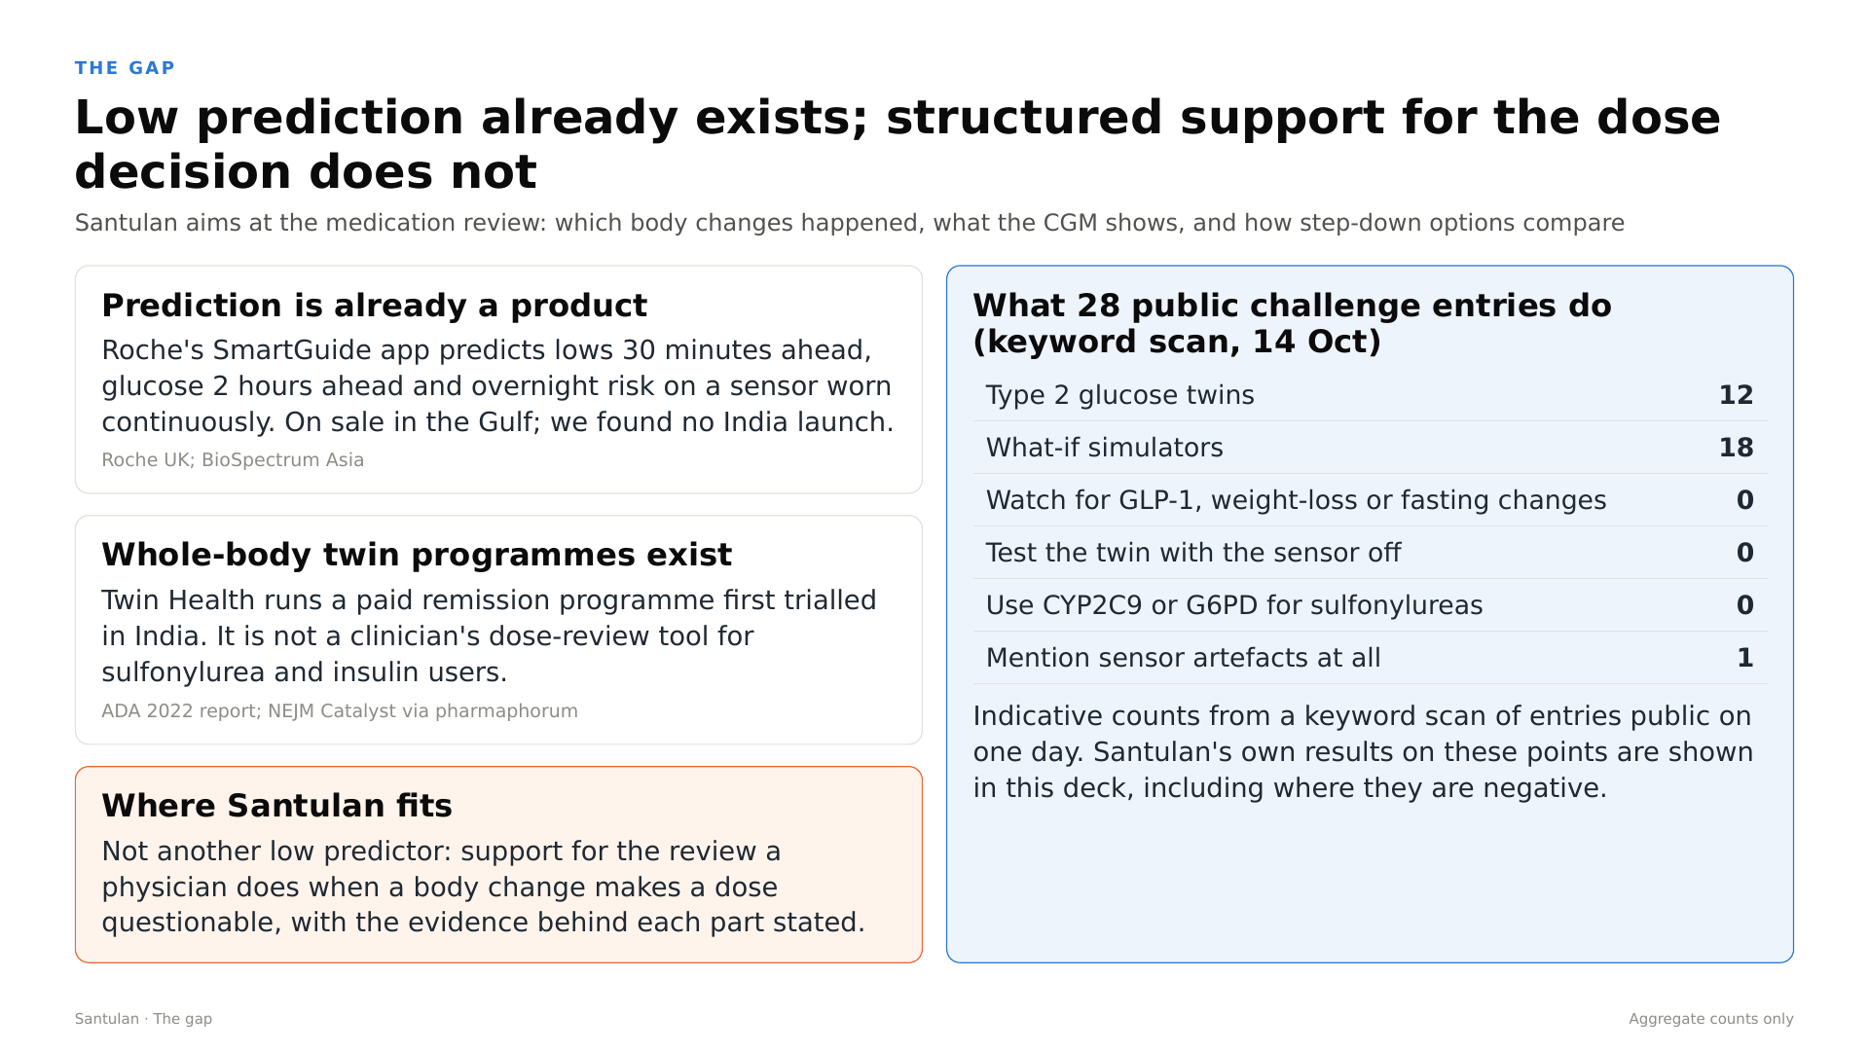
Notes:
Start about 7:24. The gap
What exists already? Prediction is already a product. Roche's SmartGuide app predicts lows 30 minutes ahead, and glucose two hours ahead, on a sensor worn continuously. It is sold in the Gulf; we found no India launch. Whole-body twin programmes exist too. Twin Health runs a paid remission programme first trialled in India, but it is not a dose-review tool for people on sulfonylureas and insulin.
So Santulan is not another low predictor. It supports the review a physician does when a body change makes a dose questionable, and it states the evidence behind each part.

Slide 7
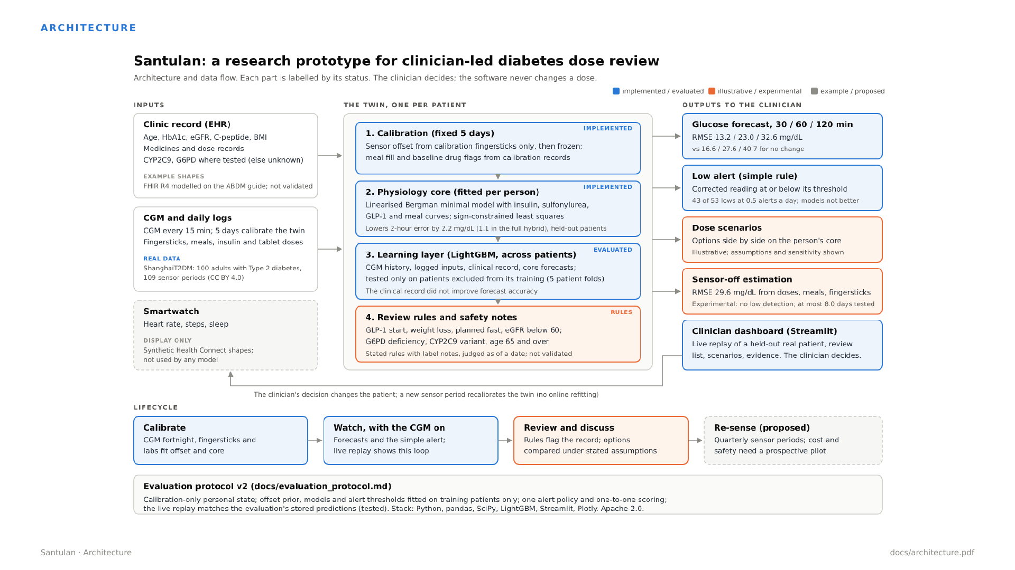
Notes:
Start about 8:07. Architecture
Here is how it is built.
On the left are the inputs. The clinic record: age, HbA1c, eGFR, C-peptide, medicines and doses, and CYP2C9 and G6PD where tested. These are example record shapes, not validated. The sensor and daily logs: CGM every 15 minutes, fingersticks, meals and every dose, from the real ShanghaiT2DM data. And a smartwatch panel, which is display only and feeds no model.
In the middle is one twin per patient, in four layers. First, calibration: a fixed five days, with the sensor offset from calibration fingersticks only, then frozen. Second, the physiology core: a linearised Bergman minimal model, with insulin, sulfonylurea, GLP-1 and meal curves, fitted to each person by sign-constrained least squares, so every coefficient keeps a physical meaning. Third, a learning layer, LightGBM trained across patients, which combines the recent readings, the logged inputs, the clinical record and the core's own forecasts. Fourth, the review rules and safety notes.
On the right are the outputs: forecasts, the simple low alert, dose scenarios, the experimental sensor-off estimate, and the clinician dashboard. The clinician's decision changes the patient, and a new sensor period recalibrates the twin. There is no online refitting.

Slide 8
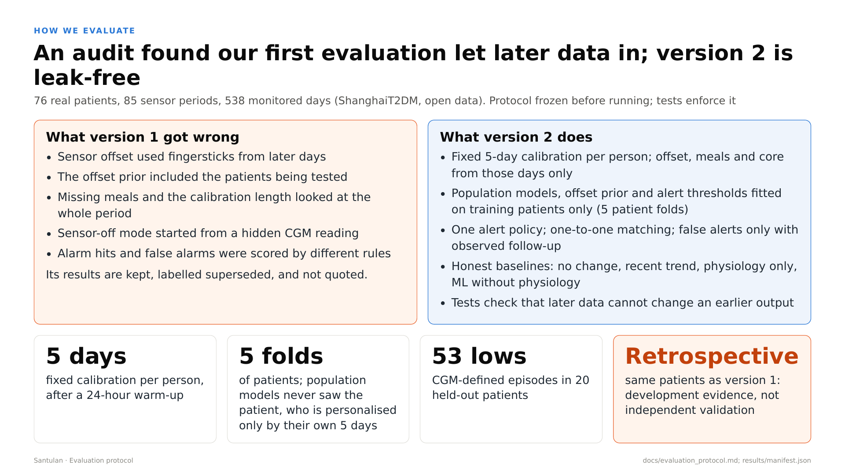
Notes:
Start about 9:31. How we evaluate
Before the results, an honest note on how we got them. An audit of our first evaluation found that later data had leaked in, for example the sensor offset used fingersticks from later days, and alarms were scored inconsistently. Those version 1 results are kept in the repository, labelled superseded, and we do not quote them.
Version 2 fixes all of this, and its protocol was frozen before we ran it. Each person gets a fixed five-day calibration after a 24-hour warm-up, and their offset, meal fill and physiology come from those days only. Population models, the offset prior and the alert thresholds are fitted on training patients only, across five patient folds, so every forecast comes from a population model trained without that patient, personalised only by their own five days. There is one alert policy, and one-to-one matching of alerts to lows. And tests check that later data cannot change an earlier output.
This covers 76 patients, 85 sensor periods and 538 monitored days. It is retrospective development evidence on the same patients, not independent validation.

Slide 9
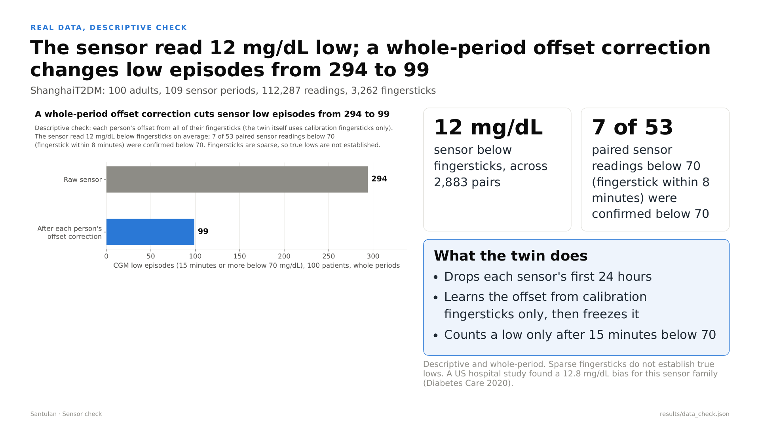
Notes:
Start about 10:47. The sensor check
First, a descriptive check of the sensor itself. Wherever a fingerstick was within 8 minutes of a sensor reading, we compared the two. Across 2,883 pairs, the sensor read 12 milligrams per decilitre below the fingerstick on average. A US hospital study found 12.8 for this sensor family. And of 53 sensor readings below 70 with a fingerstick nearby, only 7 were confirmed below 70.
A descriptive correction over each whole period, with each person's offset from all of their fingersticks, changes low episodes from 294 to 99. Fingersticks are sparse, so this does not establish true lows, but it shows why the reference matters. The twin itself is stricter. It drops the first 24 hours, learns the offset from calibration fingersticks only, then freezes it, and counts a low only after 15 minutes below 70.

Slide 10
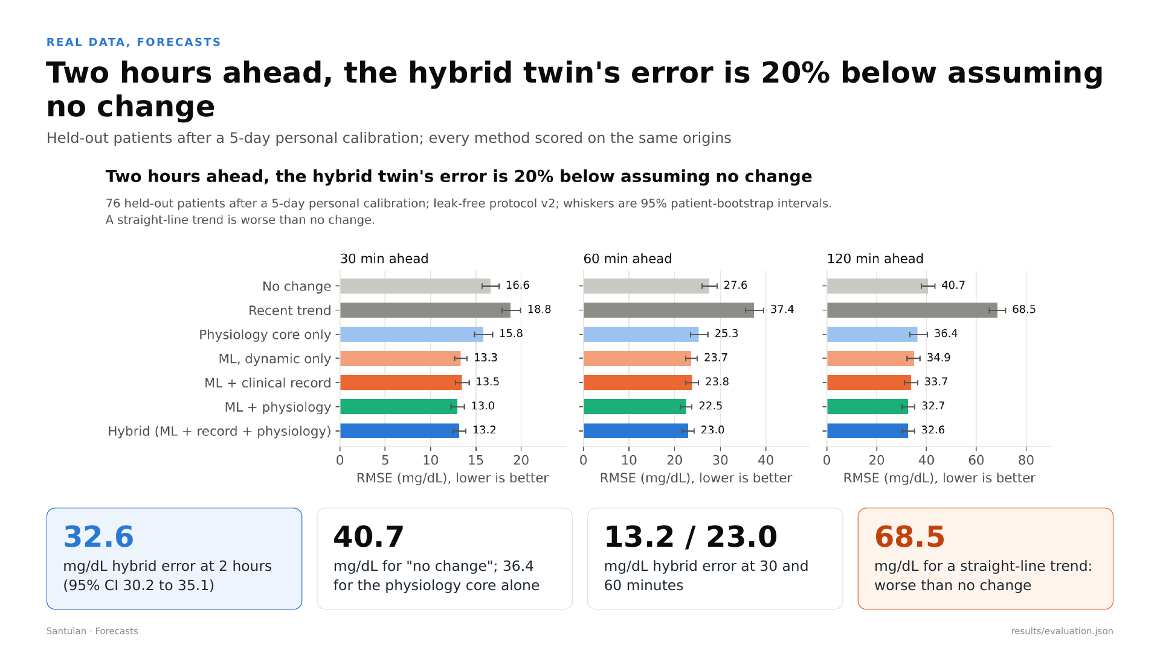
Notes:
Start about 11:47. Forecasts
Now forecasting, on held-out patients, with every method scored at the same moments.
The simplest baseline is to assume nothing changes. Two hours ahead it is off by 40.7 milligrams per decilitre, measured as root mean squared error. A straight-line trend is far worse, at 68.5, so extending the recent slope is a bad idea. The physiology core alone gets 36.4. Machine learning with only the recent readings and logged inputs gets 34.9. The hybrid, with the clinical record and the physiology core, gets 32.6, with a 95 percent interval of 30.2 to 35.1. That is 20 percent below assuming no change. At 30 and 60 minutes, the hybrid's errors are 13.2 and 23.0.

Slide 11
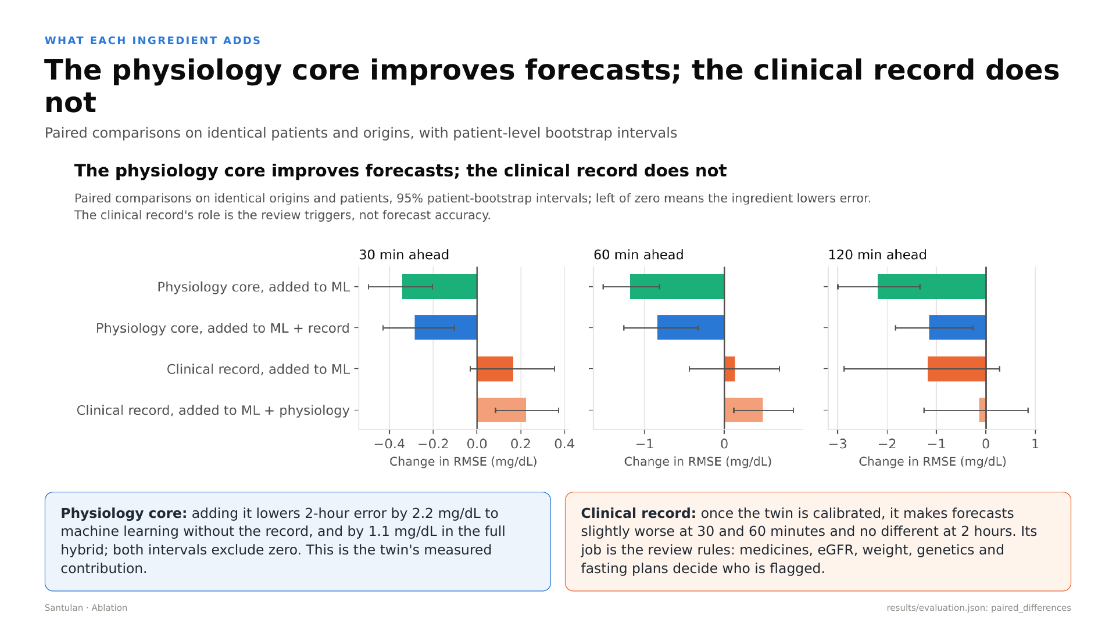
Notes:
Start about 12:37. What each ingredient adds
The physiology core helps. Added to machine learning without the clinical record, it lowers the two-hour error by 2.2 milligrams per decilitre; in the full hybrid, by 1.1. Both intervals exclude zero. That is the twin's measured contribution, and the reason the core exists.
The clinical record does not help forecasting. Once the twin is calibrated to the person, adding age, HbA1c, kidney function and the rest makes forecasts slightly worse, 0.2 higher at 30 minutes and 0.5 at 60, and no different at two hours. We publish that. The record's job in Santulan is the review rules: medicines, eGFR, weight, genetics and fasting plans decide who is flagged for a dose review.

Slide 12
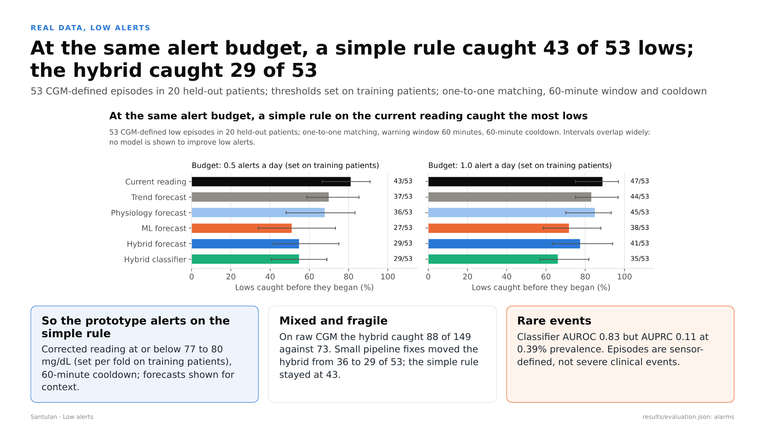
Notes:
Start about 13:27. Low alerts
Can the twin warn of lows? We compared every alert method at the same alert budget, with thresholds chosen on training patients only.
At half an alert a day, a simple rule, alert when the corrected reading is at or below a threshold of about 77 to 80, caught 43 of 53 lows before they began. The hybrid forecast caught 29 of 53, though it emitted fewer alerts than its budget on held-out patients: 0.37 a day, against 0.50 for the simple rule. The trend and physiology forecasts caught 37 and 36, machine learning without physiology 27, and a dedicated classifier 29. At one alert a day, the simple rule caught 47 of 53 and the hybrid 41 of 53. Even then, with 0.81 alerts a day, the hybrid caught fewer lows than the simple rule at half an alert a day. And the learned results are fragile: two small fixes to our pipeline this week moved the hybrid from 36 to 29, while the simple rule stayed at 43.
The intervals overlap widely: 53 episodes in 20 patients is a small sample. The simple rule's median warning was 15 minutes, with 0.42 false alerts a day. On the raw, uncorrected sensor, the hybrid caught 88 of 149 against 73 for the simple rule, so the picture is mixed.
So the prototype alerts on the simple rule and shows the forecasts for context. No model is shown to improve low alerts.

Slide 13
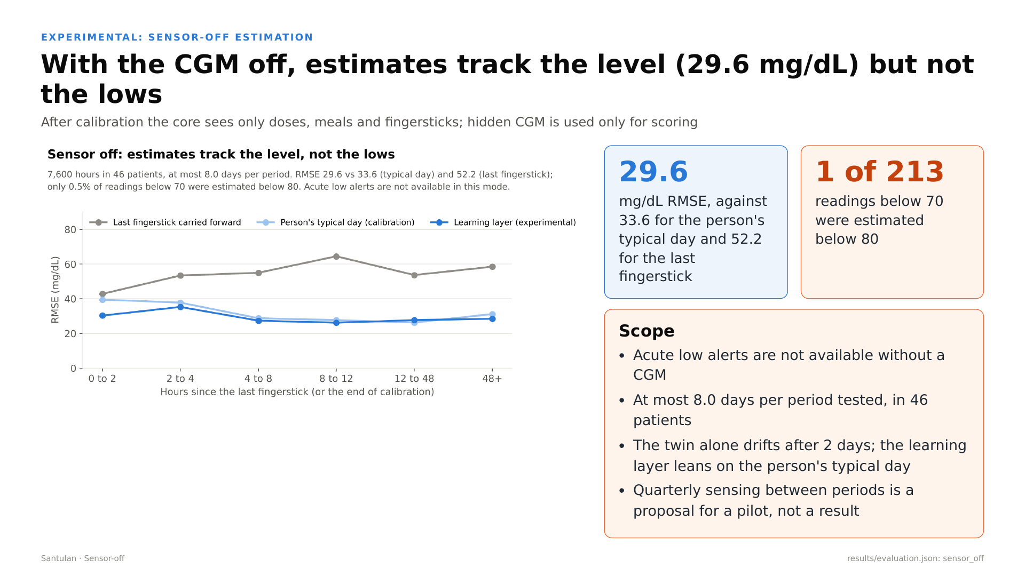
Notes:
Start about 15:09. Sensor off
What if the sensor is off? This part is experimental. After calibration, we hid the sensor and gave the twin only doses, meals and fingersticks, in 46 patients, for at most 8.0 days per period. The hidden readings were used only for scoring.
The learning layer tracked the level with an error of 29.6 milligrams per decilitre, against 33.6 for the person's typical day from calibration and 52.2 for carrying the last fingerstick forward. The physiology core alone drifts after about two days, so the learning layer leans on the person's typical day.
But it does not detect lows. Of 213 readings below 70, only 1 was estimated below 80. So acute low alerts are not available without a CGM, and quarterly sensing between periods is a proposal for a pilot, not a result.

Slide 14
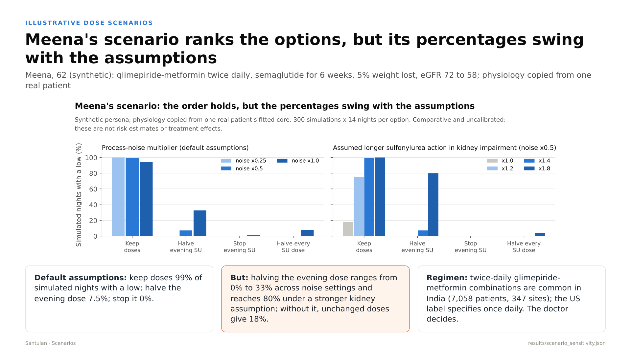
Notes:
Start about 16:08. Dose scenarios (recording 2)
Now the dose review, on a synthetic patient. Meena is 62. She takes a glimepiride and metformin combination twice daily, started semaglutide six weeks ago, has lost 5 percent of her weight, and her eGFR has fallen from 72 to 58. Her physiology is copied from one real patient's fitted core.
Under the default assumptions, keeping her doses gives a low on 99% of simulated nights, halving the evening dose 7.5%, and stopping it 0. But these percentages swing. Halving the evening dose ranges from 0% to 33% across noise settings, and reaches 80% under a stronger kidney assumption. Without any kidney effect, unchanged doses give 18%. The order holds; the numbers are not risk estimates. Here is the clinic view.
[Start docs/demo_2_clinic_tour.mp4 now and talk over it. It runs 2 minutes 1 second. Start each paragraph when its caption appears.]
[Clip 2 at 0:06]
The clinic list shows synthetic patients, with the review triggers and safety notes that fire as of the demo date, and a comparative simulated share of nights with a low.
[Clip 2 at 0:20]
On Meena's page, every trigger shows its reason, its dates and the label note behind it: the GLP-1 start, the weight loss, a planned one-day fast, and kidney function now below 60. Below that are her next three simulated days on current doses.
[Clip 2 at 0:46]
The scenarios tab puts the options side by side on her core: nights with a low, time in range and time above range. Every assumption sits on a slider: how much less she eats, the extra drug effect from weight loss, and slower clearance by the kidneys.
[Clip 2 at 1:07]
Raising the process noise moves the percentages, but not the order. That is why we present them as comparisons under assumptions, never as risks.
[Clip 2 at 1:22]
The evidence tab carries the retrospective results with their baselines and intervals, including the negative findings: the clinical record not helping forecasts, and the simple alert rule matching or beating the models.
[Clip 2 at 1:42]
And the data tab shows example record shapes: a FHIR-style bundle modelled on the ABDM guide, and smartwatch data. They are not validated against those profiles, and no model uses the watch data.
[If the recording ends before you finish, stay on slide 14 until you do.]

Slide 15
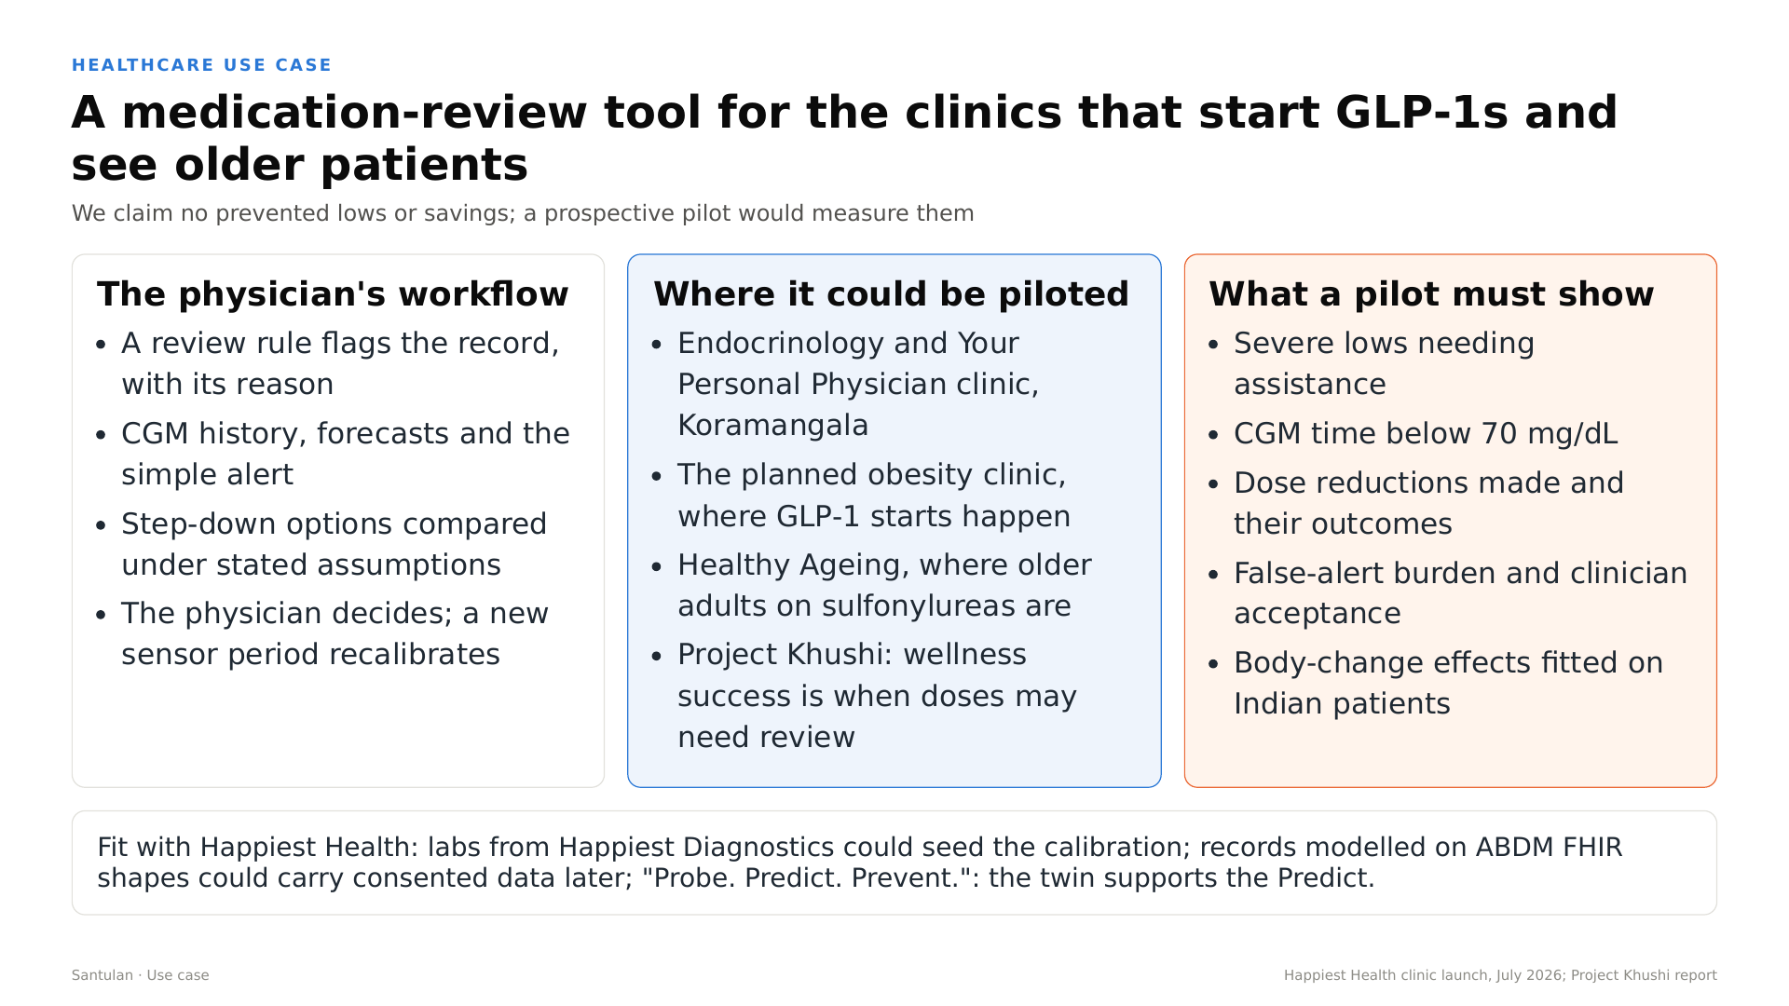
Notes:
Start about 19:05. Healthcare use case
Where would this be used? As a medication-review tool in the clinics that start GLP-1s and see older patients. The physician's workflow is simple. A review rule flags the record, with its reason. The doctor sees the CGM history, the forecasts and the simple alert, compares step-down options under stated assumptions, and decides. A new sensor period recalibrates the twin.
We claim no prevented lows and no savings. A prospective pilot must show severe lows needing assistance, CGM time below 70, the dose reductions made and their outcomes, the false-alert burden and clinician acceptance, and body-change effects fitted on Indian patients.

Slide 16
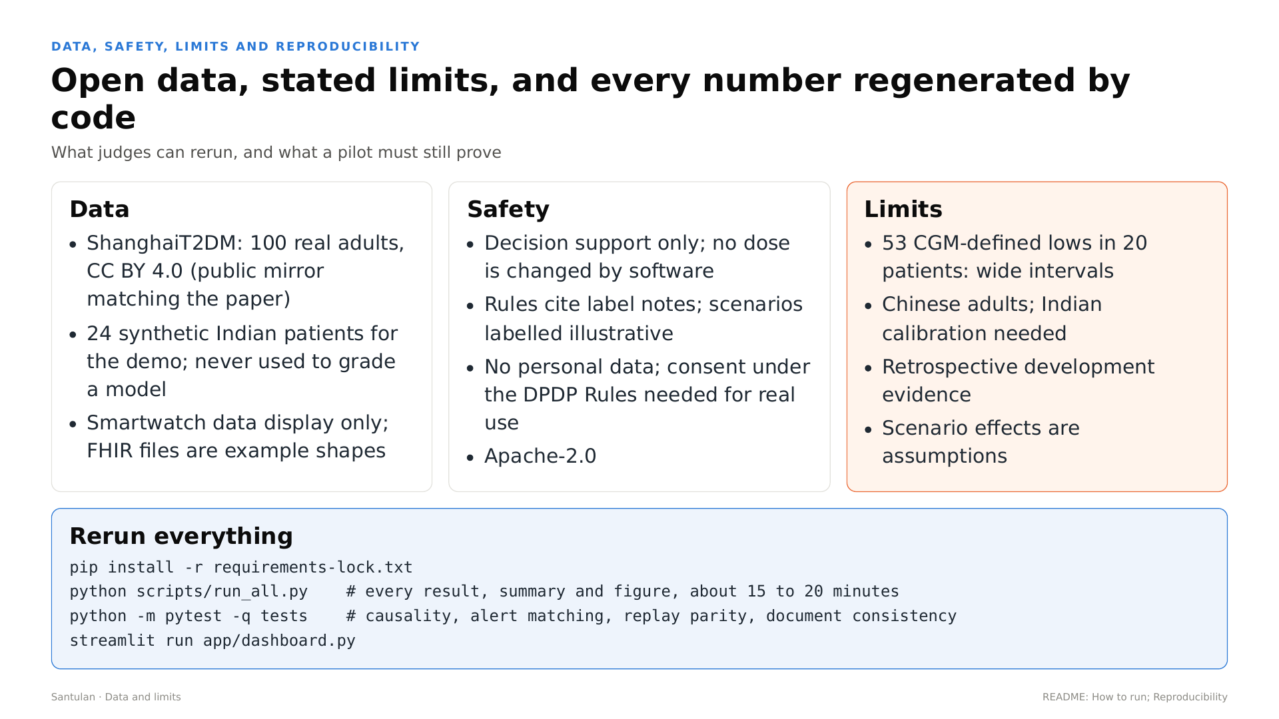
Notes:
Start about 19:50. Data, safety and limits
Everything here uses open or synthetic data. The real results come from ShanghaiT2DM, 100 adults, under a CC BY 4.0 licence. Our 24 synthetic Indian patients are only for the demo and never grade a model. Santulan is decision support only. Rules cite their label notes, scenarios are labelled illustrative, and no personal data is collected; real use would need consent under India's DPDP Rules.
Our limits, plainly: 53 sensor-defined lows in 20 patients, so the intervals are wide; Chinese adults, so India needs its own calibration; retrospective evidence; and scenario effects that are assumptions. Anyone can rerun every number with the four commands on this slide, and the tests check these documents against the results.

Slide 17
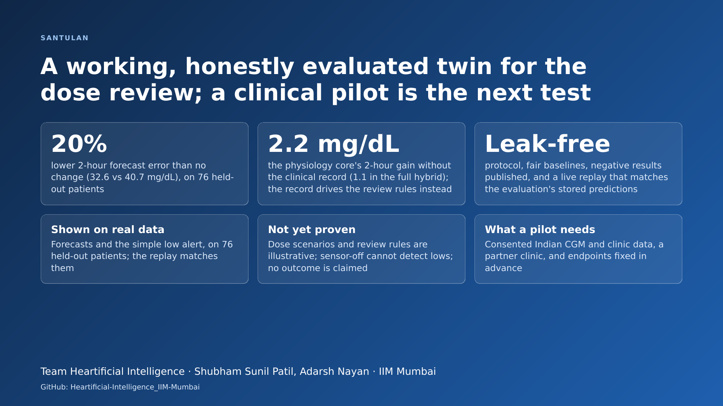
Notes:
Start about 20:41. Close
So Santulan is a working, honestly evaluated twin for the dose review. Two hours ahead, its forecasts are 20 percent better than assuming no change, 32.6 against 40.7, on 76 held-out patients. The physiology core adds a measured 2.2 milligrams per decilitre without the clinical record, and 1.1 in the full hybrid. The simple alert caught 43 of 53 lows, and we say so even though our models did not beat it. What is not yet proven, we label, and a clinical pilot is the next test. Thank you.
[Hold the last slide for 5 seconds, then stop recording. Check the length: it must be 20:00 or more.]

