Slide 1
Version Control System using Git

Slide 2
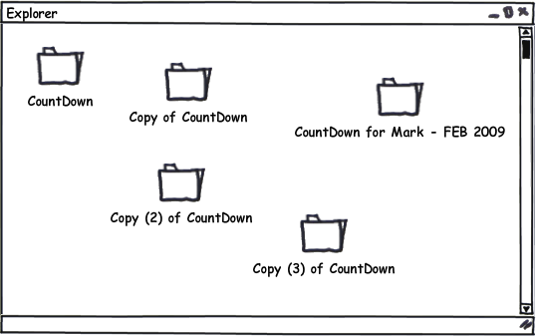
Maintaining group Projects
Patches are mostly sent via email
Difficult to roll back
Almost impossible to maintain if the number of people working in the project is large
Testing new unstable features

Slide 3
2.
Version Control System

Slide 4

Version Control: What is it?
A method for recalling versions of a codebase
Keeping a record of changes
Who did what and when in the system
Save yourself when things inevitably go wrong

Slide 5
Version Control: Why?
Individual
Back-ups of the project
Create a “checkpoint” in the project at any stage: Fearlessly modify code
Tagging: Mark certain point in time
Branching: Release versions and continue development

Slide 6
Version Control: Why?
Team
Everything in “Individual”
Allow multiple developer to work on the same codebase
Merge changes across same files: handle conflicts
Check who made which change: blame/praise

Slide 7
Version Control: Types
Centralised VCS
Distributed VCS

Slide 8
Centralised VCS
A single authoritative data source (repository)
Check-outs and check-ins are done with reference to this central repository

Slide 9
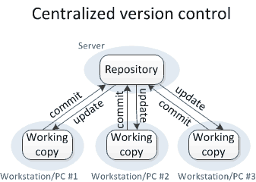
Centralised VCS

Slide 10
Centralised VCS
Examples:
Concurrent Version System (CVS)
Subversion (SVN)

Slide 11
No single repository is authoritative
Data can be checked in and out from any repository
Distributed VCS

Slide 12
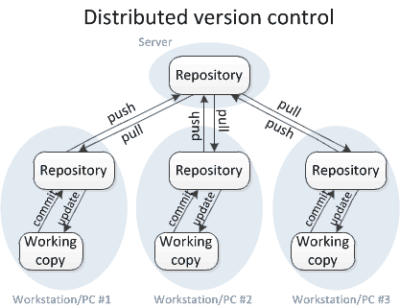
Distributed VCS

Slide 13
Examples
Git
Mercurial
Distributed VCS

Slide 14
3.
Git
--everything-is-local

Slide 15

Free, open source
Fully distributed
Handle small files very effectively
Tracks contents, not files
Data = Snapshot
No network
Three stages

Slide 16
Created by Linus Torvalds in less than 2 weeks
Currently maintained by Junio C Hamano

Slide 17
Git: Stages
Three stages:
Working directory
Staging directory
Git directory (repository)

Slide 18
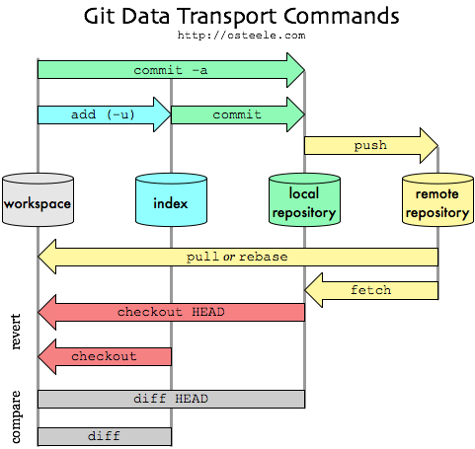
Git: Development

Slide 19
Git: Development
Setup
git init
git clone <remote-url>

Slide 20
Configuring GIT
STEP BY STEP
From a command line:
git config –global user.name “FirstName LastName”
git config –global user.email “yourname@maine.edu”
git config –global color.ui “auto”
Mac/linux
git config – global core.editor “nano –w”
Windows
git config –global core.editor “’c:/program files (x86)/Notepad++/notepad++.exe’ –multiInst –notabbar –nosession noPlugin”
git config --list

Slide 21
GIT
STEP BY STEP
From a command line:
Go to folder for git repository
Clone remote repository
git clone https://github.com/npd2020/electronics.git
Go to folder electronics
Create folder “first_second your name (without space)”
Greate (or copy) file in out folder
git add .
git commit –m “name of commit”
git pull --rebase
git push //user: npd2020 paswd: standardmodel123
git status // get status of repository
git log // see history of commit
Wifi: stone , password: 31415926

Slide 22
git status // get status of repository
git log // see history of commit

Slide 23
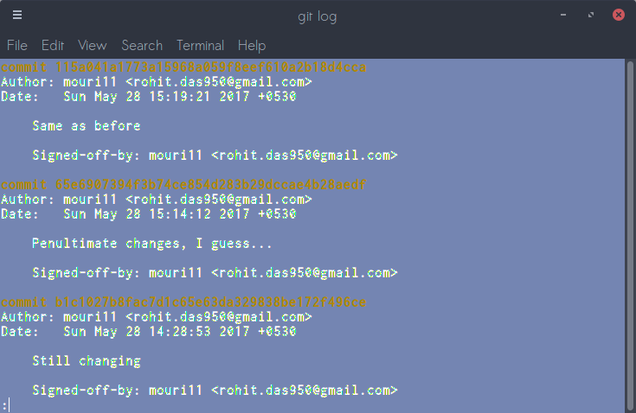
Git: Development
Commit logs

Slide 24
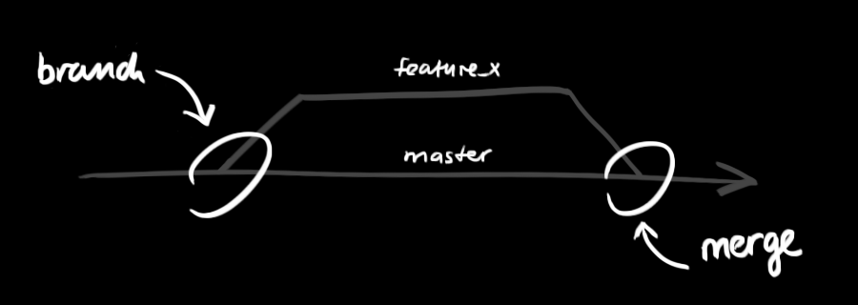
Git: Development
Branches
git checkout –b <branch-name>

Slide 25
Git: Development
View changes
git diff

Slide 26
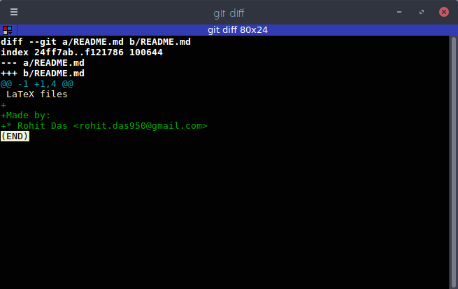
Git: Development
View changes

Slide 27
Git: Development
Update staging area
git add <files>
Add file contents to the index

Slide 28
Git: Development
Create “snapshots” of your codebase
git commit
Records changes to the repository

Slide 29
Git: Development
Merge other branches
git merge

Slide 30
Git: Development
Make patches
git format-patch --stdout > fix.patch
Patch created as “fix.patch”
Prepare patches for email submission
Send patch via mail

Slide 31
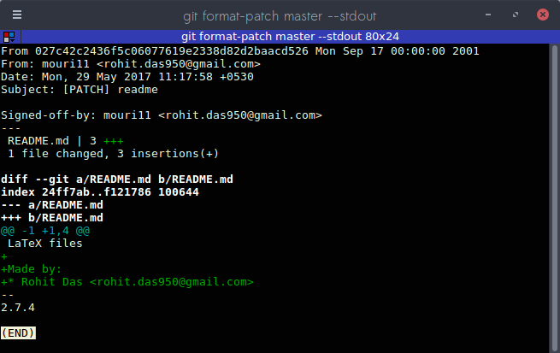
Git: Development
Make patches

Slide 32
Git: Development
Applying patches
git apply < fix.patch
Applies changes from the patch

Slide 33
Result?
Much efficient workflow
Creating and merging branches are very easy and fast

Slide 34
Result?
The development process of the Linux kernel is maintained using Git
The Linux kernel development process has:
Over 2000 individual contributors per year
Grows by nearly 300,000 lines per year

