Slide 1
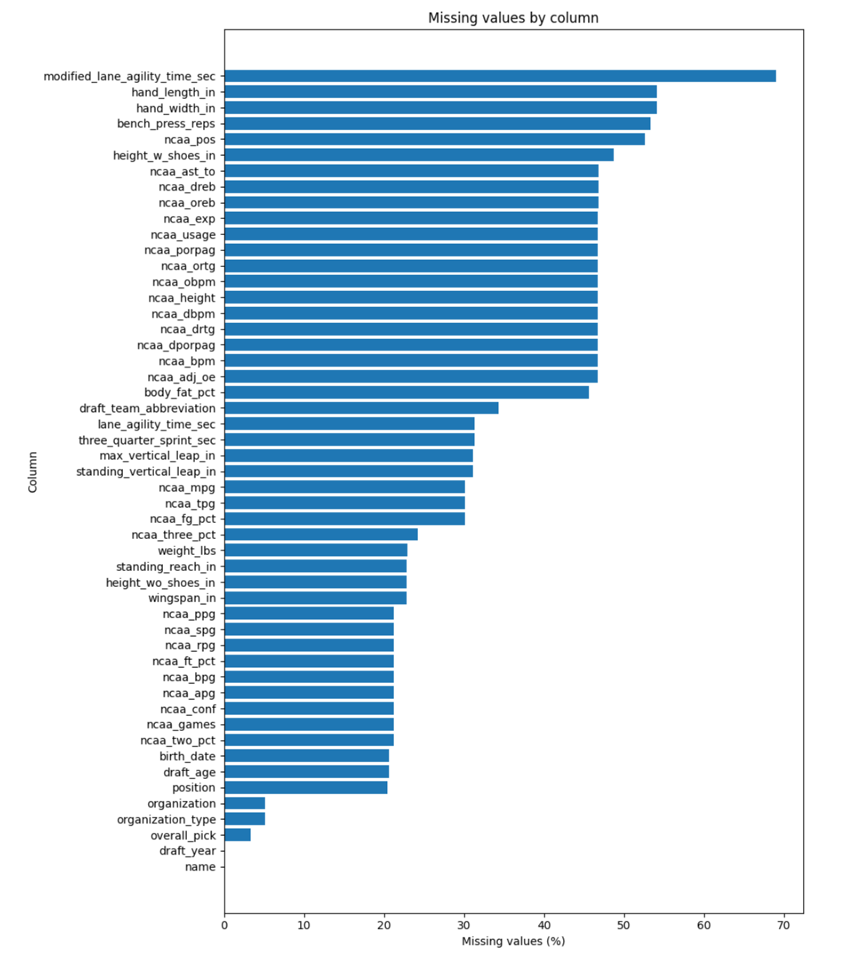
Data assessment and preparation
Initial assessment
Player-level dataset for NBA Draft classes 2000-2026
2,347 players, 51 attributes
2026 players included without final draft labels
Main data issues
- Missing values are systematic, not random
- Combine data missing for some prospects
- NCAA statistics absent for international / non-college players
- Some advanced NCAA metrics had scale inconsistencies
Final preprocessing decisions
- Target transformed to 5 draft outcome groups
- NCAA-only scope: 1,773 historical / 74 in 2026 pool
- Leakage, sparse and inconsistent features removed
- Position-wise median imputation, one-hot encoding, scaling
Reasoning
Exact pick prediction is noisy and context-dependent.
Broader outcome groups are more stable and easier to interpret.

Slide 2
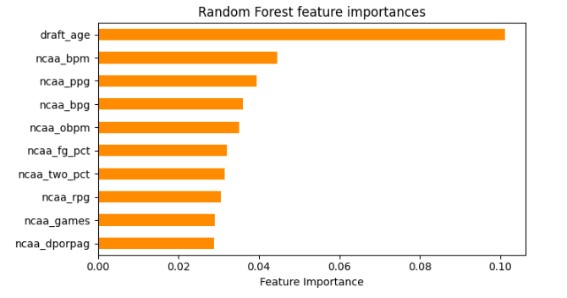
Modeling and evaluation
Selected final model for final 2025 test
Modeling setup
Random Forest with
n_estimators=300,
max_depth=None,
min_samples_leaf=5,
max_features=sqrt,
class_weight=balanced_subsample
Selected after hyperparameter tuning and cross-validation on 2000-2024 data
Train/validation experiment on historical NCAA-based data
Models tested:
Dummy Classifier, Logistic Regression, Gaussian Naive Bayes,
Linear SVM, Decision Tree, Random Forest
Main metric: macro F1-score (unbalanced classes)
model | macro_f1 | balanced_accuracy
Dummy Classifier | 0.102 | 0.200
Logistic Regression | 0.437 | 0.483
Gaussian Naive Bayes | 0.080 | 0.202
Linear SVM | 0.390 | 0.448
Decision Tree | 0.424 | 0.425
Random Forest | 0.530 | 0.522

Slide 3
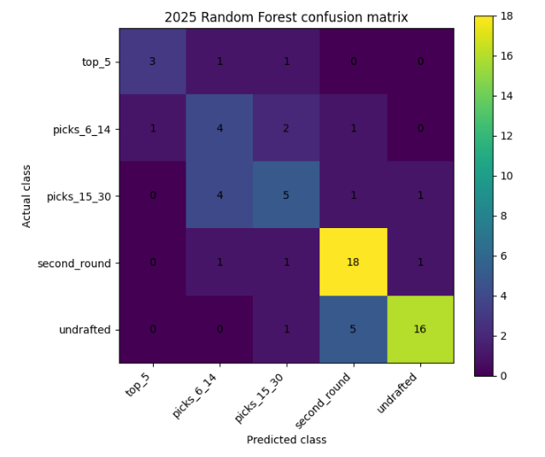
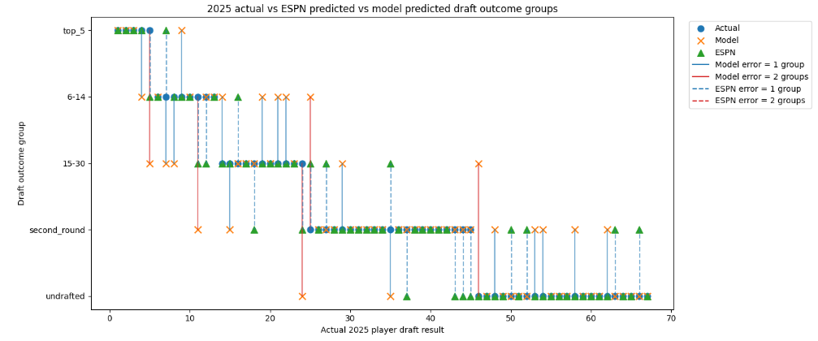
2025 test prediction
Final 2025 test: train on 2000-2024, test on 2025 draft class
Comparison with expert predictions - ESPN mock draft from June 25, 2025
Main finding
The model was reasonably close to the expert baseline, but ESPN performed better overall. The largest differences appeared in context-heavy prospects, while the model still identified several less-publicized second-round players.
Method
Accuracy
Macro F1
Balanced acc.
Random Forest
0.687
0.634
0.628
ESPN mock
0.731
0.727
0.727
Model vs ESPN
0.507
0.492
0.491

Slide 4
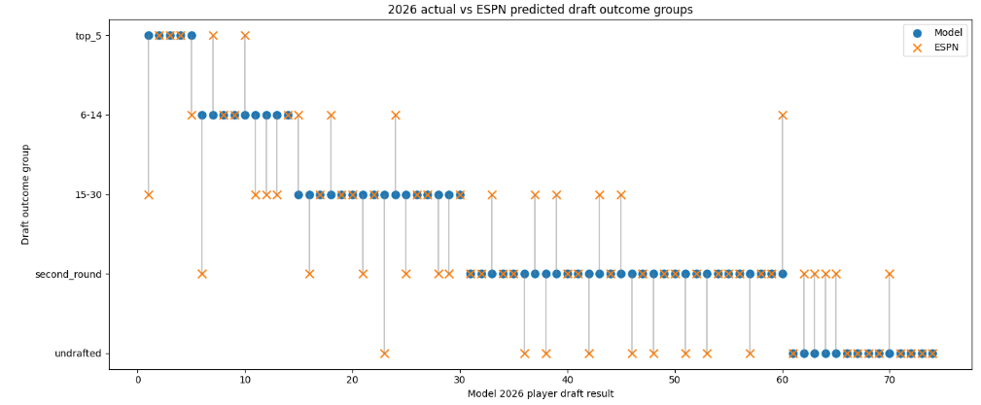
2026 prospective prediction and expert comparison
2026 prediction
Final model trained on all known historical outcomes from 2000-2025
2026 class is a prediction pool, not a test set
Raw model output first produced too many top_5-like profiles
Post-processing
To make the output more realistic, raw probabilities were converted into a draft-board ranking. Fixed draft capacities were then applied: 5 top_5, 9 picks_6_14, 16 picks_15_30, 30 second_round.
Model vs ESPN agreement | Value
Macro F1 | 0.503
Balanced accuracy | 0.509
Largest disagreements
Allen Graves: model top_5, ESPN picks_15_30
Amari Allen: model picks_6_14, ESPN second_round
Jacob Cofie: model picks_15_30, ESPN undrafted
Yaxel Lendeborg: model second_round, ESPN picks_6_14

Slide 5
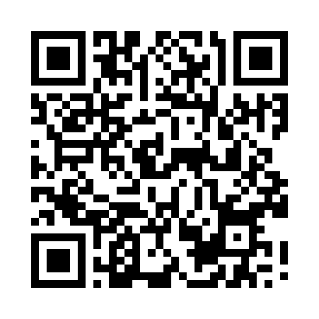
Discussion, deployment and conclusion
Conclusions
NBA Draft outcomes can be predicted to a meaningful degree from structured pre-draft data when the target is formulated as broad outcome groups. The Random Forest model provides an interpretable statistical baseline and a prospective 2026 prediction.
Limitations
No scouting reports, team needs, workouts, interviews, medical information or draft rumors
NCAA-only scope excludes several international prospects
Classification is not the same as a true constrained ranking task
Deployment idea
Final result
A GitHub Pages dashboard shows the 2026 model prediction and ESPN comparison. After the draft, a script will add actual results and update confusion matrices and visualizations without retraining the model.
The model does not predict draft picks any better than actual experts, but it comes close to their performance despite a huge number of limitations.

