Slide 1
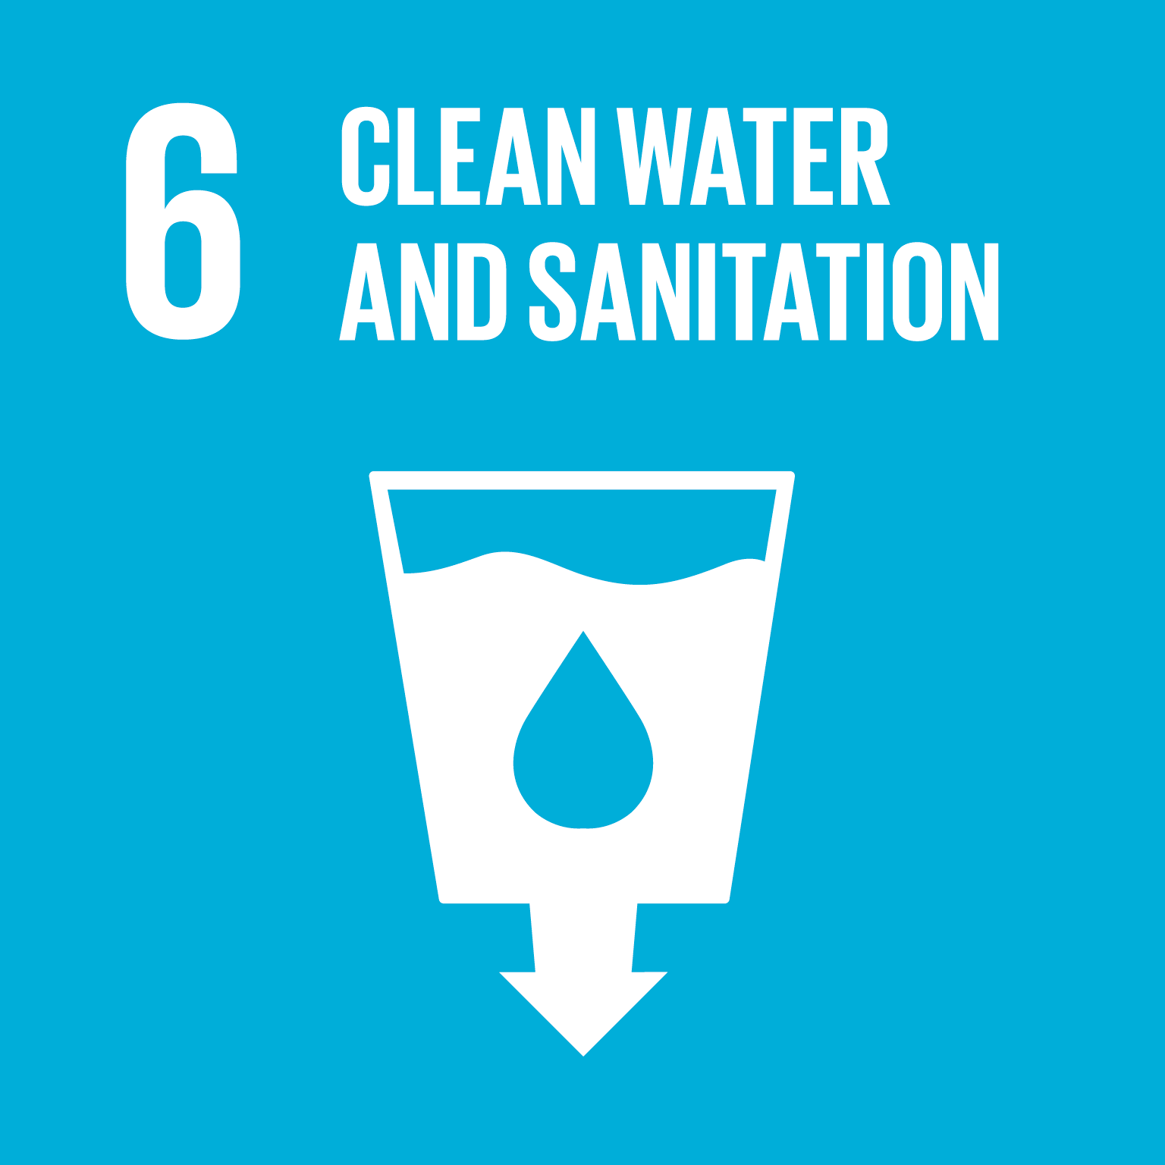

Slide 2
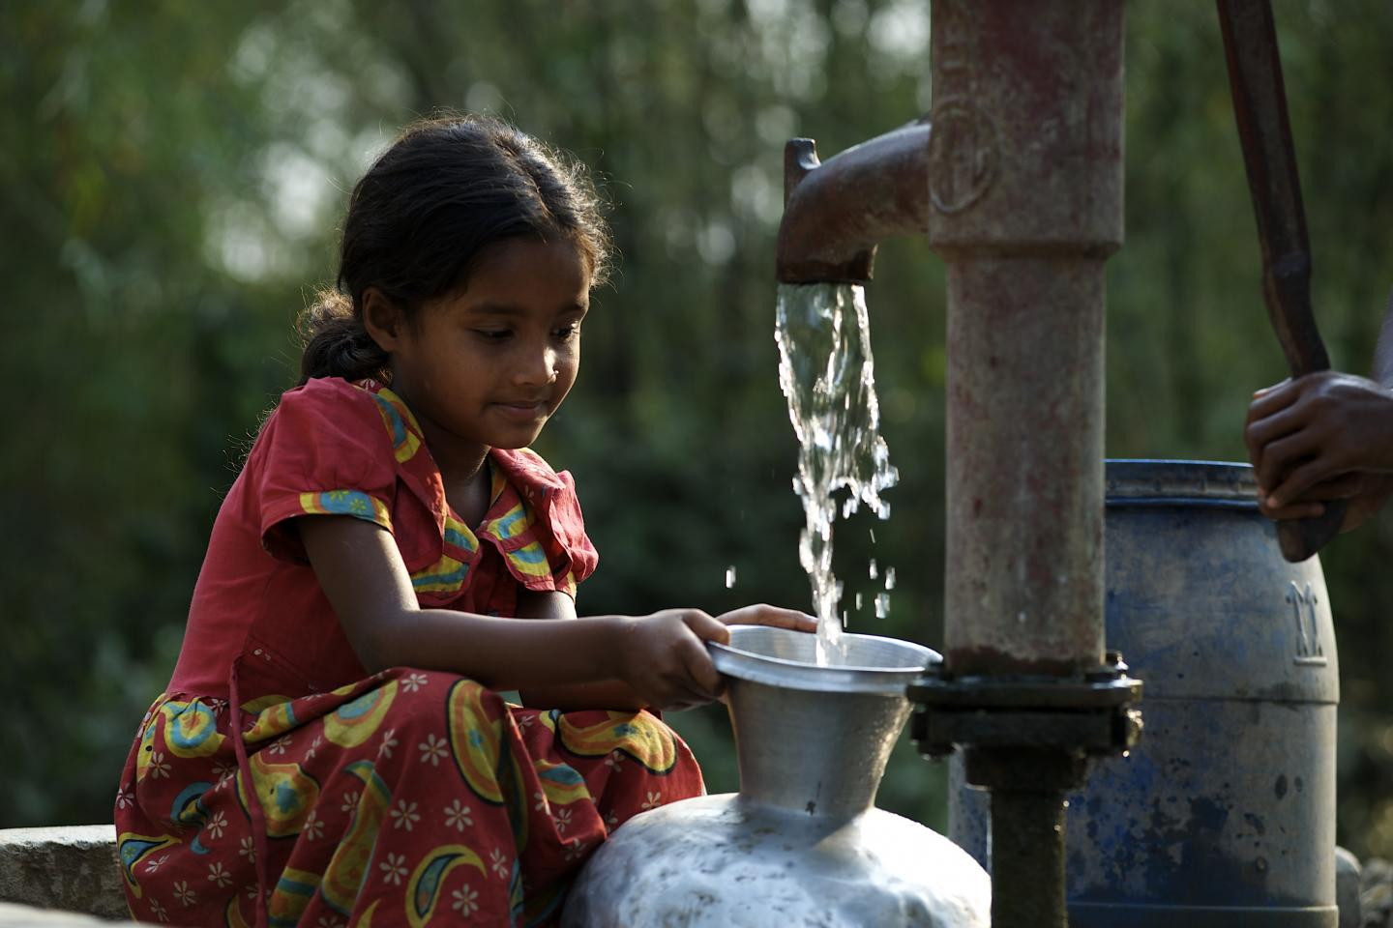
What is SDG 6?
Ensure availability and sustainable management of water and sanitation for all.
SDG 6 focuses on universal access to safe drinking water, sanitation, and hygiene. It also emphasizes protecting water ecosystems and improving water quality and efficiency.
SDG 6 includes 8 targets (6 outcome-oriented and 2 implementation targets) and 11 indicators to measure progress

Slide 3
Targets of SDG 6
6.1
Safe and Affordable Drinking Water
6.2
Sanitation and Hygiene
6.3
Water quality and Wastewater
6.4
Water use and Efficiency

Slide 4
Targets of SDG 6
6.5
Integrated Water Resource Management
6.6
Protect and Restore Ecosystem
6.a
International Cooperation
6.b
Community Participation

Slide 5
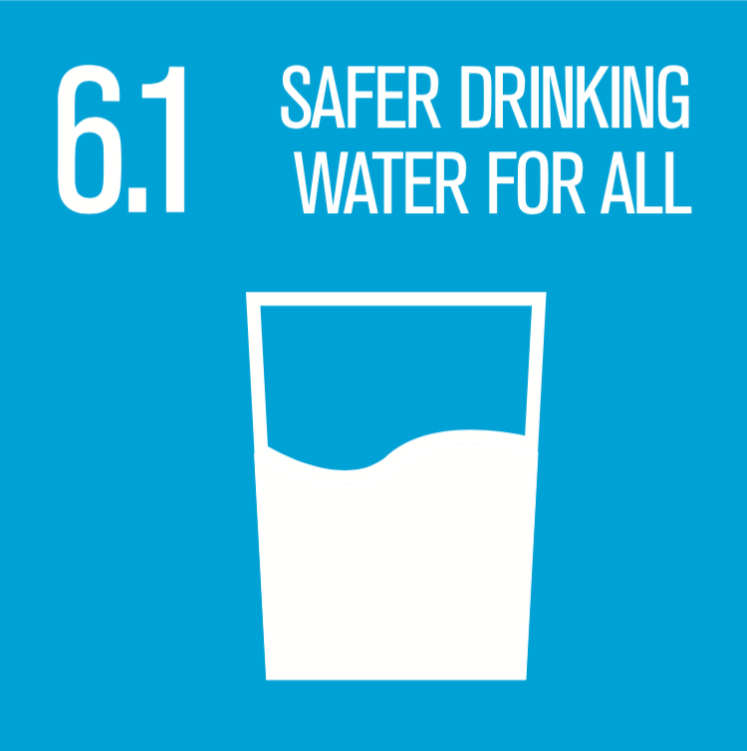
Target 6.1 – Safe and Affordable Drinking Water
Statement: By 2030, achieve universal and equitable access to safe and affordable drinking water for all.
Indicator 6.1.1: Proportion of population using safely managed drinking water services.
Current Progress in Bangladesh: As of 2023, 47.9% of the population has access to safely managed drinking water services .
Challenges: Arsenic contamination, saline water, rural infrastructure gaps.
Suggestions: Invest in piped systems and purification technologies.

Slide 6
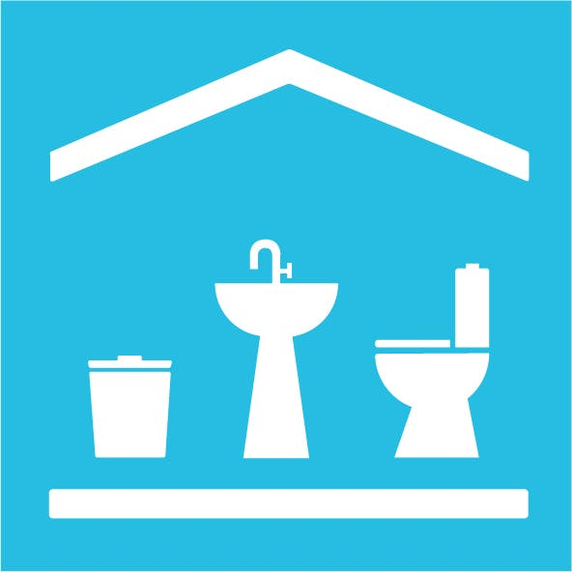
Target 6.2 – Sanitation and Hygiene
Statement: By 2030, achieve access to adequate and equitable sanitation and hygiene for all and end open defecation.
Indicators:
6.2.1a – Proportion using safely managed sanitation services.
6.2.1b – Proportion with handwashing facilities with soap and water.
Current Progress in Bangladesh: In 2023, 84.6% had access to sanitation services, and 74.8% used handwashing facilities
Challenges: Waste disposal in slums, low awareness.
Suggestions: Sanitation campaigns, slum focus.
Example: BRAC’s WASH program improves access and awareness.

Slide 7

Target 6.3 - Water Quality and
Wastewater
Statement: By 2030, improve water quality by reducing pollution, minimizing hazardous releases, and increasing treatment.
Indicators:
6.3.1 – Proportion of wastewater safely treated.
6.3.2 – Proportion of bodies of water with good ambient water quality.
Current Progress in Bangladesh: Effluent treatment plants established near Dhaka have reduced industrial wastewater pollution . However, untreated domestic wastewater remains a challenge
Challenges: Untreated industrial waste, weak enforcement.
Suggestions: Stricter regulations, expand treatment plants.
Real-Life Example: Central effluent treatment plant at Savar treats industrial waste before discharge into rivers

Slide 8
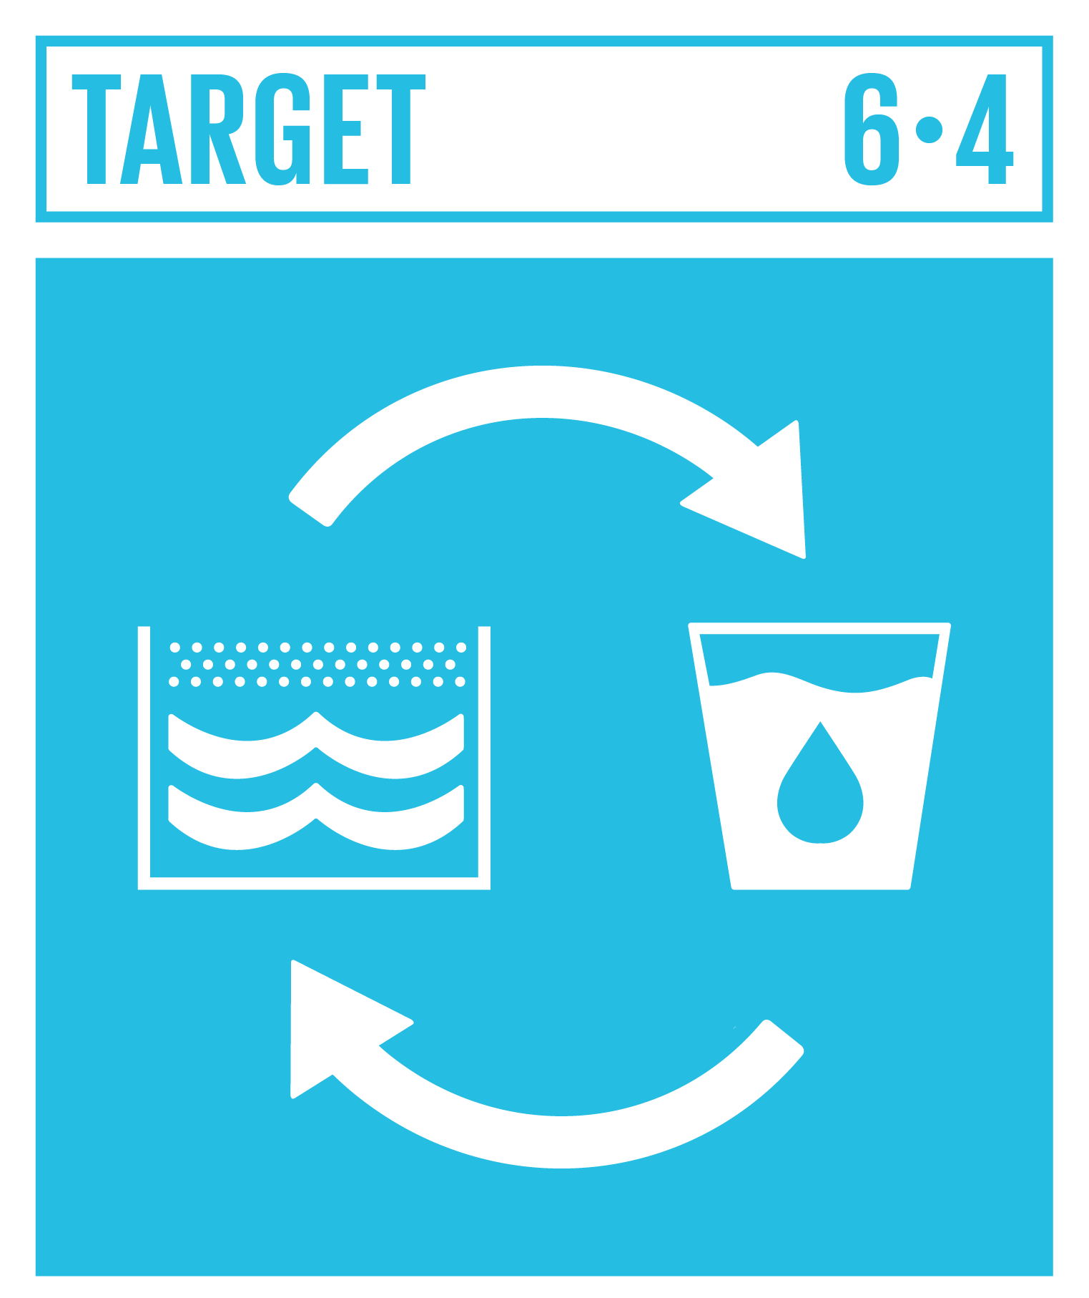
Target 6.4 – Water Use and Efficiency
Statement: By 2030, increase water-use efficiency and ensure sustainable withdrawals.
Indicators:
6.4.1 – Change in water-use efficiency.
6.4.2 – Level of water stress.
Current Progress in Bangladesh: Adoption of the Alternate Wetting and Drying (AWD) irrigation method saved up to 30% irrigation water without reducing yield . Challenges include managing freshwater demand amid population growth
Challenges: Groundwater depletion, climate stress.
Suggestions: Drip irrigation, rainwater harvesting.
Example: Rajshahi farmers use AWD in paddy fields.

Slide 9
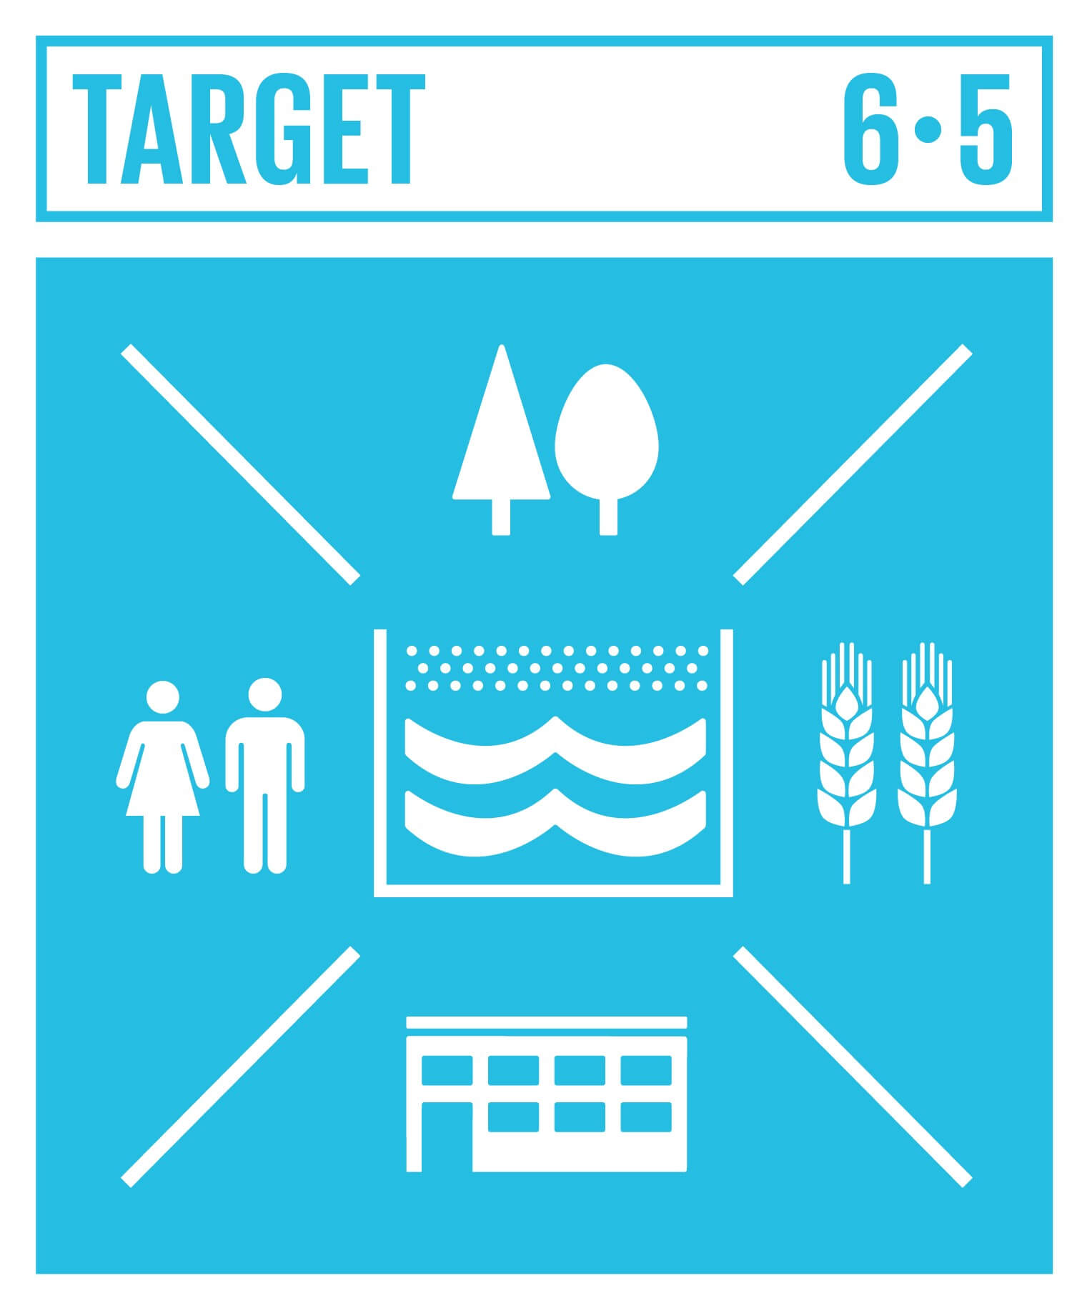
Target 6.5 – Integrated Water Resource Management
Statement: By 2030, implement integrated water resources management (IWRM) at all levels.
Indicators:
6.5.1 – Degree of IWRM implementation.
6.5.2 – Proportion of transboundary area with cooperation.
Current Progress in Bangladesh: Limited implementation due to fragmented sectoral approaches; only medium-low levels reported as of recent reviews

Slide 10
Target 6.5 – Integrated Water Resource Management
Challenges: Transboundary issues, basin planning.
Suggestions: Regional cooperation, river basin
management.
Example: Ongoing Teesta River sharing talks with India.

Slide 11
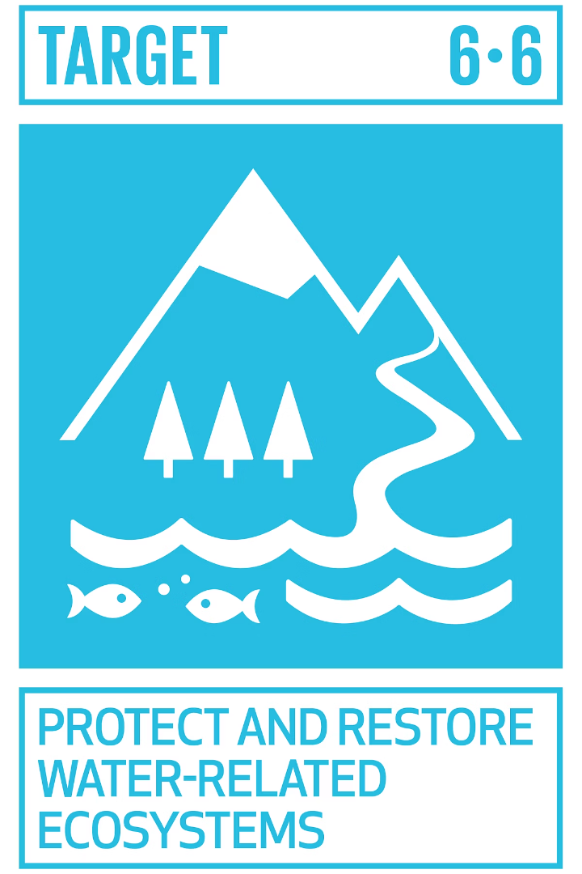



Target 6.6: Protecting Water-Related Ecosystems
Target 6.6 focuses on protecting and restoring water-related ecosystems. Between 1970 and 2015, 35% of the world’s wetlands were lost. Wetlands provide flood control, water purification, and habitat.
In Bangladesh, water-related ecosystems like the Sundarbans mangrove forest are vital for biodiversity and coastal protection. The country faces challenges due to flooding, pollution, and land reclamation that threaten these ecosystems. Conserving and restoring these habitats is critical for the livelihoods of millions and for climate resilience.
1
Rivers
2
Wetlands
3
Aquifers

Slide 12
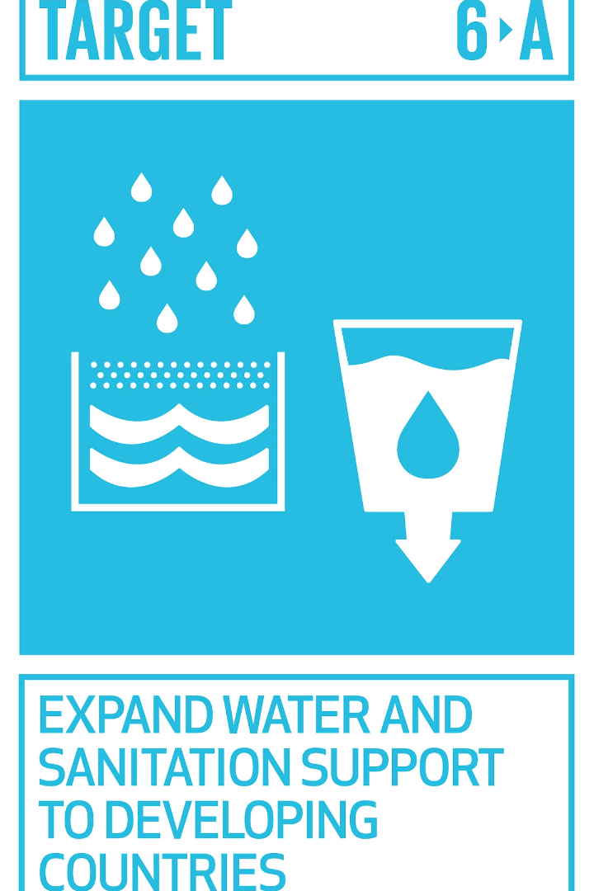
Target 6.a: Expanding International Cooperation
Target 6.a seeks to expand international cooperation and capacity-building for developing countries. This includes water harvesting, desalination, and wastewater treatment. It involves technology transfer and affordable technologies.
Wastewater Treatment
Water Harvesting
Desalination
Techniques to collect and store rainwater for future use, improving water availability in arid regions.
Processes to remove salt and impurities from seawater, providing fresh water for drinking and agriculture.
Improving methods to safely treat and recycle wastewater, reducing pollution and conserving resources.
In Bangladesh, expanding international cooperation is vital to address its water challenges, including flooding, water pollution, and groundwater contamination. Collaboration on technology transfer and capacity building supports sustainable water management, resilience against climate change, and improved access to safe water for millions of people.

