Slide 1
Scientific Calculator
Md. Jannatul Nayeem ID:2015-2-60-065

Slide 2
Presentation Overview:
Introduction
Lexer analysis and parser
Tools
Implementation details
Grammar
Parse tree
Conclusion

Slide 3
Introduction:
Implementation of Parse Tree from Grammar of Scientific Calculator, that is our project name. Our project implements a parse tree of a grammar for a scientific calculator. The functionalities of this grammar is plus (+), minus (-), division (/), multiplication (*), power, log, ln, trigonometric functions (sin, cos, tan, cosec, sec) etc.
100+50-30*2
ln20

Slide 4
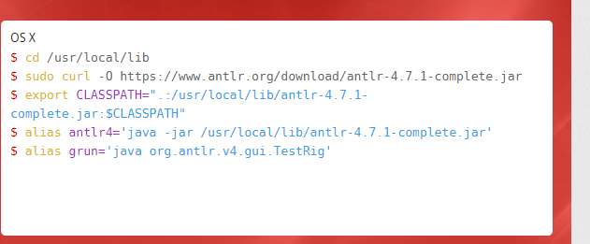
Tools:

Slide 5
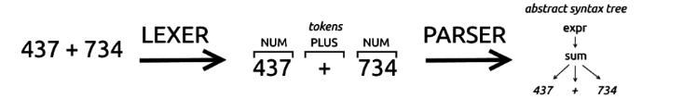
Implementation details

Slide 6
Grammar
grammar compiler;
sr: (expression NEWLINE)*|(func NEWLINE)* ;
expression:
'(' expression ')'
| expression POW expression
| expression ('*'|'/') expression
| expression ('+'|'-') expression
| INT
| VAR
| expression RELOP expression
;

Slide 7
func:
func '(' VAR ')'
| func ('*'|'/') func
| func ('+'|'-') func
| 'cos'
| 'cosec'
| 'sec'
| 'tan'
| 'sin'
| 'log'
| 'ln'
| 'sqrt'
| func '(' INT ')'
| func RELOP func
;

Slide 8
RELOP :'=' | '>' | '<' ;
INT : [0-9]+ ;
VAR :[a-zA-Z];
NEWLINE : [\r\n]+;
POW : '**';

Slide 9
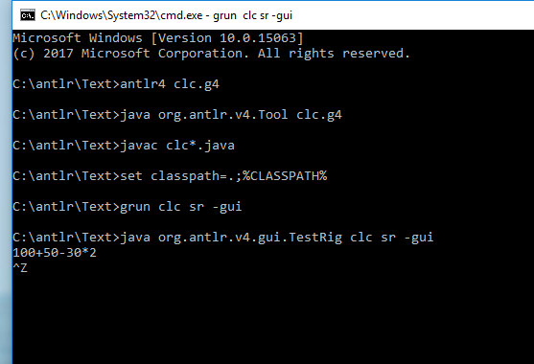
Simulation Results

Slide 10
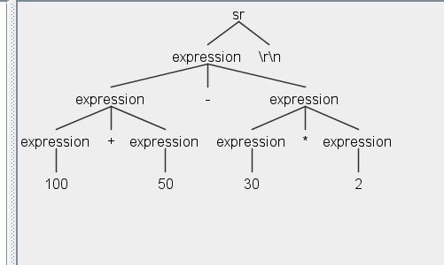
Output

Slide 11
Conclusion
We simply use this project to see how simple scientific calculator works and we can also visualize parse tree using ANTLR tools. We just implement a parse tree from the grammar of a scientific calculator.

Slide 12

Any Question?

Slide 13


