Slide 1
Welcome to PRIASHEEM

Slide 2
Presenting by:
Md. Ashfak Ragib #2015-2-60-086
Md. Jannatul Nayeem #2015-2-60-065
Pritam Chowdhury #2015-2-60-023

Slide 3
Overview
Compiler
Parser
ANTLR Tool
Context Free Grammar (CFG)
Project PRIASHEEM

Slide 4
Compiler
Compiler is a computer software that transforms computer code written in one programming language into another programming language.

Slide 5
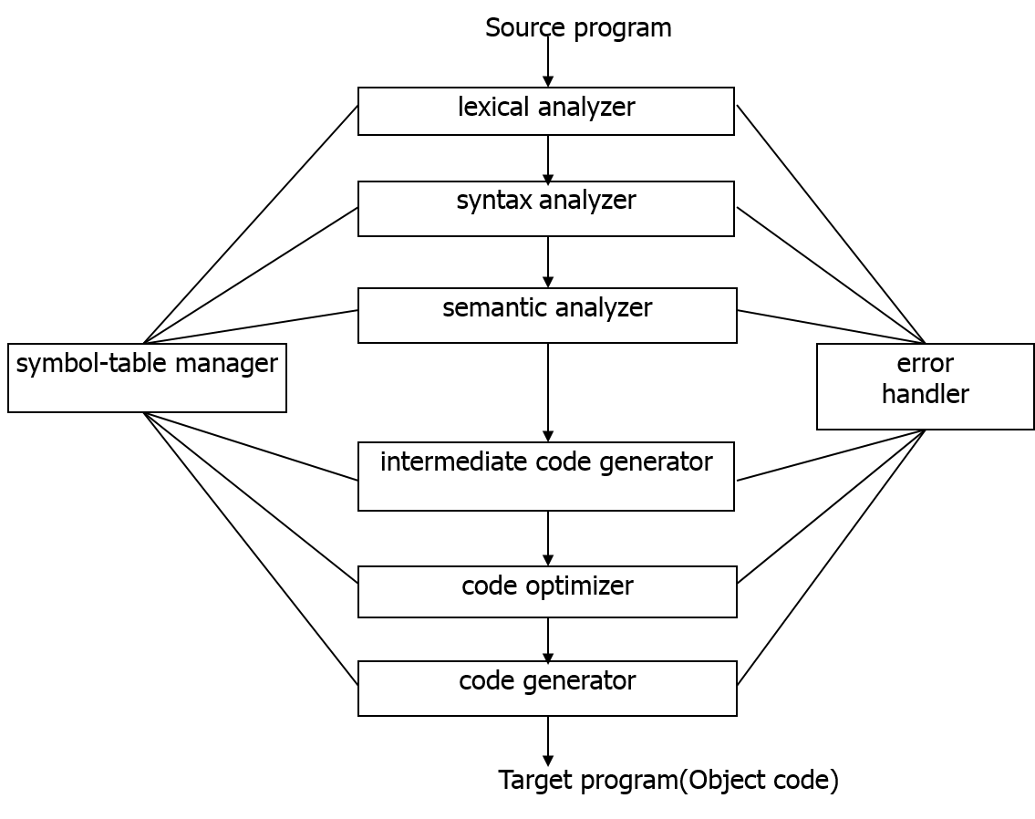
Phase of a Compiler

Slide 6
Parser
Parser is a compiler component which invoked first three stages of a compiler phase.
Lexical Analysis
Syntactic Analysis
Semantic Analysis

Slide 7
About ANTLR
ANTLR (ANother Tool for Language Recognition) is a powerful parser generator for reading, processing, executing, or translating structured text or binary files. It's widely used to build languages, tools, and frameworks. From a grammar, ANTLR generates a parser that can build and walk parse trees.

Slide 8
ANTLR Mechanism
From a formal language description called a grammar, ANTLR generates a parser for that language that can automatically build parse trees, which are data structures representing how a grammar matches the input. ANTLR also automatically generates tree walkers that can be used to visit the nodes of those trees to execute code.

Slide 9
Process Visualization
Grammar
Parse Tree
Generate Parser

Slide 10
Context Free Grammar(CFG)
In formal language theory, a context-free grammar is a certain type of formal grammar: a set of production rules that describes all possible strings in a given formal language.

Slide 11
PRIASHEEM CFG
grammar Priasheem;
begin
: (start NEWLINE)*;
start
: operational_input specification quality
| and operational_input
| start_of_property operational_input
| and operational_input end_of_property specification quality
| operational_input
| not_specified start
| quality specification operational_input
| not_specified
| quality ;

Slide 12
operational_input :
insect | animal | object ;
Insect :
'ant' | 'bee' | 'mosquito' | 'butterfly'| 'may fly'| 'beetle' | 'fly' | 'grasshopper' ;
animal :
'cat' | 'human' | 'cow' | 'monkey' | 'crow' | 'goat' | 'dog' | 'buffalo' | 'tiger' ;
Object :
'car' | 'boat' | 'book' ;
quality :
quality and quality | quality color quality | color | quality size quality |not_specified | size ;

Slide 13
specification :
‘ >> ' | ‘ -> ' ;
start_of_property :
‘ ( ‘ ;
end_of_property :
‘ ) ’ ;
and :
'&' | ‘ , ‘ ;
Size :
'big‘ | 'very big‘ | 'small‘ | 'very small‘ | 'tiny'| 'large‘ | 'medium‘ | start_of_property size | size end_of_property | size and size ;

Slide 14
color :
'red' | 'yellow' | 'green' | 'black' | 'blue' | 'green' | 'sky' | 'lemon' | 'orange' | 'pink' | 'grey' | 'brown' | 'rainbow' | 'white' | start_of_property color | color end_of_property | color and color ;
not_specified :
'null‘ ;
NEWLINE :
[\r\n]+ ;

Slide 15
Live Project Presentation

Slide 16
Thank You

Slide 17
Any Question?

