Slide 1

SIGNAL STUDIO
Understanding sound through signal properties
A tour of the heart sound and audio analysis project
Student IDs: 2305018 and 2305019
Notes:
Introduce the project as an educational signal-processing application. The examples in this deck come from the supplied MP3 and data/training/training-a/a0001.wav. The song plots use the 50–60 second excerpt.

Slide 2
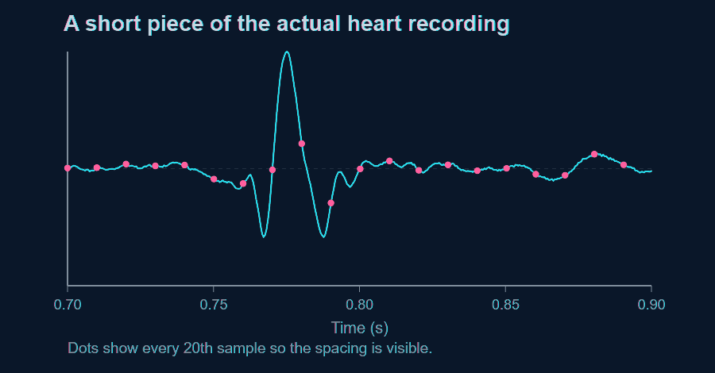
Samples turn sound into numbers
ANALYSIS / 02
The sample rate gives every value a time.
a0001.wav has 2,000 samples each second.
Sample 1,600 occurs at 1,600 / 2,000 = 0.80 s.
Nyquist frequency: 1,000 Hz.
SIGNAL STUDIO
2
Notes:
Source: a0001.wav, mono, 2,000 Hz, duration 35.666 seconds. dashboard.py uses np.arange(len(signal))/sample_rate for the waveform time axis. Clarify that the dots are a display subset; the underlying recording has 2,000 samples per second.

Slide 3
One project, five workspaces
ANALYSIS / 03
01
Heart sounds
filter → envelope → S1/S2 timing
02
Audio analyzer
waveform → spectrum → effects
03
Audio encryption
file bytes → AES-GCM → WAV carrier
04
Steganography
text bits → FFT bins → playable WAV
05
Echo Detector
autocorrelation → repeated-delay candidate
SIGNAL STUDIO
3
Notes:
This is a map of the five workspaces. Heart sounds uses filtering and timing. The audio analyzer shows waveform, spectrum, spectrogram, effects, pitch, and comparison. The crypto page encrypts original file bytes into a reversible WAV carrier. Steganography hides text bits in selected FFT magnitudes. The Echo Detector examines repetition using autocorrelation. Use this map to orient the audience before the detailed examples.

Slide 4
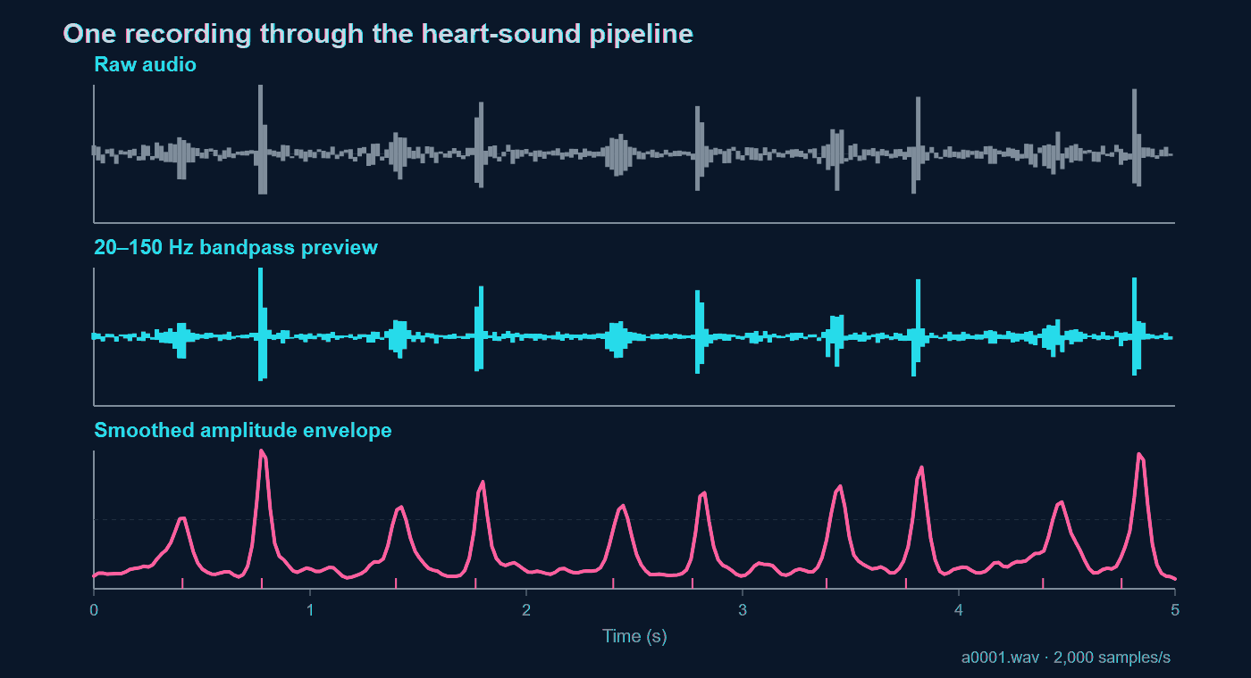
Code path: dashboard.py, models/transforms.py, models/filters.py, models/peak_detection.py
Notes:
The figure uses a0001.wav, 2,000 Hz. For the slide preview, a zero-phase 20–150 Hz bandpass and a smoothed rectified envelope were computed in JavaScript; the app performs its own SciPy Butterworth and filtfilt operations. Code: models/transforms.py design_digital_filter, models/filters.py apply_bandpass_filter, models/peak_detection.py get_envelope and detect_peaks. Explain that the envelope merges many waveform oscillations into a sound event.

Slide 5
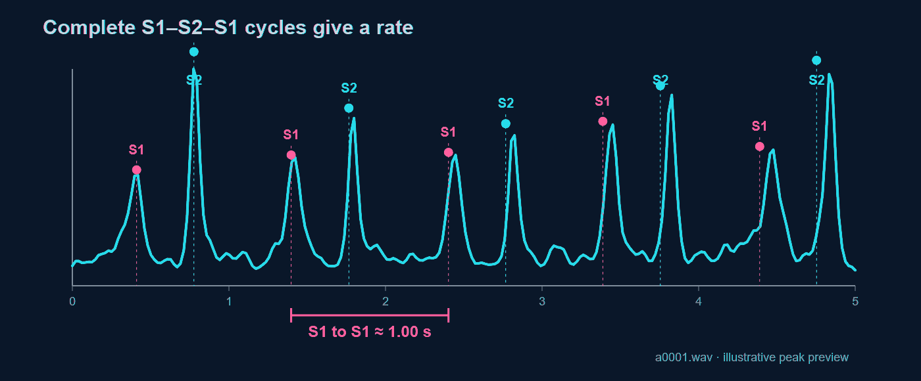
Heart timing: from peaks to BPM
ANALYSIS / 05
BPM = 60 / median(S1-to-S1 intervals)
About 60 BPM from the preview peaks; the app computes its own estimate.
SIGNAL STUDIO
5
Notes:
The displayed preview identifies alternating bursts around 0.41, 0.78, 1.40 and 1.77 seconds. A full S1–S2–S1 cycle gives one beat. models/peak_detection.py classify_s1_s2 uses plausible short and long gap rules. calculate_heart_rate uses the median complete S1-to-S1 interval. These labels and BPM are educational estimates, not medical diagnoses.

Slide 6
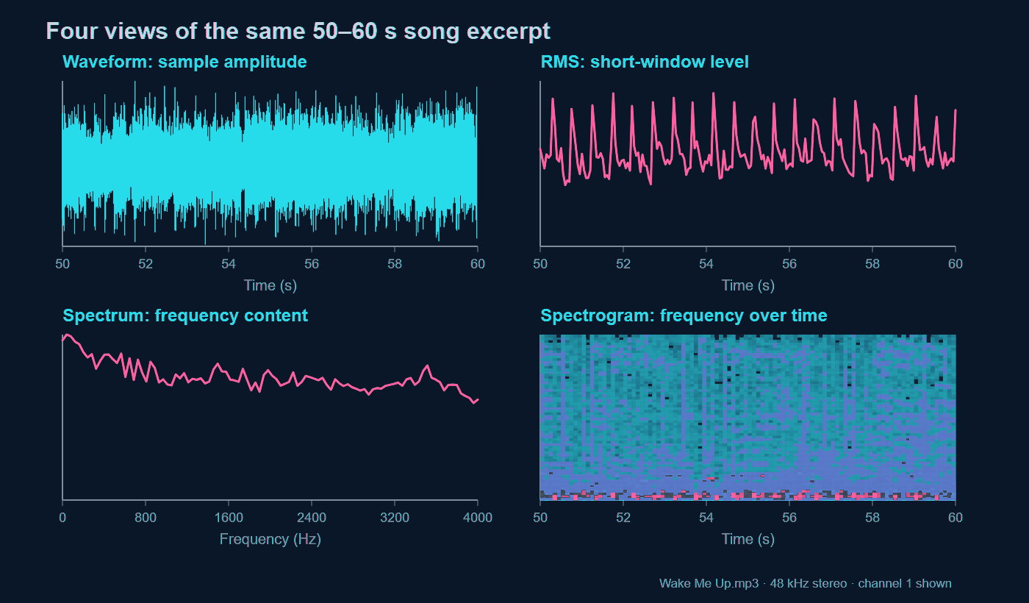
Notes:
Source: supplied Avicii Wake Me Up MP3. Chrome decoded the file at 48,000 Hz, stereo, duration about 272.46 seconds. These graphs use channel 1 from seconds 50–60. Waveform shows amplitude vs time; RMS uses short blocks for level; the spectrum averages 32 FFT windows across the excerpt; the spectrogram shows frequency changing over time. The plotted preview is separate from the app output but illustrates the same signal properties. audio_processing.py has RMS, Welch spectrum and STFT functions.

Slide 7
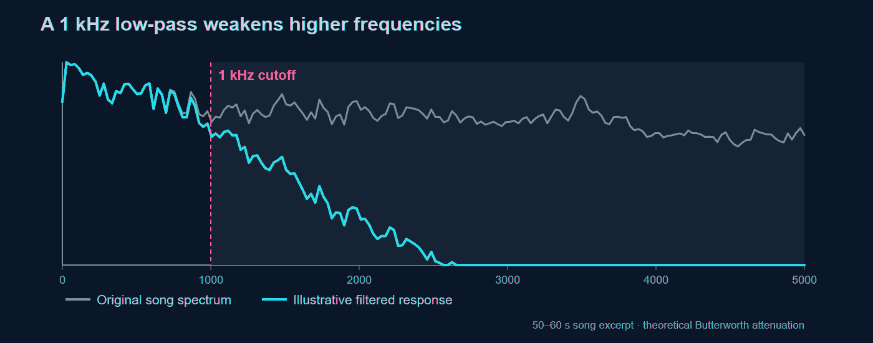
Filtering changes frequency balance
ANALYSIS / 07
The song spectrum is measured. The second curve illustrates a 1 kHz Butterworth low-pass response.
SIGNAL STUDIO
7
Notes:
The plot uses the song excerpt. The gray spectrum is measured from a window in the supplied MP3; the teal curve is a theoretical fourth-order Butterworth low-pass response applied to that spectrum. It is an illustration, not a processed export from the app. audio_processing.py frequency_filter validates cutoffs against Nyquist, designs SOS sections and applies sosfiltfilt. Mention that cutoff is gradual rather than a hard boundary.

Slide 8
Delay: copies in time
ANALYSIS / 08
FOLLOW ONE SOUND EVENT
SCHEMATIC
input
one quieter copy
output
0
0.3 s
0.6 s
0.9 s
1.2 s
Delay moves one copy later by a chosen number of samples; the original stays in place.
offset = int(delay_seconds * sample_rate); output[offset:offset + len(audio)] += audio * amount
TRY IN THE APP
Choose Delay, then move the time and amount sliders.
SIGNAL STUDIO
8
Notes:
Delay uses a time shift. The code in audio_processing.py calculates offset as delay_seconds times sample_rate, then adds one amplitude-scaled copy. A 0.3-second delay at 44.1 kHz is 13,230 samples. The timeline is schematic. In the app, choose Rooms & effects, then Delay.

Slide 9
Echo: copies in time
ANALYSIS / 09
FOLLOW ONE SOUND EVENT
SCHEMATIC
input
each repeat gets quieter
output
0
0.3 s
0.6 s
0.9 s
1.2 s
Echo is repeated delay: four later copies are mixed in, each scaled by amount to a higher power.
repeats = 4; output[start:start + len(audio)] += audio * amount ** repeat
TRY IN THE APP
Choose Echo; increase amount to hear a longer tail.
SIGNAL STUDIO
9
Notes:
Echo uses the same delay offset but four repeats in audio_processing.py. Each repeat is multiplied by amount raised to its repeat number, so an amount below 1 gives a decaying tail. The 0.3-second spacing in the diagram is an example; it is set by the time slider. Distinguish this effect from the separate Echo Detector, which looks for repeated delays in an existing recording.

Slide 10
Tremolo: volume moves in waves
ANALYSIS / 10
COMPARE THE ENVELOPES
SCHEMATIC
steady input
tremolo output
The samples stay in time. A slowly changing sine-shaped gain makes their amplitude pulse.
gain = 1 - amount + amount * (1 + sin(2*pi*rate*time)) / 2; output = audio * gain
TRY IN THE APP
Choose Tremolo; move the speed slider and listen for pulsing.
SIGNAL STUDIO
10
Notes:
Tremolo is amplitude modulation. The original waveform is multiplied by a gain that follows a sine wave. audio_processing.py uses rate=max(0.2, delay_seconds*10); that shared slider becomes tremolo speed. The diagram is schematic, not the exact song waveform. Unlike delay or echo, tremolo does not place new copies later in time.

Slide 11
Distortion: reshaping the peaks
ANALYSIS / 11
COMPARE THE WAVE SHAPES
SCHEMATIC
smooth input
saturated output
Tanh compresses high peaks smoothly. That nonlinear change creates extra harmonics.
drive = 1 + 24 * amount; output = tanh(drive * audio) / tanh(drive)
TRY IN THE APP
Choose Distortion; raise amount and compare the spectrum.
SIGNAL STUDIO
11
Notes:
The app applies tanh soft saturation in audio_processing.py. As amount rises, drive rises from 1 toward 23.8 at the UI maximum of 0.95. The output is normalized by tanh(drive). The rounded peaks in the schematic demonstrate nonlinear compression. Nonlinearity changes frequency content, creating harmonics; it is not merely louder audio.

Slide 12
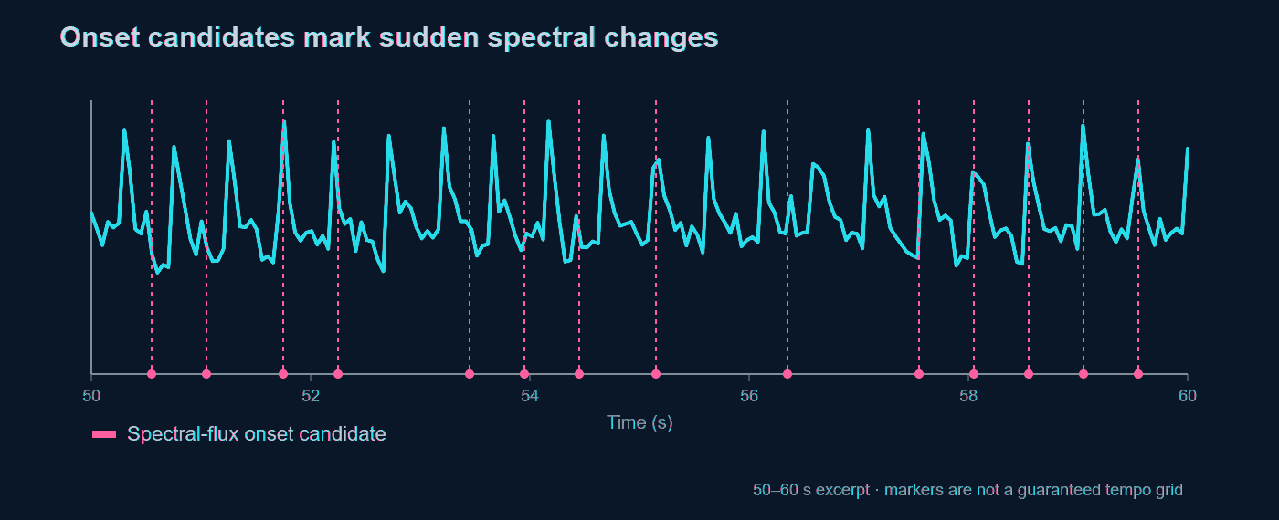
Musical onsets and pitch
ANALYSIS / 12
Onsets: positive STFT magnitude changes. Pitch: frequency = sample rate / repeating lag.
SIGNAL STUDIO
12
Notes:
The onset chart uses the 50–60 second excerpt of the user-supplied song. Candidate markers are from an illustrative spectral-flux calculation and should not be presented as the exact app output or a tempo grid. audio_processing.py detect_beats sums only positive changes in STFT magnitude and peak-picks. detect_pitch uses autocorrelation in a short frame; a polyphonic song can cause octave errors or no reliable result.

Slide 13
Similarity, alignment and echo
ANALYSIS / 13
Compare clips by lining up their loudness patterns first.
Clip A
Clip B
A shift brings matching events together before subtraction or correlation.
Echo detection slides one signal against itself. A secondary autocorrelation peak gives a candidate delay.
Repeated music can produce a similar peak, so a detected delay is evidence of repetition.
SIGNAL STUDIO
13
Notes:
audio_processing.py aligns clips using envelopes and normalized correlation, then computes waveform correlation, RMS difference and level difference on the overlap. models/echo_detector.py uses FFT autocorrelation to find a delayed self-match and checks whether the delay repeats across windows. A repeating rhythm can create a false echo candidate.

Slide 14
Encryption: protect the whole audio file
ANALYSIS / 14
FOLLOW THE BYTES
SCHEMATIC
ORIGINAL FILE
AES-GCM
ENCRYPTED WAV
bytes + filename
password-derived key
ciphertext as PCM samples
The carrier sounds like noise, but its PCM bytes must stay unchanged for decryption.
ciphertext = aesgcm.encrypt(nonce, plaintext, None); carrier = np.frombuffer(packed, dtype=np.int16)
TRY IN THE APP
Encrypt → download the WAV → decrypt using the same password.
SIGNAL STUDIO
14
Notes:
The active crypto page calls encrypt_audio_file_bytes in models/audio_crypto.py. It encrypts the original file bytes and filename with AES-GCM, using a key derived from the password by PBKDF2. The ciphertext is packed into int16 values and stored in a WAV container; its audio playback sounds noise-like. Decryption can recover the original file exactly if the password and carrier sample bytes are unchanged. Lossy conversion such as MP3 destroys the stored bytes.

Slide 15
Steganography: hide text in sound
ANALYSIS / 15
SMALL CHANGES IN FFT MAGNITUDES
SCHEMATIC
message bits
selected FFT bins
playable WAV
0 1 1 0
Bit 0 uses an even magnitude step; bit 1 uses an odd step. Phase is kept.
new_mag = quantize(abs(X[k]), bit, delta); X[k] = new_mag * exp(1j * phase)
TRY IN THE APP
Hide a short message, save the WAV, then extract the text.
SIGNAL STUDIO
15
Notes:
models/steganography.py converts UTF-8 text to bits, prefixes a signature and message length, and repeats each bit three times. It splits audio into 4096-sample blocks, takes an FFT, and changes selected mid-frequency magnitudes so their quantization index is even or odd. It keeps the phase and uses an inverse FFT to return to audio. Extraction reads the parity and uses majority vote. The lowest and highest 20 bins are skipped. This hides data; it does not encrypt the message.

Slide 16
Live sound visualizer
ANALYSIS / 16
LIVE MICROPHONE VIEW
SCROLLING SPECTROGRAM
WAVEFORM
A new color column appears each frame. It shows frequency strength and moves left as time passes.
Recent microphone samples trace sound amplitude over time.
FREQUENCY BARS
Start live display asks for microphone access. Stop closes the audio stream and releases the mic.
The bars show how much energy each frequency band has now.
LIVE DEMO
Start live display → make a sound → watch → Stop
SIGNAL STUDIO
16

Slide 17
Record and analyze a clip
ANALYSIS / 17
FROM LIVE TO RECORDED
RECORDED ANALYSIS
STOP LIVE DISPLAY
The Analyze view plots waveform, loudness, spectrum and spectrogram. It also reports duration, sample rate and peak.
Stop the live view before using the microphone recorder in the sidebar.
SAVE A CLIP
The live display stays in the browser. A recorded clip can be filtered, compared with another clip and downloaded as WAV.
Play it back, then select Analyze recording to open the audio tools.
DEMO PATH
Stop live view → record → play back → Analyze recording
SIGNAL STUDIO
17

Slide 18
Results and limits
ANALYSIS / 18
WHAT THE SIGNALS SHOW
WHAT NEEDS CARE
HEART AUDIO
Heart labels are estimates. Musical onsets are not always beats. Repeated sounds can resemble echoes.
Repeated bursts become S1/S2 timing candidates, then an estimated rate.
MUSIC
Encrypted WAV samples must remain unchanged. Steganography hides text, but does not encrypt it.
Waveform, spectrum and spectrogram reveal different parts of the same excerpt.
DEMO PATH
Upload → inspect → adjust → listen → compare
SIGNAL STUDIO
18
Notes:
Use this closing slide to separate observation from inference. The heartbeat preview shows repeating peaks that support a rough cycle estimate, but the software does not diagnose a condition. The song views show different signal properties of the same 50 to 60 second excerpt. Beat and echo detections can include false positives. Encryption needs unchanged PCM bytes, while steganography does not provide confidentiality. Finish with a short live walkthrough.

