Slide 1

SIGNAL STUDIO
Understanding sound through signal properties
A tour of the heart sound and audio analysis project
Student IDs: 2305018 and 2305019
Notes:
Introduce the project as an educational signal-processing application. The examples in this deck come from the supplied MP3 and data/training/training-a/a0001.wav. The song plots use the 50–60 second excerpt.

Slide 2
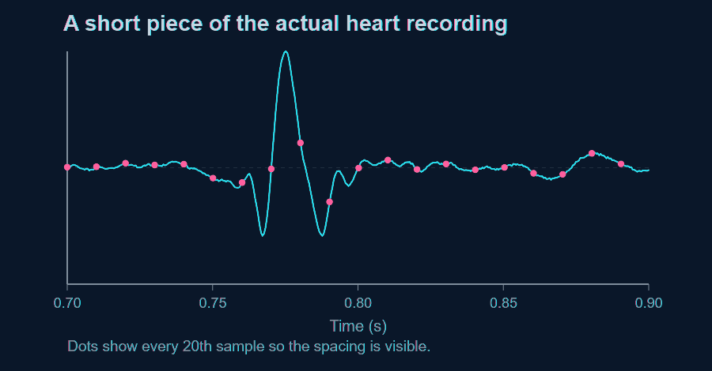
Samples turn sound into numbers
ANALYSIS / 02
The sample rate gives every value a time.
a0001.wav has 2,000 samples each second.
Sample 1,600 occurs at 1,600 / 2,000 = 0.80 s.
Nyquist frequency: 1,000 Hz.
SIGNAL STUDIO
2
Notes:
Source: a0001.wav, mono, 2,000 Hz, duration 35.666 seconds. dashboard.py uses np.arange(len(signal))/sample_rate for the waveform time axis. Clarify that the dots are a display subset; the underlying recording has 2,000 samples per second.

Slide 3
One project, five workspaces
ANALYSIS / 03
Heart sounds
Bandpass filtering, envelope peaks, S1/S2 timing
Audio analyzer
Waveform, spectrum, spectrogram, effects, beat and pitch
Audio encryption
Original file bytes packed into a PCM WAV carrier
Steganography
Text bits encoded in selected FFT magnitudes
Echo Detector
Autocorrelation searches for repeated delays
SIGNAL STUDIO
3
Notes:
These workspace names come from dashboard.py. The Audio analyzer also contains filtering, denoising, room simulation, a spectrogram painter and comparison. The slide groups functions for orientation rather than showing every control.

Slide 4
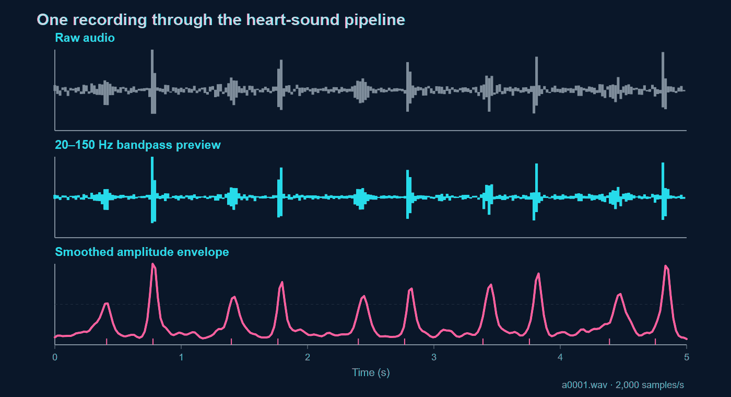
Code path: dashboard.py, models/transforms.py, models/filters.py, models/peak_detection.py
Notes:
The figure uses a0001.wav, 2,000 Hz. For the slide preview, a zero-phase 20–150 Hz bandpass and a smoothed rectified envelope were computed in JavaScript; the app performs its own SciPy Butterworth and filtfilt operations. Code: models/transforms.py design_digital_filter, models/filters.py apply_bandpass_filter, models/peak_detection.py get_envelope and detect_peaks. Explain that the envelope merges many waveform oscillations into a sound event.

Slide 5
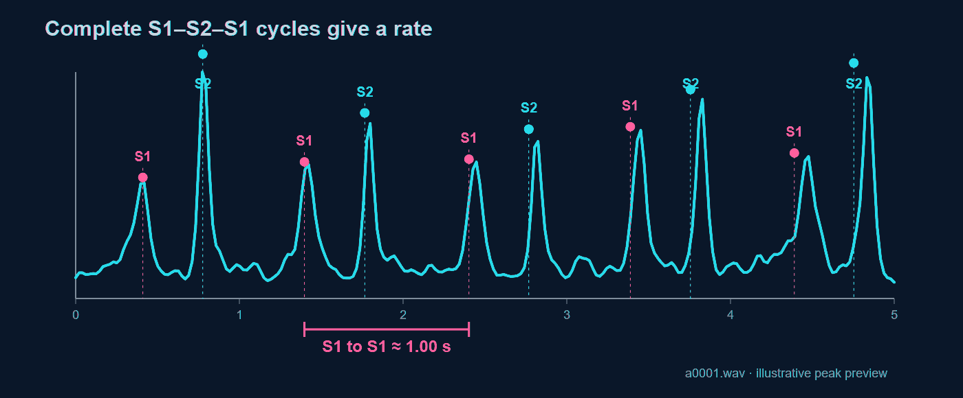
Heart timing: from peaks to BPM
ANALYSIS / 05
BPM = 60 / median(S1-to-S1 intervals)
About 60 BPM from the preview peaks; the app computes its own estimate.
SIGNAL STUDIO
5
Notes:
The displayed preview identifies alternating bursts around 0.41, 0.78, 1.40 and 1.77 seconds. A full S1–S2–S1 cycle gives one beat. models/peak_detection.py classify_s1_s2 uses plausible short and long gap rules. calculate_heart_rate uses the median complete S1-to-S1 interval. These labels and BPM are educational estimates, not medical diagnoses.

Slide 6
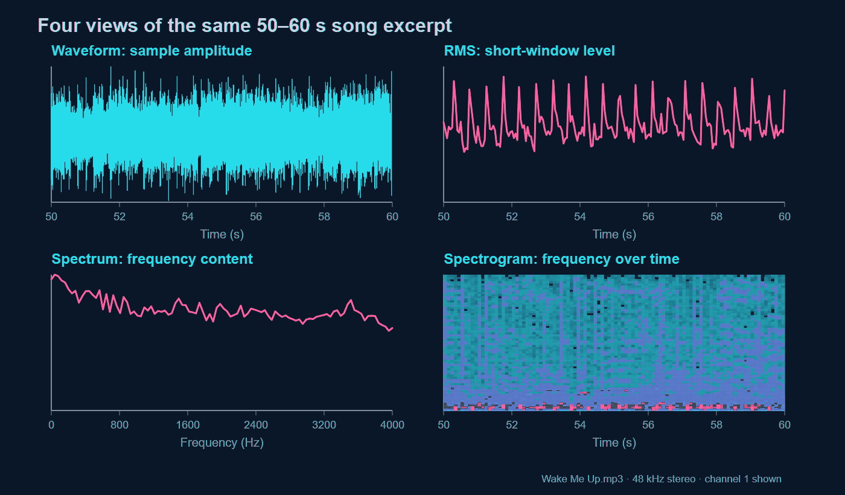
Notes:
Source: supplied Avicii Wake Me Up MP3. Chrome decoded the file at 48,000 Hz, stereo, duration about 272.46 seconds. These graphs use channel 1 from seconds 50–60. Waveform shows amplitude vs time; RMS uses short blocks for level; the spectrum averages 32 FFT windows across the excerpt; the spectrogram shows frequency changing over time. The plotted preview is separate from the app output but illustrates the same signal properties. audio_processing.py has RMS, Welch spectrum and STFT functions.

Slide 7
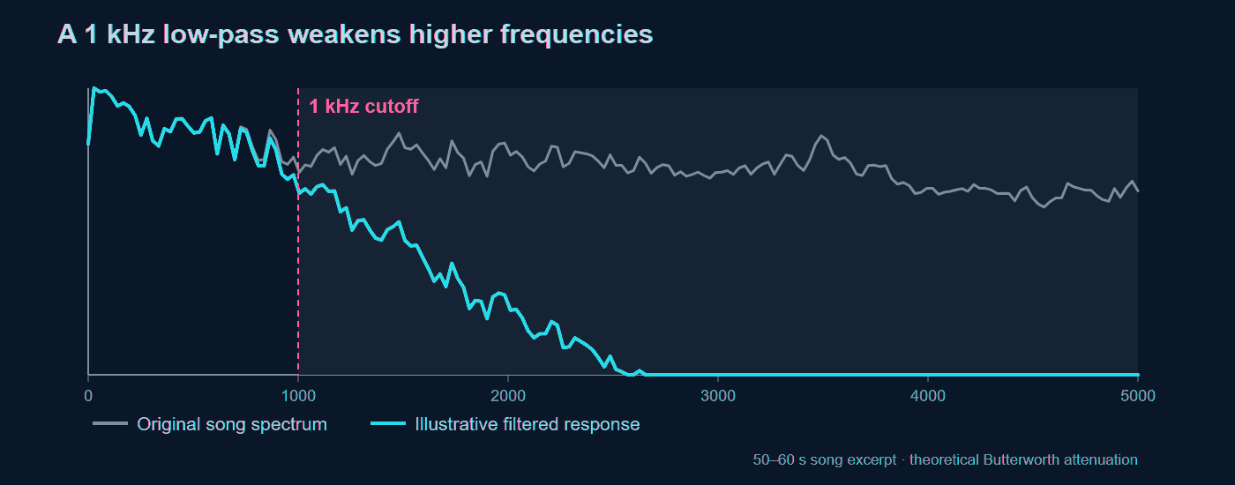
Filtering changes frequency balance
ANALYSIS / 07
The song spectrum is measured. The second curve illustrates a 1 kHz Butterworth low-pass response.
SIGNAL STUDIO
7
Notes:
The plot uses the song excerpt. The gray spectrum is measured from a window in the supplied MP3; the teal curve is a theoretical fourth-order Butterworth low-pass response applied to that spectrum. It is an illustration, not a processed export from the app. audio_processing.py frequency_filter validates cutoffs against Nyquist, designs SOS sections and applies sosfiltfilt. Mention that cutoff is gradual rather than a hard boundary.

Slide 8
Delay, echo, tremolo and distortion
ANALYSIS / 08
Echo adds later, quieter copies of the same event.
original
0.3 s
0.6 s
0.9 s
Tremolo changes gain over time. Distortion bends the waveform and adds harmonics.
output[start:start + len(audio)] += audio * amount ** repeat
SIGNAL STUDIO
8
Notes:
audio_processing.py effects implements one shifted copy for Delay and four decaying copies for Echo. The illustrated 0.3-second spacing is an example. At 44.1 kHz, 0.3 seconds is 13,230 samples. Tremolo multiplies by a sinusoidal gain. Distortion applies tanh, a nonlinear operation. Room simulation elsewhere uses convolution with synthetic impulse responses.

Slide 9
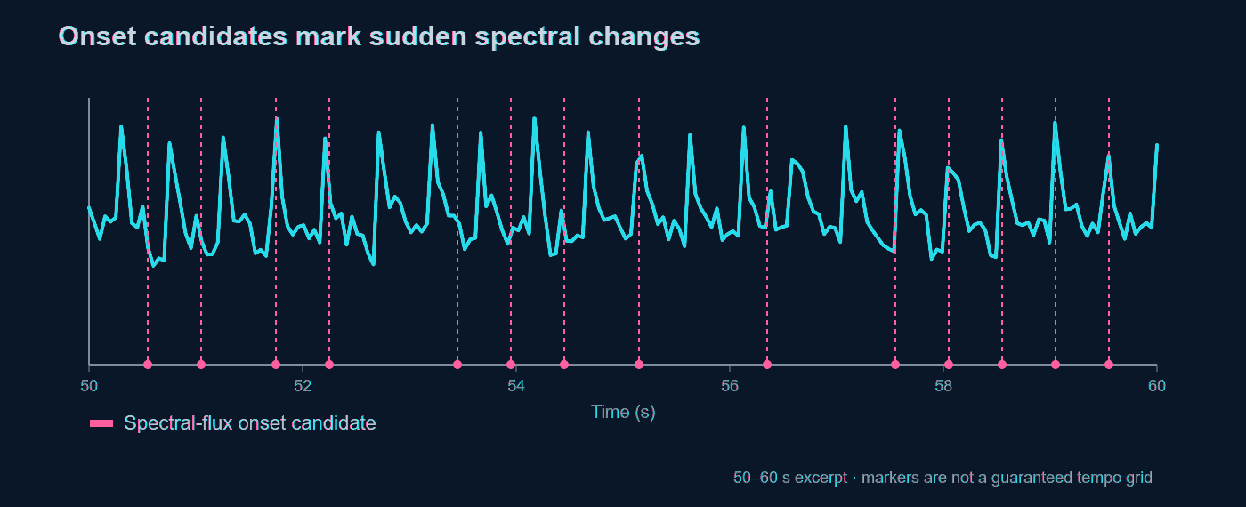
Musical onsets and pitch
ANALYSIS / 09
Onsets: positive STFT magnitude changes. Pitch: frequency = sample rate / repeating lag.
SIGNAL STUDIO
9
Notes:
The onset chart uses the 50–60 second excerpt of the user-supplied song. Candidate markers are from an illustrative spectral-flux calculation and should not be presented as the exact app output or a tempo grid. audio_processing.py detect_beats sums only positive changes in STFT magnitude and peak-picks. detect_pitch uses autocorrelation in a short frame; a polyphonic song can cause octave errors or no reliable result.

Slide 10
Similarity, alignment and echo
ANALYSIS / 10
Compare clips by lining up their loudness patterns first.
Clip A
Clip B
A shift brings matching events together before subtraction or correlation.
Echo detection slides one signal against itself. A secondary autocorrelation peak gives a candidate delay.
Repeated music can produce a similar peak, so a detected delay is evidence of repetition.
SIGNAL STUDIO
10
Notes:
audio_processing.py aligns clips using envelopes and normalized correlation, then computes waveform correlation, RMS difference and level difference on the overlap. models/echo_detector.py uses FFT autocorrelation to find a delayed self-match and checks whether the delay repeats across windows. A repeating rhythm can create a false echo candidate.

Slide 11
Encryption and steganography use audio differently
ANALYSIS / 11
Encryption
1 Original file bytes
2 AES-GCM ciphertext
3 PCM WAV samples
Recovery needs the password and unchanged sample values.
Steganography
1 UTF-8 message bits
2 FFT magnitude parity
3 Playable WAV
Three copies per bit help extraction; the message is not encrypted.
SIGNAL STUDIO
11
Notes:
models/audio_crypto.py encrypt_audio_file_bytes stores original file bytes and filename, derives a key with PBKDF2 and uses AES-GCM; WAV is a reversible int16 container and may sound like noise. models/steganography.py stores repeated UTF-8 bits in quantized FFT magnitude parity while preserving phase. This hides text in playable sound but provides no secrecy. They are distinct features and should not be described as the same process.

Slide 12
Results and limits
ANALYSIS / 12
What the examples show
a0001.wav: repeating sound bursts become candidate S1/S2 cycles after smoothing.
Wake Me Up.mp3: waveform, spectrum and spectrogram reveal different properties of the same ten seconds.
What the algorithms cannot prove
Heart labels are timing estimates. Onset and echo peaks can come from other repeating sounds. Encryption needs an unchanged PCM carrier.
Demo path: heart upload, filter and markers, then song analysis views.
SIGNAL STUDIO
12
Notes:
Close with the two source recordings and a short live demonstration. The heart results are not a diagnosis. Beat onset candidates are not a guaranteed tempo grid. Echo autocorrelation measures delayed similarity rather than proving an acoustic reflection. MP3 audio was analyzed from a decoded channel; the original MP3 is not embedded in the deck.

