Slide 1


Crime Reporting and Case Management System
Department of Computer Science and Engineering | University of Information Technology and Sciences
Software Engineering and System Analysis Lab| Autumn 2026
Project Task Force
Supervised By
Md Nayem Islam
Md Zayed Adnan Zabin
Md. Faysal
ID: 04325105101041
Role: Developer
ID: 04325105101034
Role: Developer
Lecturer
Department of CSE
Shad Ahmed
Lecturer
Department of CSE
Mahjabin Afroze Mahira
Kanis Akter
ID: 04325105101007
Role: UI Designer
ID: 04325105101018
Role: Tester

Slide 2
PROBLEM & OBJECTIVES
Why CRMS: reporting crime is slow, manual and opaque
Citizens
Objectives
Must visit a station in person; reporting is slow and discourages timely reports.
1
Let citizens register and submit crime reports online
Police officers
2
Attach evidence (image / PDF) to each report
No unified digital system to review, verify and track reports; paper and spreadsheets.
3
Track the real-time status of every report
Transparency
4
Give police tools to verify, reject and investigate
Delays and lost records; citizens cannot see what happened to their report.
5
Let admins manage users, officers and categories
OUR SOLUTION
6
Enforce secure role-based access for all roles
One role-based web platform: citizens report with evidence, police verify and investigate, admins oversee — every step visible to the citizen.
7
Reduce dependence on paper-based reporting
CRMS · Syntax Squad (Group 7)
2
Notes:
Citizens must visit a station; police use paper or spreadsheets; nobody can see report progress. Our objectives on the right turn that into a single role-based web platform. Scope is an MVP for one semester; advanced features are future work.

Slide 3
REQUIREMENTS
Key functional and non-functional requirements
Citizen
FR-01–09
Police Officer
FR-10–15
Administrator
FR-16–20
Register, login / logout, profile
Submit crime report
Upload evidence (image / PDF)
Track status, view history
Help & resources
Forgot password
Secure officer login
View & search / filter reports
Verify or reject (reason required)
Update investigation status
Add investigation remarks
Manage citizens & officers
Manage crime categories
View all reports
Dashboard statistics
NON-FUNCTIONAL REQUIREMENTS
Security
Performance
Reliability
Usability
Scalability
Maintainability
Hashed passwords, role-based access, validated uploads
Common actions respond in a few seconds
Reports and updates saved without data loss
Simple role-specific dashboards
Normalised schema, extensible categories
Separate citizen / police / admin modules
CRMS · Syntax Squad (Group 7)
3
Notes:
20 functional requirements from the SRS grouped by role, plus the non-functional qualities and the design decision that satisfies each.

Slide 4
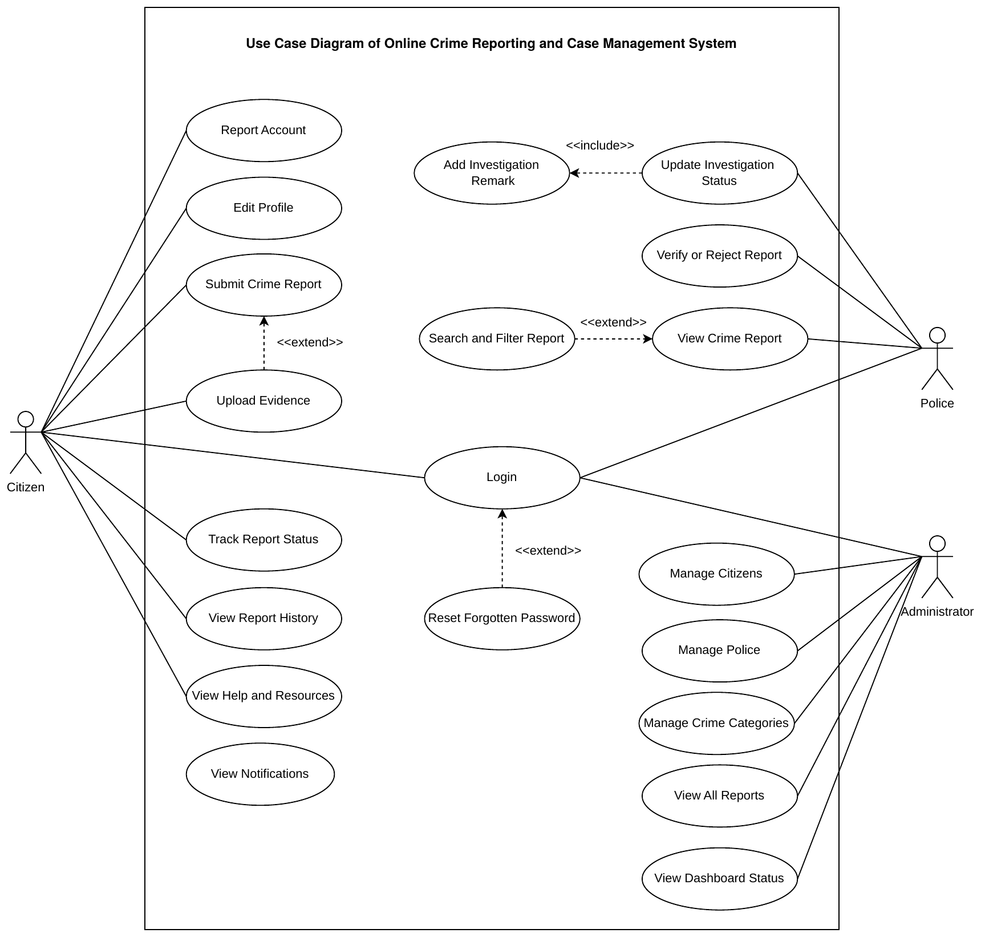
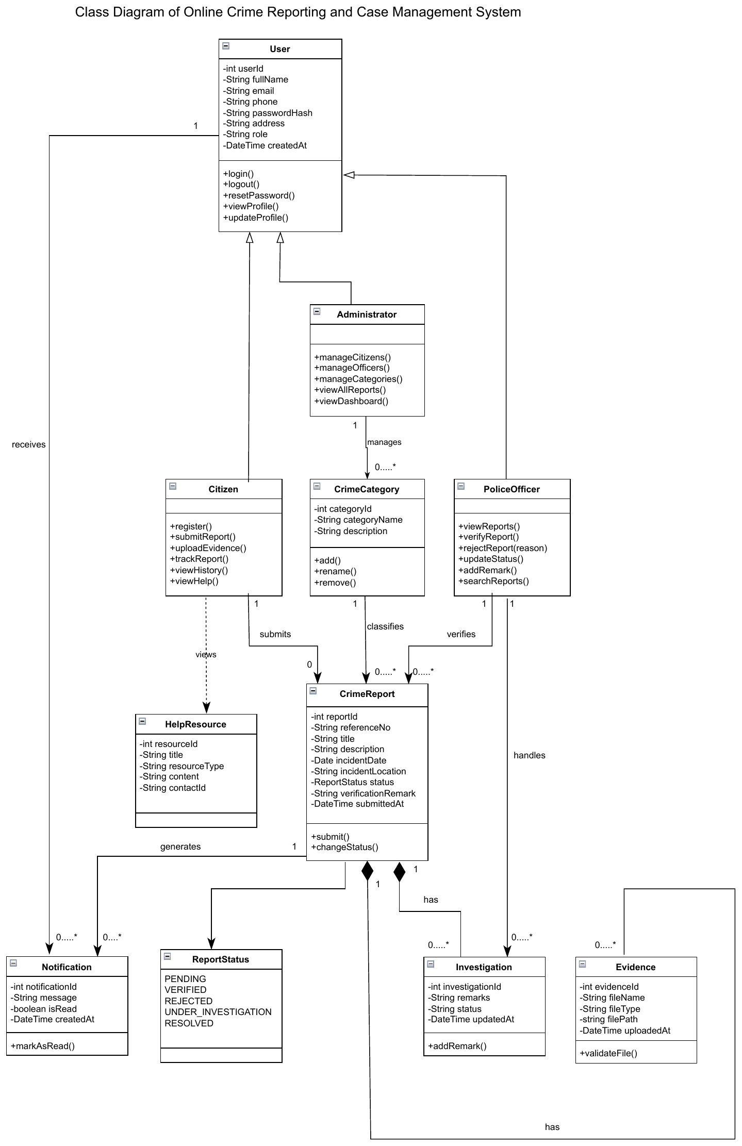
SYSTEM DESIGN · USE CASE & CLASS
Who does what, and how the data is modelled
Use case diagram
Class diagram
Citizen, Police Officer, Administrator; «extend» Upload Evidence, «include» Add Remark
User base class → 3 roles; CrimeReport owns Evidence & Investigation
CRMS · Syntax Squad (Group 7)
4
Notes:
Left: three actors and their use cases; Upload Evidence extends Submit Report, Add Remark is included in Update Status. Right: class diagram - User is the base class; Citizen, PoliceOfficer and Administrator inherit from it. CrimeReport owns Evidence and Investigation and generates Notifications.

Slide 5
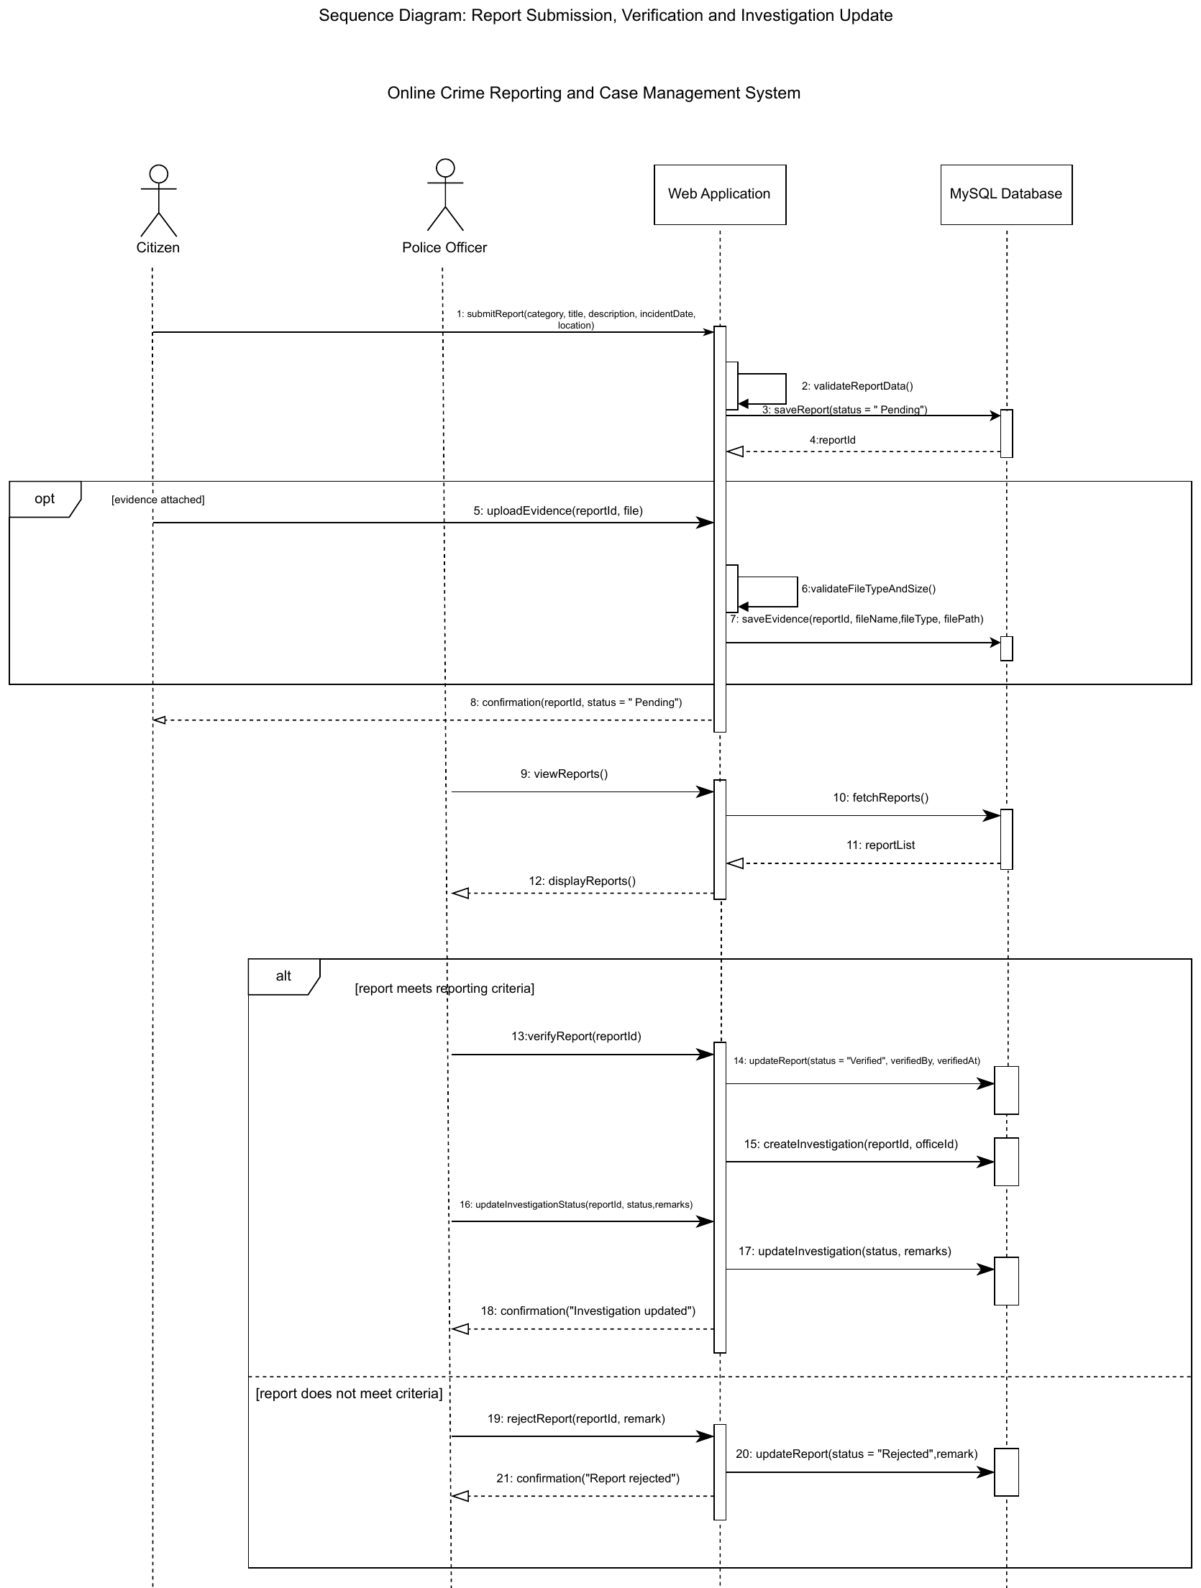
SYSTEM DESIGN · SEQUENCE
Sequence diagram and report lifecycle
REPORT LIFECYCLE
Pending
Verified
Investigating
Resolved
Closed
Rejected
reason required
How the sequence works
Citizen submits → web app validates → saves report as Pending
Optional evidence is checked for file type and size
Officer fetches reports, then verifies (investigation created) or rejects with a remark
Business rule: Resolved only after Verified
CRMS · Syntax Squad (Group 7)
5
Notes:
Left: sequence diagram - citizen submits, the web app validates and saves as Pending, evidence is optional and validated, the officer reviews and then either verifies (creating an investigation) or rejects with a remark. Right: the resulting lifecycle. A report can only be resolved after it has been verified. Rejected and Closed are final.

Slide 6
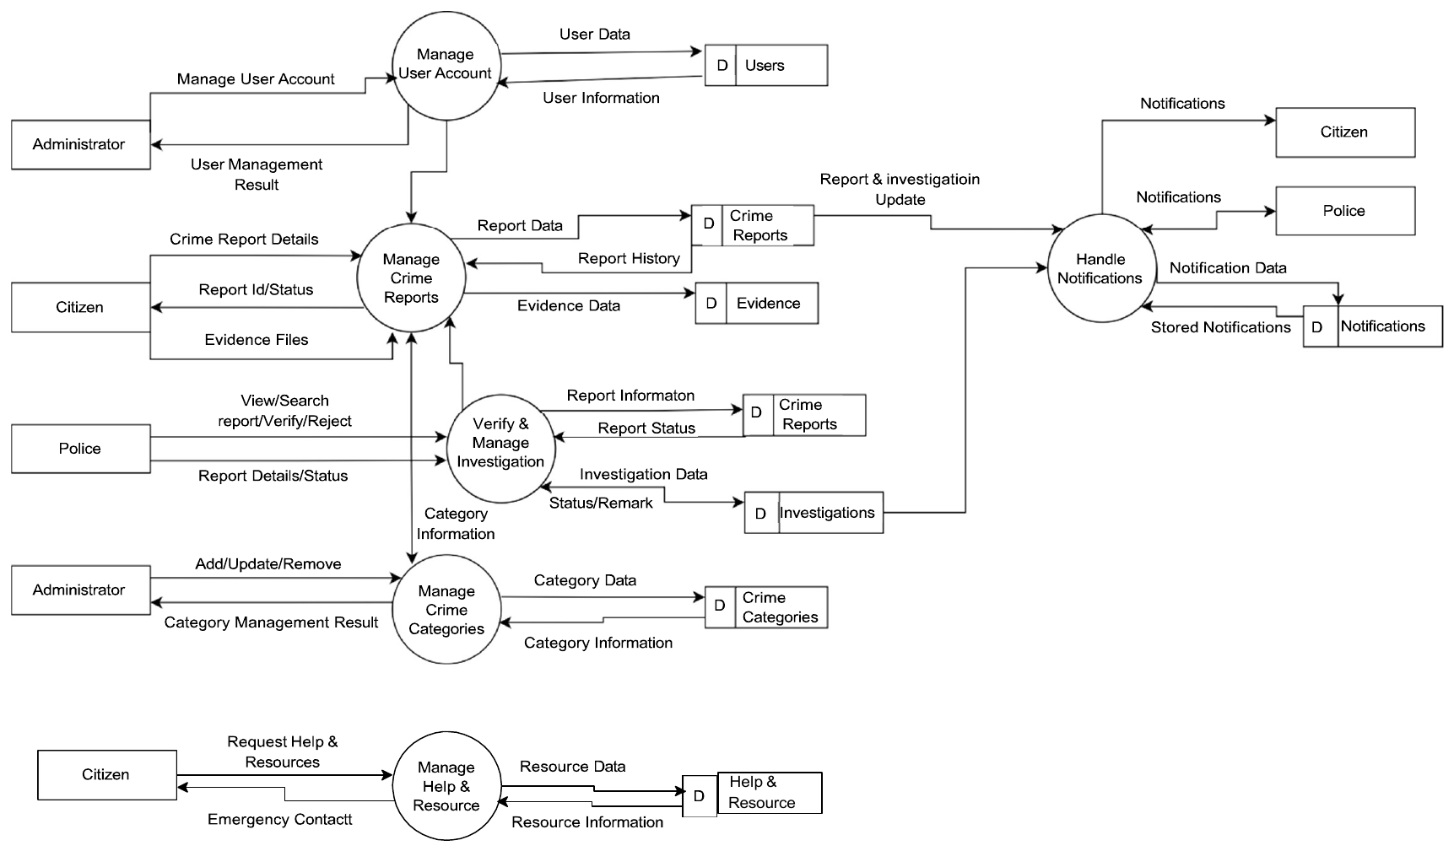
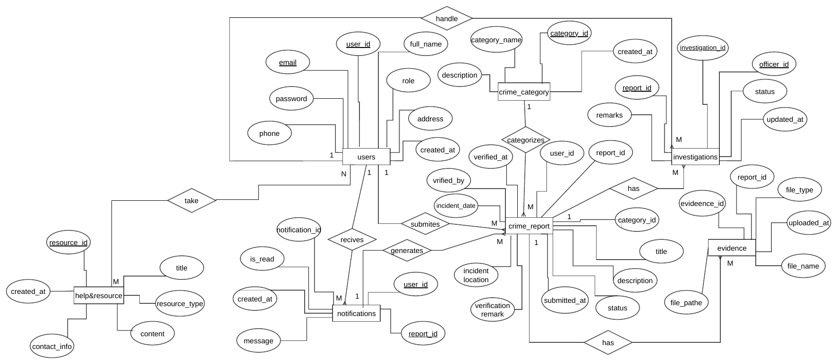
SYSTEM DESIGN · DFD & ER
Data flow and database design
ER diagram → MySQL schema
users
crime_categories
Data flow diagram (Level 1)
crime_reports
evidence
6 processes · 7 data stores · Citizen, Police, Administrator
investigations
notifications
help_resources
case_status_history
CRMS · Syntax Squad (Group 7)
6
Notes:
Left: Level 1 DFD - six processes, seven data stores, three external entities; notifications are triggered by report and investigation updates. Right: ER diagram, implemented as eight MySQL tables with foreign keys; a status-history table feeds the citizen timeline.

Slide 7
ARCHITECTURE
Three-tier layered, client–server architecture
Citizen
Police Officer
Administrator
Security built in
HTTP request / response
Passwords hashed (password_hash / verify)
CSRF token on every state-changing form
PDO prepared statements
Session ID regenerated on login
require_role() guards every page
Uploads: jpg/png/pdf, ≤ 5 MB, MIME-checked, random filenames
PRESENTATION LAYER
Browser UI
HTML5 · CSS3 · Bootstrap 5 · JavaScript · Chart.js
APPLICATION LAYER
PHP on Apache (XAMPP)
citizen/ · police/ · admin/ modules + includes/ (auth, RBAC, CSRF)
DATA LAYER
MySQL via PDO
8 tables + uploads/evidence/ file store
31 PHP files
CRMS · Syntax Squad (Group 7)
7
Notes:
Client-server web application in three layers: browser UI, PHP application layer on Apache organised into citizen, police and admin modules sharing an includes folder, and MySQL via PDO plus a file store for evidence. It is modular by role rather than strict MVC. Security mechanisms listed on the right are real code: bcrypt hashing, CSRF tokens, prepared statements, session regeneration, require_role on every page, and validated uploads.

Slide 8
LIVE DEMONSTRATION
Live demo: one report, from filing to closure
1
Log in, open dashboard
Citizen
LIVE DEMO
Local XAMPP server
2
Submit a report with category, location, date and evidence
Citizen
3
See it in the Pending Verification queue
Apache + PHP + MySQL
Three roles, three browser windows
Backup screenshots in the appendix
Police
4
Verify with remarks (or reject with reason)
Police
5
Update status: Investigating → Resolved → Closed
Police
6
Watch the timeline and notifications update
Citizen
7
Dashboard statistics, all reports, manage officers & categories
Admin
CRMS · Syntax Squad (Group 7)
8
Notes:
Live demo with three browser windows: citizen, police and admin. If anything fails, the appendix slides at the end contain screenshots of exactly this flow.

Slide 9
TESTING
Sample test cases and results
ID | Test case | Expected result | Result
TC-01 | Admin logs in with seeded credentials | Admin dashboard opens; password verifies against bcrypt hash | PASS
TC-02 | Citizen registers and logs in | Citizen dashboard shown with personal summary | PASS
TC-03 | Citizen submits a report | Reference CR-2026-00001 issued; status Pending | PASS
TC-04 | Officer opens pending queue | New report appears in Pending Verification Queue | PASS
TC-05 | Officer verifies with remarks | Status → Verified; citizen notified | PASS
TC-06 | Officer sets Investigating → Resolved → Closed | Timeline and notifications update; case closed | PASS
TC-07 | Admin views dashboard statistics | Totals, status chart and category chart match data | PASS
TC-08 | Admin adds a police officer | Officer listed in Registered Police Personnel | PASS
TC-09 | Syntax check of all PHP files (php -l) | 31 files, 0 errors | PASS
TC-10 | Seed admin password hash check | password_verify() returns true | PASS
Environment: XAMPP (Apache, PHP, MySQL) local server.
10 / 10 PASSED
CRMS · Syntax Squad (Group 7)
9
Notes:
We tested the main workflow end to end on the local XAMPP server, plus static checks on the code. All ten sample cases passed. The full set is in the testing report.

Slide 10
PROJECT MANAGEMENT
Gantt chart and team roles — a 16-week plan
Week
1
2
3
4
5
6
7
8
9
10
11
12
13
14
15
16
TEAM ROLES
Requirements & proposal
Md Nayem Islam
Analysis & architecture
ID 04325105101041
Developer
DB design & UI wireframes
Citizen module
Md Zayed Adnan Zabin
Police officer module
ID 04325105101034
Developer
Administrator module
Integration & internal testing
Mahjabin Afroze Mahira
ID 04325105101007
Bug fixing & test report
UI Designer
Documentation
Final presentation
Kanis Akter
ID 04325105101018
Plan
Build
Test
Deliver
Tester
CRMS · Syntax Squad (Group 7)
10
Notes:
We planned the work over a 16-week semester: requirements first, then design, then module-by-module development in the order citizen, police, admin, followed by integration, testing, documentation and the final presentation. Risks we tracked: PHP learning curve, integration time, secure uploads, scheduling conflicts and code loss — mitigated with tutorials, a buffer week, server-side validation, weekly check-ins and Git/GitHub.

Slide 11
CONCLUSION & FUTURE WORK
What we delivered and where it goes next
3
user roles
8
database tables
31
PHP files
10 / 10
tests passed
Delivered
Future work
Working system with Citizen, Police and Admin modules
Full report lifecycle: Pending → Verified → Investigating → Resolved → Closed (or Rejected)
Evidence upload with type, size and MIME validation
In-system notifications and status timeline
Admin analytics dashboard with live charts
Secure by design: hashing, CSRF, prepared statements, RBAC
Complete documentation: SRS, use case, class, sequence, state, DFD, ER
Complete the forgot-password / reset flow
SMS and e-mail notifications
Google Maps and GPS-based incident location
Crime heat maps and deeper analytics
Dedicated mobile application
Nearby police station / hospital locator
Live chat between citizen and officer
Production hosting with load testing
CRMS · Syntax Squad (Group 7)
11
Notes:
In summary: we delivered a working three-role system with secure authentication, evidence upload, full report lifecycle tracking, notifications and analytics, all backed by SRS, UML, DFD and ER documentation. We were honest about scope: password reset by e-mail is the first thing we would finish, followed by notifications and maps.

Slide 12
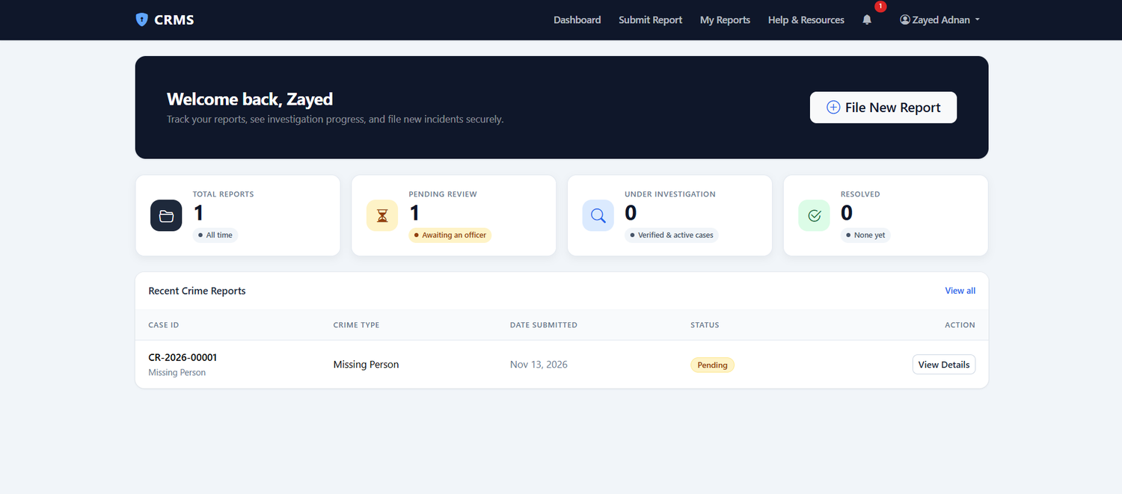
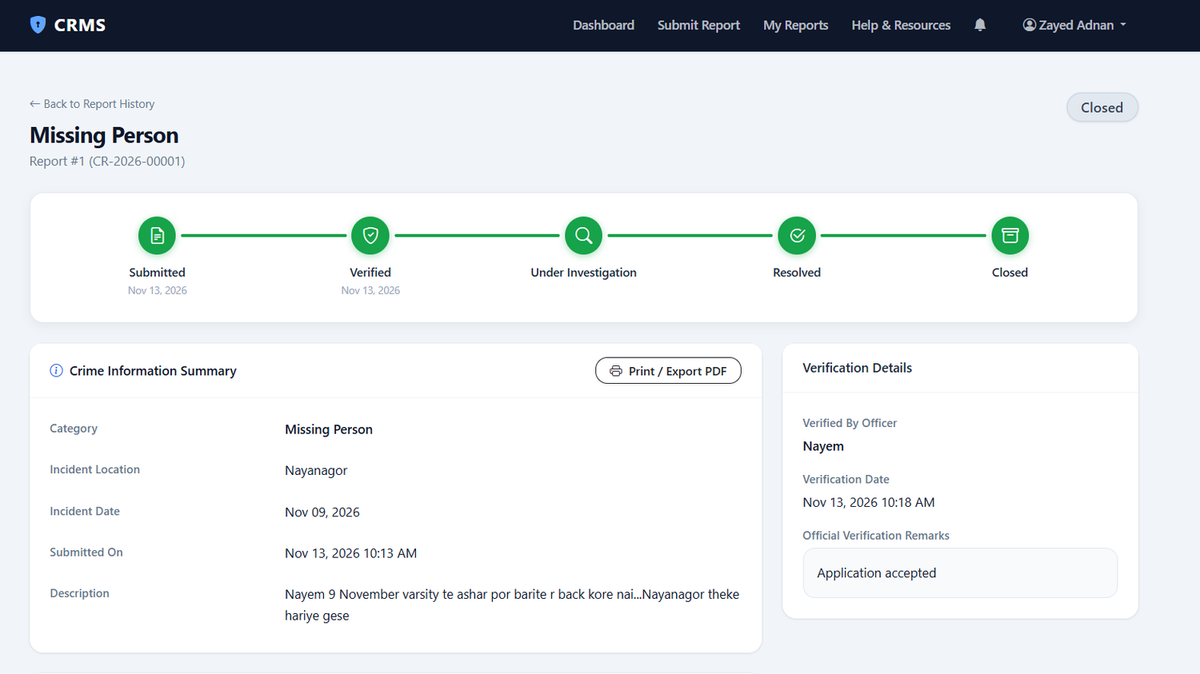
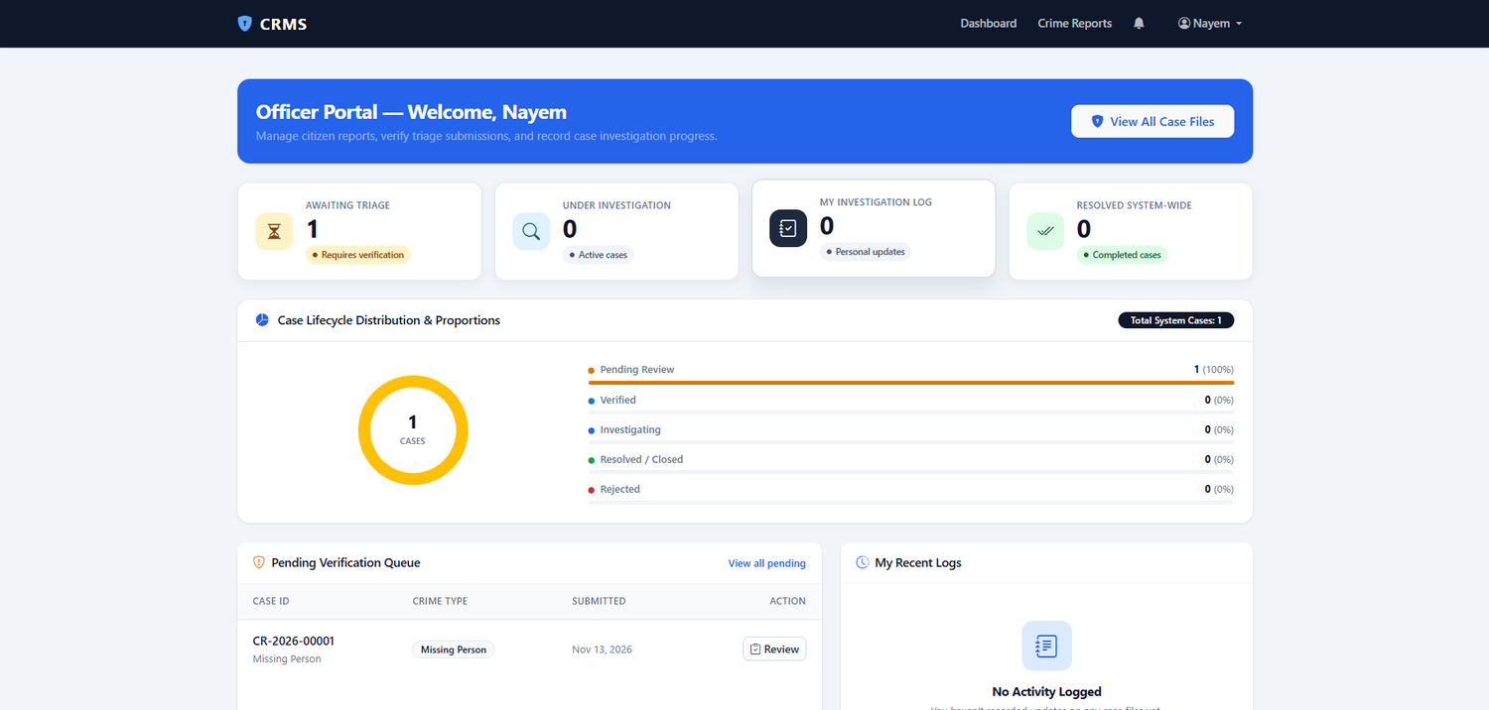
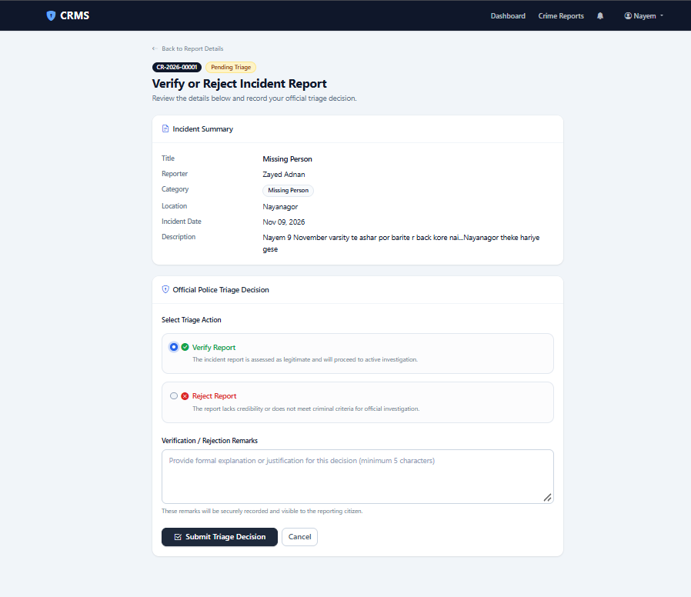
SYSTEM USER INTERFACE (UI) OVERVIEW
Citizen and police screens
Citizen dashboard
Report tracking timeline
Officer dashboard
Verify or reject report
CRMS · Syntax Squad (Group 7)
12
Notes:
Backup screens in case the live demo fails.

Slide 13
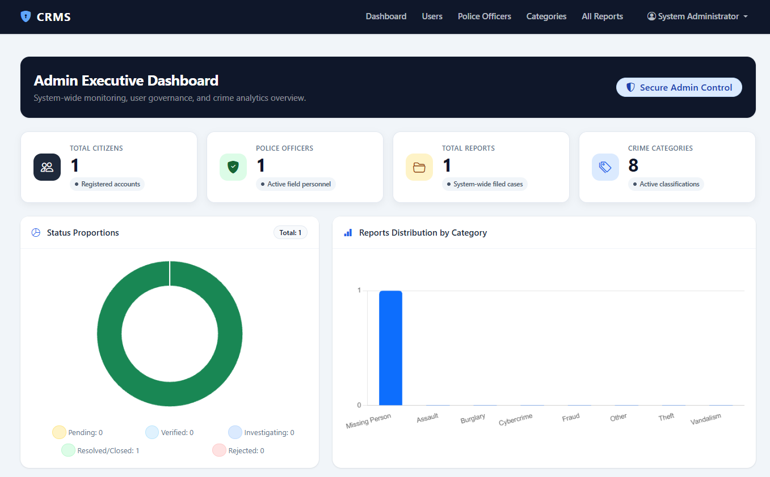
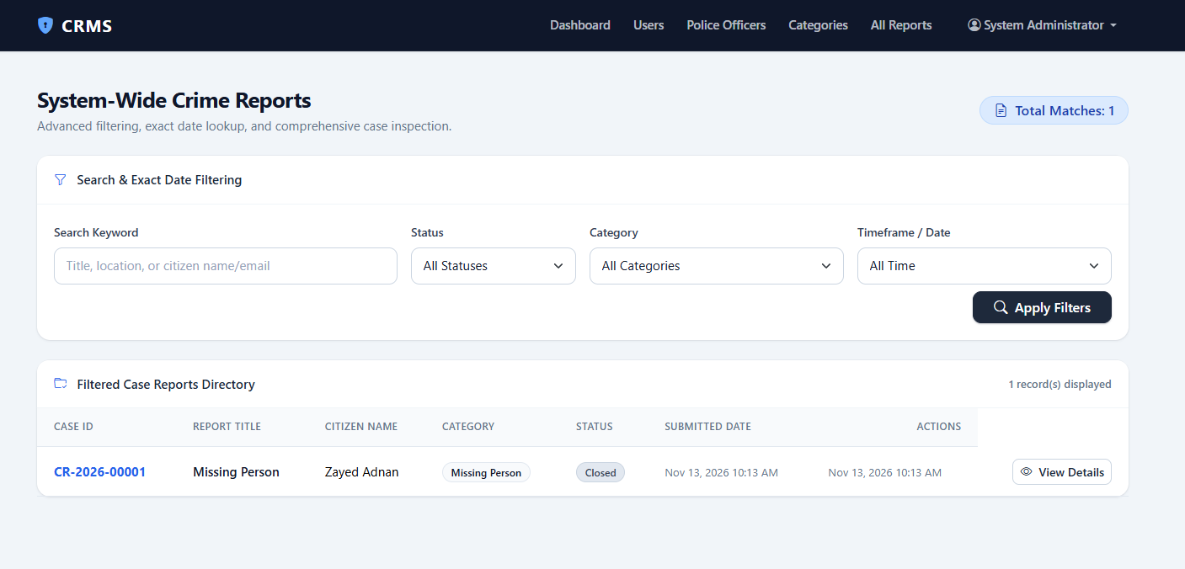
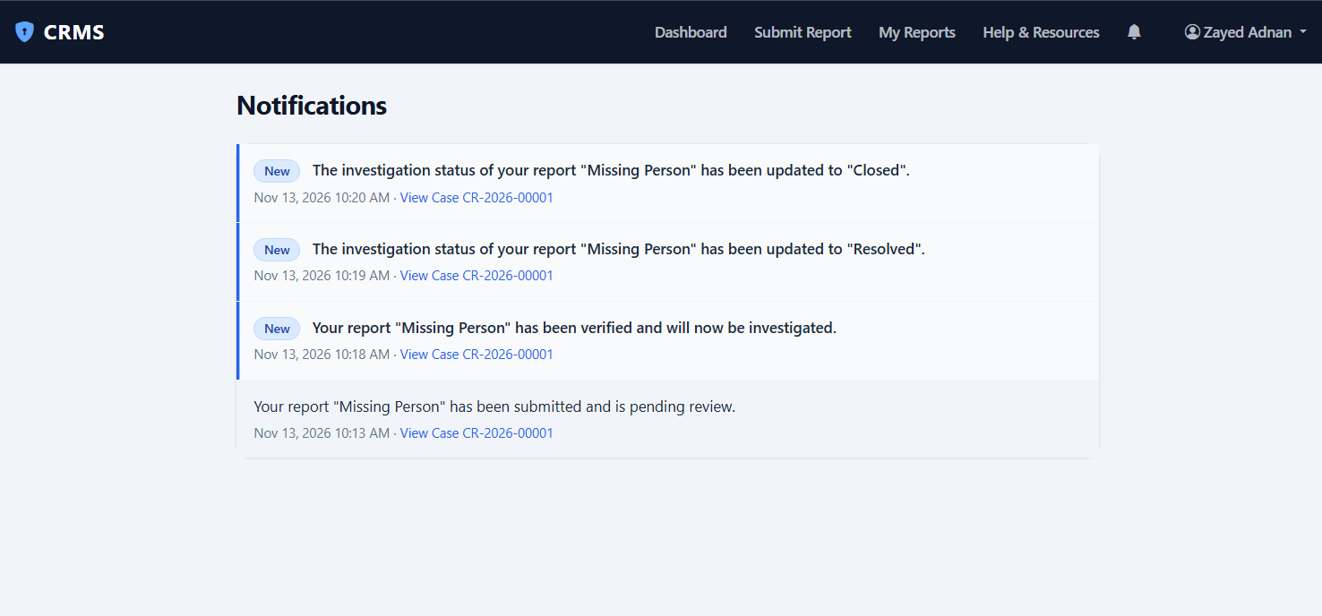
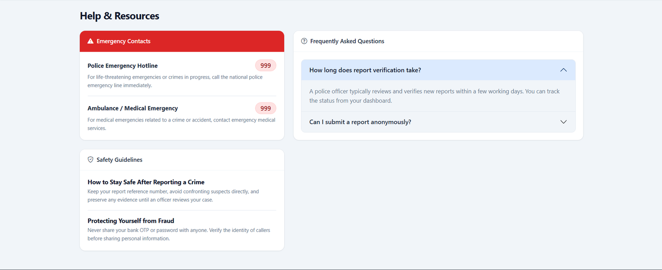
SYSTEM USER INTERFACE (UI) OVERVIEW
Admin, notifications and help
Admin executive dashboard
System-wide reports
In-system notifications
Help & resources
CRMS · Syntax Squad (Group 7)
13
Notes:
Backup screens in case the live demo fails.

Slide 14
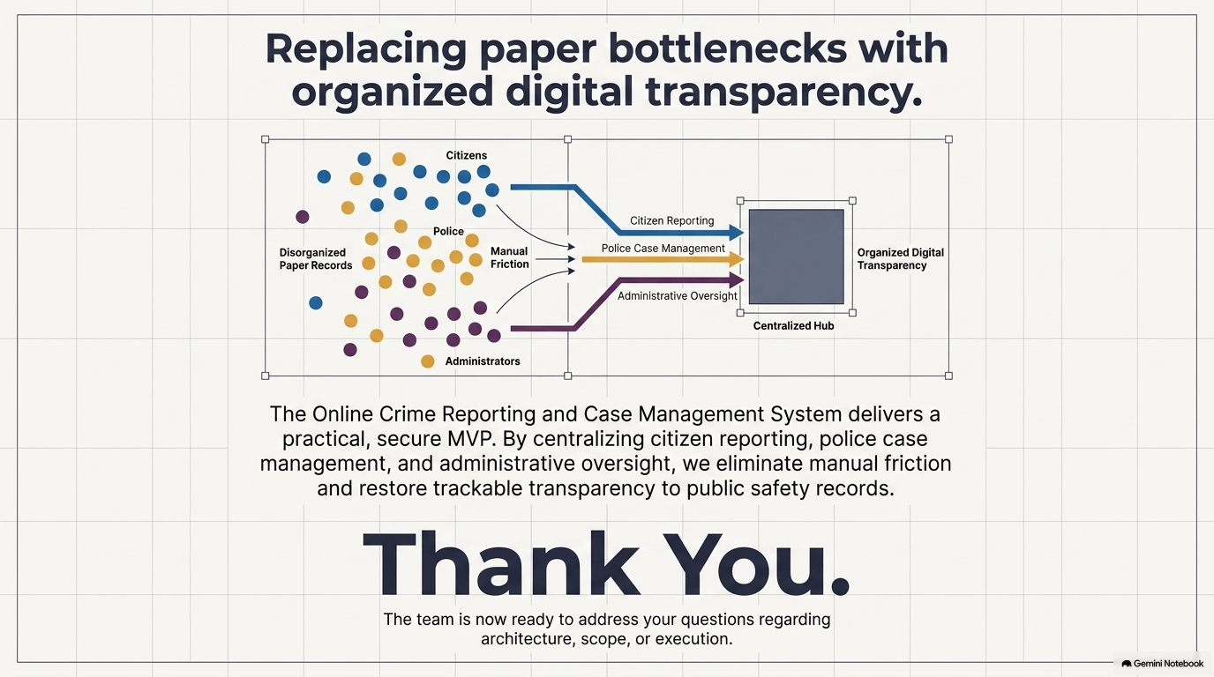
Syntax Squad (Group 7)

