Slide 1
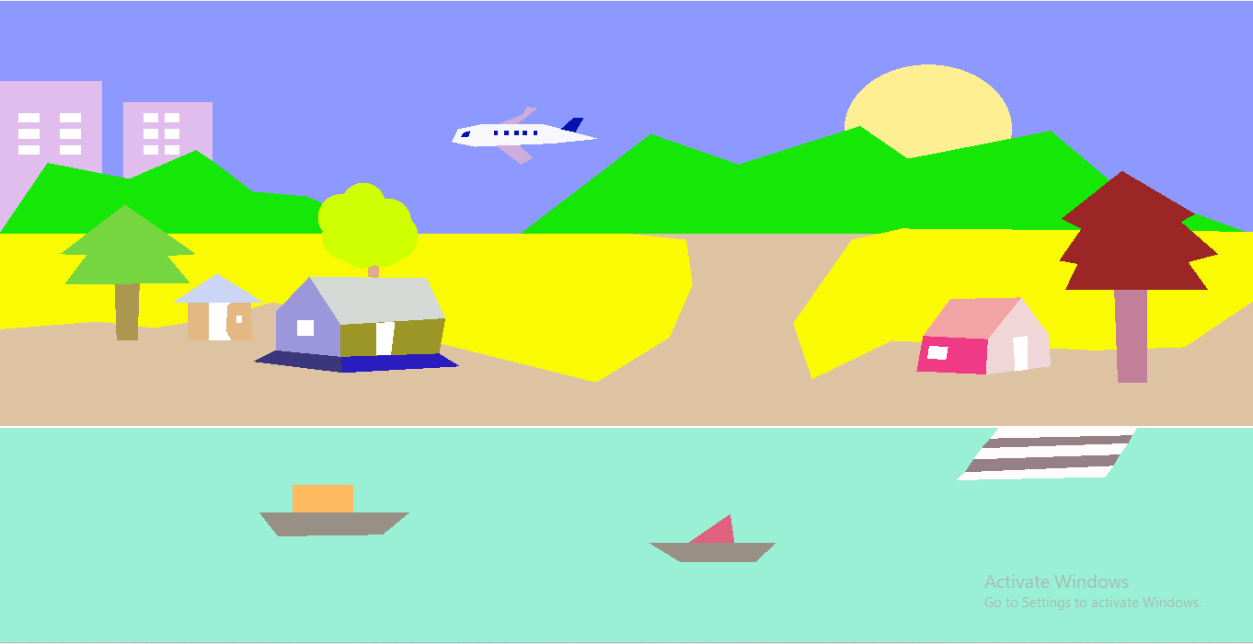
Villageseen
Presented By
Nayem Al Mahmud
Id:201-15-3110

Slide 2
Table of contents
01
02
03
04
05
06
Introduction
Static Design Overview
Learnings
Motion & key Overview
Visualizations
Conclusions

Slide 3
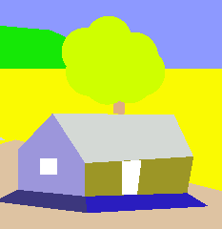
Introduction
Computer graphics have revolutionized the way we create and perceive virtual environments, transforming abstract concepts into visually stunning and immersive experiences. One compelling application of this technology is the creation of detailed village scenes. These virtual villages are not only artistic masterpieces but also serve functional purposes in various fields such as video games, films, virtual reality (VR), and architectural visualization.

Slide 4

Static Design:
Creating a compelling and realistic village scenario in computer graphics involves thoughtful planning and strategic placement of various buildings and elements. Below is a detailed outline for the building layout in a village scene:
Building Layout

Slide 5

Static Design
Sun and mountain layout Layout

Slide 6

Static Design
2layer of the Scenario

Slide 7
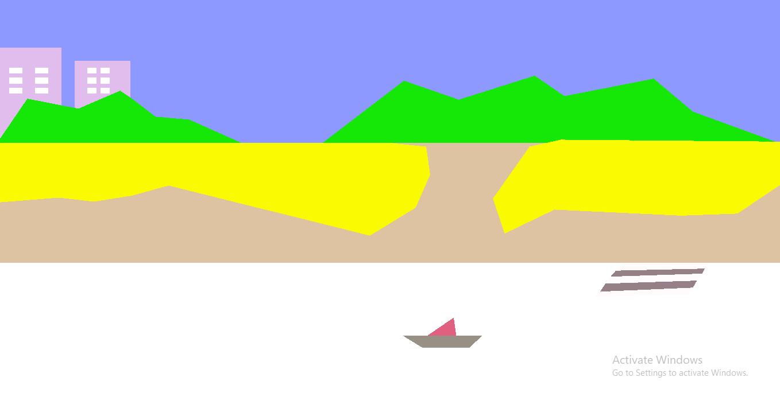
Static Design
Creating a village scene with a river and boat layout in computer graphics involves several detailed steps to ensure that the environment is both realistic and aesthetically pleasing.
Layout with river and boat

Slide 8

Overview:
Village Layout

Slide 9
Motion and key Overview
villagescene

Slide 10
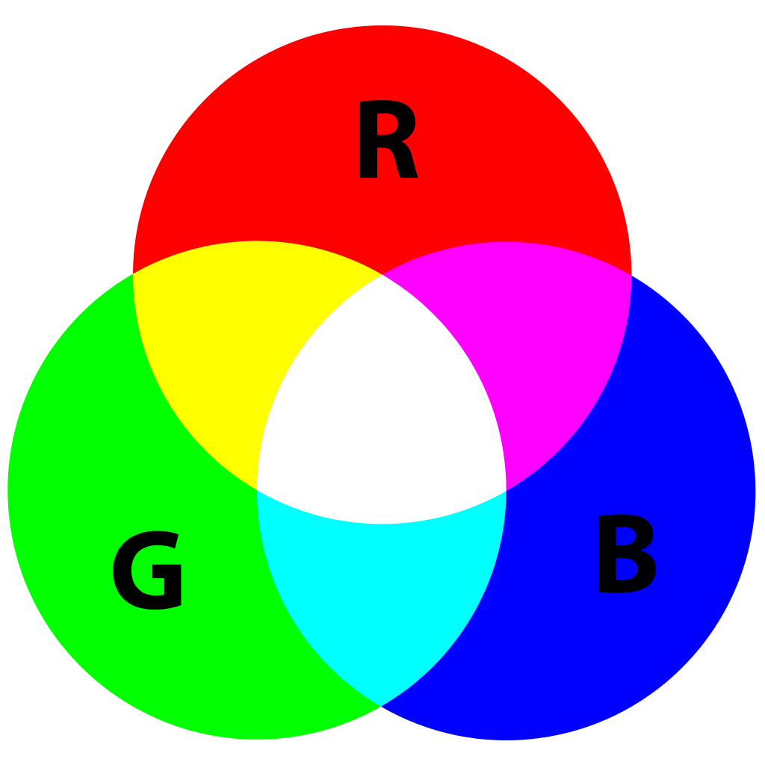


Learnings
01
02
03
04
Color combination with RGB Model
GeoGebra graphical function
Line Polygon Triangle etc Drawing
villagescene

Slide 11
Conclusions
The creation of a computer-generated village scene is a testament to the power and versatility of modern computer graphics technology. Through the meticulous application of various techniques, such as modeling, texturing, lighting, and rendering, a virtual environment can be crafted to exhibit remarkable realism and detail.

Slide 12
Visualizations
Villagescene

