Slide 1
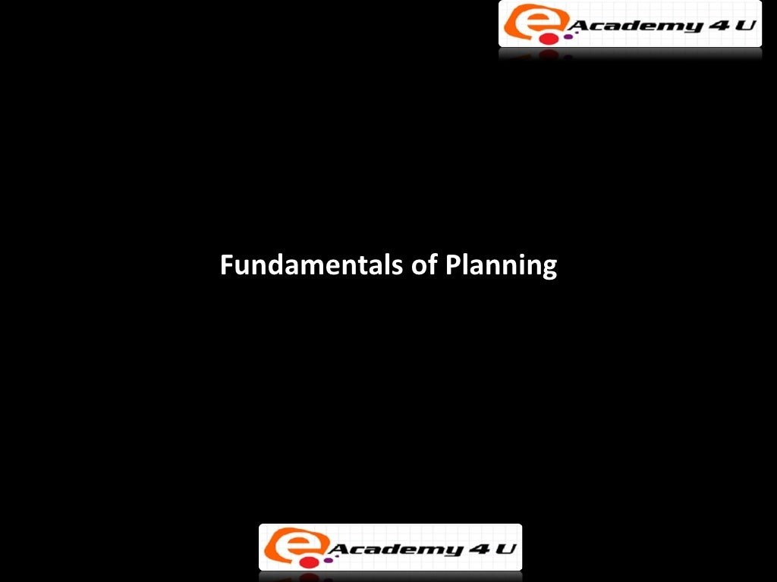

Slide 2
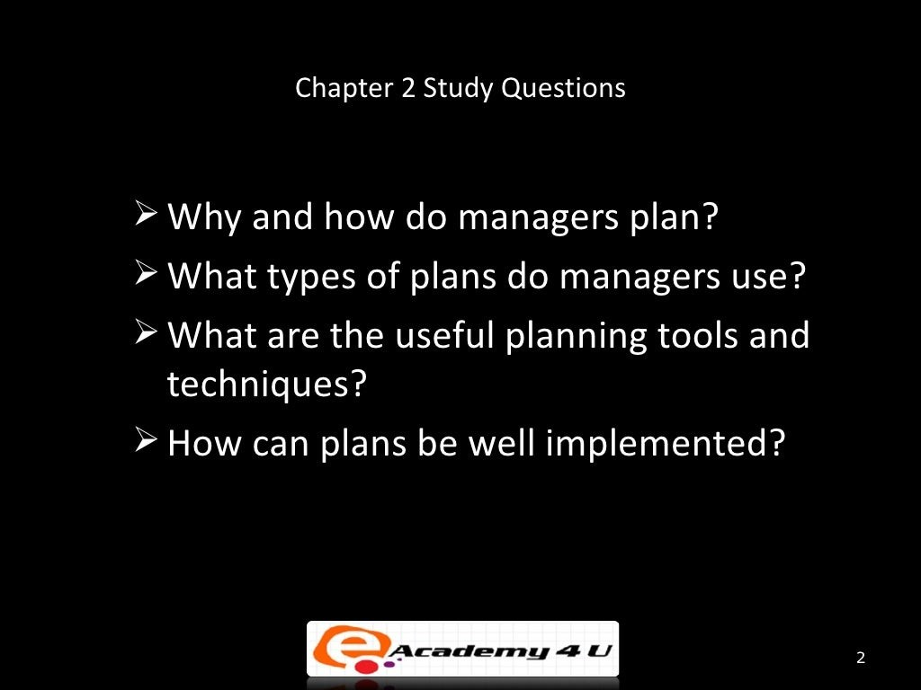

Slide 3
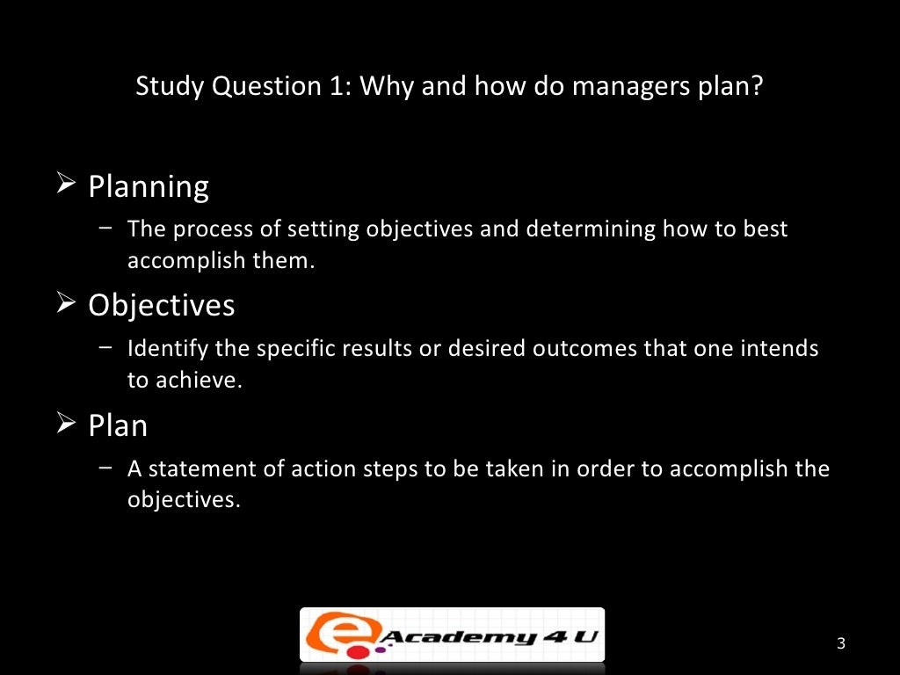

Slide 4
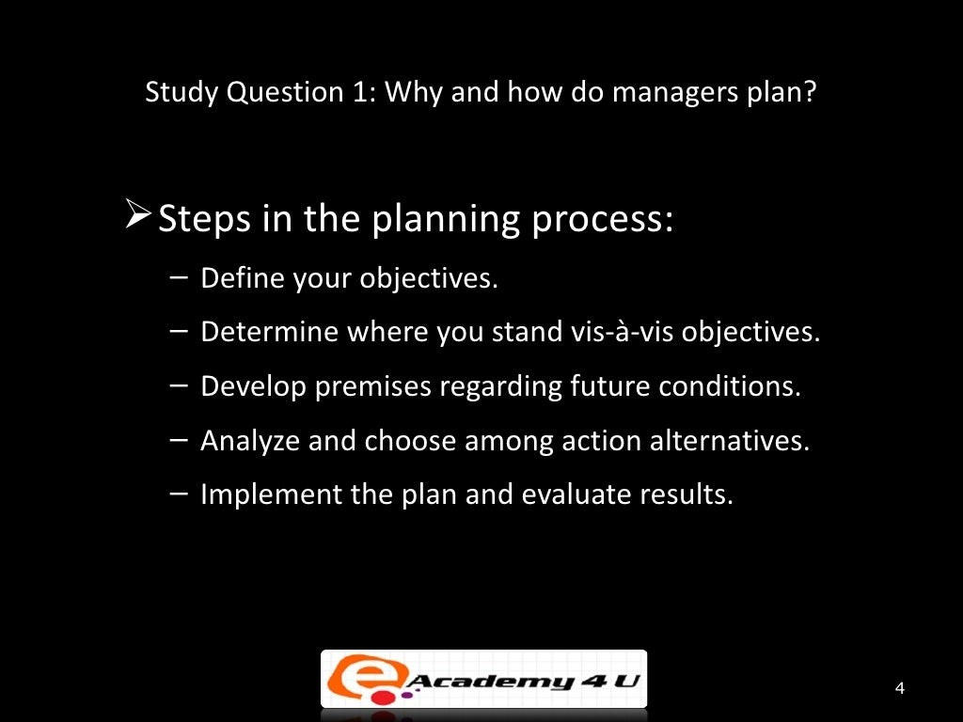

Slide 5
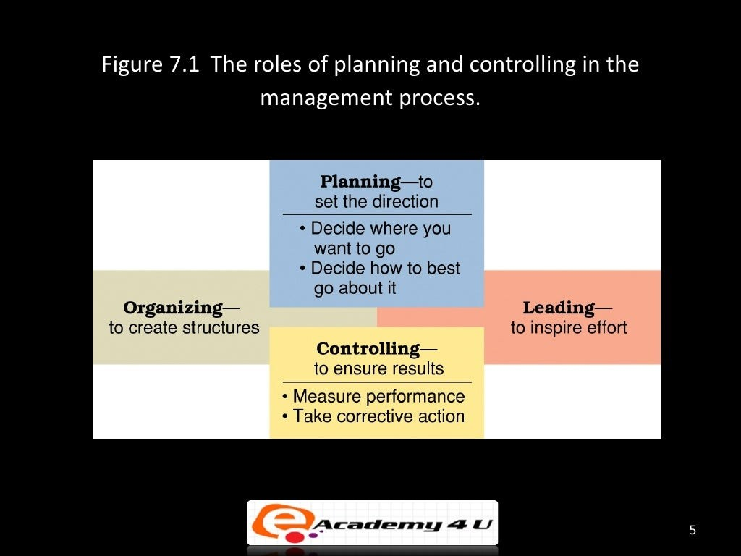

Slide 6
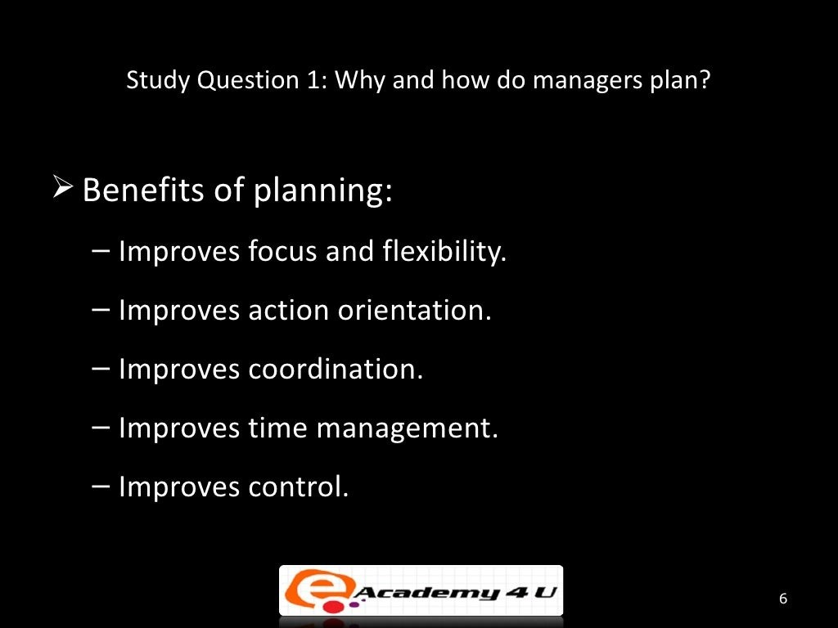

Slide 7
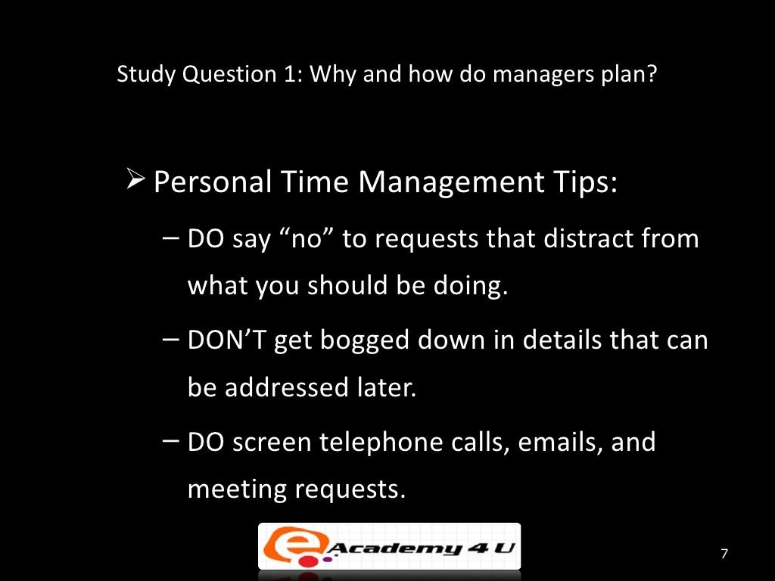

Slide 8
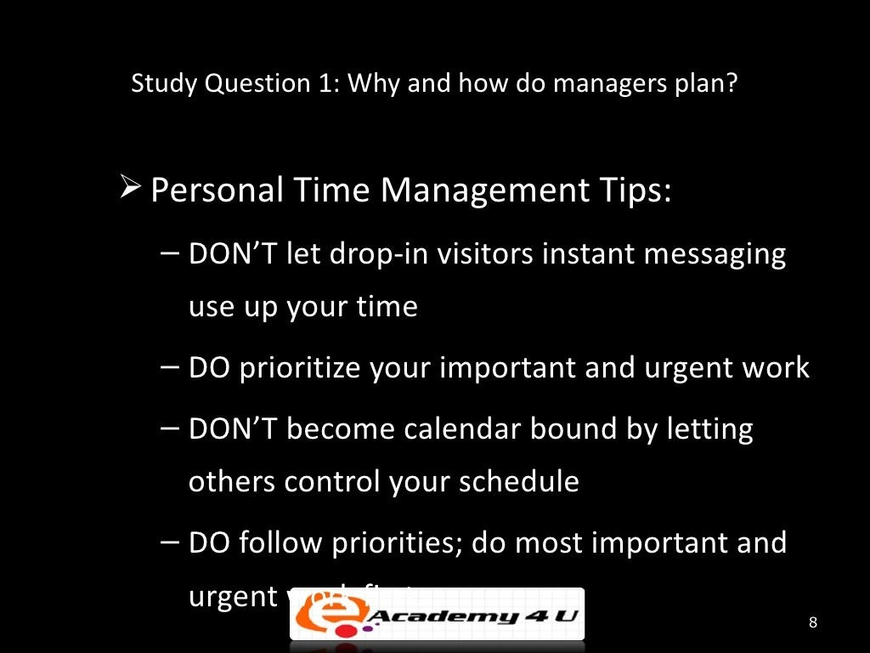

Slide 9
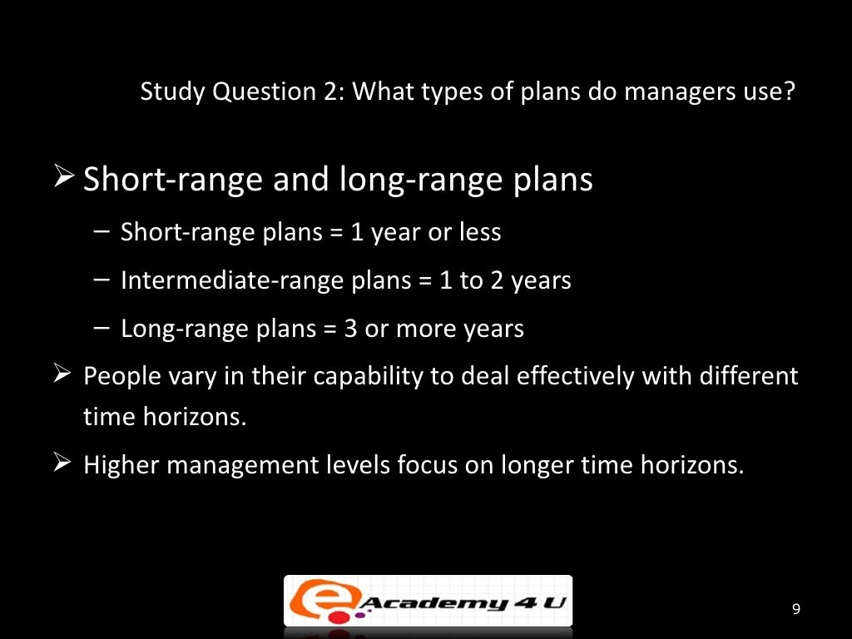

Slide 10
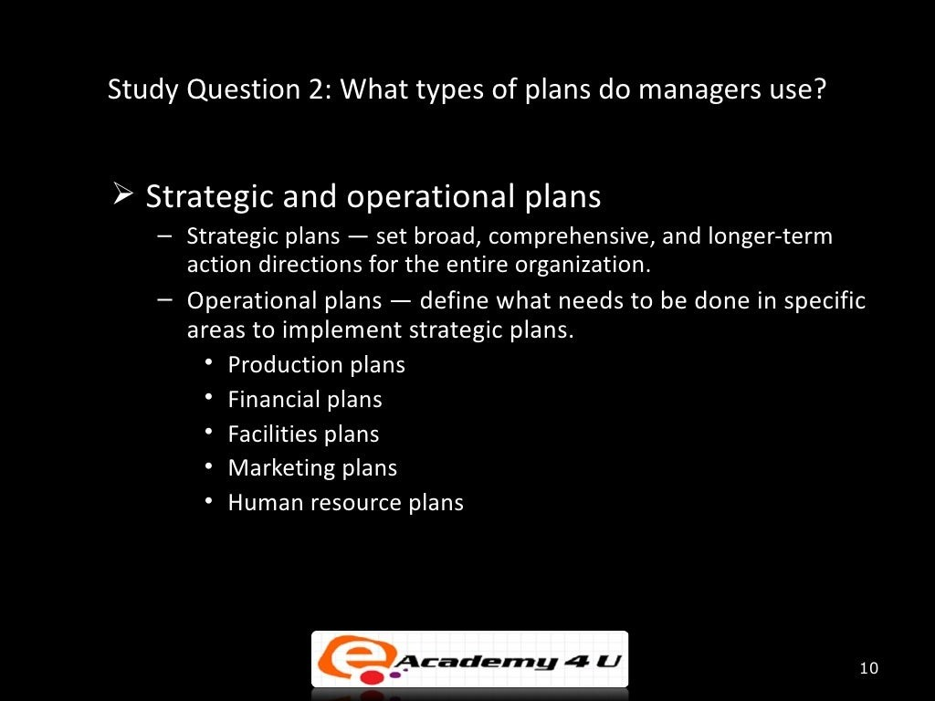

Slide 11
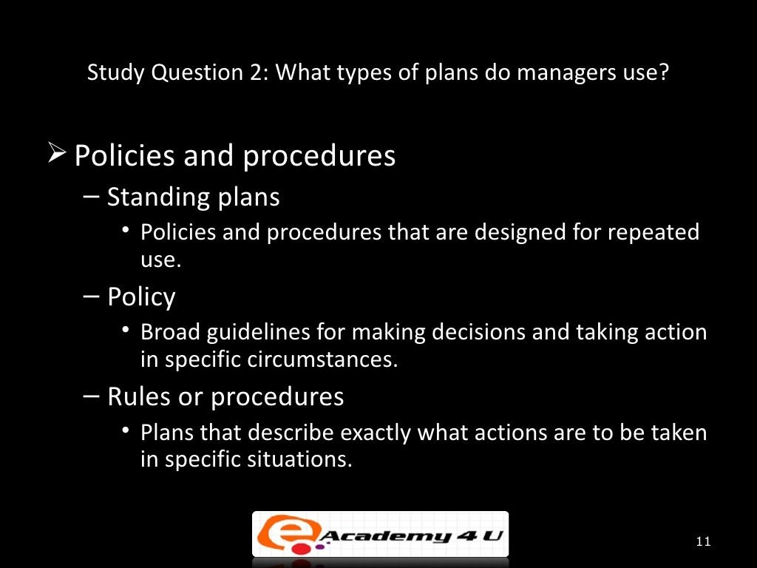

Slide 12
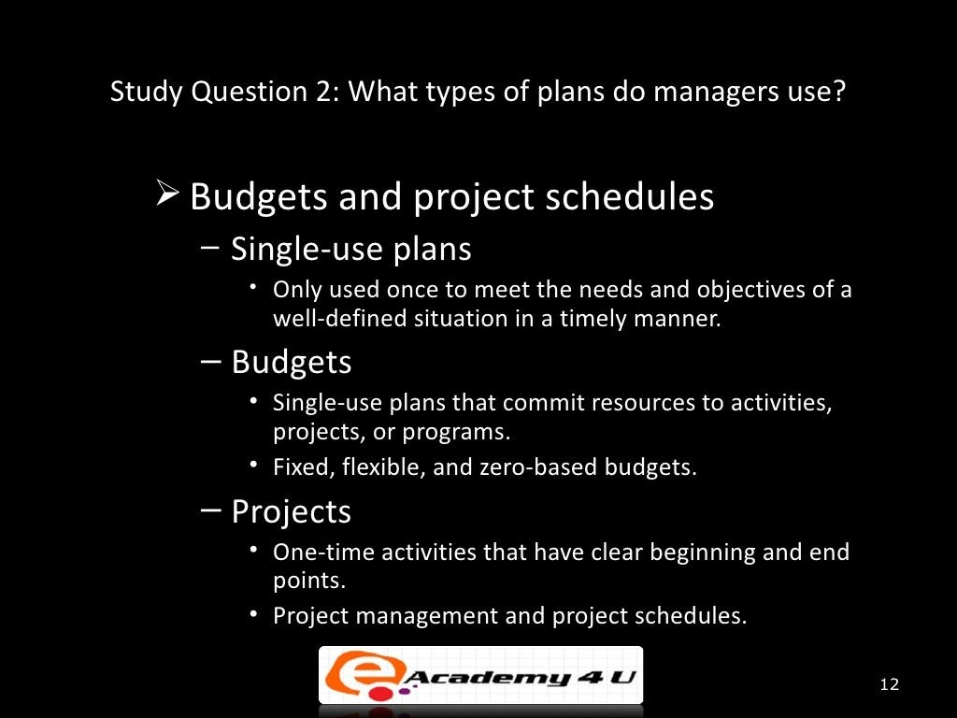

Slide 13
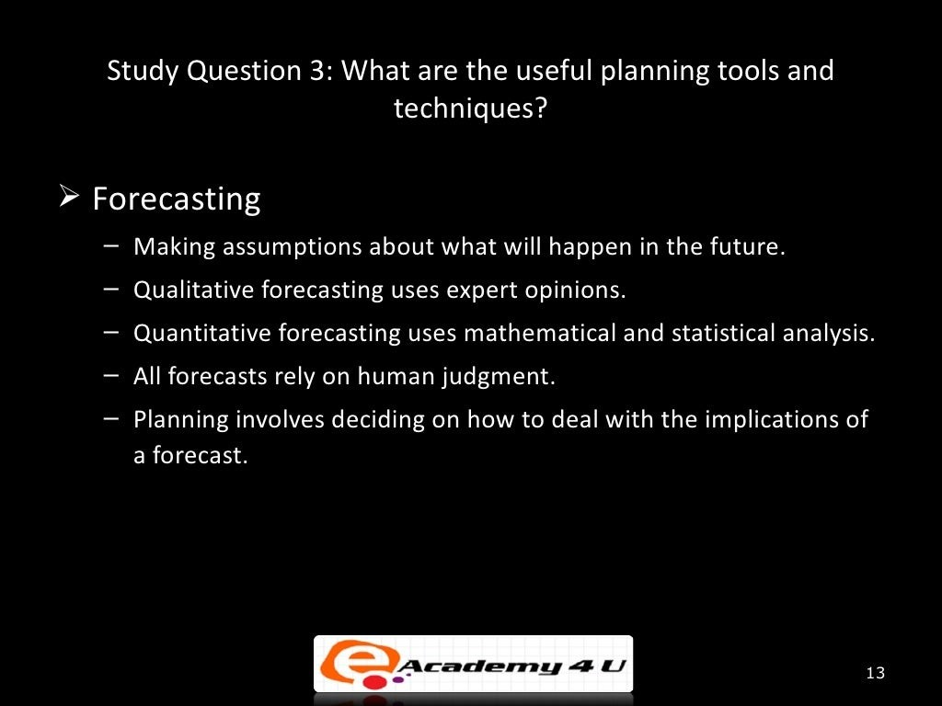

Slide 14
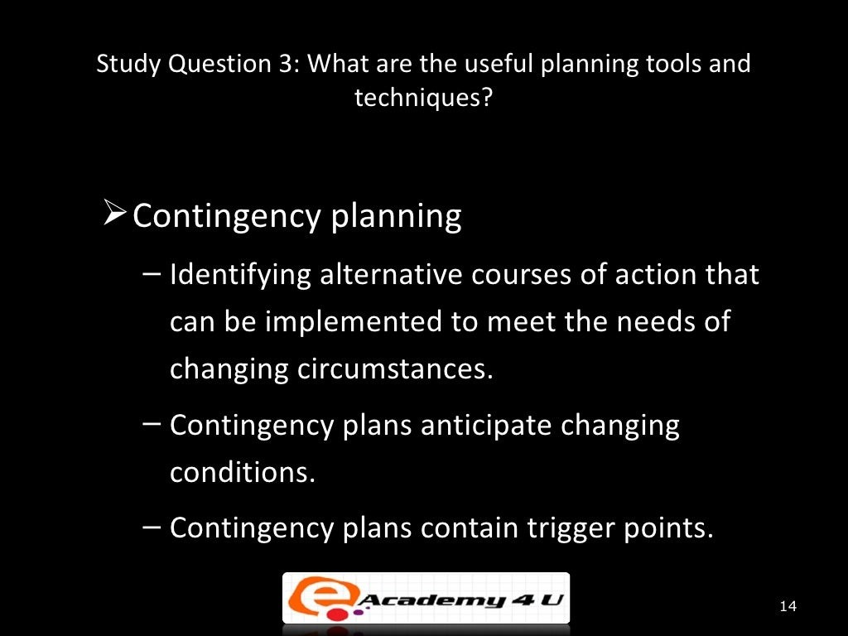

Slide 15
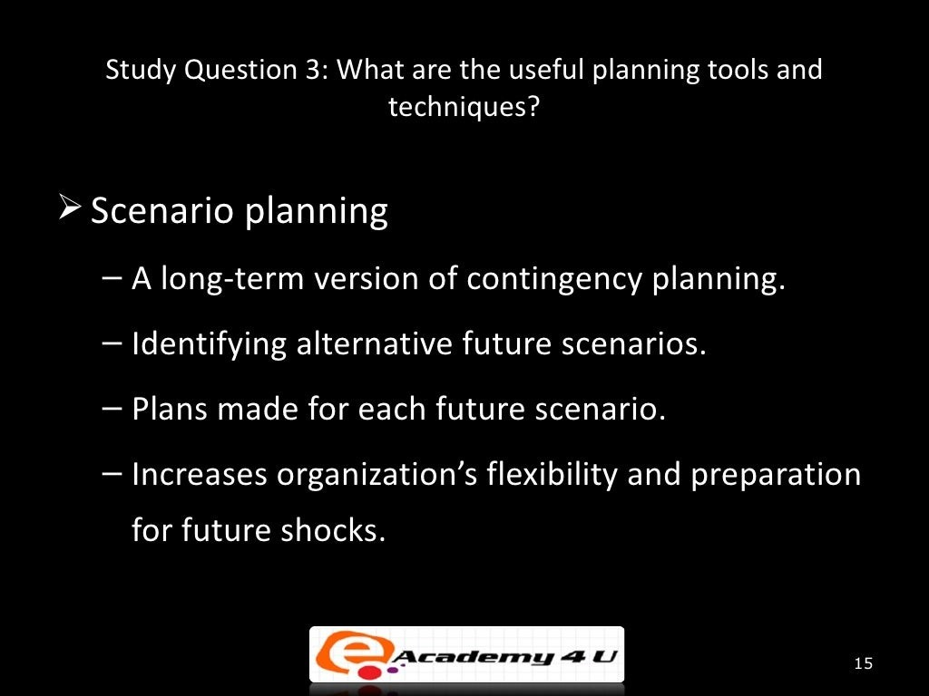

Slide 16
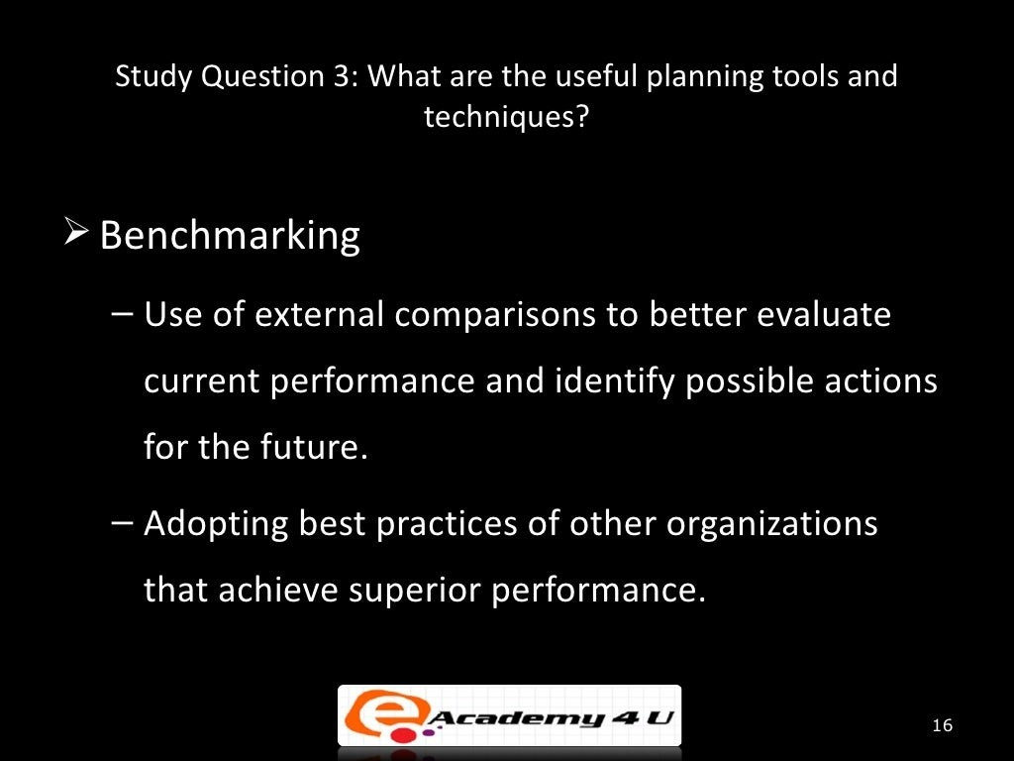

Slide 17
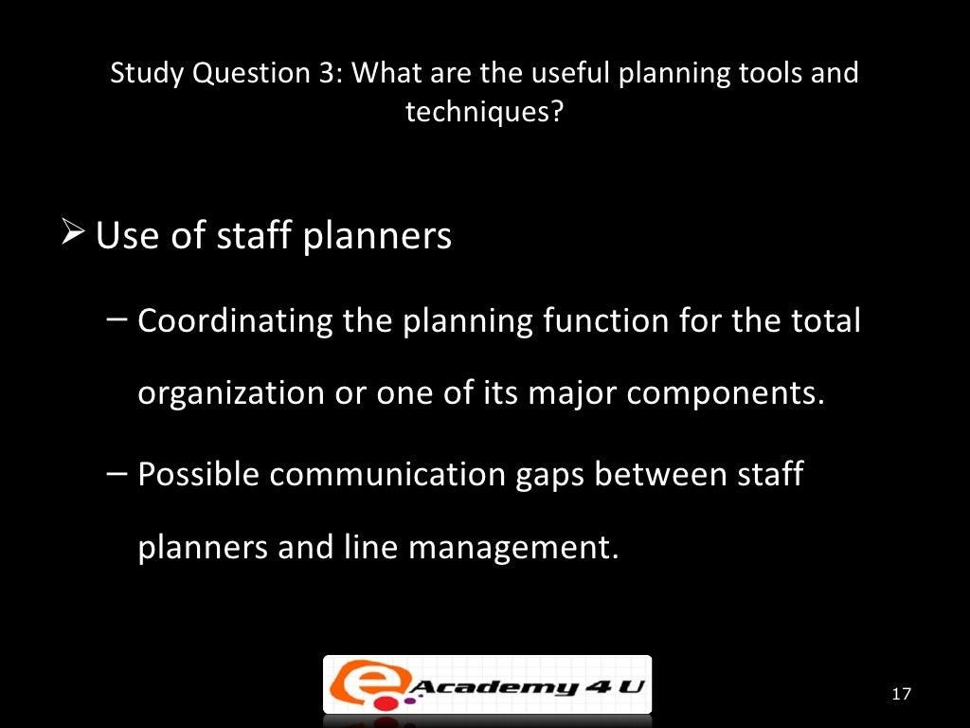

Slide 18
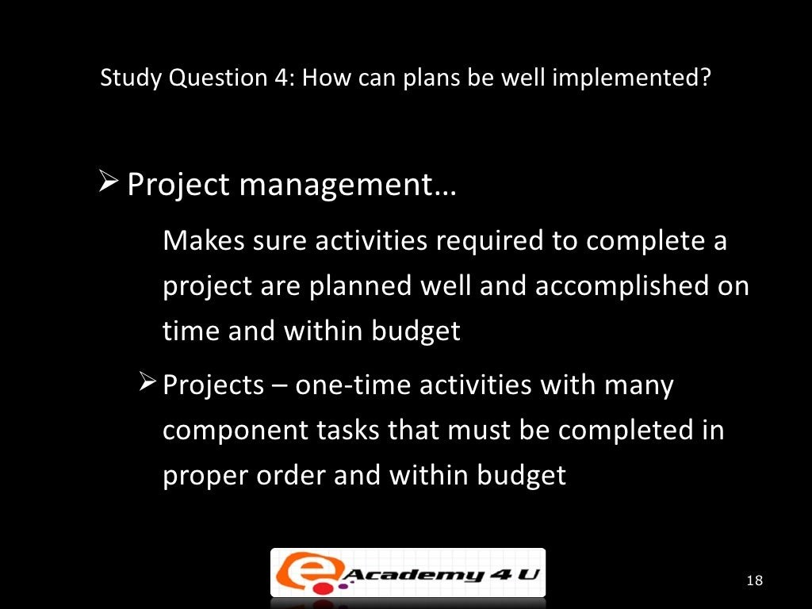

Slide 19
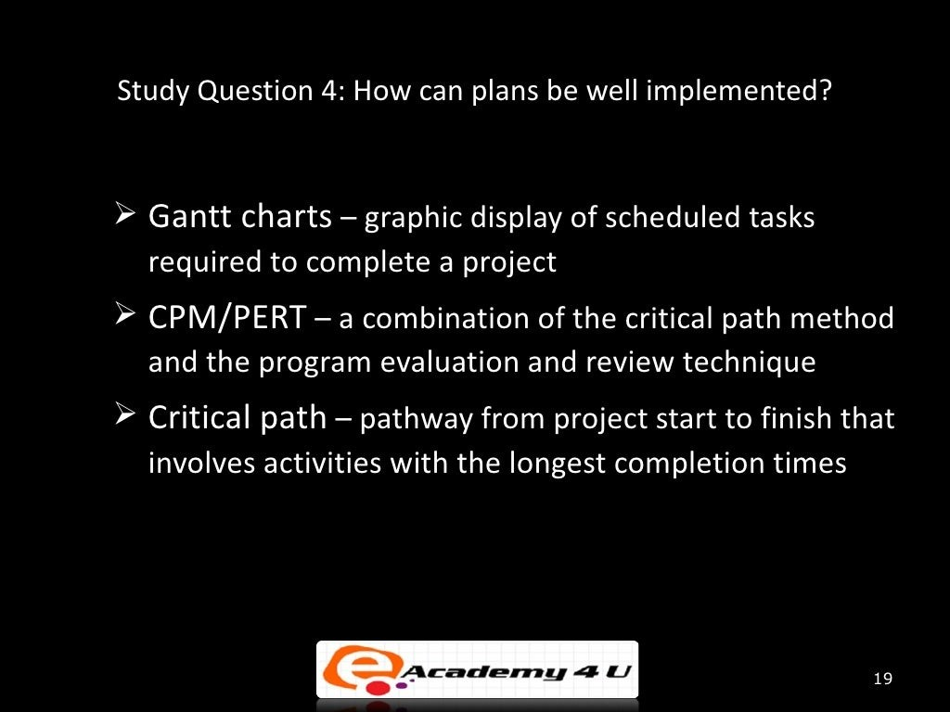

Slide 20
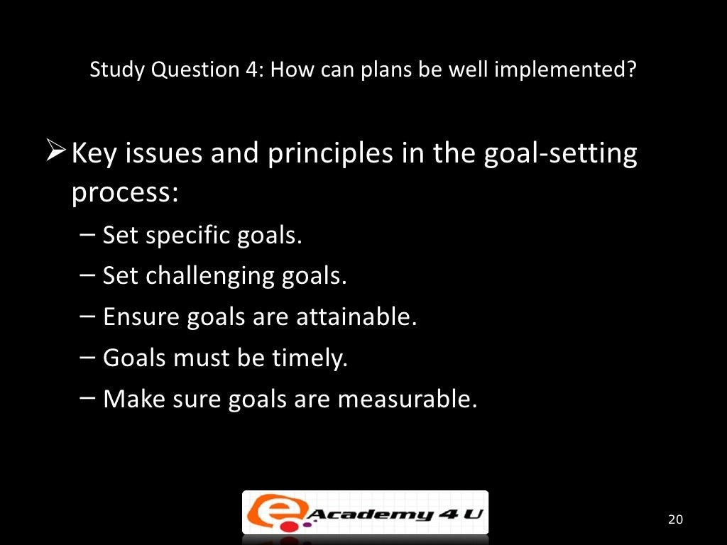

Slide 21
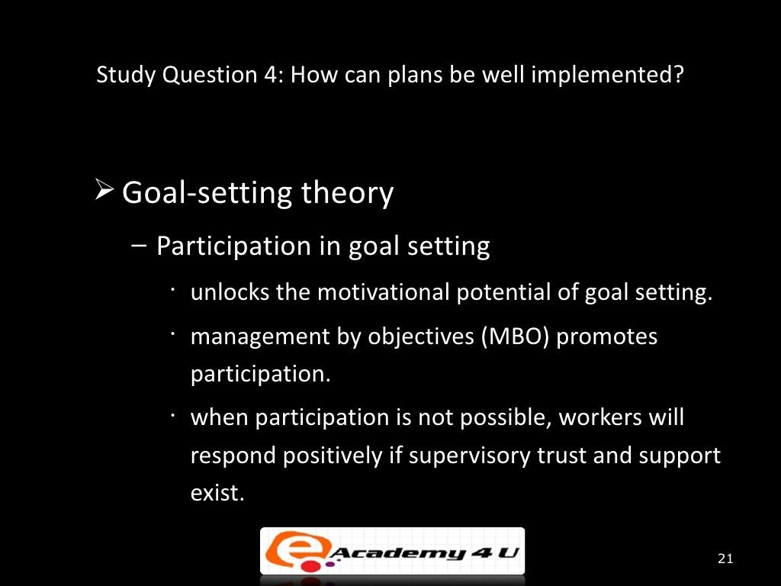

Slide 22
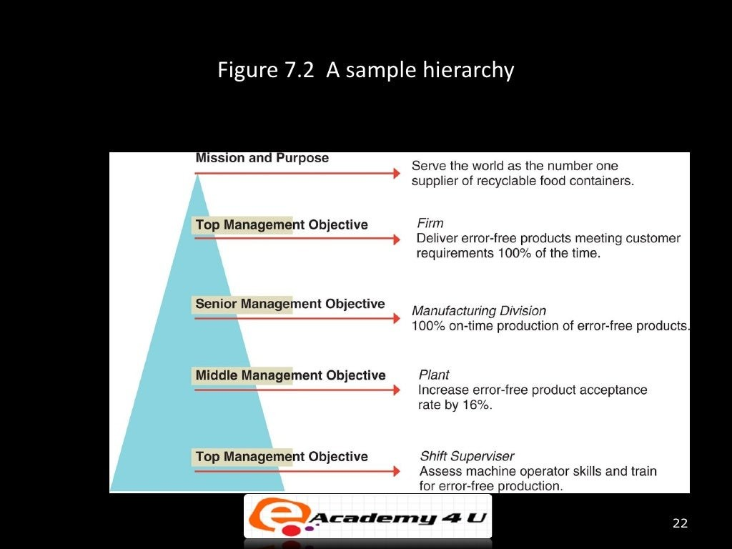

Slide 23
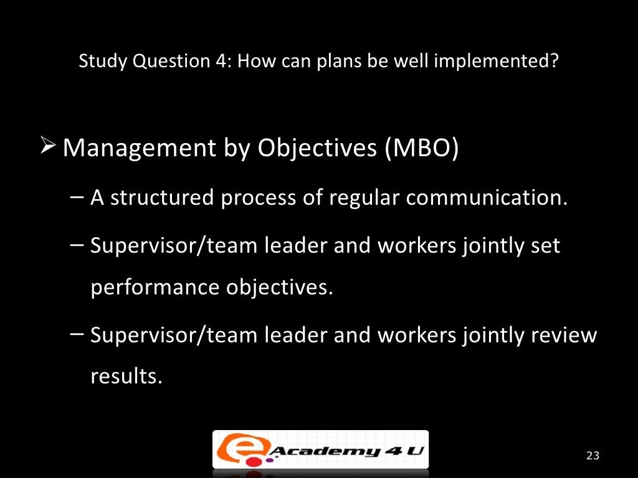

Slide 24
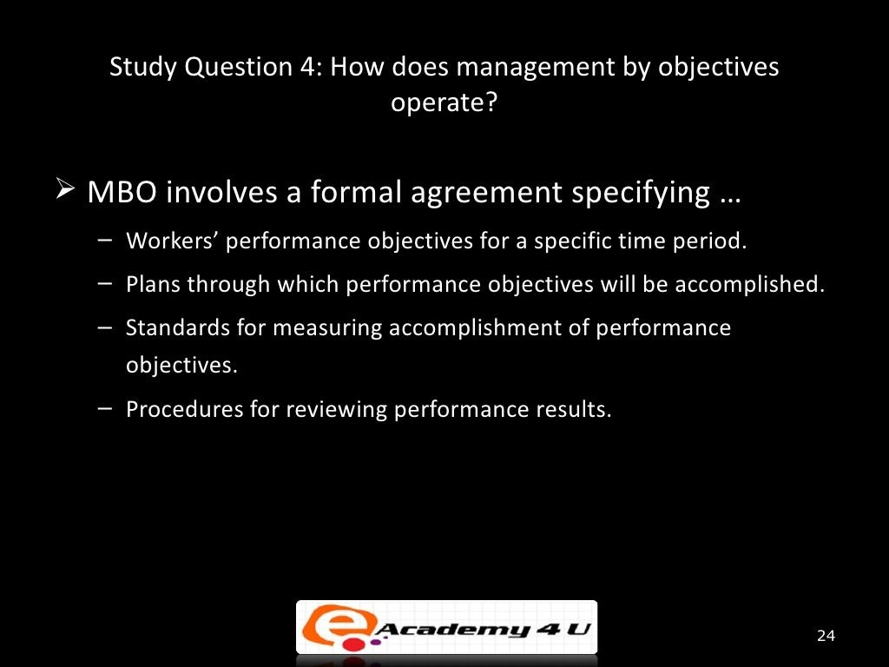

Slide 25
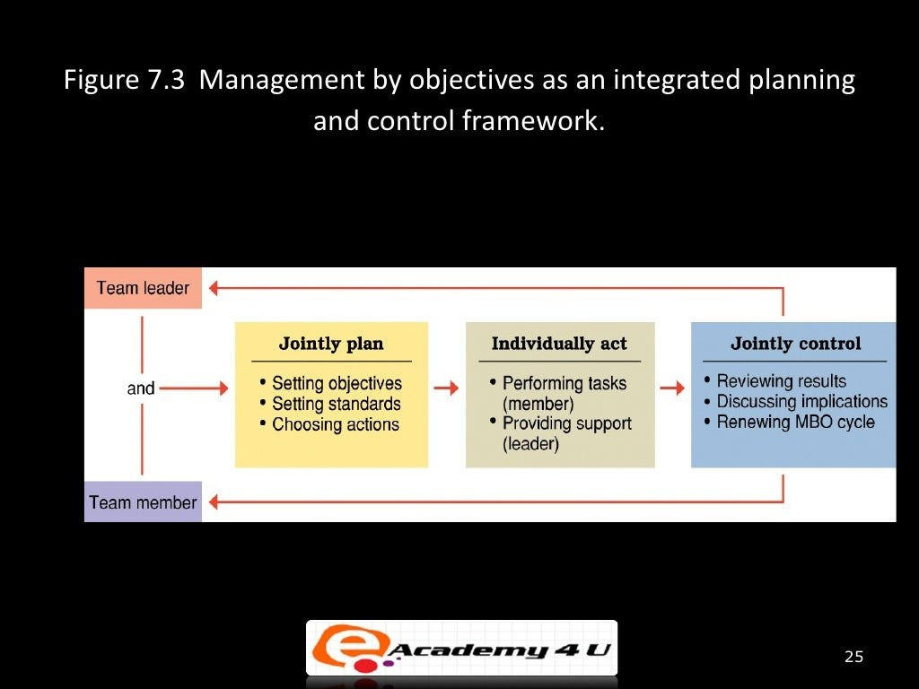

Slide 26
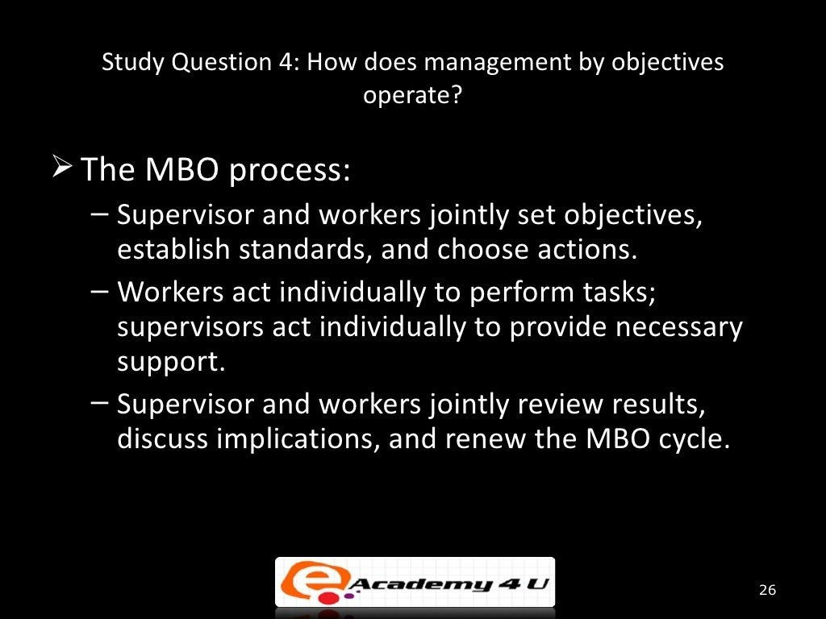

Slide 27
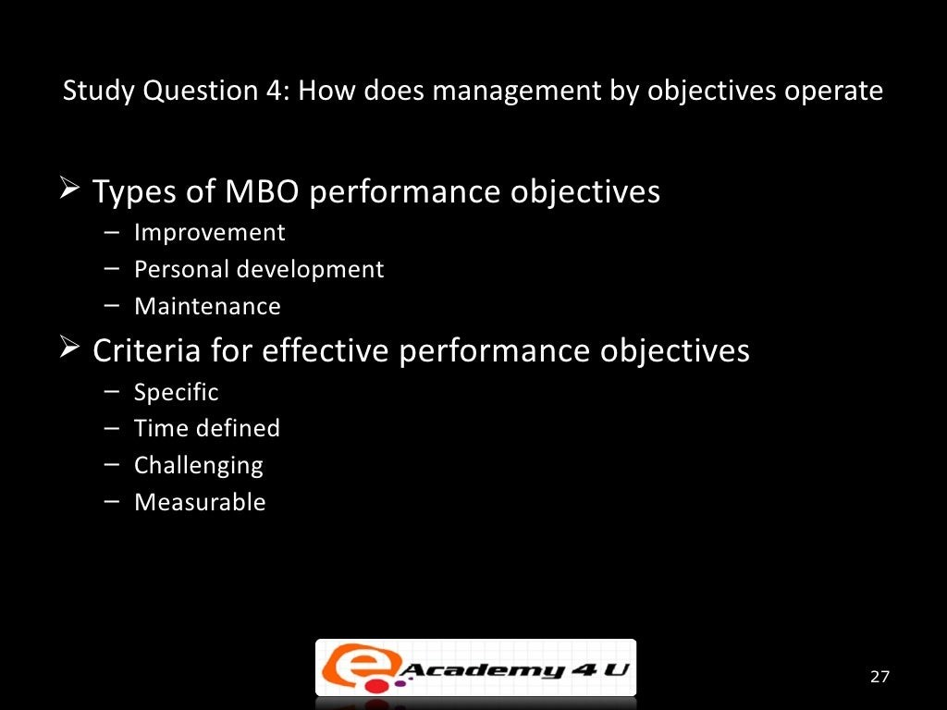

Slide 28
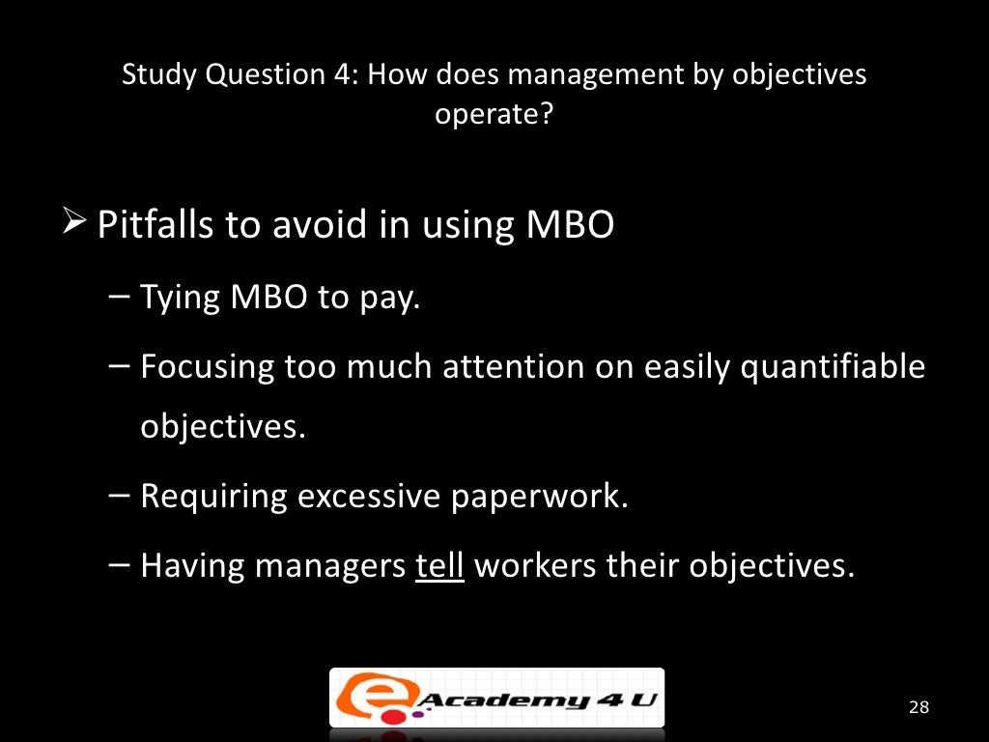

Slide 29
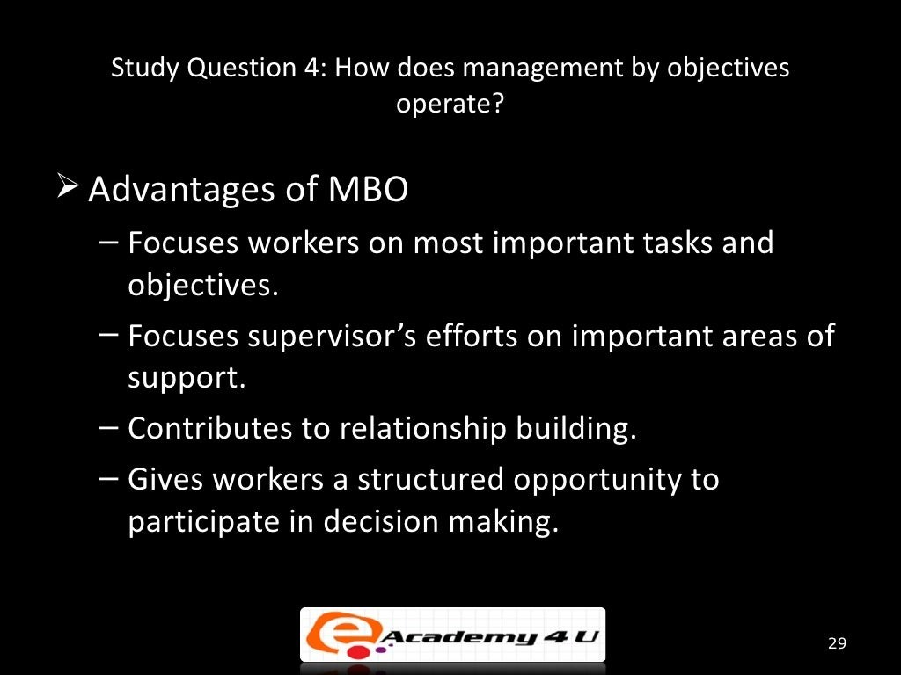

Slide 30
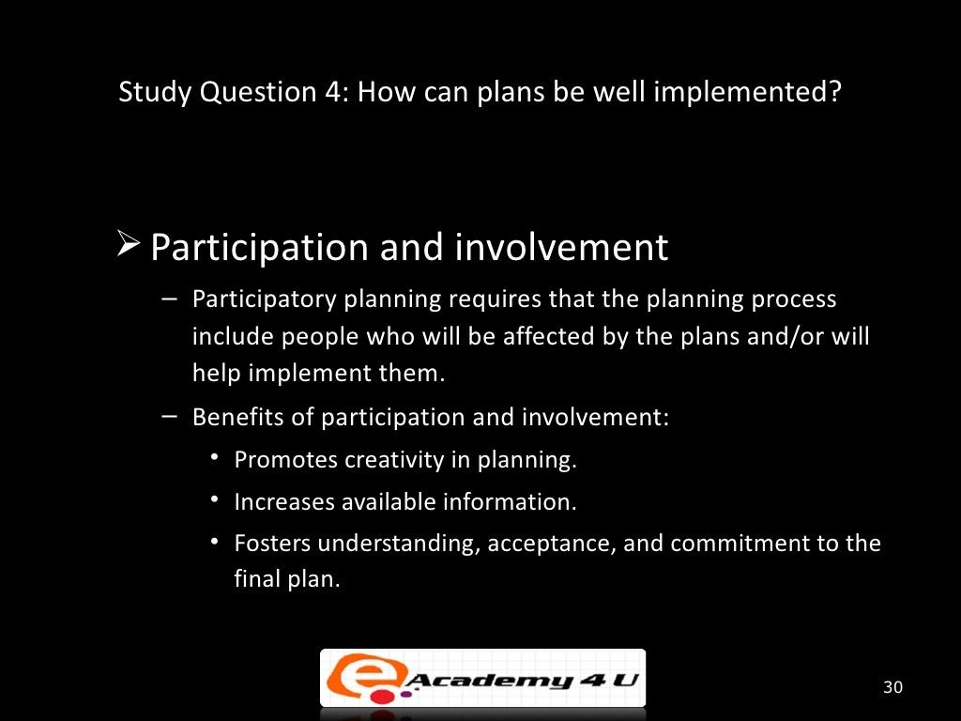

Slide 31
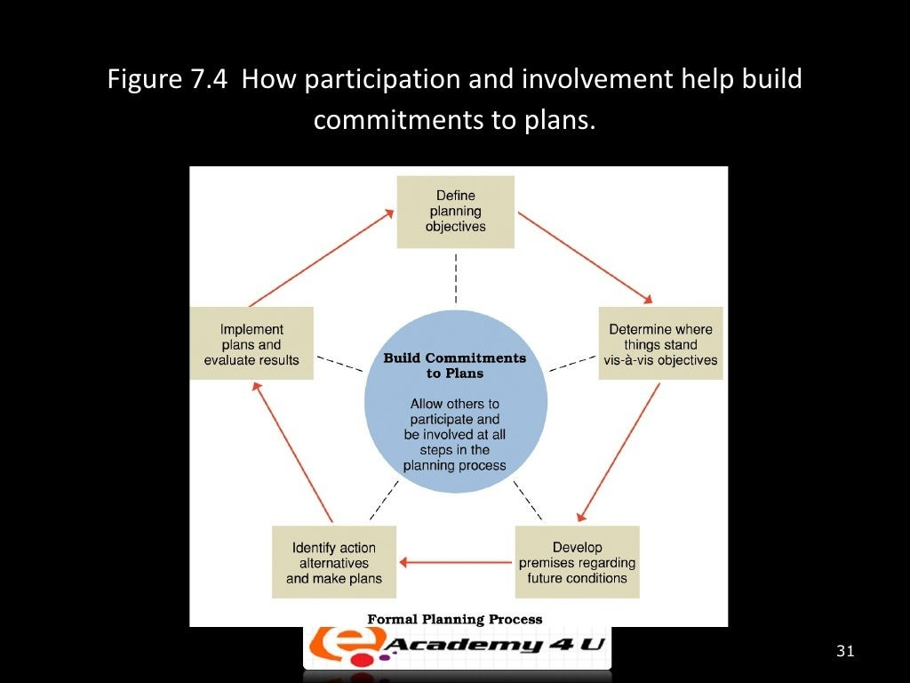

Slide 32
STRATEGIC PLANNING
Strategic planning is a process in which an organization's leaders define their vision for the future and identify their organization's goals and objectives. The process includes establishing the sequence in which those goals should be realized so that the organization can reach its stated vision.
Strategic planning typically represents mid- to long-term goals with a life span of three to five years, though it can go longer. This is different than business planning, which typically focuses on short-term, tactical goals, such as how a budget is divided up
the essential elements of a strategic plan include:
Clear mission and vision statements to frame the context of the document
Clear timelines for strategy implementation and progress monitoring
Quarterly benchmarks or objectives that will inform progress towards annual goals
Identification of the data sources used to track progress
Indication of the individuals and/or offices responsible for each strategy

Slide 33
STRATEGIC PLANNING AND ITS PROCESSE
1. Determine your strategic position
This preparation phase sets the foundation for all work going forward. You need to know where you are to determine where you need to go and how you will get there.
Involve the right stakeholders from the start, considering both internal and external sources. Identify key strategic issues by talking with executives at your company, pulling in customer insights, and collecting industry and market data. This will give you a clear picture of your position in the market and customer insight.
It can also be helpful to review—or create if you don’t have them already—your company’s mission and vision statements to give yourself and your team a clear image of what success looks like for your business. In addition, review your company’s core values to remind yourself about how your company plans to achieve these objectives.
To get started, use industry and market data, including customer insights and current/future demands, to identify the issues that need to be addressed. Document your organization's internal strengths and weaknesses, along with external opportunities (ways your organization can grow in order to fill needs that the market does not currently fill) and threats (your competition).
As a framework for your initial analysis, use a SWOT diagram. With input from executives, customers, and external market data, you can quickly categorize your findings as Strengths, Weaknesses, Opportunities, and Threats (SWOT) to clarify your current position.
An alternative to a SWOT is PEST analysis. Standing for Political, Economic, Socio-cultural, and Technological, PEST is a strategic tool used to clarify threats and opportunities for your business.
As you synthesize this information, your unique strategic position in the market will become clear, and you can start solidifying a few key strategic objectives. Often, these objectives are set with a three- to five-year horizon in mind.

Slide 34
STRATEGIC PLANNING AND ITS PROCESSE
2. Prioritize your objectives
Once you have identified your current position in the market, it is time to determine objectives that will help you achieve your goals. Your objectives should align with your company mission and vision.
Prioritize your objectives by asking important questions such as:
Which of these initiatives will have the greatest impact on achieving our company mission/vision and improving our position in the market?
What types of impact are most important (e.g. customer acquisition vs. revenue)?
How will the competition react?
Which initiatives are most urgent?
What will we need to do to accomplish our goals?
How will we measure our progress and determine whether we achieved our goals?
Objectives should be distinct and measurable to help you reach your long-term strategic goals and initiatives outlined in step one. Potential objectives can be updating website content, improving email open rates, and generating new leads in the pipeline.

Slide 35
STRATEGIC PLANNING AND ITS PROCESSE
3. Develop a plan
Now it's time to create a strategic plan to reach your goals successfully. This step requires determining the tactics necessary to attain your objectives and designating a timeline and clearly communicating responsibilities.
Strategy mapping is an effective tool to visualize your entire plan. Working from the top-down, strategy maps make it simple to view business processes and identify gaps for improvement.

Slide 36
STRATEGIC PLANNING AND ITS PROCESSE
3. Develop a plan
Now it's time to create a strategic plan to reach your goals successfully. This step requires determining the tactics necessary to attain your objectives and designating a timeline and clearly communicating responsibilities.
Strategy mapping is an effective tool to visualize your entire plan. Working from the top-down, strategy maps make it simple to view business processes and identify gaps for improvement.
Truly strategic choices usually involve a trade-off in opportunity cost. For example, your company may decide not to put as much funding behind customer support, so that it can put more funding into creating an intuitive user experience.
Be prepared to use your values, mission statement, and established priorities to say “no” to initiatives that won’t enhance your long-term strategic position.

Slide 37
STRATEGIC PLANNING AND ITS PROCESSE
4. Execute and manage the plan
Once you have the plan, you’re ready to implement it. First, communicate the plan to the organization by sharing relevant documentation. Then, the actual work begins.
Turn your broader strategy into a concrete plan by mapping your processes. Use key performance indicator (KPI) dashboards to communicate team responsibilities clearly. This granular approach illustrates the completion process and ownership for each step of the way.
Set up regular reviews with individual contributors and their managers and determine check-in points to ensure you’re on track.

Slide 38
STRATEGIC PLANNING AND ITS PROCESSE
5. Review and revise the plan
The final stage of the plan—to review and revise—gives you an opportunity to reevaluate your priorities and course-correct based on past successes or failures.
On a quarterly basis, determine which KPIs your team has met and how you can continue to meet them, adapting your plan as necessary. On an annual basis, it’s important to reevaluate your priorities and strategic position to ensure that you stay on track for success in the long run.
Track your progress using balanced scorecards to comprehensively understand of your business's performance and execute strategic goals.

