Slide 1
Order-BOT
GROUP:14 Amisha Jain Dakshya Mishra Nayonika Mohapatra Srinidhi Kulkarni

Slide 2
Problem Statement:
Order Status Chat Bot - Dell Internal Agent:
To check the status of the order in real time scenario.
Additional Capability:
Chat bot should be an aggregator(call or access the other chat bots and relay the information back here.

Slide 3
Solution :
Our approach includes various departmental bots which will be controlled by the central aggregator.
The lifecycle of orders are assumed to be :
Orders Department
Assembly Department
Manufacturing Department
Logistics Department

Slide 4
FLOW OF WORK
> User will enter a query
> Front-end will send the query to our python app
which will return response or/and tag.
> Response will directly be shown to the user by the front-end.
> For tag front-end will ask the Id from the user and will call an api service from
back-end.
> Back-end will send the response to front-end which will be displayed to the user

Slide 5
Tech-Stack
WEB :- > Front-end : BotUI (Vue framework)
> Back-end : Javascript (Node.js environment)
> Database : MongoDB
ML :-
> Python
> Tensorflow, NLTK frameworks

Slide 6
TYPES OF USERS
> Internal Dell Agents ( Customer Service Representative)
> Customers

Slide 7
Customers
Can query for order status, order refund status, order cancellation status.
If user doesn’t remember his orderId, the bot will ask to login and will display the last three orders placed.
Informal responses.

Slide 8
Internal Dell Agents
Login.
Can query for order status, order refund status, order cancellation status.
Point to point responses.

Slide 9
Text Analysis

Slide 10
What is a Contextual Chatbot
Contextual chatbots are kind of advanced chatbots. Their basic aim is to try to figure out what user intends i.e. in which sense or proportion the user is asking a question or doing some random stuff on the website. It then revert those sentiments and behaviour according to the intentions of the user.

Slide 11
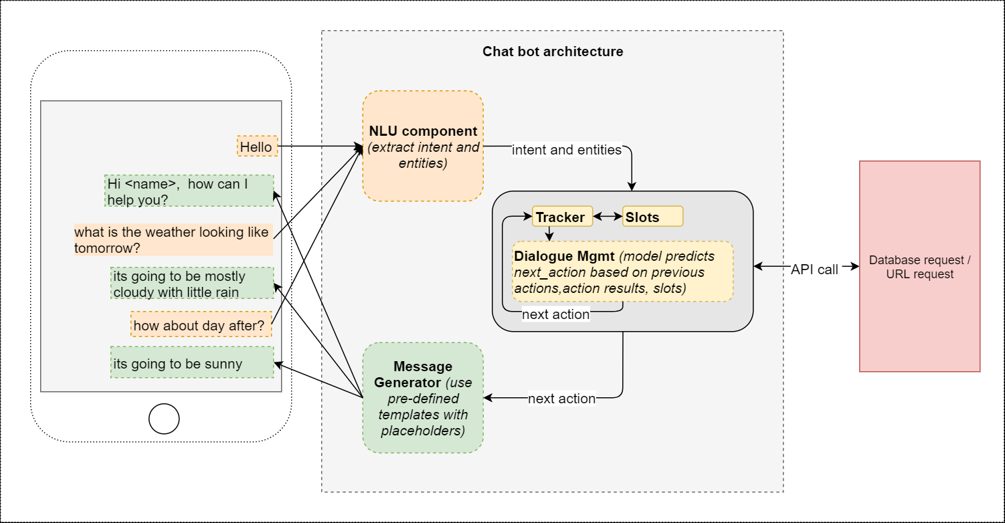

Slide 12
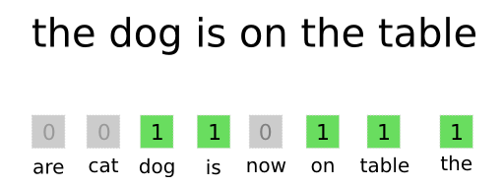
Bag of words

Slide 13
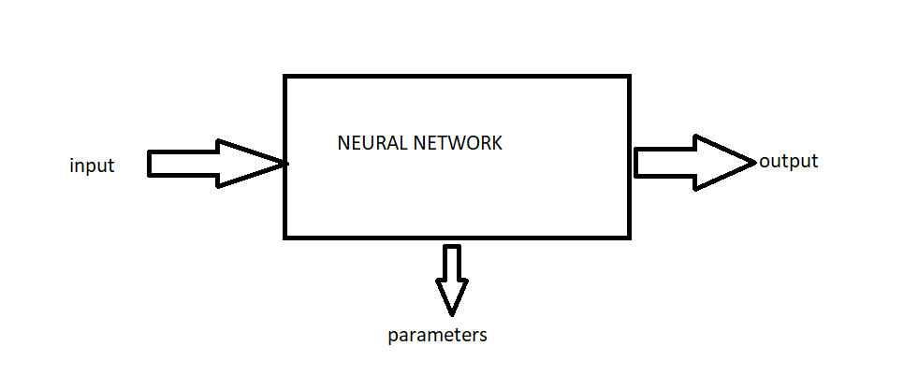

Slide 14
Significance of the System:
Chatbot applications streamline interactions between people and services.
Enhancing customer experience.
Offer companies new opportunities to improve the customers engagement process and operational efficiency .
Reducing the typical cost of customer service.

Slide 15
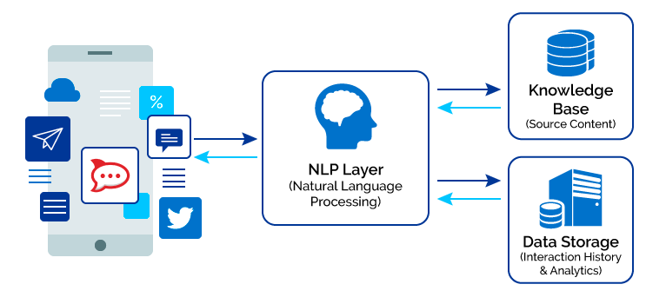
CHAT BOT FLOW:

Slide 16
ML-Approach:
We take up an approach to look for intent classification and compute vectors for intent classification in order to feed to the network and generate the response accordingly.
Dataset:
Tags of the intention
Patterns of query
Response
Tags Classification:
Intention free conversation.
Order based
Complaints
Positive
Feedback.

Slide 17
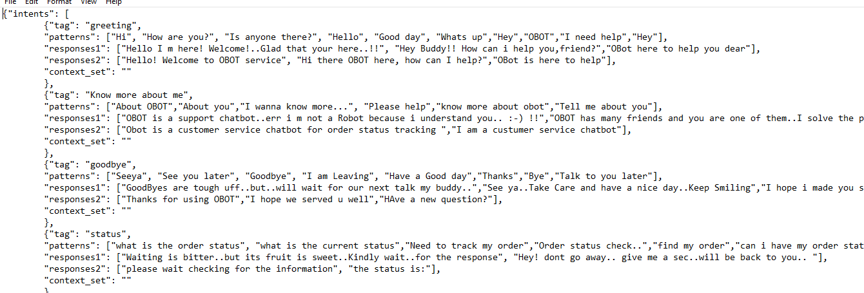
DATASET:

Slide 18
Bag of Words:
The bag-of-words model is a way of representing text data when modeling text with machine learning algorithms.
Feature Extraction in NLP.

Slide 19
Short Comings:
Features that can enhance the working of the Chatbot.
Text to Speech.
Using: gTTS API.
Qrcode/Barcode Scanner.
Using: OpenCV.

Slide 20
THANK YOU

