Slide 1
DOMINO’S
Final project – IT Talents Season 15

Slide 2
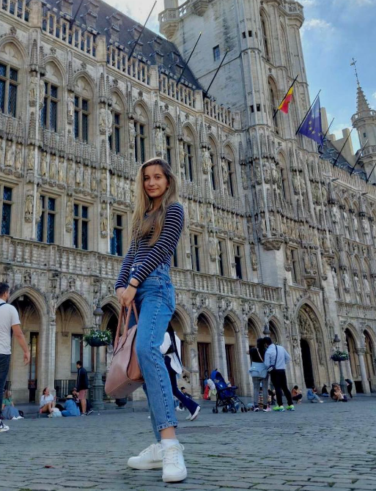
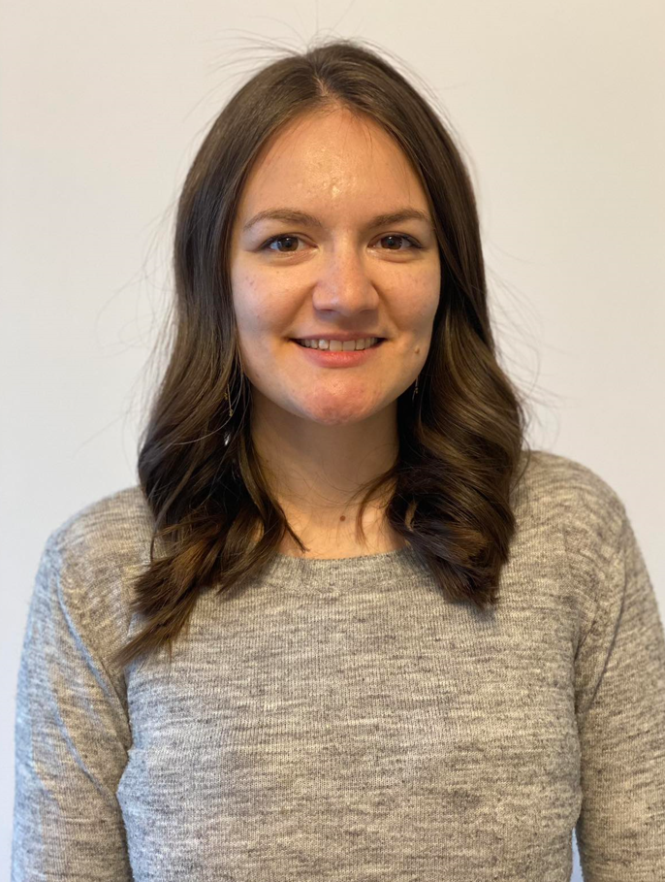
Who are we?
Nayme Mollova
Anastassia Toseva
Student at Faculty of Mathematics and Informatics, SU
Age : 23
Online shop owner
Age: 31

Slide 3
Address
Category
User
Add
Edit
Delete
Register
Login
Edit profile
Change password
Logout
Add
Edit
Delete
Product
Add
Edit
Delete
Main functionalities:
Ingredient
Order
Add
Edit
Delete
Cart
Create
Add product
Delete product

Slide 4
Java EE
MySQL Workbench
Hibernate
Spring Validation
Maven
Lombok
Used technologies
BCrypt
Postman
Spring Data JPA
GIT
IntelliJ Idea

Slide 5
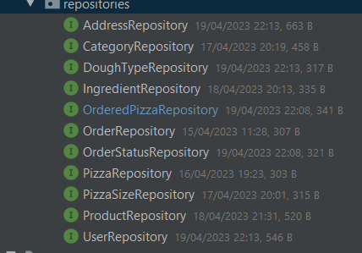

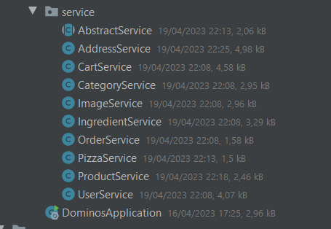
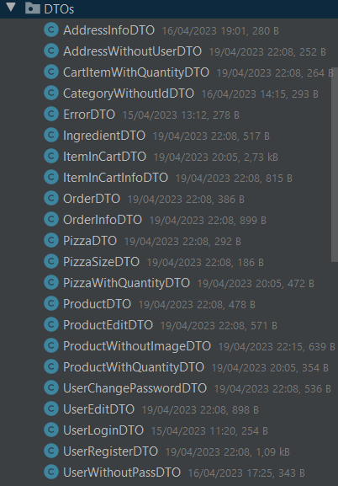
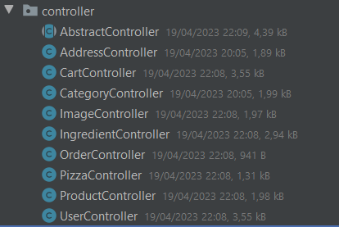
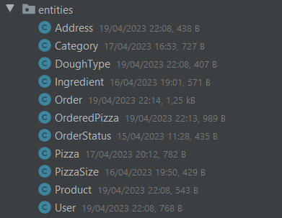
Class Structure

Slide 6
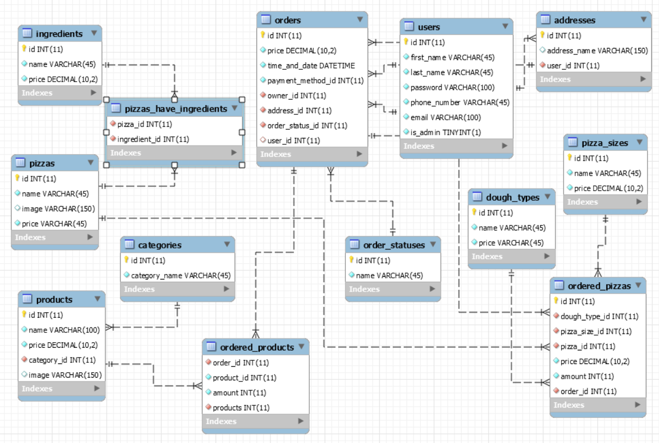

Slide 7
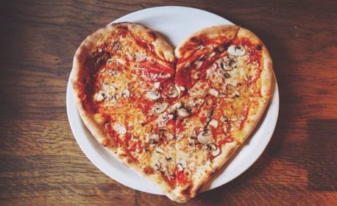
DEMO
Thank you for your attention!
Questions?

