Slide 1

EDA OF
By – Nayna Goyal

Slide 2
INTRODUCTION
Problem Statement
Questions& Analysis
Conclusion
Actionable Insights
This project is about Exploratory Data Analysis of "Crime Against Women in India".
The data refers to State/UT-wise details of cases registered and their disposal under
crime against Women by crime heads. The dataset contains complete information
about various aspects of crimes happened in India from 2001-2010.
Data source –
Name: "Crime Against Women In India"
Sponsoring Organization: 1. This data set is taken from kaggle, which was actually taken from National Crime Records Bureau (NCRB) and Govt. of India has published and shared this dataset on Open Govt Data Platform portal under Govt. Open Data License - India.
Description: "Total Crime Against Women" includes: Rape, Kidnapping and Abduction, Dowry Death, Cruelty by Husband and Relatives, Assault on Women with intent to outrage her modesty, Insult to modesty of Women, Importation of Girls from foreign country, Commission of Sati Prevention Act, Immoral Traffic (Prevention) Act, Indecent Representation of Women (Prohibition) Act and Dowry Prohibition Act.

Slide 3
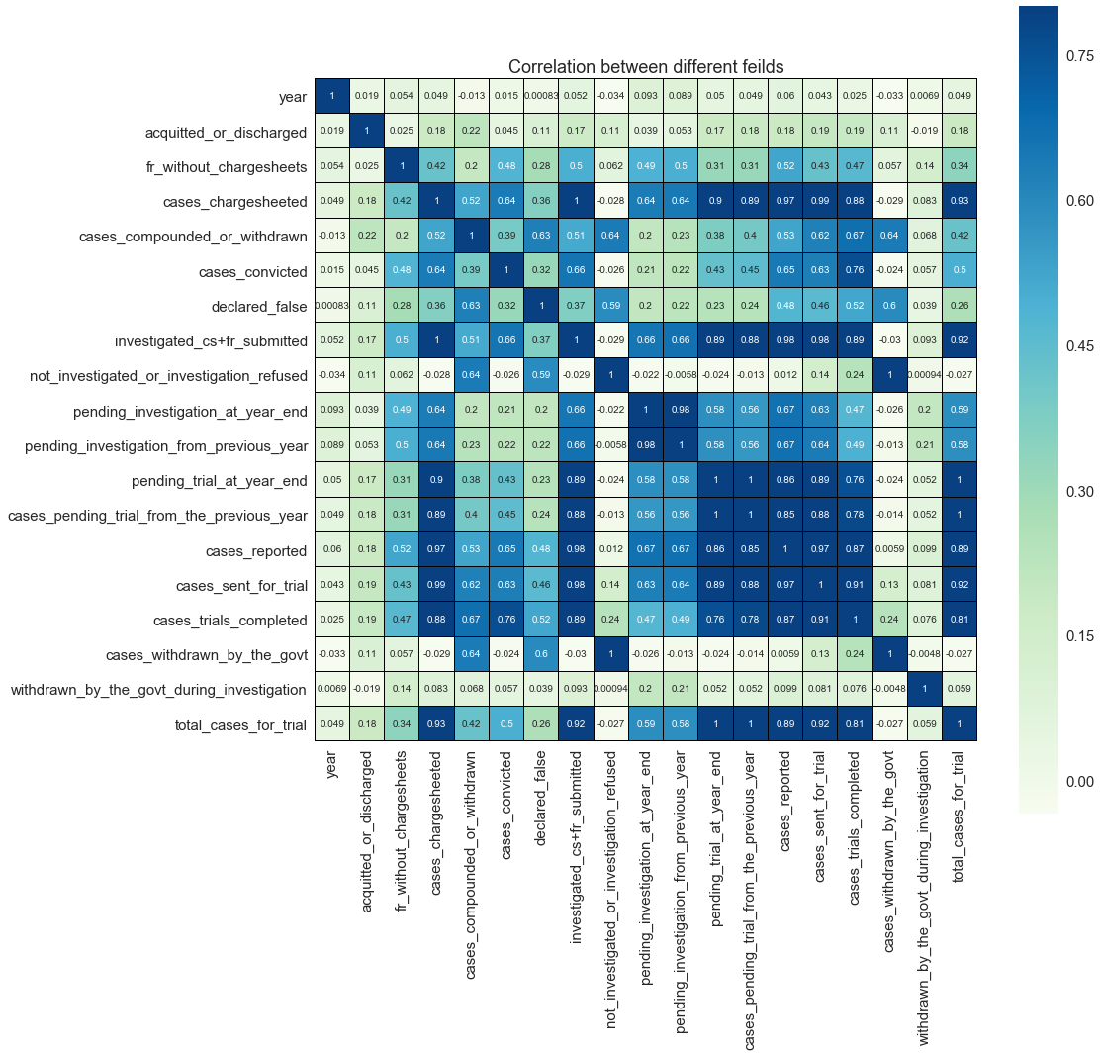
CORRELATION
Highly Correlated fields -
Cases pending trial from the previous year is highly correlated with cases pending trial at year end – This may due to the backlog which keeps increasing.
Total cases reported is highly correlated with cases investigated, chart-sheet prepared and final report submitted - Police is working ☺
Cases sent for trial is highly correlated with cases reported and cases trials completed.
Cases withdrawn by the Govt. is highly correlated with cases not investigated or investigation refused.
-1 - +1

Slide 4

PROBLEM STATEMENT
This is Exploratory Data Analysis on crime against women in India. The dataset taken contains complete information about various aspects of crimes happened in India from 2001-2010.

Slide 5





QUESTIONS?
?
?
?
?
?
Area
Crime
Time
Trust
Result
Is your State safe for women?
Most Reported Crimes?
Are women getting safer from time to time?
Are there any loopholes in legislation?
What is the outcome of cases reported?

Slide 6
QUESTIONS?
Area
Crime
Time
Trust
Result
Is your State safe for women?
Most Reported Crimes?
Are women getting safer from time to time?
Are there any loopholes in legislation?
What is the outcome of cases reported?

Slide 7
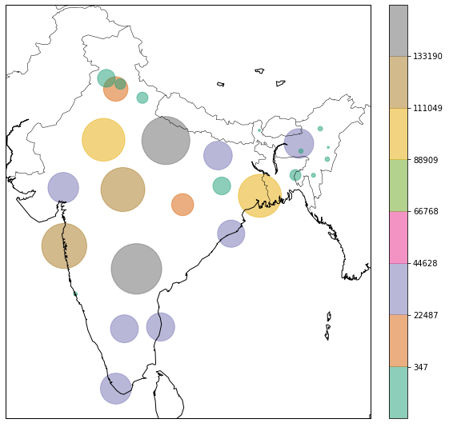
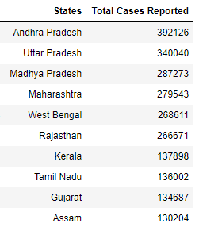
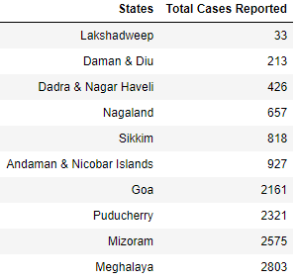
Is Your State Safe For Women?
States in terms of the total number of crimes reported against women.
Top 10
Unsafe States
Top 10
Safe States

Slide 8
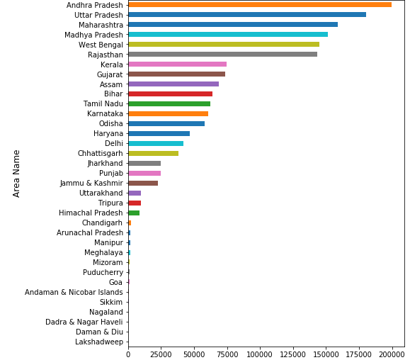
Cases Reported With Respect To Different States
Union Territories have less number of cases reported than States.
Here we should also consider the influence of population.

Slide 9
QUESTIONS?
Area
Crime
Time
Trust
Result
Is your State safe for women?
Most Reported Crimes?
Are women getting safer from time to time?
Are there any loopholes in legislation?
What is the outcome of cases reported?

Slide 10
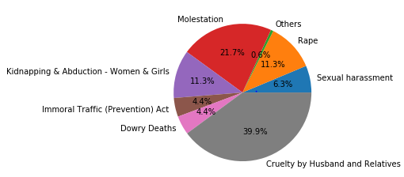
Crime Reported Percentage Distribution
Cruelty by Husband and Relatives, Molestation and Rape cases comprises of 72.9% of total cases reported.

Slide 11
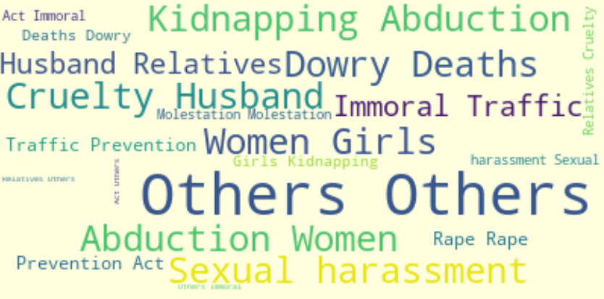
CRIMES WORD MAP

Slide 12
QUESTIONS?
Area
Crime
Time
Trust
Result
Is your State safe for women?
Most Reported Crimes?
Are women getting safer from time to time?
Are there any loopholes in legislation?
What is the outcome of cases reported?

Slide 13
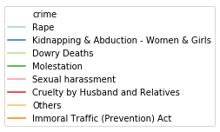
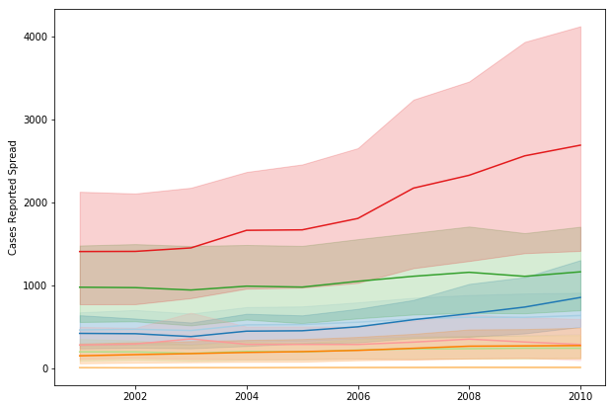

CASES REPORTED SPREAD PER YEAR
Year on year, total crime against women is increasing
Among all crimes, “Cruelty by Husband and Relatives" has more cases reported and it keeps increasing.

Slide 14
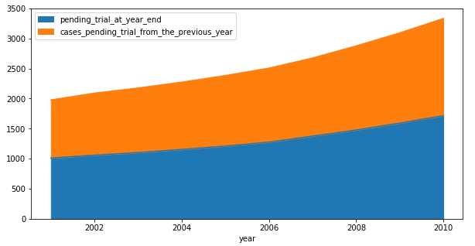
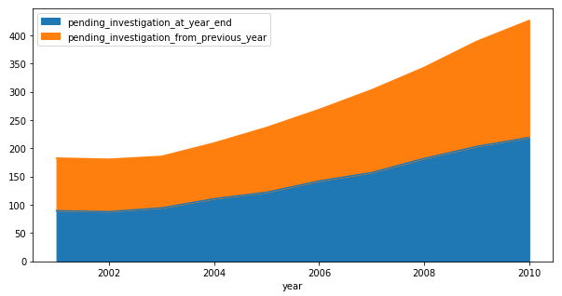
PREVIOUS YEAR VS. YEAR END
This indicates the inefficiencies where number of pending cases at year end keeps increasing and adding up to backlog for next year.
Trial Pending by Previous Year
Advocates
Court Management
Absenteeism
Judges
REASONS
Investigation Pending by Previous Year

Slide 15
QUESTIONS?
Area
Crime
Time
Trust
Result
Is your State safe for women?
Most Reported Crimes?
Are women getting safer from time to time?
Are there any loopholes in legislation?
What is the outcome of cases reported?

Slide 16
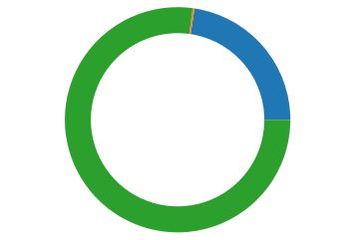
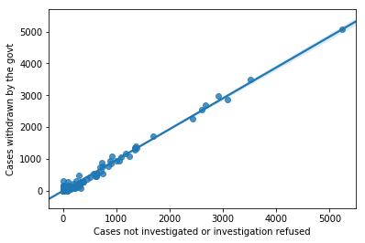
Different types of Withdrawn comparison
Cases Compounded or Withdrawn
77.1%
Cases withdrawn by the Govt. is directly influenced by Cases not investigated or for which investigation was refused.
Cases Withdrawn by the Government
22.6%
Cases Withdrawn by the Govt. During Investigation
0.3%
It says, Govt. don’t investigate much before withdrawing a case.
23% of cases were withdrawn by Govt. rest were compounded.
16

Slide 17
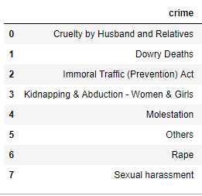
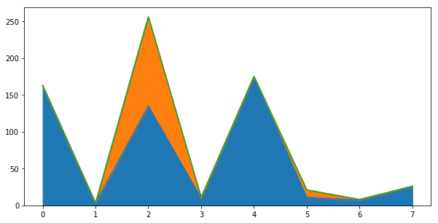
As per crime
Cases Compounded or Withdrawn
77.1 %
Cases Withdrawn by the Government
22.6%
Cases Withdrawn by the Govt. During Investigation
Only in “Immoral Traffic Act” we can see some cases were withdrawn by the Government, else mostly cases are compounded.
0.3%

Slide 18
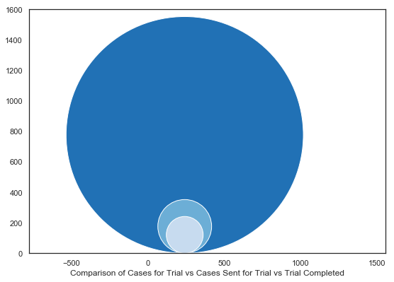
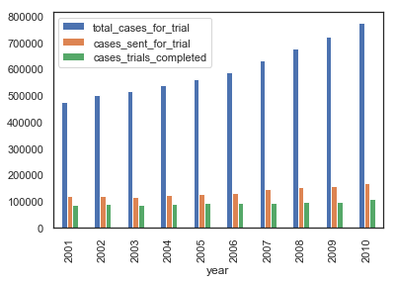
Cases For Trial
Its clearly visible that the overall cases for trial is quite high as comparison to cases sent for trial and trial completed is even lesser.
Most of the cases are not being sent for trial itself, and this leads to increase in backlogs.
Whereas the number of case completed per year remains same.
Sent For Trial
Trial Completed
OVERALL TRIAL’S ANALYSIS

Slide 19
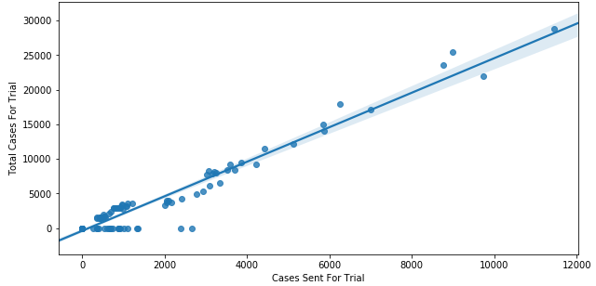
Trial Analysis in ANDHRA PRADESH
Although cases sent for trial is increasing as number of cases for trial increases but the rate of increase of later is higher.

Slide 20
QUESTIONS?
Area
Crime
Time
Trust
Result
Is your State safe for women?
Most Reported Crimes?
Are women getting safer from time to time?
Are there any loopholes in legislation?
What is the outcome of cases reported?

Slide 21
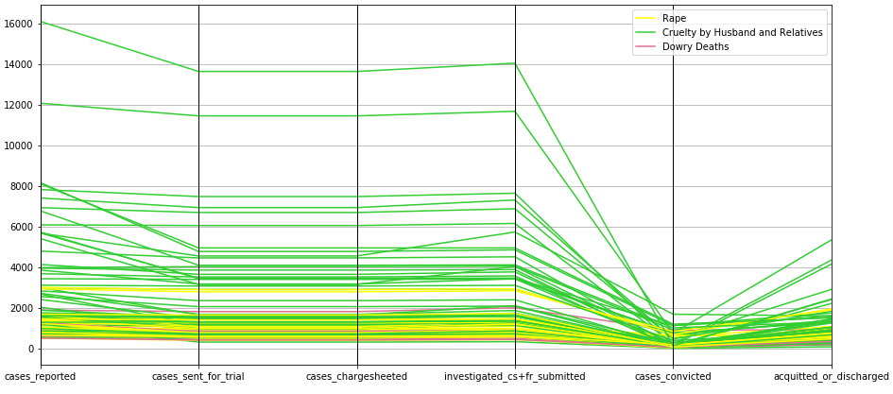
CASE LIFE CYCLE
THE END RESULT
CASES UNDER WOMEN ASSAULTED
For cases reported under women assaulted, charge sheets were prepared, cases got investigated and final report got submitted, even sent for trial but at last most of the cases got acquitted or accused got discharged instead of convicted. Some reasons for this may be –
Lack of proof submission in trials
Improper investigation
Evidence gets erased
Poverty vs. wealth

Slide 22
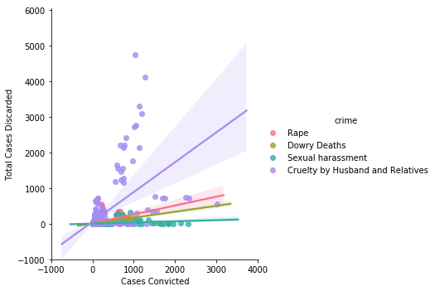
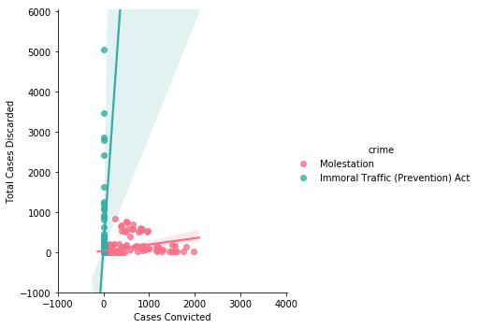
Cases final state - discarded or convicted?
We can notice, “Cruelty by Husband and Relatives” is widely spread and we can notice that mostly these cases are discarded rather than convicted.
Also cases under “Immoral Traffic Act” is widely spread towards cases discarded.

Slide 23
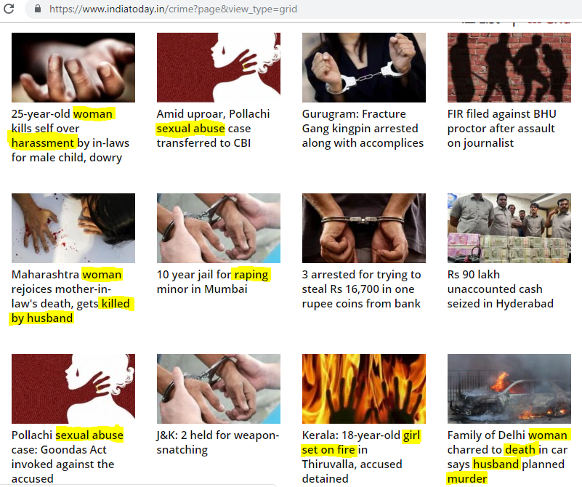
THE TRUTH
India Today’s 14th March, 2019
News of crime. This is not based
on any data collected but the reality.

Slide 24
Conclusion & Actionable Insights
Area
Crime
Time
Trust
Result
AP, UP and MP are most unsafe areas for women. Whereas Union Territories are the safest areas.
Cruelty by Husband/Relatives, Molestation and Rape cases comprises of 72.9% of total cases reported.
Year on year, total crime against women is increasing. And also pending cases are not reducing.
Most of the cases are not being sent for trial itself, and this leads to increase in backlogs.
Mostly cases are discarded rather than convicted.
Con.
Proper planning of the cities, slums, villages, with proper lighting or development, education to women on their rights and encouragement to come forward to register the cases is required.
The incorporation of stringent laws and stricter punishments are important to deter people from committing such crimes.
An improvement in court management should certainly be considered.
More and more fast track court should establish
More concentration and awareness should be spread to collect proper proofs for submission in trials.
AI

Slide 25
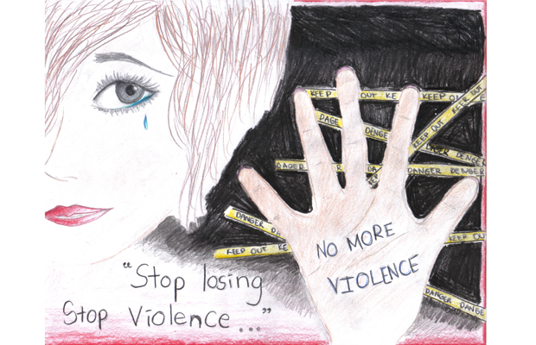
Thank you!
Nayna Goyal
Email:
Project Link:
naynagoyal89@gmail.com
https://github.com/Nayna89/Data-Science/tree/master/EDA_CrimeAgainstWomen

