Slide 1

EDA OF
By – Nayna Goyal

Slide 2
INTRODUCTION
Data
Analysis by Questions
Conclusion
Actionable Insights
Problem Statement
This project is about Exploratory Data Analysis of "Crime Against Women in India".
The data refers to State/UT-wise details of cases registered and their disposal under
crime against Women by crime heads. The dataset contains complete information
about various aspects of crimes happened in India from 2001-2010.
Data source –
Name: "Crime Against Women In India"
Sponsoring Organization: 1. This data set is taken from kaggle, which was actually taken from National Crime Records Bureau (NCRB) and Govt. of India has published and shared this dataset on Open Govt Data Platform portal under Govt. Open Data License - India.

Slide 3
UNDERSTANDING DATA
CATEGORIES
Area_Name
Year
Group_Name
CASES
Cases_Reported
Cases_Acquitted_or_Discharged
Cases_Convicted
TRIALS
Total_Cases_for_Trial
Cases_Sent_for_Trial
Cases_Trials_Completed
NEGATIVE RESULT
Cases_Compounded_or_Withdrawn
Cases_Declared_False_on_Account_of_Mistake_of_Fact_or_of_Law
Cases_not_Investigated_or_in_which_investigation_was_refused
Cases_Withdrawn_by_the_Govt
Cases_withdrawn_by_the_Govt_during_investigation
PENDING
Cases_Pending_Investigation_from_previous_year
Cases_Pending_Investigation_at_Year_End
Cases_Pending_Trial_from_the_previous_year
Cases_Pending_Trial_at_Year_End
Description: "Total Crime Against Women" includes: 'Rape‘, 'Kidnapping & Abduction - Women & Girls‘, 'Dowry Deaths‘, 'Molestation‘, 'Sexual harassment‘, 'Cruelty by Husband and Relatives‘, 'Importation of Girls‘, 'Immoral Traffic (Prevention) Act‘, 'Indecent Representation of Women (Prohibition) Act‘, 'Sati Prevention Act‘, 'Total Crime Against Women‘.
POSITIVE RESULT
Cases_Chargesheeted
Cases_charge_sheets_were_not_laid_but_Final_Report_submitted
Cases_Investigated_Chargesheets+FR_Submitted

Slide 4
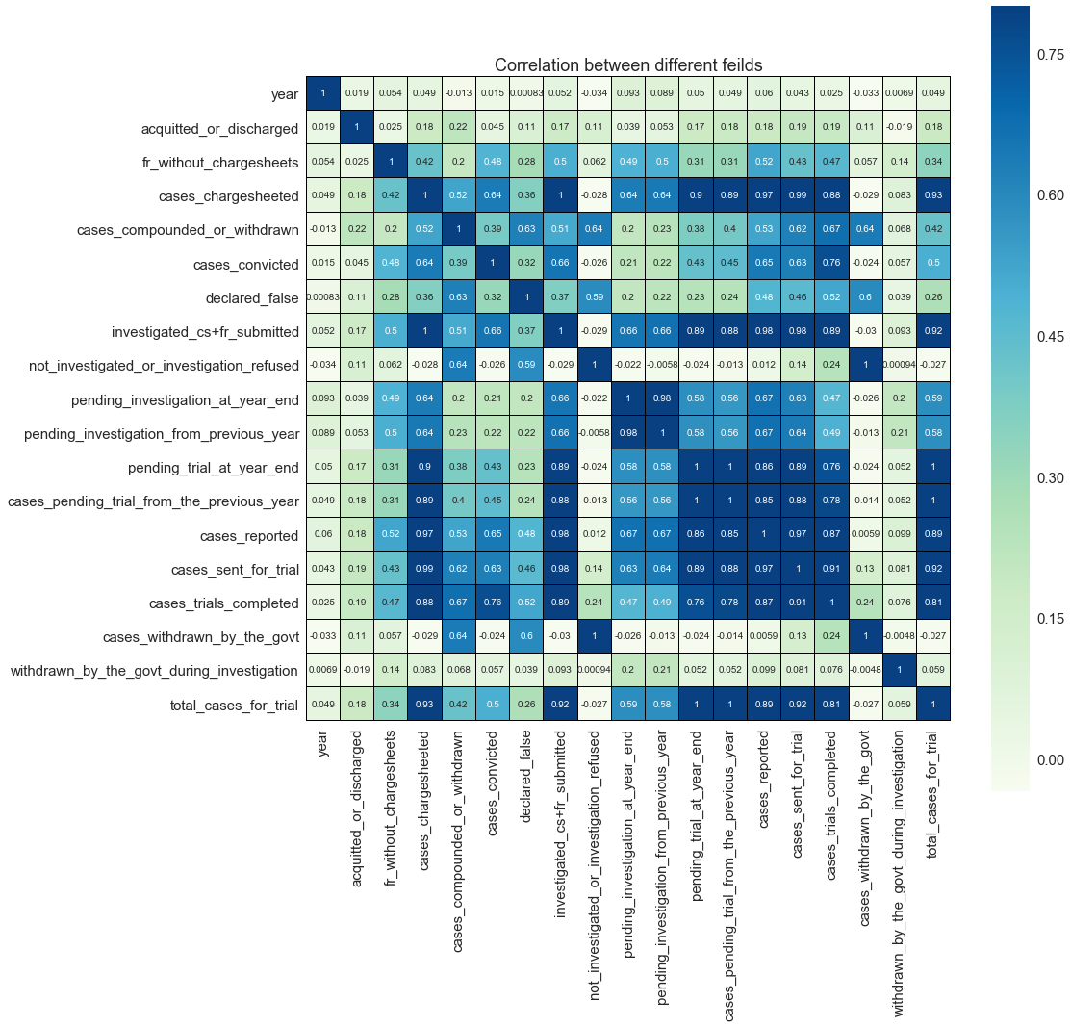
CORRELATION
Highly Correlated fields -
Cases pending trial from the previous year is highly correlated with cases pending trial at year end – This may due to the backlog which keeps increasing.
Total cases reported is highly correlated with cases investigated, chart-sheet prepared and final report submitted - Police is working ☺
Cases sent for trial is highly correlated with cases reported and cases trials completed.
Cases withdrawn by the Govt. is highly correlated with cases not investigated or investigation refused.
-1 - +1

Slide 5

PROBLEM STATEMENT
Exploratory Data Analysis of crime against women in India, which will help us understand different types of crimes, major factors and their solutions.
5

Slide 6





QUESTIONS?
?
?
?
?
?
Area
Crime
Time
Trust
Result
Is your State safe for women?
Most Reported Crimes?
Are women getting safer from time to time?
Are there any loopholes in legislation?
What is the outcome of cases reported?

Slide 7
QUESTIONS?
Area
Crime
Time
Trust
Result
Is your State safe for women?
Most Reported Crimes?
Are women getting safer from time to time?
Are there any loopholes in legislation?
What is the outcome of cases reported?

Slide 8
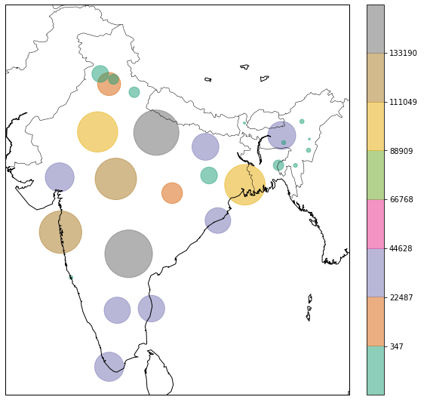
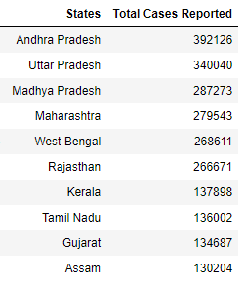
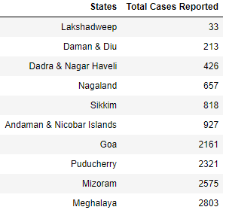
Is Your State Safe For Women?
States in terms of the total number of crimes reported against women.
Top 10
Unsafe States
Top 10
Safe States

Slide 9
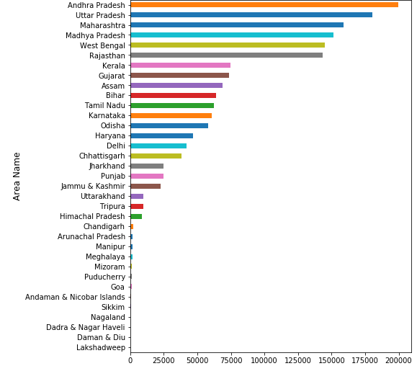
Cases Reported With Respect To Different States
Union Territories have less number of cases reported than States.
Here we should also consider the influence of population.

Slide 10
QUESTIONS?
Area
Crime
Time
Trust
Result
Is your State safe for women?
Most Reported Crimes?
Are women getting safer from time to time?
Are there any loopholes in legislation?
What is the outcome of cases reported?

Slide 11
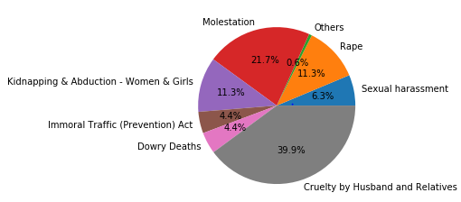
Crime Reported Percentage Distribution
Cruelty by Husband and Relatives, Molestation and Rape cases comprises of 72.9% of total cases reported.

Slide 12
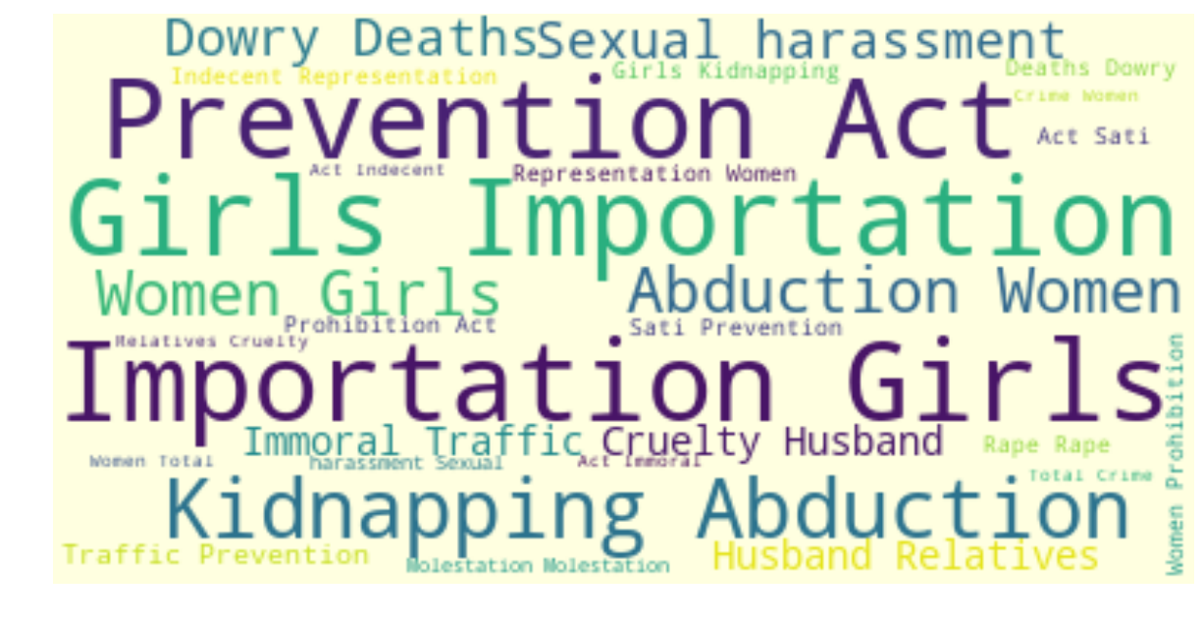
CRIMES WORD MAP

Slide 13
QUESTIONS?
Area
Crime
Time
Trust
Result
Is your State safe for women?
Most Reported Crimes?
Are women getting safer from time to time?
Are there any loopholes in legislation?
What is the outcome of cases reported?

Slide 14
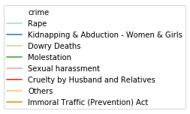
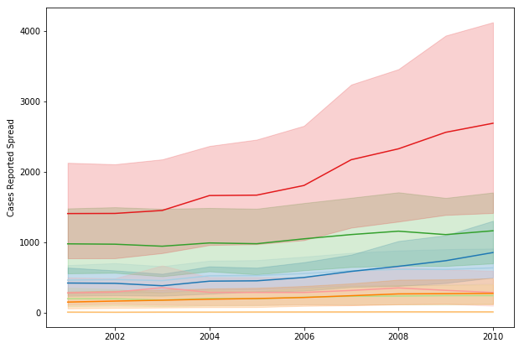

CASES REPORTED SPREAD PER YEAR
Year on year, total crime against women is increasing
Among all crimes, “Cruelty by Husband and Relatives" has more cases reported and it keeps increasing.
14

Slide 15
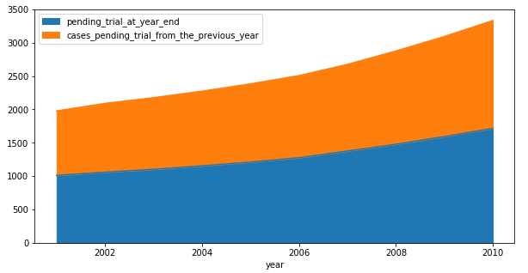
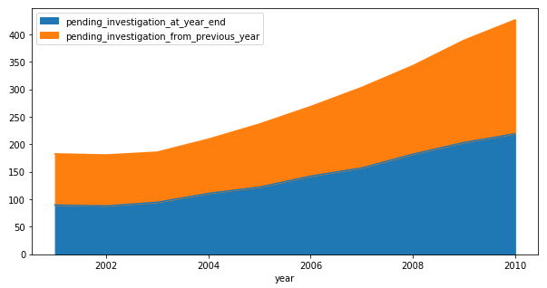
PREVIOUS YEAR VS. YEAR END
This indicates the inefficiencies where number of pending cases at year end keeps increasing and adding up to backlog for next year.
Trial Pending by Previous Year
Advocates
Court Management
Absenteeism
Judges
REASONS
Investigation Pending by Previous Year

Slide 16
QUESTIONS?
Area
Crime
Time
Trust
Result
Is your State safe for women?
Most Reported Crimes?
Are women getting safer from time to time?
Are there any loopholes in legislation?
What is the outcome of cases reported?

Slide 17
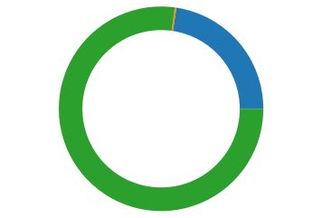
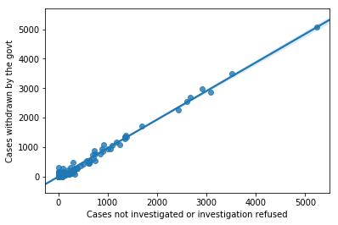
Different types of Withdrawn comparison
Cases Compounded or Withdrawn
77.1%
Cases withdrawn by the Govt. is directly influenced by Cases not investigated or for which investigation was refused.
Cases Withdrawn by the Government
22.6%
Cases Withdrawn by the Govt. During Investigation
0.3%
It says, Govt. don’t investigate much before withdrawing a case.
23% of cases were withdrawn by Govt. rest were compounded.
17

Slide 18
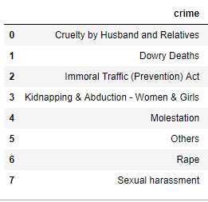
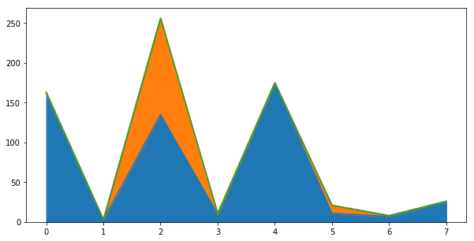
As per crime
Cases Compounded or Withdrawn
77.1 %
Cases Withdrawn by the Government
22.6%
Cases Withdrawn by the Govt. During Investigation
Only in “Immoral Traffic Act” we can see some cases were withdrawn by the Government, else mostly cases are compounded.
0.3%

Slide 19
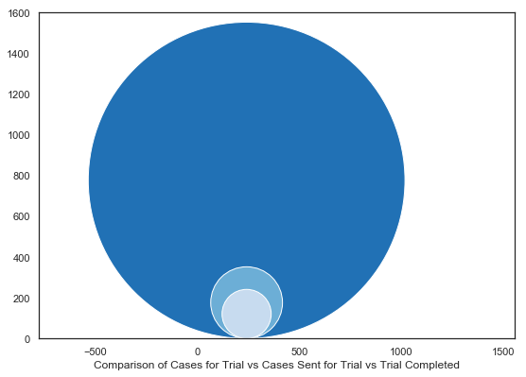
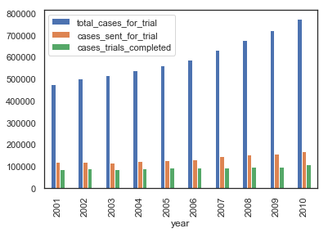
Cases For Trial
Its clearly visible that the overall cases for trial is quite high as comparison to cases sent for trial and trial completed is even lesser.
Most of the cases are not being sent for trial itself, and this leads to increase in backlogs.
Whereas the number of case completed per year remains same.
Sent For Trial
Trial Completed
OVERALL TRIAL’S ANALYSIS

Slide 20
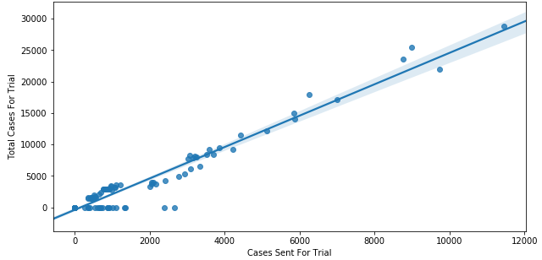
Trial Analysis in ANDHRA PRADESH
Although cases sent for trial is increasing as number of cases for trial increases but the rate of increase of later is higher.

Slide 21
QUESTIONS?
Area
Crime
Time
Trust
Result
Is your State safe for women?
Most Reported Crimes?
Are women getting safer from time to time?
Are there any loopholes in legislation?
What is the outcome of cases reported?

Slide 22
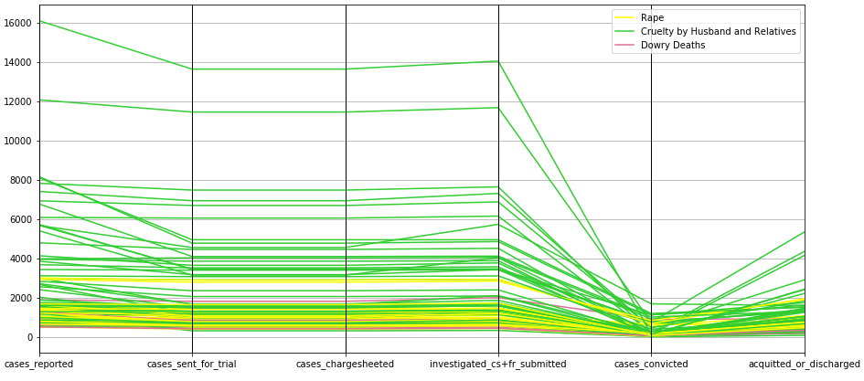
CASE LIFE CYCLE
THE END RESULT
CASES UNDER WOMEN ASSAULTED
For cases reported under women assaulted, charge sheets were prepared, cases got investigated and final report got submitted, even sent for trial but at last most of the cases got acquitted or accused got discharged instead of convicted. Some reasons for this may be –
Lack of proof submission in trials
Improper investigation
Evidence gets erased
Poverty vs. wealth
22

Slide 23
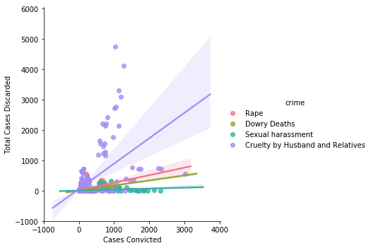
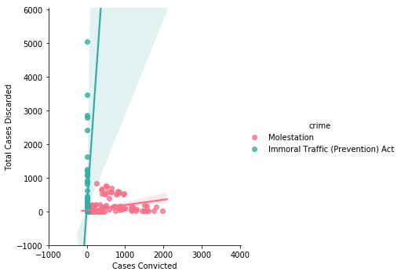
Cases final state - discarded or convicted?
We can notice, “Cruelty by Husband and Relatives” is widely spread and we can notice that mostly these cases are discarded rather than convicted.
Also cases under “Immoral Traffic Act” is widely spread towards cases discarded.

Slide 24
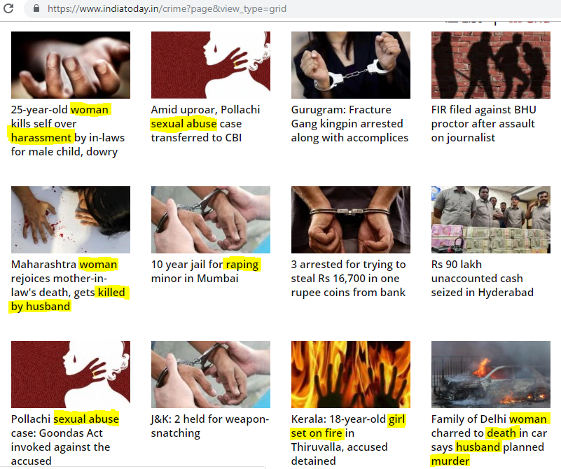
THE TRUTH
India Today’s 14th March, 2019
News of crime. This is not based
on any data collected but the reality.

Slide 25
Conclusion & Actionable Insights
Area
Crime
Time
Trust
Result
AP, UP and MP are most unsafe areas for women. Whereas Union Territories are the safest areas.
Cruelty by Husband/Relatives, Molestation and Rape cases comprises of 72.9% of total cases reported.
Year on year, total crime against women is increasing. And also pending cases are not reducing.
Most of the cases are not being sent for trial itself, and this leads to increase in backlogs.
Mostly cases are discarded rather than convicted.
Con.
Proper planning of the cities, slums, villages, with proper lighting or development, education to women on their rights and encouragement to come forward to register the cases is required.
The incorporation of stringent laws and stricter punishments are important to deter people from committing such crimes.
An improvement in court management should certainly be considered.
More and more fast track court should establish
More concentration and awareness should be spread to collect proper proofs for submission in trials.
AI

Slide 26
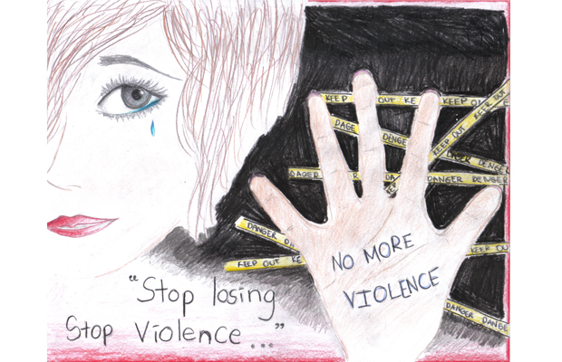
Thank you!
Nayna Goyal
Email:
Project Link:
naynagoyal89@gmail.com
https://github.com/Nayna89/Data-Science/tree/master/EDA_CrimeAgainstWomen
26

