Slide 1
Password Protection Program
Team 28 – Tuples1
Suhavi Sandhu | Shabana Dhayananth | Joseph Lu

Slide 2
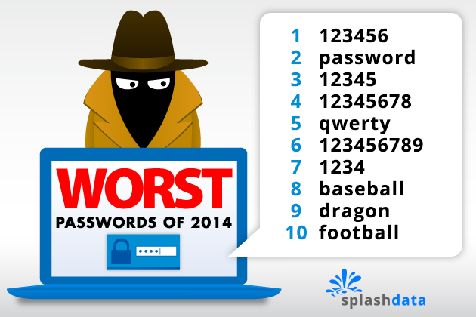
Introduction - purpose
PROBLEM
Insecure password choices
Poor memory
Don’t change passwords
SOLUTION
Encrypted password manager
Single Master Password
PasswordProtectionProgram - Group 28

Slide 3

Introduction - Scope
Offline, Desktop Implementation
One master account
One Factor Authentication
All implementation using python libraries
Python Cryptography Library
PasswordProtectionProgram - Group 28

Slide 4
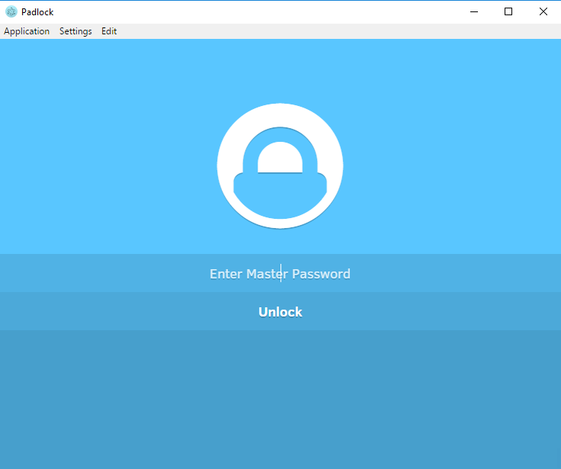
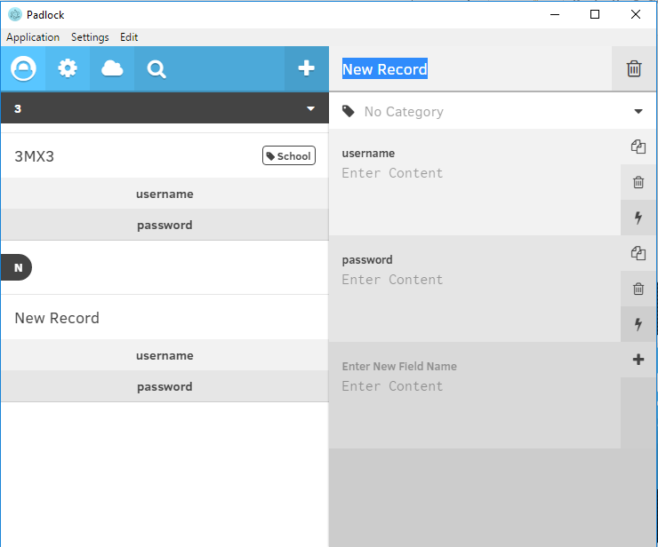
Padlock
PasswordProtectionProgram - Group 28

Slide 5
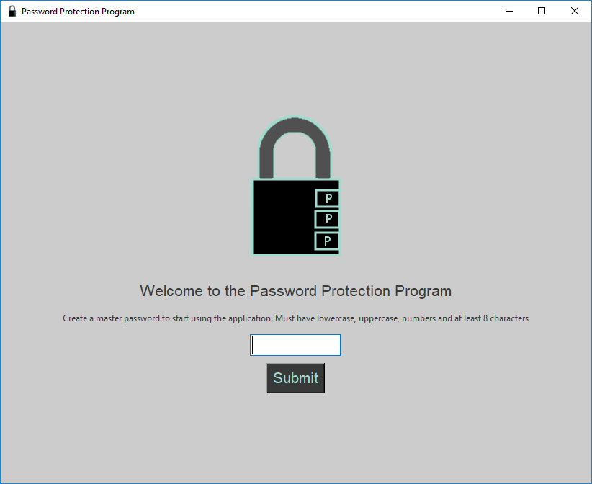
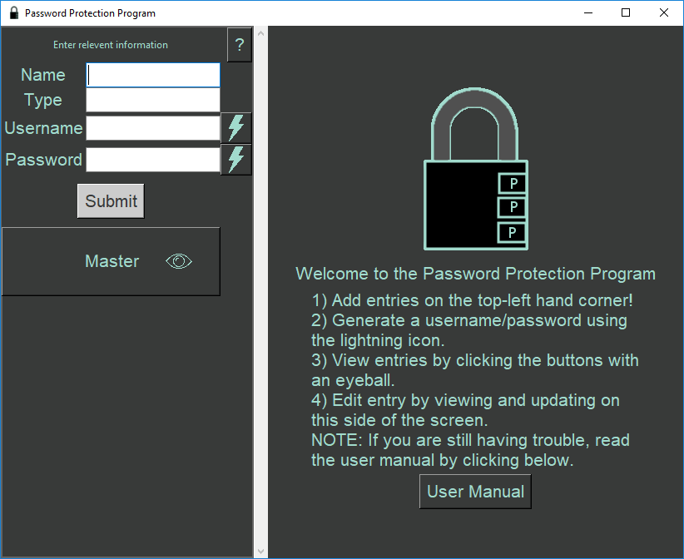
Demonstration
PasswordProtectionProgram - Group 28

Slide 6
Implementation
ENCRYPTION – Cryptography
key using Key stretching (PBKDF2HMAC)
Fernet Library (AES)
DATABASE – SQLite, PeeWee
Insert, Gets (4), delete, update
GUI – Tkinter
Easy to use because highly documented
High fan in
PasswordProtectionProgram - Group 28

Slide 7
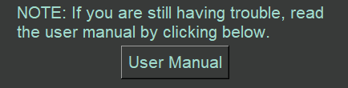
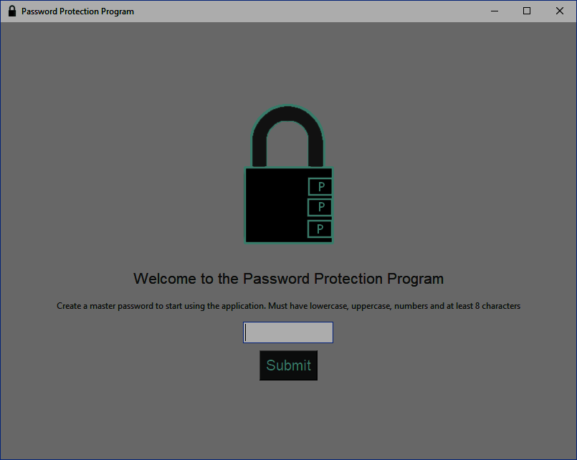
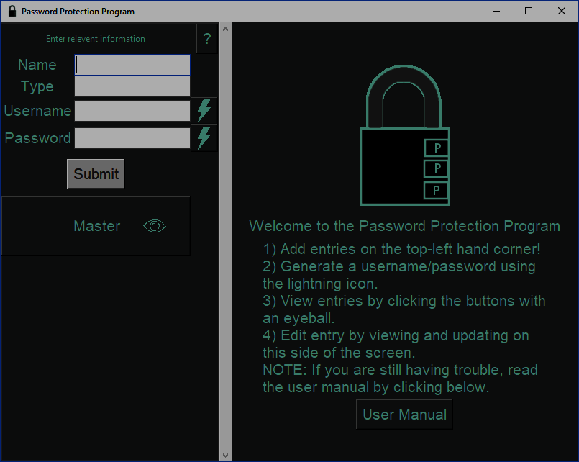
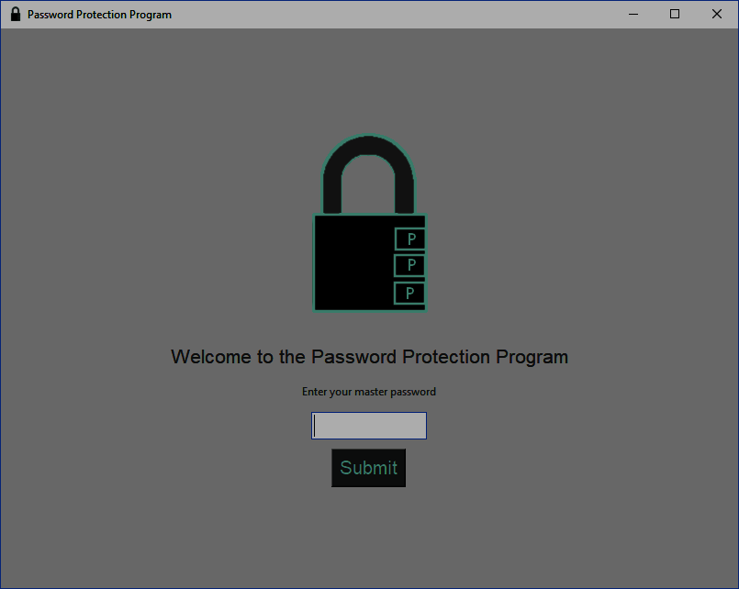
Non-Functional Requirements
Usability
Intuitive
Instruction/ User Manual
Appearance
Minimalistic (Not many Screens)
Separate Sections
Security
Inactivity Timeout
Robust
Maintainable
modular
1
2
3
PasswordProtectionProgram - Group 28

Slide 8
Testing
GUI
Automated and Manual Testing
Database
Automated Testing
Encryption and Random Password Generation
Automated Testing
Cannot Test Security or Randomness
PasswordProtectionProgram - Group 28

Slide 9
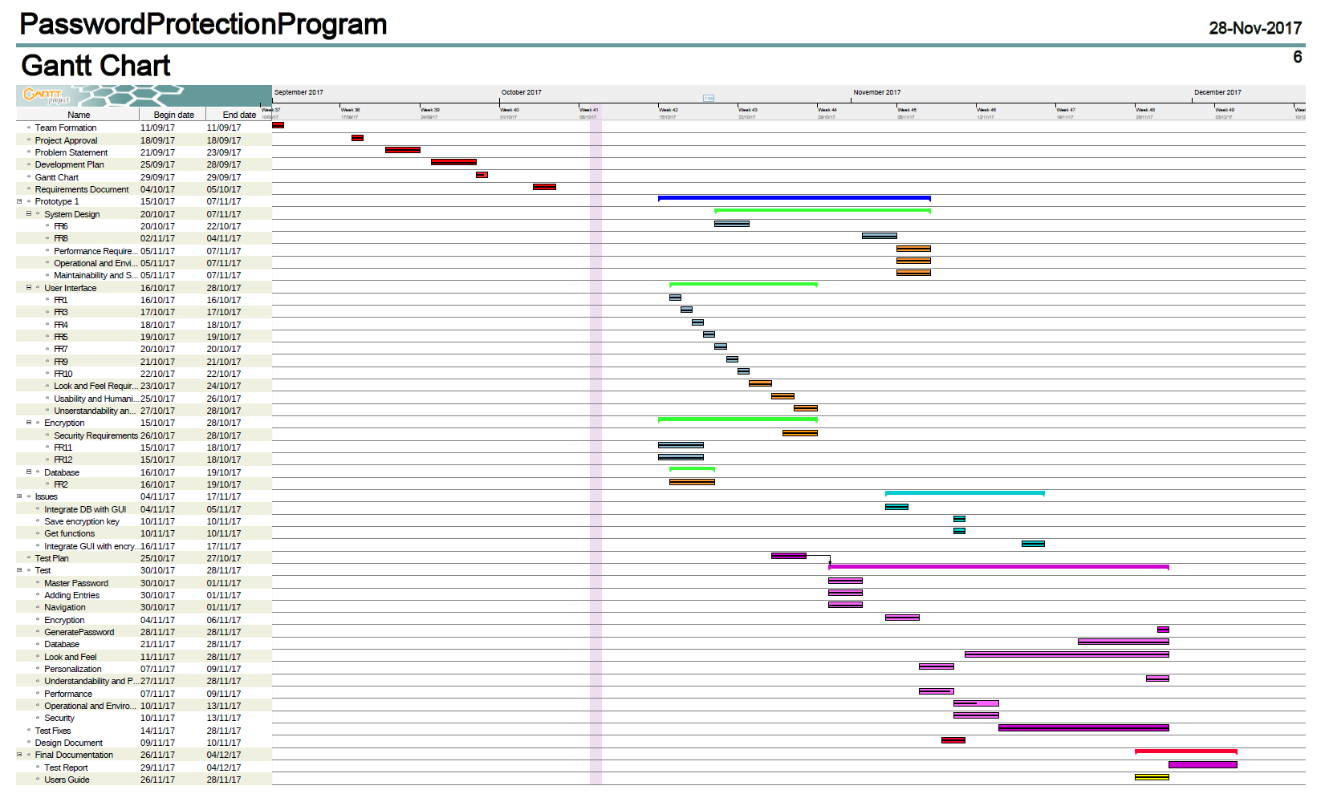
Project Schedule

Slide 10

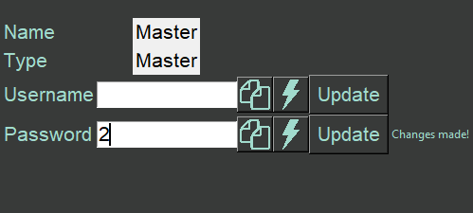
Future Plans
“forgot master password”
Possibly 2 factor authentication
Security requirements for changing master password
Sorting by account types
Searching
PasswordProtectionProgram - Group 28

Slide 11
Thank you for listening ☺
Any questions?

