Slide 1
Password Protection Program
Team 28 – Tuples1
Suhavi Sandhu | Shabana Dhayananth | Joseph Lu

Slide 2
Introduction - purpose
PROBLEM
Insecure password choices
Poor memory
Don’t change passwords
SOLUTION
Encrypted password manager
Single Master Password
User-friendly interface

Slide 3
Introduction - Scope
Offline, Desktop Implementation
One master account
One Factor Authentication
All implementation using python libraries
Python Cryptography Library

Slide 4
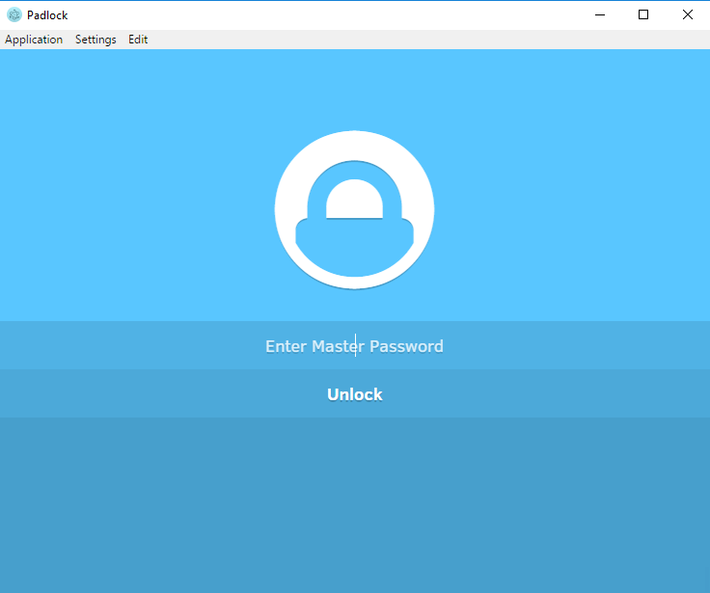
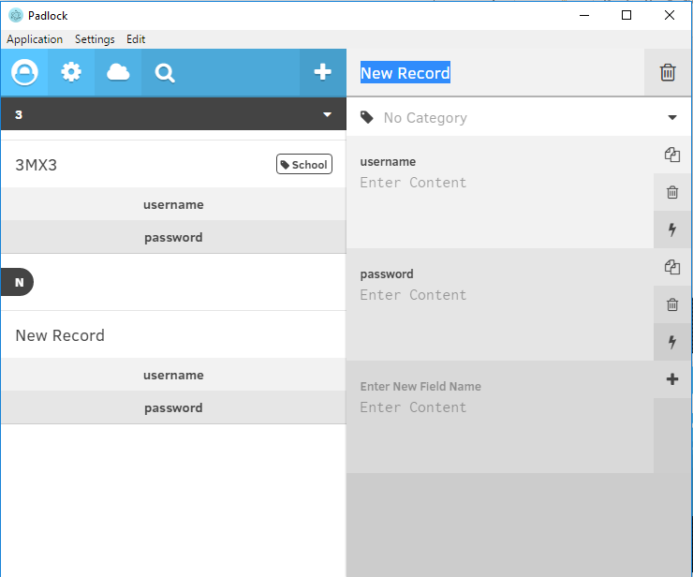
Padlock

Slide 5
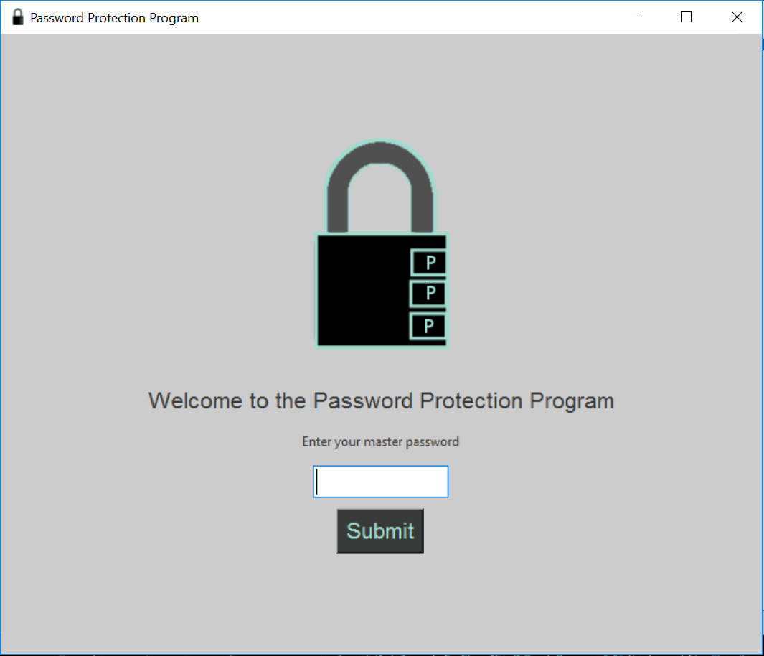
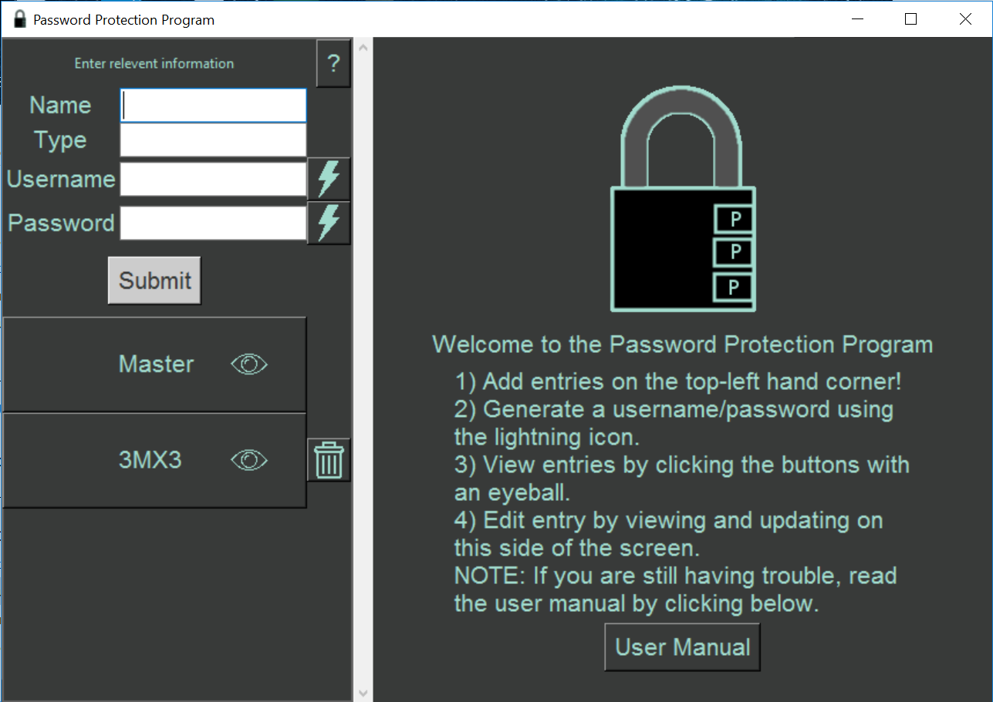
Demonstration

Slide 6
Implementation
GUI – Tkinter
Easy to use because highly documented
High fan in
DATABASE – SQLite, PeeWee
Insert, Gets (4), delete, update
ENCRYPTION – Cryptography
key using Key stretching (PBKDF2HMAC)
Fernet Library (AES)

Slide 7
Non-Functional Requirements
Usability
Intuitive
Instruction/ User Manual
Appearance
Minimalistic (Not many Screens)
Separate Sections
Security
inactivity

Slide 8
Qualities
User-friendly
No prior instruction necessary for use
Robust
Maintainable
modular
Secure
Cryptography library

Slide 9
Testing
GUI
Automated and Manual Testing
Database
Automated Testing
Encryption and Random Password Generation
Automated Testing
Cannot Test Security of Cryptography Library

Slide 10
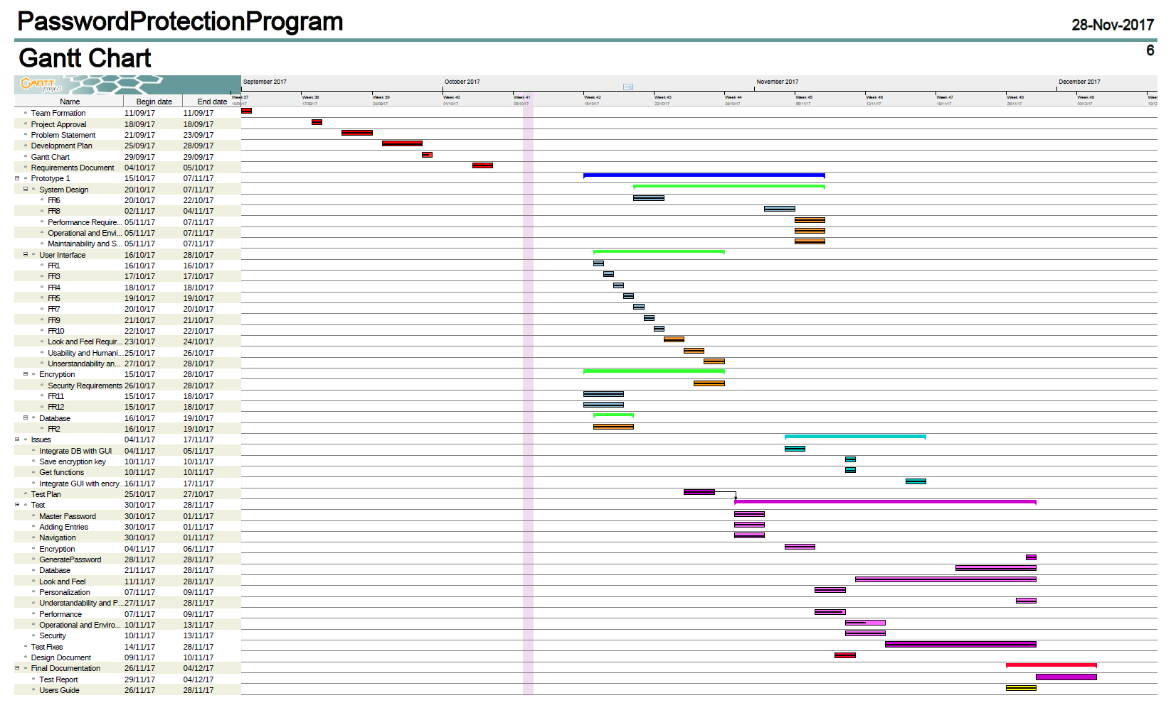
Project Schedule

Slide 11
Future PLans
“forgot master password”
Possibly 2 factor authentication
Security requirements for changing master password
Sorting by account types

