Slide 1
Password Protection Program
Team 28 – Tuples1
Suhavi Sandhu | Shabana Dhayananth | Joseph Lu

Slide 2
Introduction - purpose
Encrypted password manager
User-friendly interface
Intuitive

Slide 3
Introduction - Scope

Slide 4
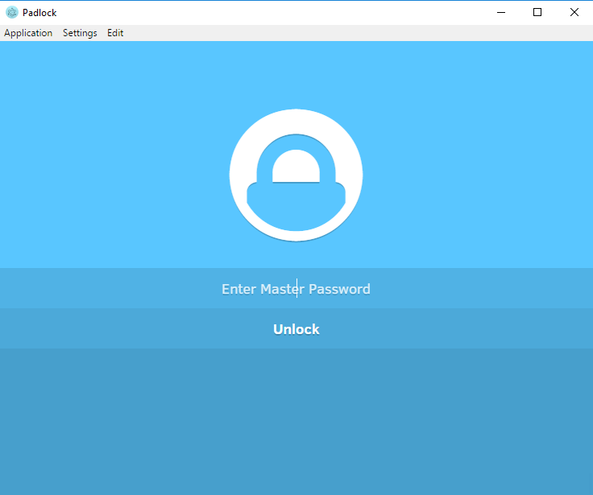
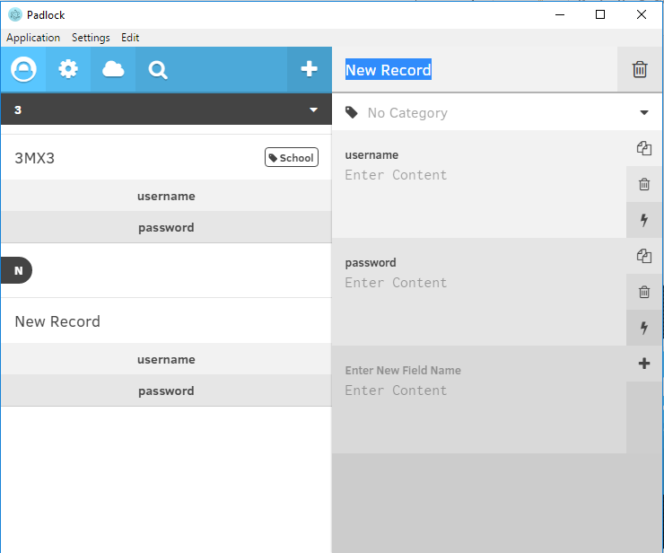

Slide 5
Demonstration

Slide 6
Functional Requirements

Slide 7
Non-Functional Requirements
Performance
Appearance
usability

Slide 8
Qualities
User-friendly
Robust
Maintainable
secure

Slide 9
Testing

Slide 10
Project Schedule

Slide 11
Future Plans

Slide 12
