Slide 1







Presented by: (Batch-B6)
180040132-N.Satish
180040135-T.Venkata Teja
180040153-T.Narendra

Slide 2


Handwriting Detection is a technique or ability of a Computer to receive and interpret intelligible handwritten input
from source such as paper documents, touch screen, photo graphs etc.
Way to Recognize Handwriting
Optical Character
Recognition
Intelligent Word Recognition

Slide 3
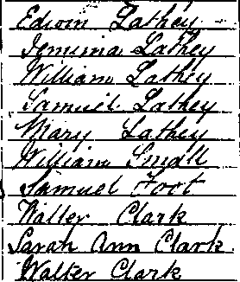
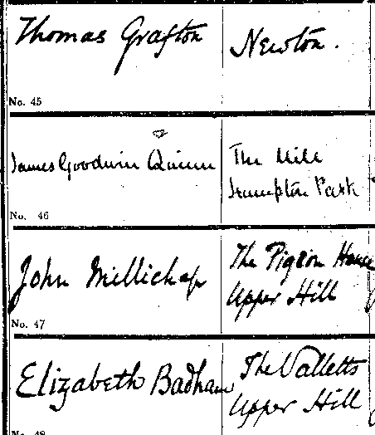
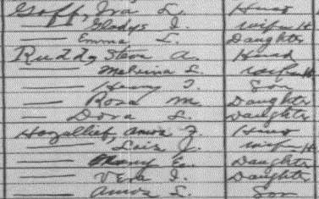
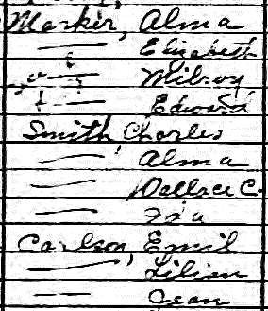
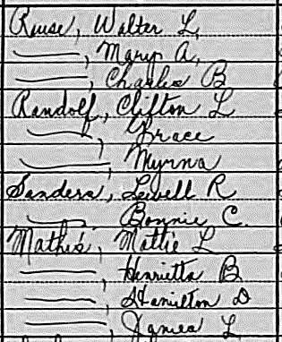
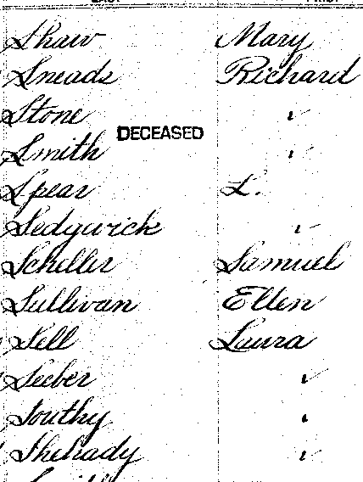

Slide 4

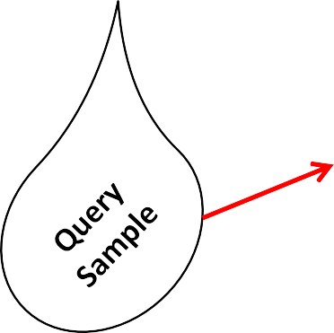
Identification System
Writer 1 Writer n
Database
with samples of known authorship

Slide 5



Slide 6

On-line handwriting recognition involves the automatic conversion of text as it is written on a special digitizer or PDA, where a sensor picks up the pen-tip movements as well as pen-up/pen-down switching. That kind of data is known as digital ink and can be regarded as a dynamic representation of handwriting. The obtained signal is converted into letter codes which are usable within computer and text-processing applications. The elements of an on-line handwriting recognition interface typically include:
a pen or stylus for the user to write with.
a touch sensitive surface, which may be integrated with, or adjacent to, an output display.
a software application which interprets the movements of the stylus
across the writing surface, translating the resulting strokes into digital text.

Slide 7

Off-line handwriting recognition involves the automatic conversion of text in an image into letter codes which are usable within computer and text-processing applications. The data obtained by this form is regarded as a static representation of handwriting. Off-line handwriting recognition is comparatively difficult, as different people have different handwriting styles. And, as of today, OCR engines are primarily focused on machine printed text and ICR for hand "printed" (written in capital letters) text.
There is no OCR/ICR engine that supports handwriting recognition as of today.

Slide 8

Recognition strategies heavily depends on the nature of the data to be recognized.
In the cursive case, the problem is made complex by the fact that the writing is fundamentally ambiguous as the letters in the word are generally linked together, poorly written and may even be missing.
On the contrary, hand printed word recognition is more related to printed word recognition, the individual letters composing the word being usually much easier to isolate and to identify.
Continue..

Slide 9

Character Recognition techniques can be classified according to two criteria:
the way preprocessing is performed on the data
the type of the decision algorithm
Preprocessing techniques include :
the use of global transforms (correlation, Fourier descriptors, etc.)
local comparison (local density, intersections with straight lines, variable masks, etc.)
geometrical or topological characteristics (strokes, loops, openings, diacritical marks, skeleton, etc.)
Decision methods include:
various statistical methods,
neural networks, structural matching (on trees, chains, etc.)
stochastic processing (Markov chains, etc.).

Slide 10

Two main types of strategies have been applied to this problem:
the holistic approach - recognition is globally performed on the whole representation of words and there is no attempt to identify characters individually.
The main advantage of holistic methods is that they avoid word
segmentation
the analytical approach - deal with several levels of representation corresponding to increasing levels of abstraction (usually the feature level, the grapheme or pseudo-letter level and the word level). Words are not considered as a whole, but as sequences of smaller size units which must be easily related to characters in order to make recognition independent from a specific vocabulary

Slide 11

Feature extraction works in a similar fashion to neural network recognizers however, programmers must manually determine the properties they feel are important.
Some example properties might be:
Aspect Ratio
Percent of pixels above horizontal half point
Percent of pixels to right of vertical half point
Number of strokes
Average distance from image center
Is reflected y axis
Is reflected x axis

Slide 12





(A)
(B)
(C)
Different stages of handwriting segmentation.

Slide 13

Handwriting Recognition aims to design systems which are able to recognize handwriting of natural language
Methods and recognition rates depend on the level of constraints on handwriting.
The constraints are mainly characterized by the:
types of handwriting
number of scriptors
size of the vocabulary
spatial layout.
Continue..

Slide 14

nr?
Segmentation problem (can't read word until it is segmented; can't
segment word until it is read)
m?
– Different handwriting styles
– Use of dictionary to correct for errors in reading
Srnitb --> Smith

Slide 15




Outlines of word are traced and smoothed:
Handwriting slope is corrected for automatically:

Slide 16

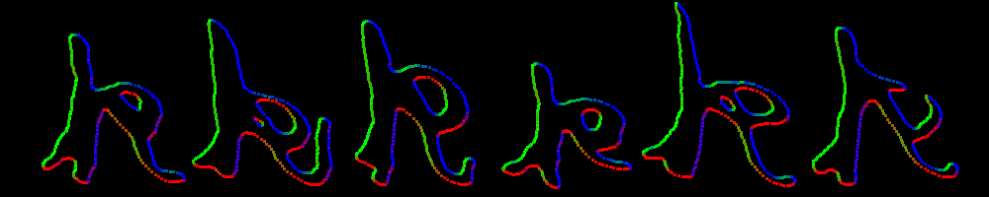
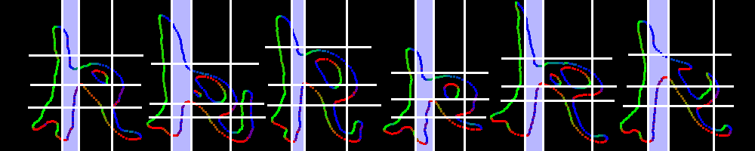
Goal: robustly cut letters into segments
Match multiple segments to detect letters
Easier than matching whole letter

Slide 17
ADVANTAGES:
The most important advantage of speech
over handwriting is the speed of data entry. This is because it is much easier to dictate the
machine than to write
DISADVANTAGES:
Has also drawbacks, such as it is noisy to hear
someone sitting next to us and talking to his machine. Moreover, anyone who wants to input
confidential data to his/her computer is not willing to do it in public places. Most importantly, it
is not possible to speak to a machine in a natural way due to constraints such as
out of vocabulary
wards, background noise, cross-talk, accented speech and so on.

Slide 18

So after all these stuff…
We have a brief Idea about Automatic Handwriting
Detection..
online and offline detection is available
Online procedure is easier then Offline procedure(difficult one)
Today’s business world need some computerized authentication for security purpose
the (AHD) fulfill their need.
Handwriting recognition is important for genealogy...
...but it is hard
Current methods don't work very well...
...and they don't operate much like the human brain

Slide 19


