Slide 1
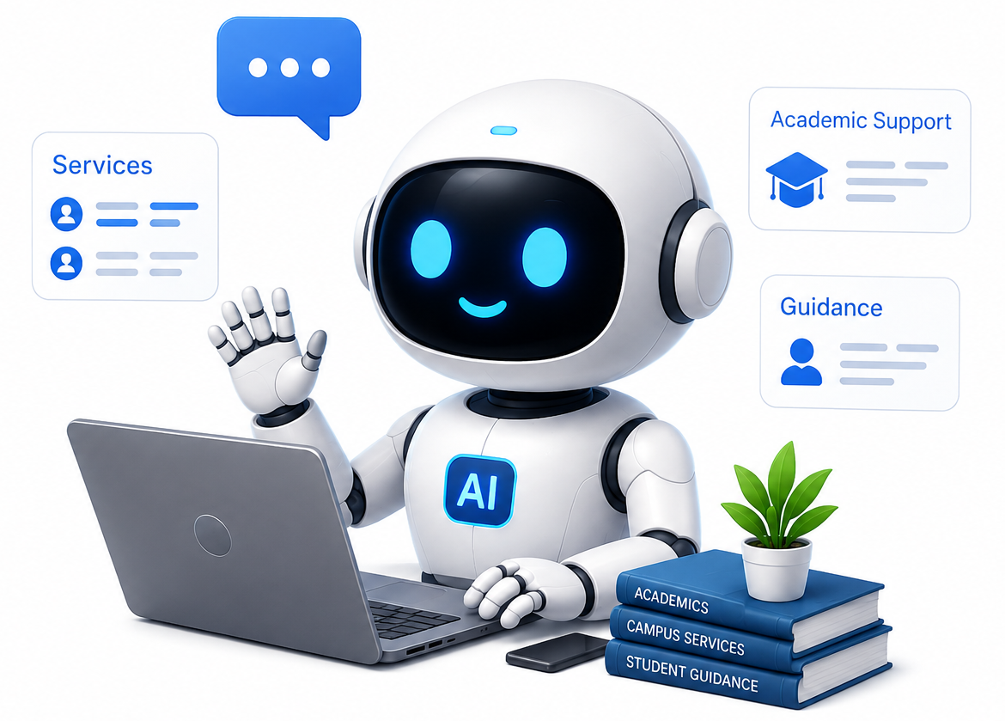
🎓 Advanced Visual Programming PROJECT
AI Campus
Assistant System

Slide 2

AI Campus Assistant System
Introduction
Problem Statement
Objectives
The AI Campus Assistant is a smart, web-based chatbot for university services built using ASP.NET Core 8.0 and AI technology. Three user roles: • Student • Teacher • Admin Available 24/7 — students no longer need to visit the office for admissions, fees, results, or timetables.
Students wait in long queues for basic information
Build an AI chatbot to answer campus queries
Admin offices closed nights & weekends
Reduce daily workload for admin staff
Provide 24/7 support for all students
Staff spend too much time on repeated questions
Implement easy-to-use portals for each role
Information scattered across many websites
Deliver real-time access to important data
No personalized support for individual students
Generate helpful analytics for the admin

Slide 3



System Modules
3 core user roles — each with dedicated features and access
Student Module
Teacher Module
Admin Module
Login & secure portal access
Login with faculty credentials
Full system management dashboard
View timetable & exam schedule
View assigned courses & classes
Add / manage students & faculty
Check fee status & pay online
Manage student attendance
Update fees, timetables, results
View results & CGPA
Upload course materials
View AI query analytics & reports
Chat with AI assistant 24/7
Post announcements for students
Manage announcements & notices
Receive exam & fee notifications
Check class timetables
Monitor system health & logs
AI Campus Assistant System | 2025

Slide 4






Key Features
24/7
3
AI
Available
User Roles
Powered
AI Chat Assistant
Secure Role-Based Login
NLP-powered bot answers fee, schedule, result questions in plain language instantly
Separate portals for Student, Teacher, Admin with JWT security
Real-Time Data Access
Smart Notifications
Live university database — fee status, results, timetables always updated
Automated alerts for fee deadlines, exams, results via email & in-app
Responsive Interface
Admin Analytics
Works on mobile, tablet, desktop — no app installation required
Real-time charts for query trends, user activity & system health
AI Campus Assistant System | 2025

Slide 5
Tools & Technologies
A
M
G
D
ASP.NET Core
MongoDB
Gemini AI
Docker
MVC Framework (.NET 8)
NoSQL Database v2.28
Google AI API (Pro)
Containerization
B
B
C
V
Bootstrap 5
BCrypt.Net
C# / Razor
Visual Studio
Frontend UI Framework
Password Hashing
Language & View Engine
Development IDE

Slide 6
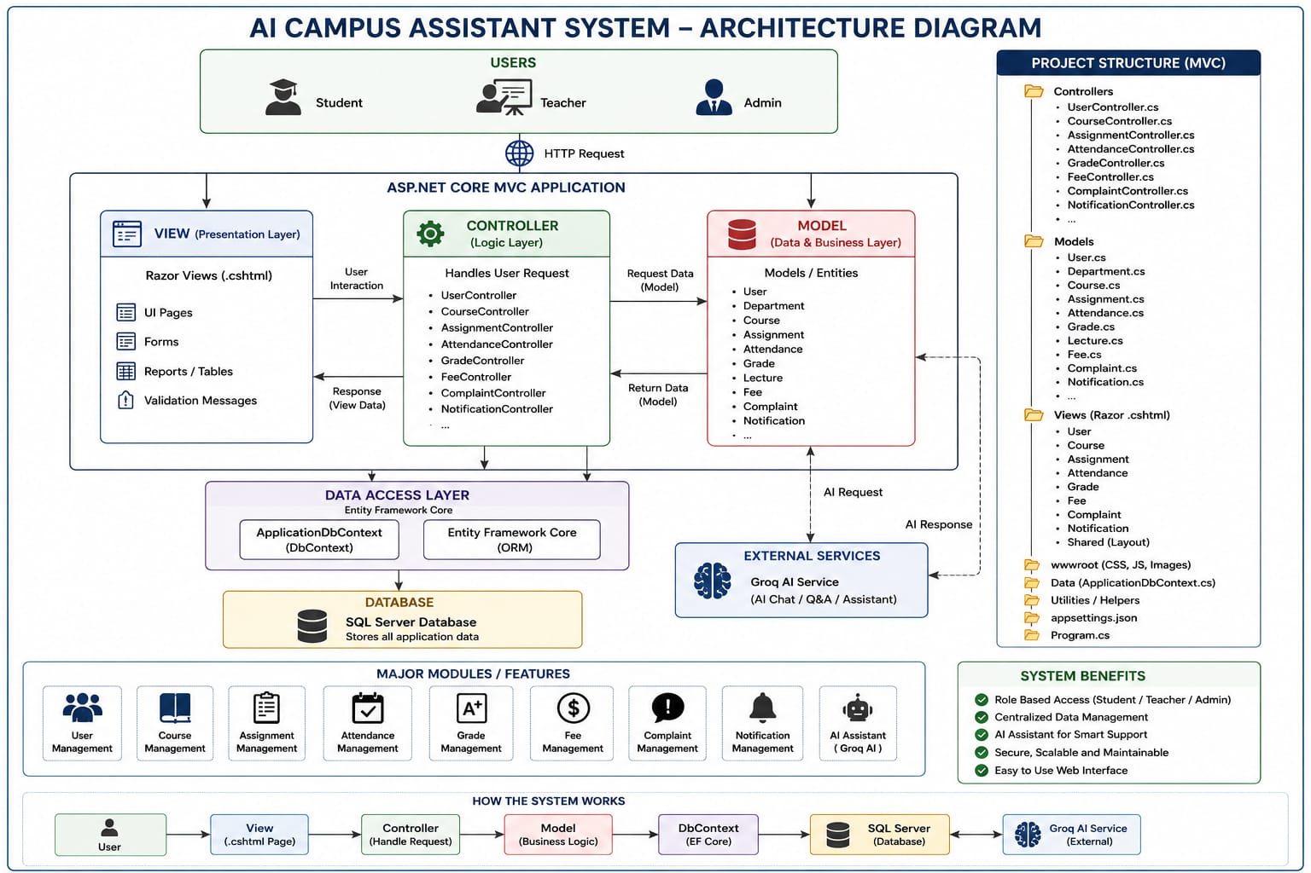
System Architecture
3. REDUCE PHASE

Slide 7
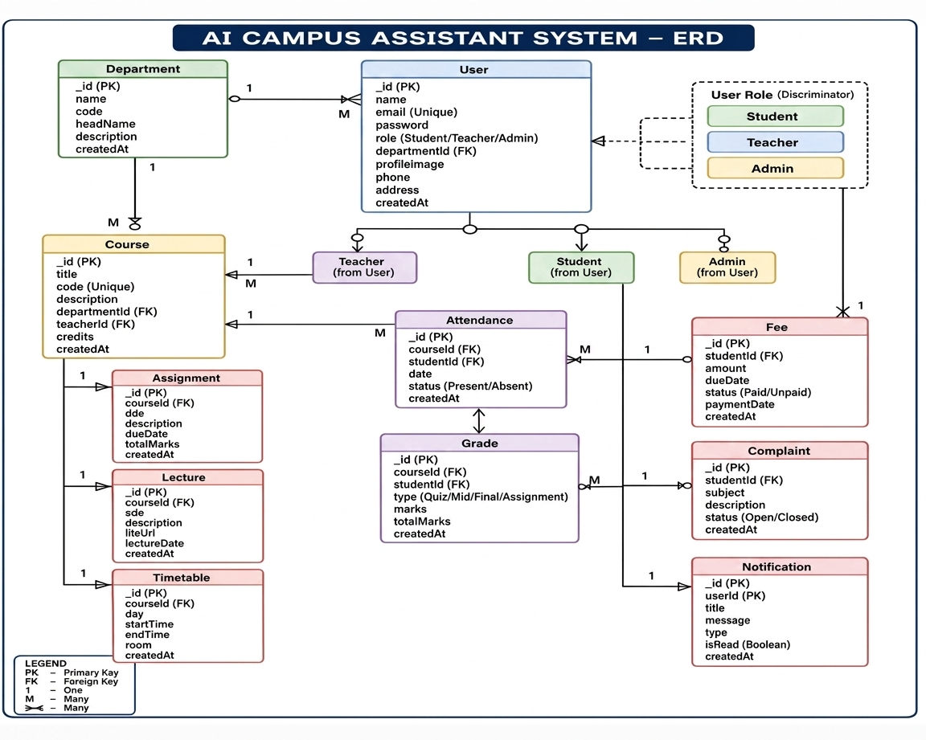
ERD
3. REDUCE PHASE

Slide 8


Advantages & Disadvantages
ADVANTAGES
DISADVANTAGES
Available 24/7 — help anytime, anywhere
Cannot handle emotional situations
Reduces staff workload significantly
Needs continuous AI retraining
Instant & consistent answers for all
High initial setup & cost
Handles thousands of users at once
Limited Urdu/local language support
Personalized data per student login
Requires stable internet connection
Lowers university operational cost
May give wrong answers sometimes
AI learns from repeated queries
Some students prefer human support
AI Campus Assistant System | 2025

Slide 9




Future Work
Multilingual Support
Dedicated Mobile App
Add full Urdu & regional language processing for wider accessibility across Pakistan
Launch Android & iOS apps with offline mode, push notifications, and biometric login
LMS Integration
Peer-to-Peer Chat
Connect with Moodle / Google Classroom to auto-sync assignments, grades, and deadlines
Allow students to connect with seniors and mentors through the same platform
Voice Assistant
Predictive Analytics
Enable voice-based queries so students can speak questions instead of typing them
AI predicts students at-risk of failing based on attendance and fee defaults
Future Work
AI Campus Assistant System | 2025

Slide 10
CONCLUSION
1
The modular design makes the system easy to maintain and scale for future needs.
2
Integrated AI provides instant academic and teaching support for all users
3
Strong security protocols ensure that all institutional data remains private and safe.
4
Routine tasks like grading and attendance are now fully automated and fast.

Slide 11
Any Questions?

Slide 12
THANK YOU!

