Slide 2
Comparative Evaluation of Grok-3 Model in Multi-Language Battles
Dataset: Multi-model battle evaluations
Focus: Measuring Grok-3’s strengths and weaknesses across languages and other models
Tools used: Python, Pandas, Matplotlib, Seaborn
Prepared by: Grok Team
This project aims to understand how Grok performs compared to other LLMs in real evaluation battles.

Slide 3
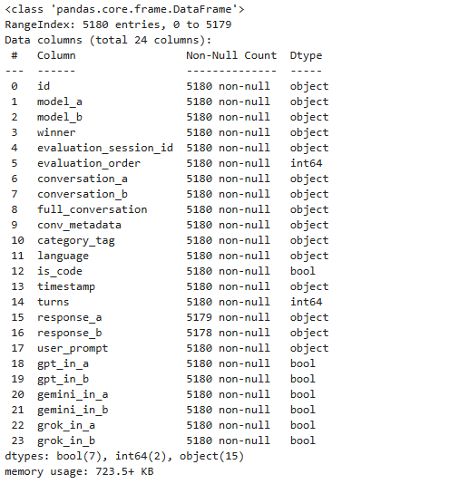
Dataset Structure and Features
24 columns representing model interactions and outcomes and 5180 record
Each row = one battle between two models
Key columns: model_a, model_b, winner, language, user_prompt, response_a, response_b
Additional flags: grok_in_a, grok_in_b, timestamp
The dataset captures both the content and outcome of
model-to-model evaluations.

Slide 4
How the Battles Were Evaluated
Each battle compares Grok-3 against another model (Gemini, Claude, GPT, etc.)
“winner” column defines which response was preferred
Analytical objectives:
Compute Grok’s win rate per opponent
Compute Grok’s win rate per language
Qualitatively inspect loss cases
Grok’s results were analyzed both quantitatively and qualitatively.

Slide 5
Classification of Battle Results (Winner column)
model_a → Model A wins
model_b → Model B wins
tie → Equal performance
both_bad → Both responses unsatisfactory
Only the first three were used for the main analysis
“Both bad” results (~10%) were excluded from win-rate analysis to avoid bias.

Slide 6
Global Distribution of Grok Battles
Total battles analyzed: ≈ 5180
Wins: 1963
Losses: 1875
Ties: 829
Both bad: 517 (excluded)
Overall win rate ≈ 48 %
Conclusion:
Grok performs competitively but not dominantly across all opponents.

Slide 7
Grok Team: Feature Analysis & Win Patterns in Arena Matches
winner_name
grok-3-preview-02-24 1055
grok-4-0709 281
grok-3-mini-beta 22
grok-3-mini-high 8
Conclusion:
Grok-3-preview-02-24 is best classes .

Slide 8
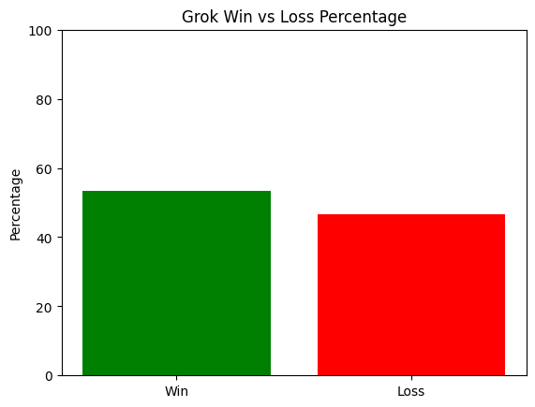
Grok Team: Win Rate Analysis & Feature Impact on Arena Success
Grok win percentage: 53.35%
Grok loss percentage: 46.65%

Slide 9
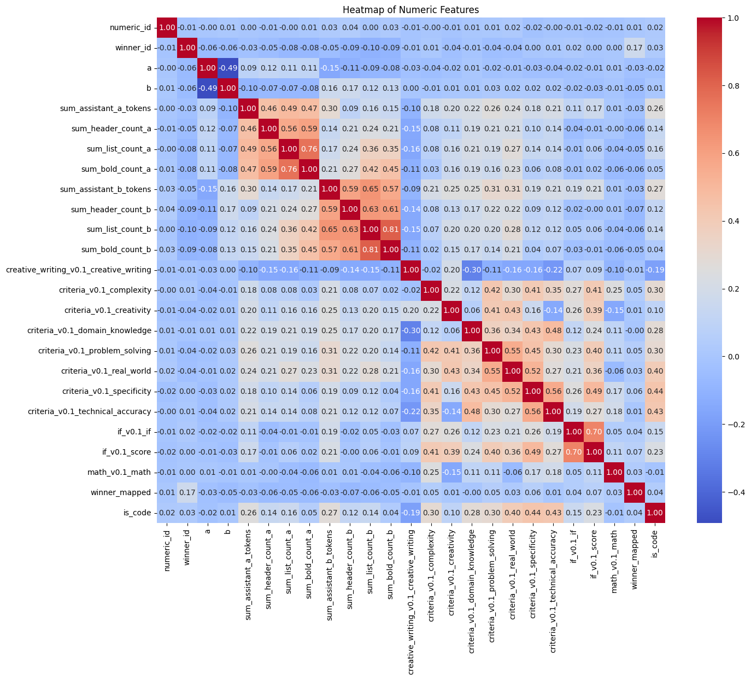
Grok Team: Feature Correlation Analysis & Win Drivers in LLM Arena
winner_mapped
is_code +0.23
tokens_a +0.17
problem_solving +0.16
specificity +0.14
bold_count_a +0.11
Conclusion:
Code usage has the strongest positive correlation with winning (+0.23)
Longer, structured responses (tokens, bold, lists) favor Grok
Problem-solving & specificity are critical success factors
High inter-feature correlation → risk of multicollinearity.

Slide 10
Grok Team: Feature Correlation Analysis & Win Drivers in LLM Arena
sum_assistant_a_tokens ↔ sum_header_count_a,+0.49
sum_list_count_a ↔ sum_bold_count_a,+0.76
sum_header_count_b ↔ sum_list_count_b,+0.63
criteria_v0.1_problem_solving ↔ criteria_v0.1_real_world,+0.55
.

Slide 11
Grok Team: What These Distributions Really Show
Formatting features (tokens, headers, lists, bold) are right-skewed and very similar across all winners → they barely help explain who wins.
Task-type flags (creative writing, problem solving, real-world, technical, IF, math, code) are mostly binary and evenly spread across Grok / Other Model / Tie / Both Bad → they describe the task, not the winner.
“Both Bad” answers are a bit less structured, but overlap with others is large → only a weak signal of low quality.
Conclusion: these features are secondary context; real win/loss patterns must come from content/quality features or direct A–B comparisons, not just formatting or task type.

Slide 12
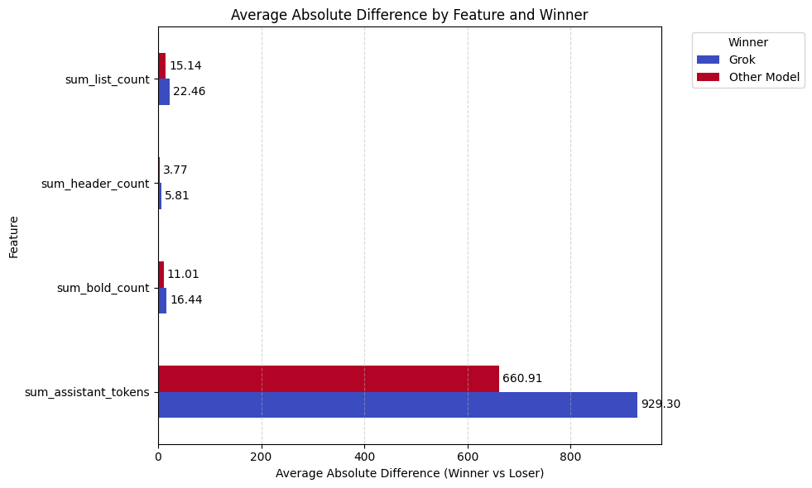
Grok Team: Winner–Loser Style Gap
Chart shows the average absolute gap in tokens, headers, lists, and bold between the winning and losing answer.
For every feature, this gap is larger when Grok wins than when Other Model wins.
So Grok’s wins tend to happen when the winner’s answer is much more different in length/format from the loser’s answer.

Slide 13
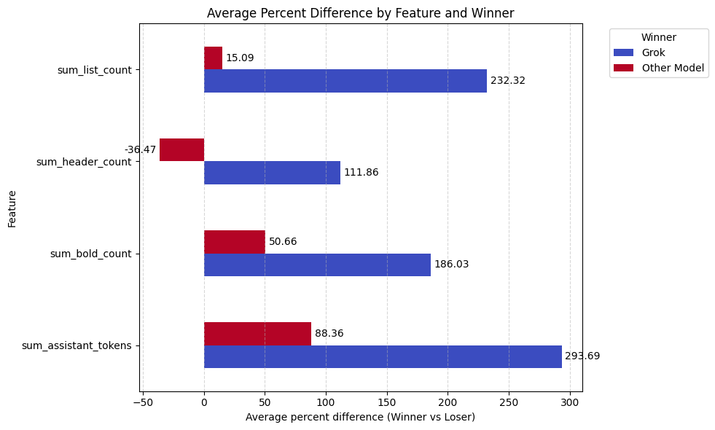
Grok Team:Grok Dominates Wins with Heavily Formatted, Lengthy Response
Tokens: Grok wins yield +294% more tokens vs. +88% for Other Model
.Bold: +186% (Grok) vs. +51% (Other).
Lists: +232% (Grok) vs. +15% (Other).
Headers: +112% (Grok) vs. -36% (Other)
Conclusion: Users strongly prefer Grok’s rich, structured, and verbose style; the Other Model wins more often with simpler, concise outputs.

Slide 14
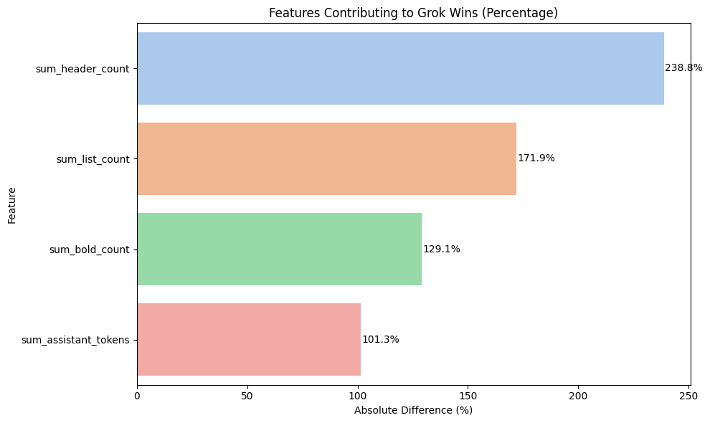
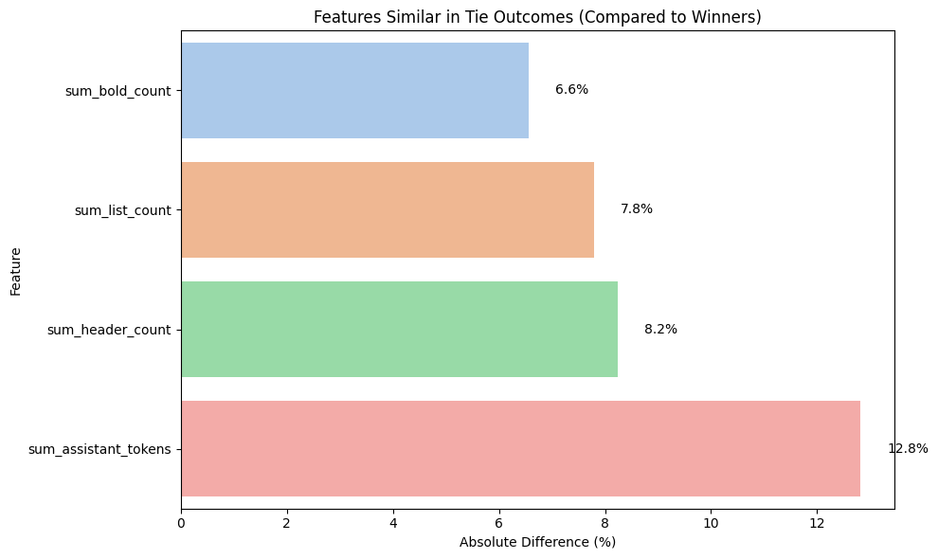
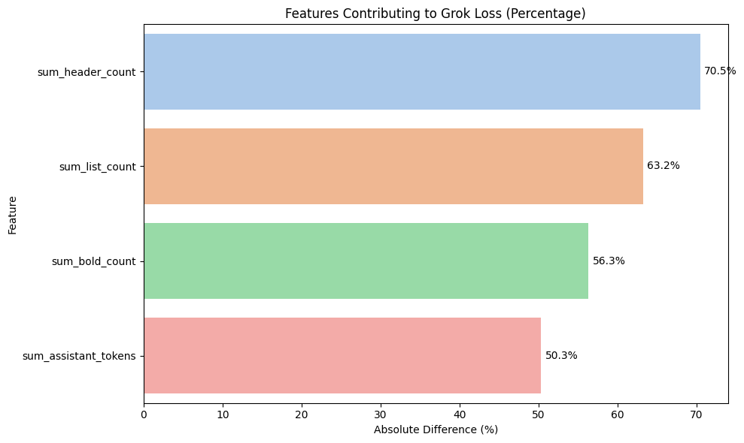
Grok Team:The Decisive Factor in Grok's Success and Failure
Headers drive 238% difference in Grok wins — the single most powerful predictor of victory.
In losses, even Grok uses 70% fewer headers than in its wins — formatting collapse causes defeat.
Ties occur when both models match winner-level formatting (differences <13%).
Response length matters least — it’s structure, not volume, that wins.
Conclusion:Grok wins by mastering structured, hierarchical formatting — especially headers. Without it, it loses. Ties are "double wins" in formatting.To beat Grok: Use more headers than Grok does in its best games

Slide 15
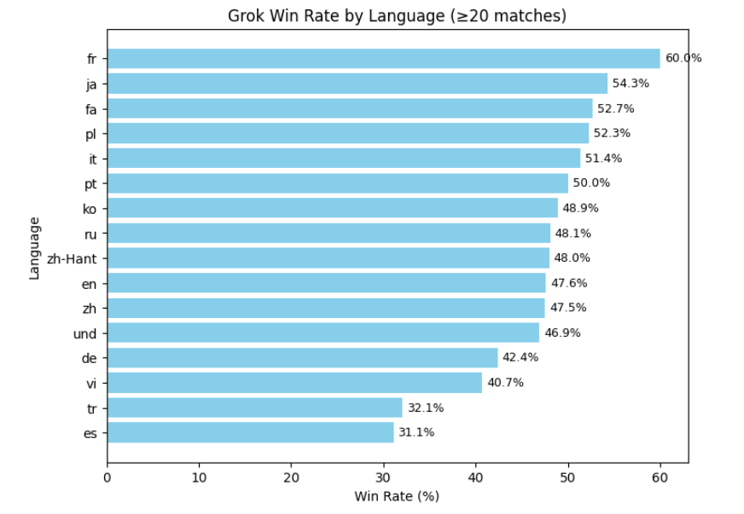
Grok Performance Across Languages
Highest win rates: French, Polish, Japanese
Moderate: Persian (≈ 52 %), Korean (≈ 49 %)
Weakest: Spanish, Turkish, Arabic
Only languages with ≥ 30 matches were considered
Conclusion:
Grok’s multilingual ability is strong overall
but uneven across regions.

Slide 16
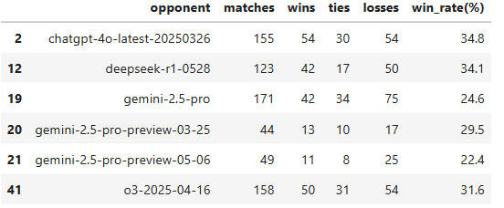
Models Where Grok Struggled
Focused subset: Opponents with Grok win rate < 35 %
Typical rivals: Claude-3-Sonnet, Gemini 2.5 Pro, O3-series
Analysis limited to battles Grok lost against these models
Next step: Inspect prompts and responses qualitatively
Conclusion:
These models consistently outperform Grok in reasoning and clarity tasks.

Slide 17
Quantitative Analysis — Persian Losses
Metric | Grok | Opponent | Observation
Avg. response length | 2916 | 1845 | Grok answers are longer
Avg. line count | 39.9 | 33.2 | Grok is more verbose
List-style responses (%) | 72.7 % | 63.6 % | Both structured; Grok overuses lists
Avg. prompt length (chars) | 123 | — | Short prompts

Slide 18
Quantitative Analysis — English Losses
Metric | Grok | Opponent | Observation
Avg. Response Length | 5149 chars | 3273 chars | Grok’s replies are about 57 % longer → tendency toward verbosity
Avg. Line Count | 79.5 lines | 62.1 lines | Grok writes more paragraphs → less concise structure
List-Style Responses (%) | 84.8 % | 78.0 % | Both use lists, but Grok relies on enumeration more heavily
Avg. Prompt Length (chars) | 540.9 | — | English prompts are roughly 4× longer than Persian ones
Avg. Prompt Length (words) | 69.1 | — | Complex, multi-step instructions are common

Slide 19
Quantitative Analysis — English Losses
In English battles, Grok produces significantly longer and more structured answers than its opponents,
yet it still loses in overall evaluation.
The results indicate that Grok’s verbosity does not translate to higher quality — responses often include redundant reasoning or loosely connected facts.
Opponent models (Claude, Gemini, O-series) typically provide shorter, logically cohesive explanations that better follow the prompt’s intent.
The longer prompts suggest higher reasoning complexity, exposing Grok’s difficulty in maintaining coherence over extended instructions.
Conclusion:
Grok’s English responses are fluent and rich in detail but lose due to redundancy and limited reasoning precision.

Slide 20
Persian vs English — Comparative Summary
Feature | Persian | English | Interpretation
Response length | Longer | Shorter | Persian answers verbose
Structure (lists %) | 73 % | ~55 % | Persian more structured
Prompt length | Short | Long | English prompts more detailed
Reasoning accuracy | Lower | Higher | Better reasoning in English
Grok writes fluently in Persian but shows weaker reasoning control compared to English.

Slide 21
Summary of Insights
Grok’s global win rate ≈ 48 %
Performs well in structured factual queries
Weak in concise reasoning tasks
Persian outputs are verbose and less precise
English outputs are concise but still lose in reasoning depth
Conclusion:
Grok balances fluency and verbosity but needs reasoning-focused tuning.

