Slide 1


CMR TECHNICAL CAMPUS UGC (Autonomous) Kandlakoya, Medchal Road, Hyd-501401 Department of Computer Science and Engineering
Mini Project Review
PREDICTING ACCURACY OF PLAYERS IN THE CRICKET USING MACHINE LEARNING
BATCH NO-04
Project Guide:
Dr. D.T.V. Dharmajee Rao
Dean Academics & Professor of CSE
Project Coordinator:
Dr. J. Narasimha Rao
Associate Professor, CSE Department
Presented by:
217R1A05Q8 : Shaik Nazeer
217R1A05Q4 : Sakali Naresh
217R1A05P9 : Pinjarla Dheeraj

Slide 2
ABSTRACT
Predict cricket player performance using machine learning techniques
Analyzed historical player statistics: batting/bowling averages, strike rates, economy rates, and fielding stats
Employed various models: linear regression, decision trees, random forests, and support vector machines
Assessed performance using mean absolute error, mean squared error, and R-squared value.
Insights for coaches and selectors to enhance player selection and strategy methodology applicable to other sports

Slide 3
EXISTING SYSTEM
Traditional player evaluations rely on manual assessments and historical records, lacking precision and scalability
The interplay of batting, bowling, and fielding statistics complicates accurate player accuracy assessments through conventional means
Existing models often overlook intricate relationships between performance metrics and struggle to adapt to evolving game dynamics
Manual data analysis is time-consuming, error-prone, and lacks efficiency in processing large datasets
Growing interest in machine learning to enhance accuracy prediction, leveraging advanced algorithms for scalable and precise player assessments

Slide 4
Disadvantages of Existing System
Subjectivity
Limited Scalability
Lack of Adaptability
Limited Precision
Error-Prone Manual Processing

Slide 5
PROPOSED SYSTEM
Leverage machine learning for accurate prediction of player accuracy in cricket, addressing existing method limitations
Introduces objectivity in player assessment through data-driven analysis, reducing reliance on subjective evaluations
Analyzes multiple metrics: batting average, bowling average, strike rate, economy rate, and fielding stats for a holistic view
Automated data processing enables efficient evaluation of player accuracy across diverse datasets and numerous players
Facilitates timely decision-making for coaches and selectors through up-to-date insights into player performance

Slide 6
Advantages of Proposed System
1. Enhanced Accuracy
2. Objective Evaluation
3. Scalability
4. Adaptability to Game Dynamics
5. Comprehensive Performance Metrics

Slide 7
HARDWARE REQUIREMENTS
System : i3 processor or above
RAM : 4 GB
Hard Disk : 20 GB
SOFTWARE REQUIREMENTS
Operating System : Windows 7 or Above.
Coding Language : python.

Slide 8
Novelty Of Project
Advanced Machine Learning Techniques
Utilizes cutting-edge algorithms (e.g., random forests, support vector machines) for accurate player performance predictions.
Comprehensive Data Analysis
Integrates diverse player statistics (batting, bowling, fielding) to create a holistic performance model.
Feature Selection Methods
Employs innovative feature selection techniques to identify key performance indicators, enhancing model accuracy.
Objective Performance Metrics
Implements robust evaluation metrics (MAE, MSE, R-squared) for objective assessment of predictive models.
Cross-Sport Applicability
Provides a scalable methodology that can be adapted to other sports for similar performance prediction and analysis.

Slide 9
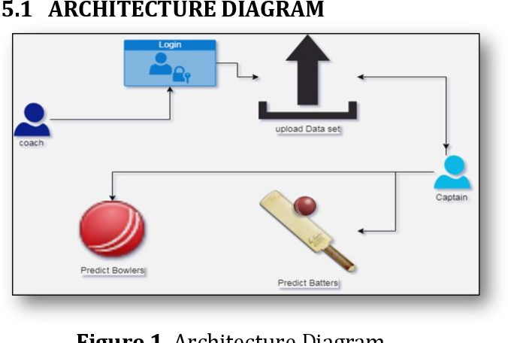
Architecture

Slide 10
Modules
Home
Coach/Captain login
Register Here(New User)

Slide 11
Home The Home module is the central hub for users, showcasing key features, updates, and links to other sections for easy navigation Coach/Captain Login This section allows coaches and team captains to securely log in and manage their teams, access scheduling tools, and track performance metrics Register Here (New User) This module enables new users to fill out a registration form, providing essential information to create an account, allowing them to log in and utilize platform features tailored to their roles.

Slide 12
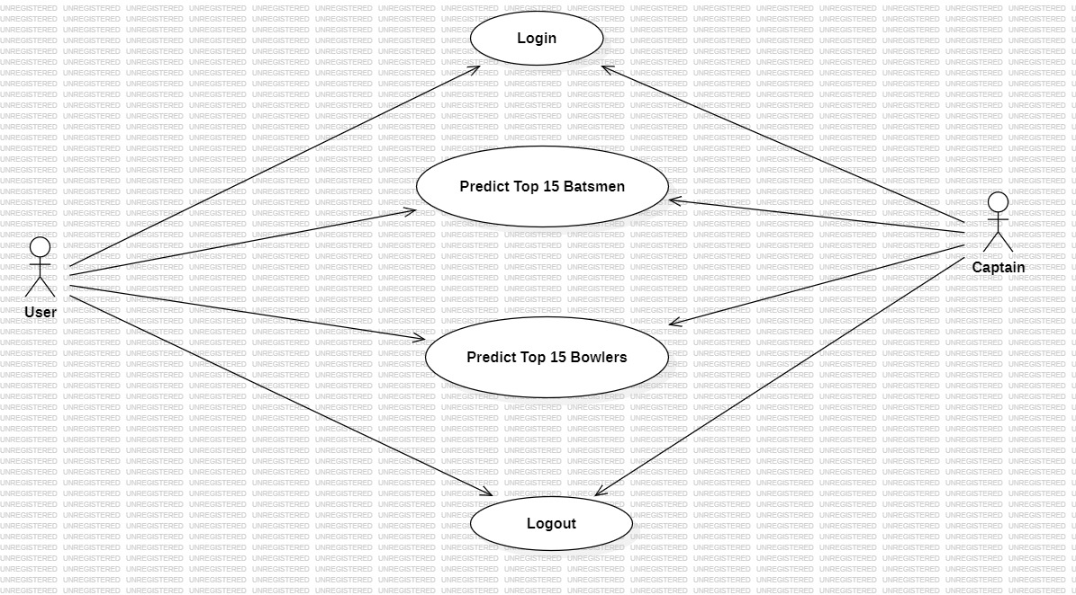
Use case diagram

Slide 13
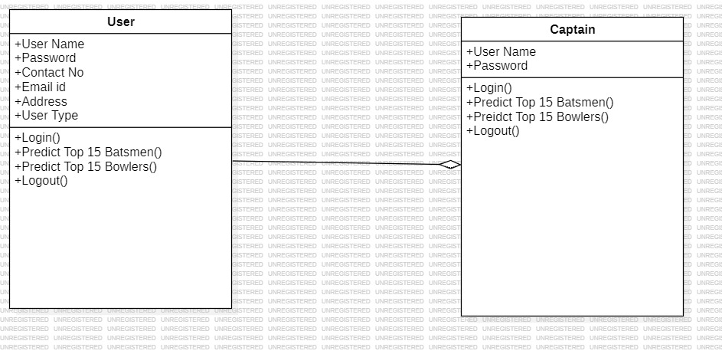
class diagram

Slide 14
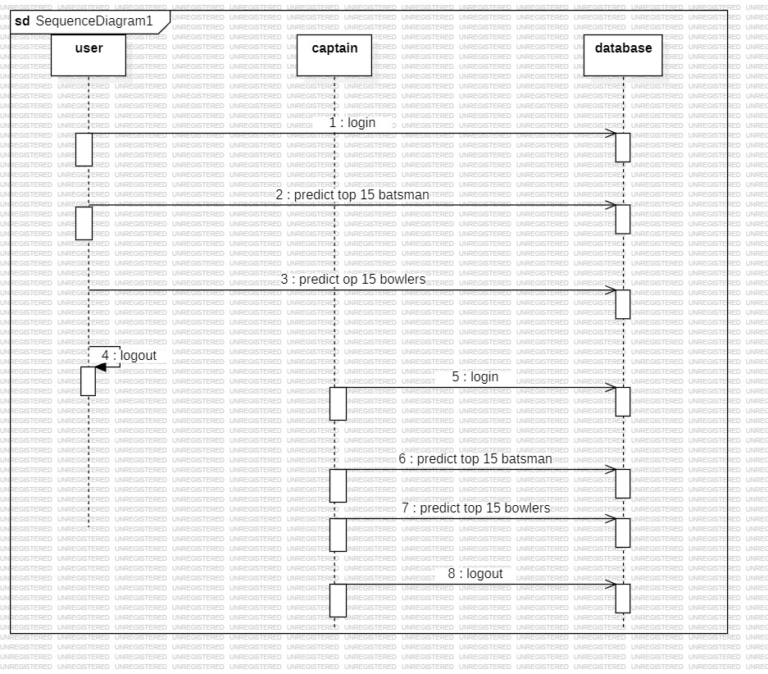
Sequence diagram

Slide 15
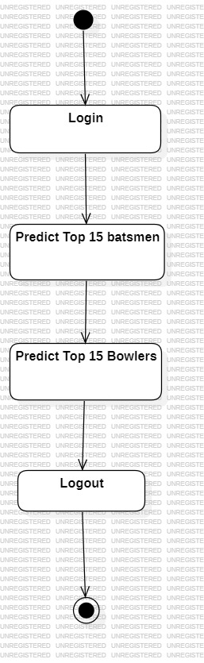
Activity diagram

Slide 16
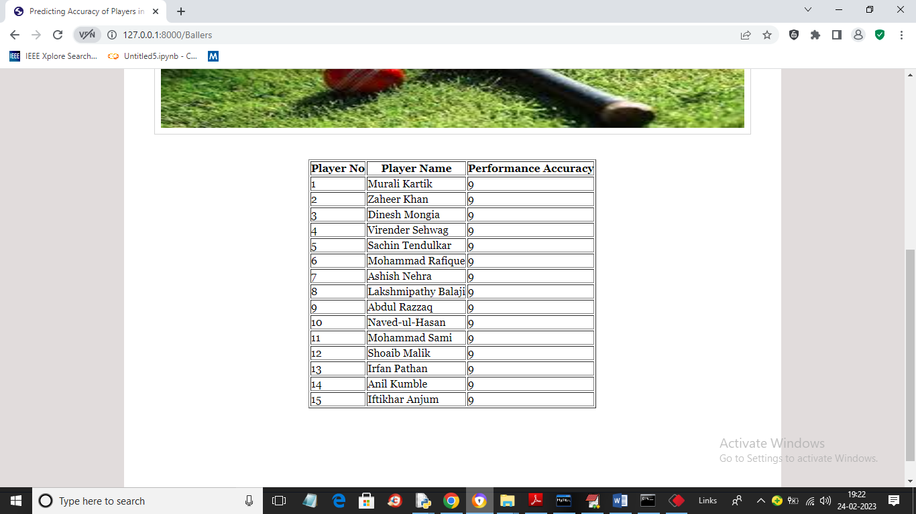
RESULT

Slide 17
References
Patel, M., & Raj, R. K. (2020). Predictive Analysis of Cricket Data Using Machine Learning Techniques. International Journal of Computer Sciences and Engineering, 8(11), 246-250.
Shrivastava, A., & Rathi, V. (2019). Cricket Analytics using Machine Learning. International Journal of Computer Applications, 975(15), 8887-8890.

Slide 18
THANK YOU

