Slide 1
Employee Data Analysis using Excel
STUDENT NAME: H.Najeera
REGISTER NO: 312207774
DEPARTMENT: COMMERCE
COLLEGE: THE QUAIDE MILLETH COLLEGE FOR MEN

Slide 2
PROJECT TITLE
Employee Performance Analysis using Excel

Slide 3


AGENDA
Problem Statement
Project Overview
End Users
Our Solution and Proposition
Dataset Description
Modelling Approach
Results and Discussion
Conclusion
3/21/2024 Annual Review

Slide 4

PROBLEM STATEMENT
The organization seeks to analyze employee performance data to identify trends, measure productivity, and evaluate overall employee effectiveness. The goal is to utilize Excel to consolidate, visualize, and interpret performance metrics such as sales numbers, project completion rates, attendance, and feedback scores.

Slide 5

PROJECT OVERVIEW
.
This project aims to analyze employee performance using Excel by consolidating data from various sources, calculating key performance indicators, and creating visualizations. The goal is to identify trends, support management decisions, and improve organizational productivity.

Slide 6

WHO ARE THE END USERS?
The end users of this analysis are company management, HR professionals, and team leaders. They will use the insights to make informed decisions on promotions, training, resource allocation, and overall workforce management.

Slide 7

OUR SOLUTION AND ITS VALUE PROPOSITION
Our solution is an Excel-based tool that automates employee performance analysis and generates actionable insights. It offers a streamlined approach to evaluating productivity and efficiency,and enhance overall organizational productivity.

Slide 8
Dataset Description
The dataset includes employee details (ID, department, role) and performance metrics such as sales figures, project completion rates, attendance records, and review scores, used to assess and compare individual and team performance.

Slide 9

THE "WOW" IN OUR SOLUTION
Our solution transforms complex performance data into clear, actionable insights with just a few clicks in Excel. It simplifies decision-making by providing instant, visually engaging analysis, enabling management to quickly identify top performers.
3/21/2024 Annual Review
9

Slide 10
MODELLING
The process involves using Excel formulas and pivot tables to calculate key performance indicators (KPIs) from raw data. These KPIs are then visualized through dynamic charts and dashboards, which automatically update with new data to offer real-time insights and trends.
10

Slide 11
RESULTS
The analysis reveals performance trends, identifies top performers, and pinpoints areas for improvement, aiding better decision-making and boosting organizational productivity.
11

Slide 12
conclusion
The Excel-based performance analysis tool effectively provides actionable insights into employee productivity and efficiency, supporting informed management decisions and enhancing overall organizational performance.

Slide 13
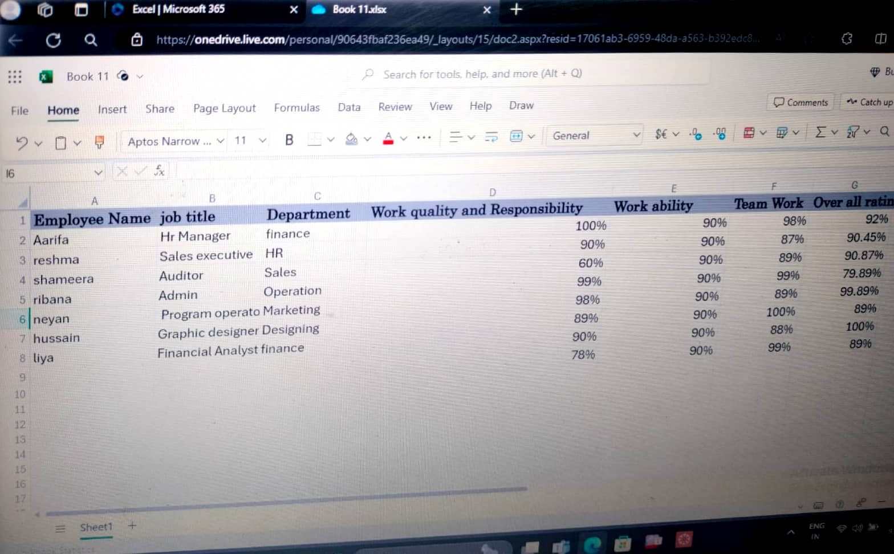

Slide 14
