Slide 1
Artificial Intelligence
A Modern Approach
Stuart Russell and Peter Norvig
By
Instructor
Ahmed M. Khedr

Slide 2
Today’s class
Course overview
Introduction
  What is AI?
  History of AI
  Intelligent Agents

Slide 3
Course Overview

Slide 4
Academic integrity
Instructor’s responsibilities:
  Be respectful
  Be fair
  Be available
  Tell the students what they need to know and how they will be graded
Students’ responsibilities:
  Be respectful
  Do not cheat, plagiarize, or lie, or help anyone else to do so
  Do not interfere with other students’ academic activities

Slide 5
Big Questions
Can machines think?
And if so, how?
And if not, why not?
And what does this say about human beings?

Slide 6
What is artificial intelligence?
There are no clear consensus on the definition of AI
Q. What is artificial intelligence?
A. It is the science and engineering of making intelligent machines, especially intelligent computer programs. It is related to the similar task of using computers to understand human intelligence, but AI does not have to confine itself to methods that are biologically observable.
Q. Yes, but what is intelligence?
A. Intelligence is the computational part of the ability to achieve goals in the world. Varying kinds and degrees of intelligence occur in people, many animals and some machines.

Slide 7
Other possible AI definitions
  AI is a collection of hard problems which can be solved by humans and other living things, but for which we don’t have good algorithms for solving.
  e. g., understanding spoken natural language, medical diagnosis, learning, self-adaptation, reasoning, chess playing, proving math theories, etc.
  System that Act like human (Turing test)
    Natural Language processing for communication
    Knowledge representation to store information
    Automated Reasoning to use stored information
    Machine Learning to adapt to new circumstances and to detect and extrapolate (to infer ) patterns

Slide 8
  Other possible AI definitions
  System that Think like human (human-like patterns of thinking steps)
    Through Introspection trying to catch our own thoughts as they go by.
    Through psychological experiments.
    Once we have a sufficiently precise theory of the mind it becomes possible to express the theory as a computer program.
  System that think rationally (logically, correctly)
  Aristotle was one of the first to attempt to codify “right Thinking” which is called Syllogisms
  Example Socrates is a man
  all men are mortal
  therefore Socrates is mortal
- Acts Rationally acting so as to achive one’s goal given
one’s beliefs.

Slide 9
What’s easy and what’s hard?
It’s been easier to mechanize many of the high level cognitive tasks we usually associate with “intelligence” in people
  e. g., symbolic integration, proving theorems, playing chess, some aspect of medical diagnosis, etc.
It’s been very hard to mechanize tasks that animals can do easily
  walking around without running into things
  catching prey and avoiding predators
  interpreting complex sensory information (visual, aural, …)
  modeling the internal states of other animals from their behavior
  working as a team (ants, bees)

Slide 10
History of AI
AI has roots in a number of scientific disciplines
  computer science and engineering (hardware and software)
  philosophy (rules of reasoning)
  mathematics (logic, algorithms, optimization)
  cognitive science and psychology (modeling high level human/animal thinking)
  neural science (model low level human/animal brain activity)
  Linguistics, economics, etc.
The birth of AI (1943 – 1956)
  Pitts and McCulloch (1943): simplified mathematical model of neurons (resting/firing states) can realize all propositional logic primitives (can compute all Turing computable functions)
  Allen Turing: Turing machine and Turing test (1950)
  Claude Shannon: information theory; possibility of chess playing computers

Slide 11
Early enthusiasm (1952 – 1969)
  1956 Dartmouth conference
  John McCarthy (Lisp);
  Marvin Minsky (first neural network machine);
  Alan Newell and Herbert Simon (GPS) General Problem Solver;
  Emphasize on intelligent general problem solving
  GSP (means-ends analysis);
  Lisp (AI programming language);
  Resolution by John Robinson (basis for automatic theorem proving);
  heuristic search (A*, AO*, game tree search)
Emphasis on knowledge (1966 – 1974)
  Domain specific knowledge is the key to overcome existing difficulties
  Knowledge representation (KR) paradigms
  Declarative vs. procedural representation

Slide 12
Knowledge-based systems (1969 – 1979)
  DENDRAL: the first knowledge intensive system (determining 3D structures of complex chemical compounds)
  MYCIN: first rule-based expert system (containing 450 rules for diagnosing blood infectious diseases)
  EMYCIN: an ES shell
  PROSPECTOR: first knowledge-based system that made significant profit (geological ES for mineral deposits)
AI became an industry (1980 – 1989)
  wide applications in various domains
  commercially available tools
Current trends (1990 – present)
  more realistic goals
  more practical (application oriented)
  distributed AI and intelligent software agents
  resurgence of neural networks and emergence of genetic algorithms

Slide 13
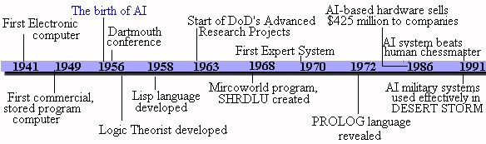
History

Slide 14
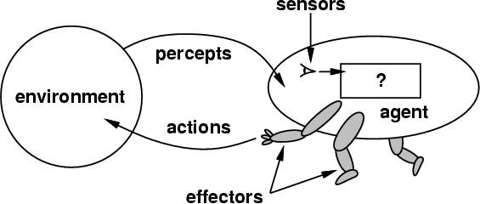
Chapter 2: Intelligent Agents
Definition: An Intelligent Agent perceives it environment via sensors and acts rationally upon that environment with its effectors.
Hence, an agent gets percepts one at a time, and maps this percept sequence to actions.
Properties
  Autonomous
  Interacts with other agents
  plus the environment
  Reactive to the environment
  Pro-active (goal- directed) future problems

Slide 15
What do you mean, sensors/percepts and effectors/actions?
Humans
  Sensors: Eyes (vision), ears (hearing), skin (touch), tongue (gustation), nose (olfaction).
  Percepts:
    At the lowest level – electrical signals from these sensors
    After preprocessing – objects in the visual field (location, textures, colors, …), auditory streams (pitch, loudness, direction), …
  Effectors: limbs, digits, eyes, tongue, …
  Actions: lift a finger, turn left, walk, run, carry an object, …
The Point: percepts and actions need to be carefully defined, possibly at different levels of abstraction

Slide 16
A more specific example:
Automated taxi driving system
Percepts: Video, sonar, speedometer, odometer, engine sensors, keyboard input, microphone, GPS, …
Actions: Steer, accelerate, brake, horn, speak/display, …
Goals: Maintain safety, reach destination, maximize profits (fuel, tire wear), obey laws, provide passenger comfort, …
Environment: U.S. urban streets, freeways, traffic, pedestrians, weather, customers, …
Different aspects of driving may require different types of agent programs!

Slide 17
Rationality
An ideal rational agent should, for each possible percept sequence, do whatever actions that will maximize its performance measure based on
  (1) the percept sequence, and
  (2) its built-in and acquired knowledge.
Hence it includes information gathering, not "rational ignorance."
Rationality => Need a performance measure to say how well a task has been achieved.

Slide 18
Autonomy
A system is autonomous to the extent that its own behavior is determined by its own experience and knowledge.
Therefore, a system is not autonomous if it is guided by its designer according to a priori decisions.
To survive agents must have:
  Enough built- in knowledge to survive.
  Ability to learn.

Slide 19
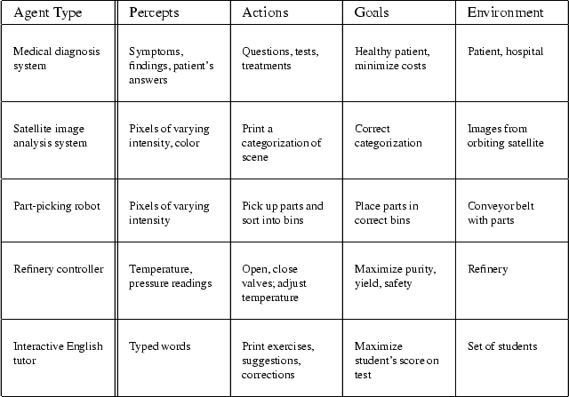
Examples of Agent Types and their Descriptions

Slide 20
Some Agent Types
Table-driven agents
  use a percept sequence/ action table in memory to find the next action. They are implemented by a (large) lookup table.
Simple reflex agents
  are based on condition-action rules and implemented with an appropriate production (rule-based) system. They are stateless devices which do not have memory of past world states.
Agents with memory
  have internal state which is used to keep track of past states of the world.
Agents with goals
  are agents which in addition to state information have a kind of goal information which describes desirable situations. Agents of this kind take future events into consideration.
Utility-based agents
  base their decision on classic axiomatic utility-theory in order to act rationally.

Slide 21
Simple Reflex Agent
Table lookup of percept- action pairs defining all possible condition- action rules necessary to interact in an environment
  Problems
  Too big to generate and to store (Chess has about 10^120 states, for example)
  Not adaptive to changes in the environment; requires entire table to be updated if changes occur
Use condition-action rules to summarize portions of the table
If Car-in-front –is –braking then initiate-braking

Slide 22
A Simple Reflex Agent: Schema
Agent
Sensors
What the world is like now
Environment
What action I should do now
Condition-action rules
Effectors

Slide 23
Reflex Agent with Internal State
Encode "internal state" of the world to remember the past as contained in earlier percepts
Needed because sensors do not usually give the entire state of the world at each input, so perception of the environment is captured over time. "State" used to encode different "world states" that generate the same immediate percept.
Requires ability to represent change in the world; one possibility is to represent just the latest state, but then can't reason about hypothetical courses of action

Slide 24
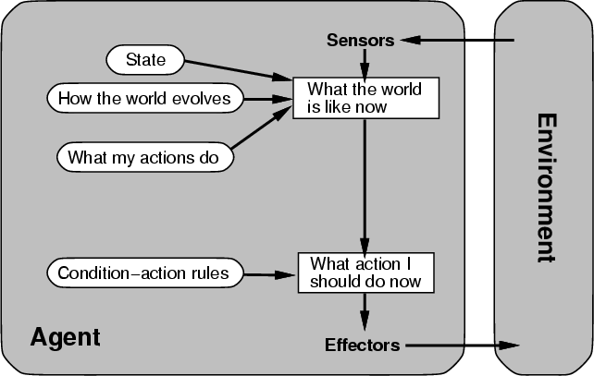
Agents that Keep Track of the World

Slide 25
Goal- Based Agent
• Choose actions so as to achieve a (given or computed) goal.
• A goal is a description of a desirable situation
• Keeping track of the current state is often not enough -- need to add goals to decide which situations are good
• May have to consider long sequences of possible actions before deciding if goal is achieved -- involves consideration of the future, “what will happen if I do...?”

Slide 26
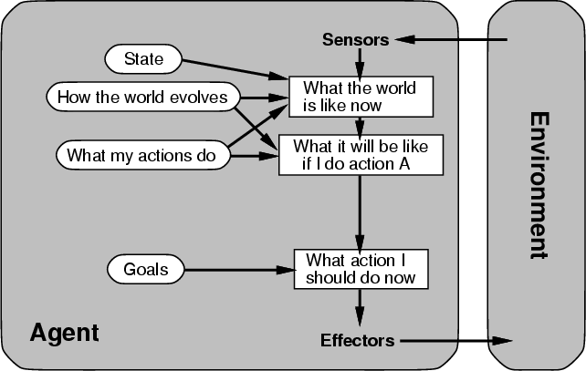
Agents with Explicit Goals

Slide 27
Utility- Based Agent
• When there are multiple possible alternatives, how to decide which one is best?
• A goal specifies a crude distinction between a happy and unhappy state, but often need a more general performance measure that describes "degree of happiness"
• Utility function U: States --> Reals indicating a measure of success or happiness when at a given state
• Allows decisions comparing choice between conflicting goals, and choice between likelihood of success and importance of goal (if achievement is uncertain)

Slide 28
A Complete Utility- Based Agent
Sensors
State
What the world is like now
How the world evolves
What it will be like if I do action A
What my actions do
Environment
How happy I will be in such a state
Utility
What action I should do now
Effectors

Slide 29
Properties of Environments
• Accessible/ Inaccessible.
  If an agent's sensors give it access to the complete state of the environment needed to choose an action, the environment is accessible.
  Such environments are convenient, since the agent is freed from the task of keeping track of the changes in the environment.
• Deterministic/ Non-deterministic.
  – An environment is deterministic if the next state of the environment is completely determined by the current state of the environment and the action of the agent.
  – In an accessible and deterministic environment the agent need not deal with uncertainty.
• Episodic/ Nonepisodic.
  An episodic environment means that subsequent episodes do not depend on what actions occurred in previous episodes.
  Such environments do not require the agent to plan ahead.

Slide 30
Properties of Environments
• Static/ Dynamic.
  – A static environment does not change while the agent is thinking.
  – In a static environment the agent need not worry about the passage of time while he is thinking, nor does he have to observe the world while he is thinking.
  – In static environments the time it takes to compute a good strategy does not matter.
• Discrete/ Continuous.
  – If the number of distinct percepts and actions is limited the environment is discrete, otherwise it is continuous.
•

Slide 31
Characteristics of environments
 | Accessible | Deterministic | Episodic | Static | Discrete
Solitaire
Backgammon
Taxi driving
Internet shopping
Medical diagnosis

Slide 32
Characteristics of environments
 | Accessible | Deterministic | Episodic | Static | Discrete
Solitaire | No | Yes | Yes | Yes | Yes
Backgammon
Taxi driving
Internet shopping
Medical diagnosis

Slide 33
Characteristics of environments
 | Accessible | Deterministic | Episodic | Static | Discrete
Solitaire | No | Yes | Yes | Yes | Yes
Backgammon | Yes | No | No | Yes | Yes
Taxi driving
Internet shopping
Medical diagnosis

Slide 34
Characteristics of environments
 | Accessible | Deterministic | Episodic | Static | Discrete
Solitaire | No | Yes | Yes | Yes | Yes
Backgammon | Yes | No | No | Yes | Yes
Taxi driving | No | No | No | No | No
Internet shopping
Medical diagnosis

Slide 35
Characteristics of environments
 | Accessible | Deterministic | Episodic | Static | Discrete
Solitaire | No | Yes | Yes | Yes | Yes
Backgammon | Yes | No | No | Yes | Yes
Taxi driving | No | No | No | No | No
Internet shopping | No | No | No | No | No
Medical diagnosis

Slide 36
Characteristics of environments
 | Accessible | Deterministic | Episodic | Static | Discrete
Solitaire | No | Yes | Yes | Yes | Yes
Backgammon | Yes | No | No | Yes | Yes
Taxi driving | No | No | No | No | No
Internet shopping | No | No | No | No | No
Medical diagnosis | No | No | No | No | No
→ Lots of real-world domains fall into the hardest case!

Slide 37
Summary
• An agent perceives and acts in an environment, has an architecture and is implemented by an agent program.
• An ideal agent always chooses the action which maximizes its expected performance, given percept sequence received so far.
• An autonomous agent uses its own experience rather than built- in knowledge of the environment by the designer.
• An agent program maps from percept to action & updates its internal state.
  – Reflex agents respond immediately to percpets.
  – Goal-based agents act in order to achieve their goal( s).
  – Utility-based agents maximize their own utility function.
• Representing knowledge is important for successful agent design.
• Some environments are more difficult for agents than others. The most challenging environments are inaccessible, non-deterministic, non-episodic, dynamic, and continuous.

