Slide 1
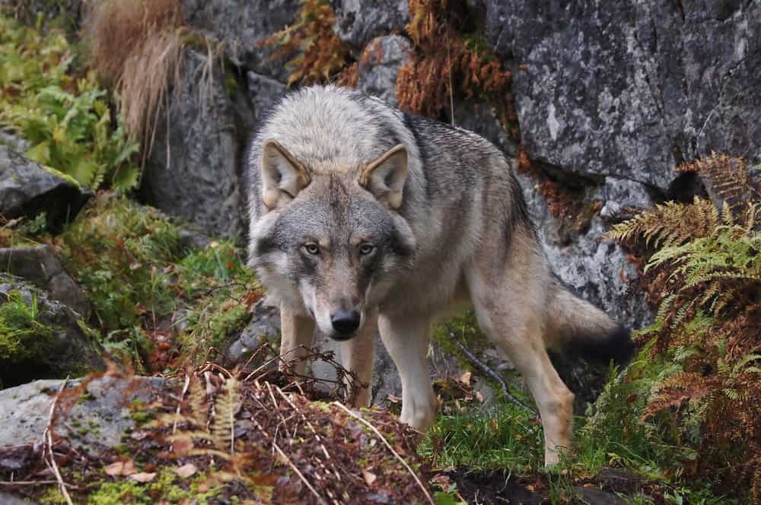
Once, there was a boy who became bored when he watched over the village sheep grazing on the hillside. To entertain himself, he sang out, “Wolf! Wolf! The wolf is chasing the sheep!”
When the villagers heard the cry, they came running up the hill to drive the wolf away. But, when they arrived, they saw no wolf. The boy was amused when seeing their angry faces.
“Don’t scream wolf, boy,” warned the villagers, “when there is no wolf!” They angrily went back down the hill.
Later, the shepherd boy cried out once again, “Wolf! Wolf! The wolf is chasing the sheep!” To his amusement, he looked on as the villagers came running up the hill to scare the wolf away.
Notes:
Once, there was a boy who became bored when he watched over the village sheep grazing on the hillside. To entertain himself, he sang out, “Wolf! Wolf! The wolf is chasing the sheep!”
When the villagers heard the cry, they came running up the hill to drive the wolf away. But, when they arrived, they saw no wolf. The boy was amused when seeing their angry faces.

Slide 2
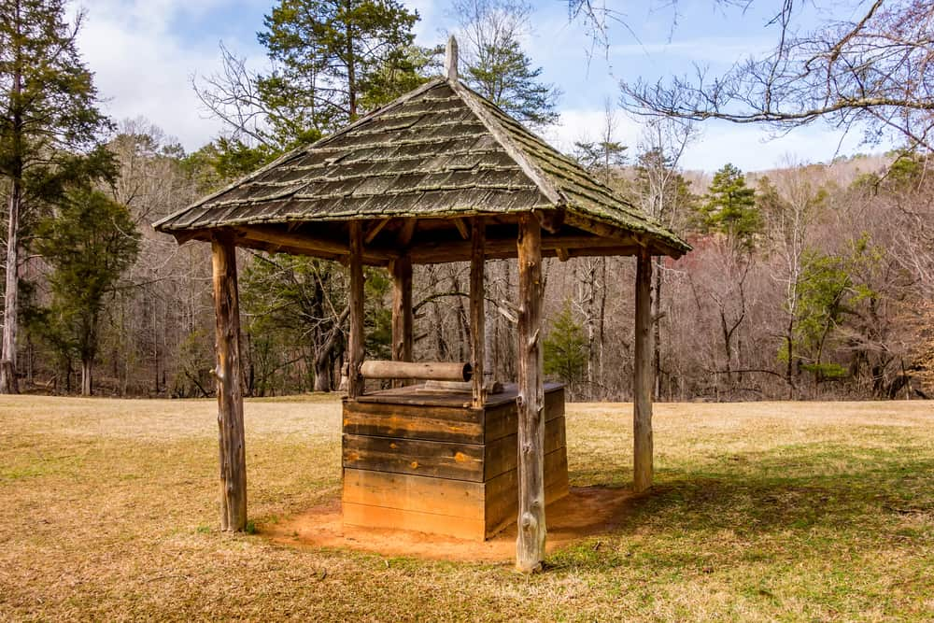
One day, a farmer was looking for a water source for his farm, when he bought a well from his neighbor. The neighbor, however, was cunning. The next day, as the farmer came to draw water from his well, the neighbor refused to let him take any water.
When the farmer asked why, the neighbor replied, “I sold you the well, not the water,” and walked away. Distraught, the farmer went to the emperor to ask for justice. He explained what had happened.
The emperor called on Birbal, one of his nine, and wisest, courtiers. Birbal proceeded to question the neighbor, “Why don’t you let the farmer take water from the well? You did sell the well to the farmer?”
The neighbor replied, “Birbal, I did sell the well to the farmer but not the water within it. He has no right to draw water from the well.”
Birbal said, “Look, since you sold the well, you have no right to keep the water in the farmer’s well. Either you pay rent to the farmer, or take it out immediately.” Realizing that his scheme had failed, the neighbor apologized and went home.
9. Elephant and Friends
Notes:
One day, a farmer was looking for a water source for his farm, when he bought a well from his neighbor. The neighbor, however, was cunning. The next day, as the farmer came to draw water from his well, the neighbor refused to let him take any water.

Slide 3
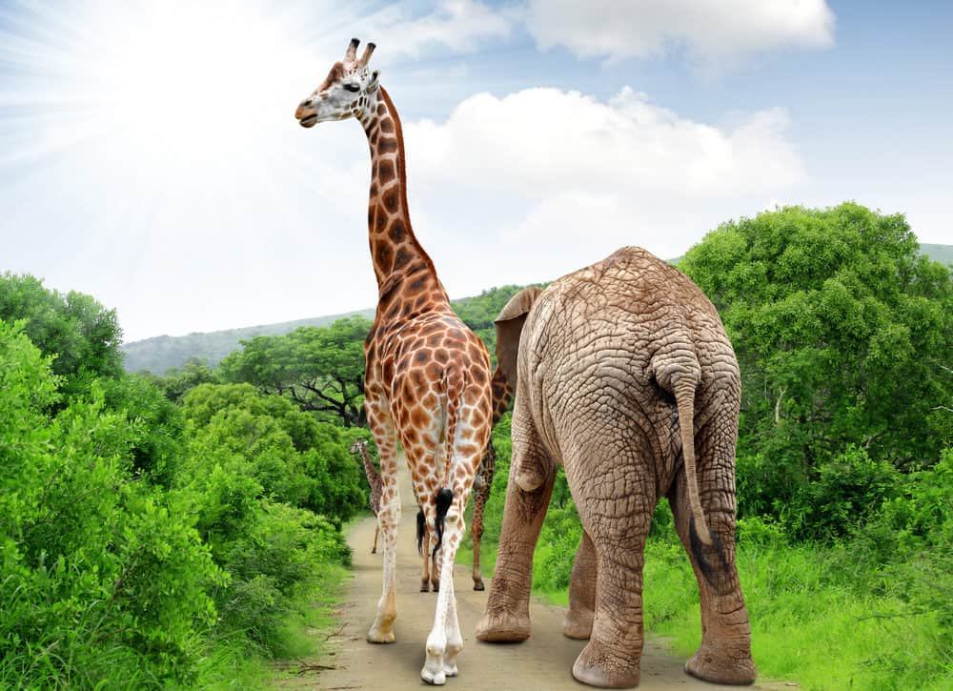
A lone elephant walked through the forest, looking for friends. She soon saw a monkey and proceeded to ask, ‘Can we be friends, monkey?’ The monkey quickly replied, ‘You are big and can’t swing on trees like I do, so I cannot be your friend.’ Defeated, the elephant continued to search when it stumbled across a rabbit. She proceeded to ask him, ‘Can we be friends, rabbit?’ The rabbit looked at the elephant and replied, “You are too big to fit inside my burrow. You cannot be my friend.” Then, the elephant continued until she met a frog. She asked, “Will you be my friend, frog?” The frog replied, “You are too big and heavy; you cannot jump like me. I am sorry, but you can’t be my friend.” The elephant continued to ask the animals she met on her way, but always received the same reply. The following day, the elephant saw all the forest animals run in fear. She stopped a bear to ask what was happening and was told the tiger was attacking all the small animals. The elephant wanted to save the other animals, so she went to the tiger and said, “Please, sir, leave m
Notes:
A giraffe and an elephant

Slide 4
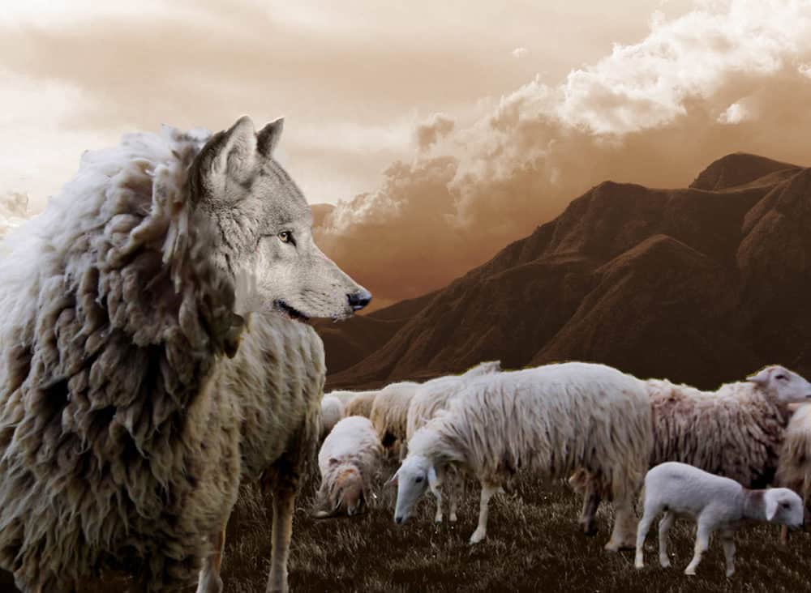
A wolf had gotten seriously hurt during a fight with a bear. He wasn’t able to move, and so, could not satisfy his thirst or hunger. One day, a sheep passed by his hiding place, and so the wolf decided to call out to him. “Please fetch me some water,” said the wolf. “That might give me some strength to get some solid food.” “Solid food!” the sheep said. “I suppose that means me. If I brought you something to drink, it would merely be to wash me down. Don’t speak to me about fetching a drink.”
Notes:
A wolf had gotten seriously hurt during a fight with a bear. He wasn’t able to move, and so, could not satisfy his thirst or hunger.
One day, a sheep passed by his hiding place, and so the wolf decided to call out to him. “Please fetch me some water,” said the wolf. “That might give me some strength to get some solid food.”
“Solid food!” the sheep said. “I suppose that means me. If I brought you something to drink, it would merely be to wash me down. Don’t speak to me about fetching a drink.”

Slide 5
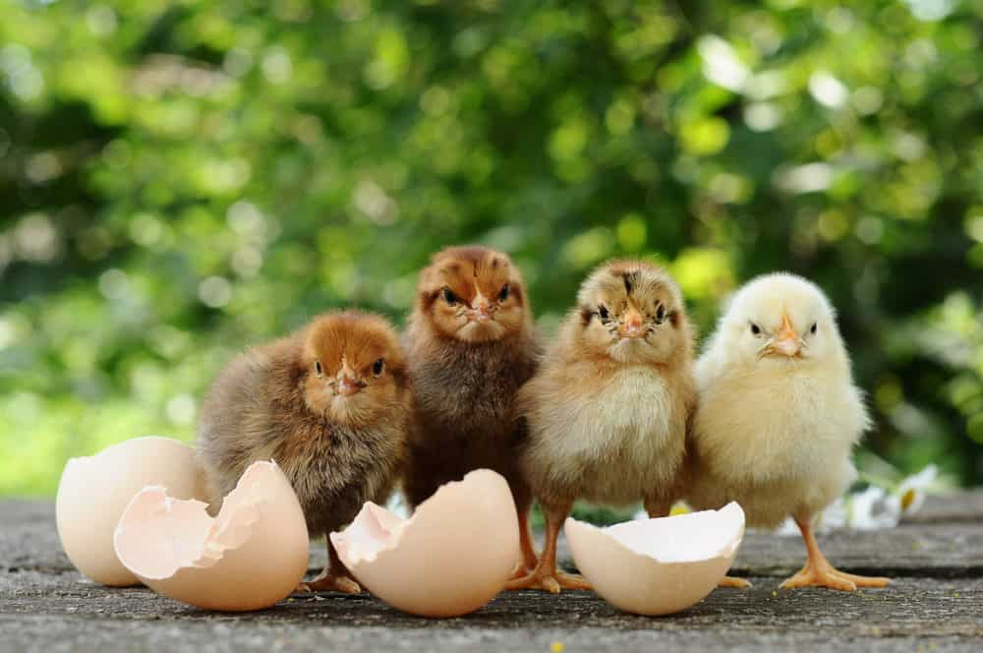
One day, Molly the milkmaid had filled her pails with milk. Her job was to milk the cows, and then bring the milk to the market to sell. Molly loved to think about what to spend her money on. As she filled the pails with milk and went to market, she again thought of all the things she wanted to buy. As she walked along the road, she thought of buying a cake and a basket full of fresh strawberries. A little further down the road, she spotted a chicken. She thought, “With the money I get from today, I’m going to buy a chicken of my own. That chicken will lay eggs, then I will be able to sell milk and eggs and get more money!”
Notes:
New born chiks

