Slide 1

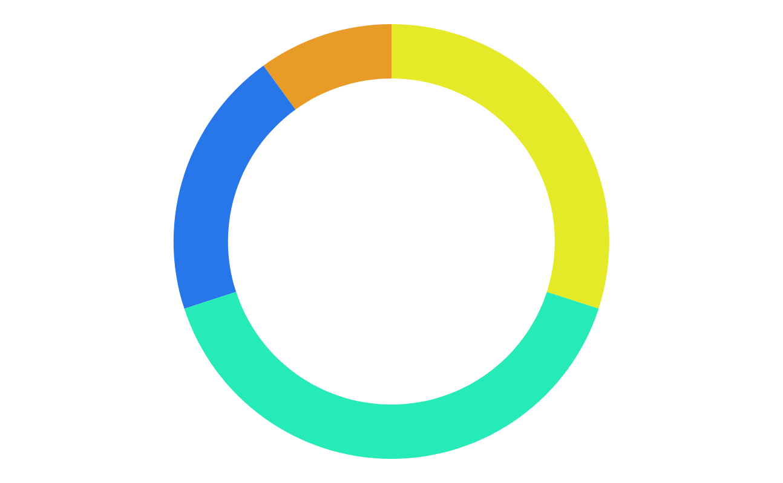
Github Issue Taxonomy
None
Features
Questions
Team Members Zaara Zabeen Arpa | ID:200042101 Sadnam Sakib Apurbo | ID:200042135 Nazia Karim Khan Oishee | ID:200042137
Bugs
Github Repository Link
Notes:
https://github.com/Nazia-Karim-Khan-Oishee/GitHub-Issue-Taxonomy

Slide 2
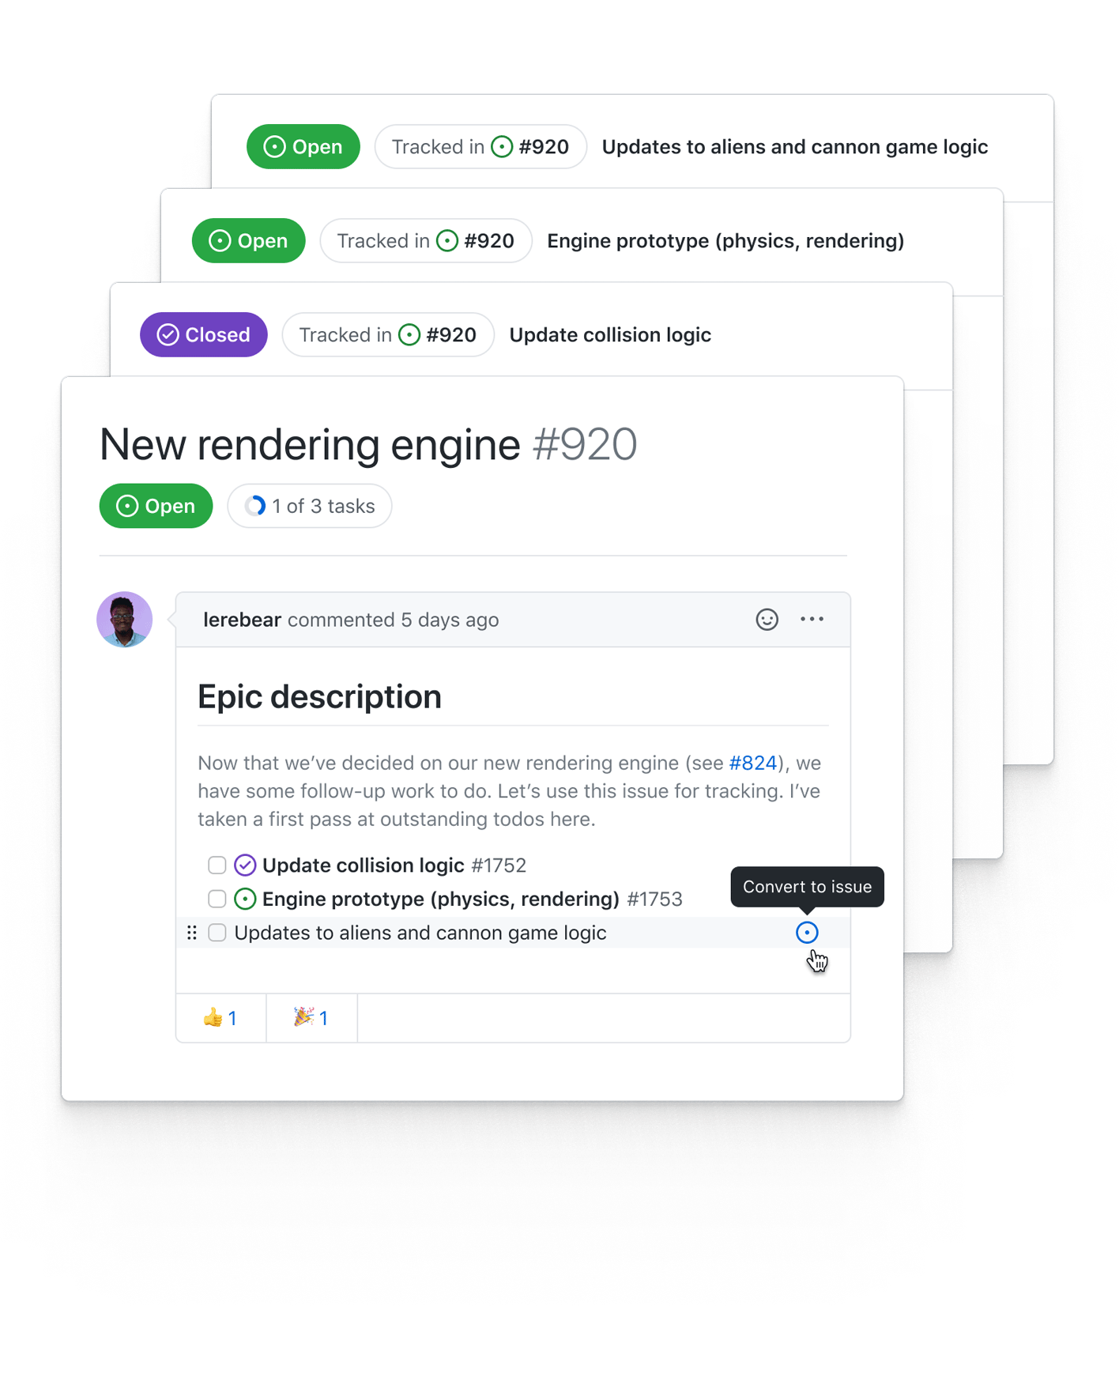
What are github issues?
01
Collaborative Issue Tracking
02
Organization and Categorization
03
Integration with Development Workflow

Slide 3
Problem Description
Manual Categorization
Reduced Efficiency
Project managers label the issues manually
Categories can be bug,feature,question etc
Time consuming
Prone to human error
Inefficient bug resolving

Slide 4
Solution
01
Automating issue categorization
02
Classification using neural network based models
03
Using natural language processing

Slide 5
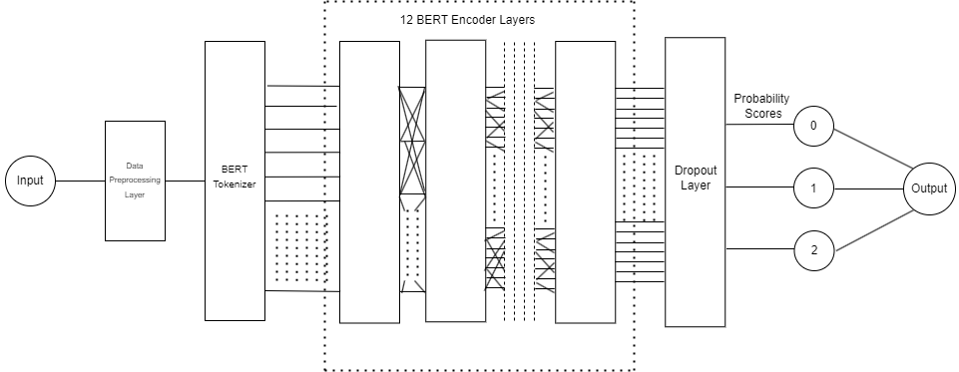
Neural Network Architecture

Slide 6
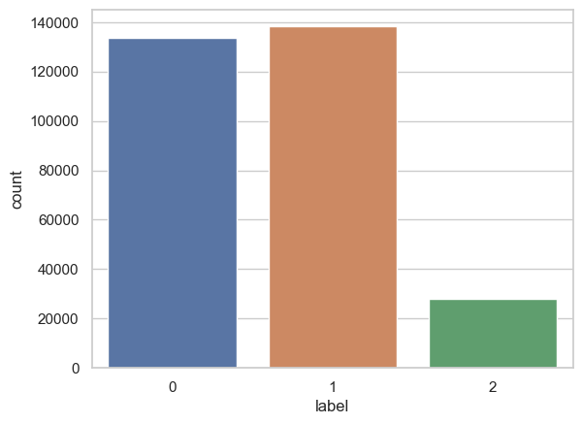
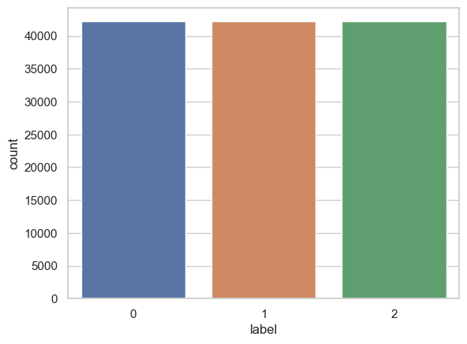
Implementation
Creating Dataframes & Concatenating Data
Downsampling Data

Slide 7
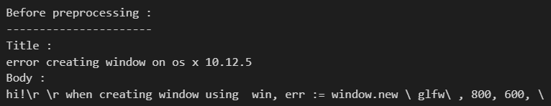
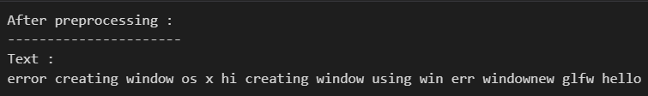
Data Pre-processing
Merge lines,Remove stopwords, punctuations,URL etc
Input Data

Slide 8
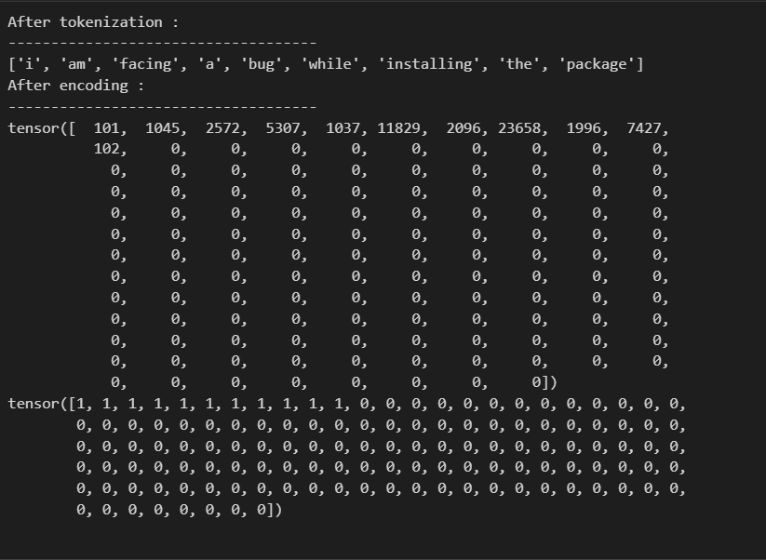
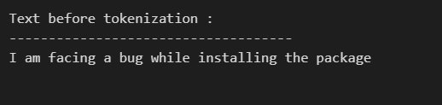
BERT Tokenizer
Text
Input ID
Attention Mask

Slide 9
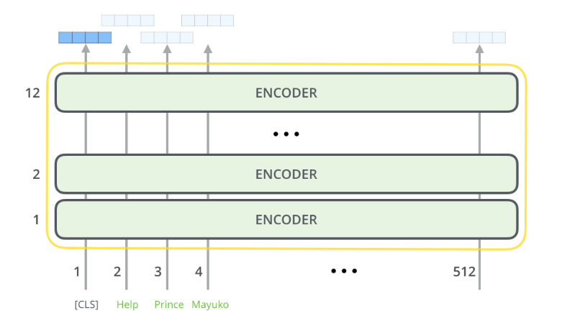
BERT Base Model
12 Encoder layer
768 feed-forward networks
Takes a sequence of words as input
Each layer passes results through a feed-forward network
hands it off to the next encoder.

Slide 10
Loss Function
Softmax Activation
Cross Entropy Loss Function
Backpropagation

Slide 11
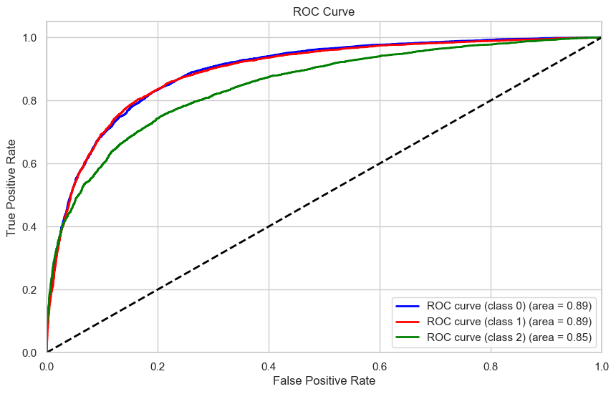
Model Performance Assessment
F1 Score
Class 0 : 75%
Class 1 : 74%
Class 2 : 70%
Accuracy: 73%

Slide 12
Thank You

