Slide 1

Implementing Swagger on New and Existing Projects

Slide 2
Steps
1. Install Swagger -
$ npm install swagger-jsdoc --save
$ npm install swagger-ui-express --save
2. Add the requirement to app.js:
var swaggerJSDoc = require('swagger-jsdoc');
const swaggerUi = require('swagger-ui-express');

Slide 3
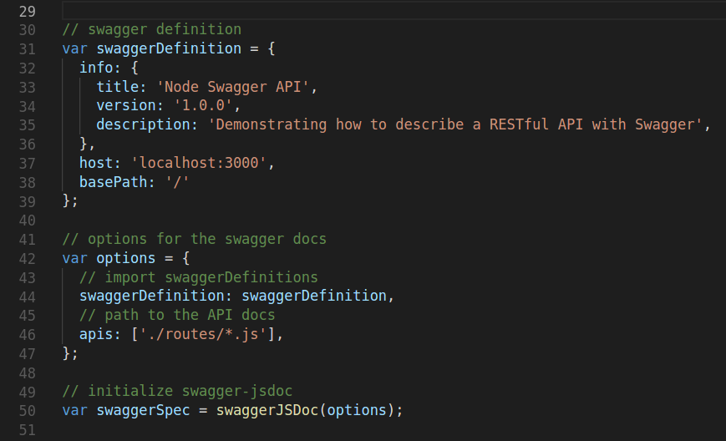
3. Then add the following code to app.js just below var app = express();
// swagger definition
var swaggerDefinition = {
info: {
title: 'Node Swagger API',
version: '1.0.0',
description: 'Demonstrating how to describe a RESTful API with Swagger',
},
host: 'localhost:3000',
basePath: '/',
};
// options for the swagger docs
var options = {
// import swaggerDefinitions
swaggerDefinition: swaggerDefinition,
// path to the API docs
apis: ['./routes/*.js'],
};
// initialize swagger-jsdoc
var swaggerSpec = swaggerJSDoc(options);

Slide 4
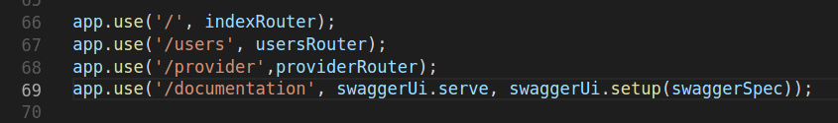
4. Add the route after the other routes to serve up the Swagger spec in app.js:
app.use('/documentation',
swaggerUi.serve,swaggerUi.setup(swaggerSpec));

Slide 5
Updating the Route Handlers
swagger-jsdoc uses JSDoc-style comments to generate the Swagger spec. So, add such comments, in YAML, to the route handlers that describe their functionality.
We use this to add definition to each and every APIs being used.
Add the comments in /routes/users.js just above the handler as follows:

Slide 6
Post - Register
/**
* @swagger
* /users/register:
* post:
* tags:
* - User
* description: Register User
* produces:
* - application/json
* parameters:
* - name: User
* in: body
* required: true
* schema:
* $ref:'#/definitions/Users'
* responses:
* 200:
* description: succes
*/
router.post('/register', userCont.addUser);

Slide 7
Definition of Users
Add the following code above the previous code: This is the defination of the schema used.
/** * @swagger
* definitions:
* Users:
* properties:
* firstname:
* type: string
* lastname:
* type: string
* username:
* type: string
* password:
* type: string
* address:
* type: string
* email:
* type: string
* phone:
* type: integer
*/

Slide 8
Post - Register
/**
* @swagger
* /users/register:
* post:
* tags:
* - User
* description: Register User
* produces:
* - application/json
* parameters:
* - name: User
* in: body
* required: true
* schema:
* $ref:'#/definitions/Users'
* responses:
* 200:
* description: succes
*/
router.post('/register', userCont.addUser);

Slide 9
Post - Login
/**
* @swagger
* /users/login:
* post:
* tags:
* - User
* description: Login User
* produces:
* - application/json
* parameters:
* - name: User
* in: body
* required: true
* schema:
* $ref:'#/definitions/Users' //Users conatins the schema of Registration form
* //in a collection or table of database
*responses:
* 200:
* description: succes
*/
router.post('/login', userCont.loginUser);

Slide 10
Get – User Details (Token Based Authentication)
/**
* @swagger
* /users/userprofile:
* get:
* security:
* - bearerAuth:[]
* tags:
* - User
* description: Return User details
* produces:
* - application/json
* parameters:
* - name: Authorization
* in: header
* required: true
* responses:
* 200:
* description: 'Will send `Authenticated`'
* 400:
* description: 'Need Permission'
*/
router.post('/userprofile', TokenVerfy, userCont.userprofile);

Slide 11
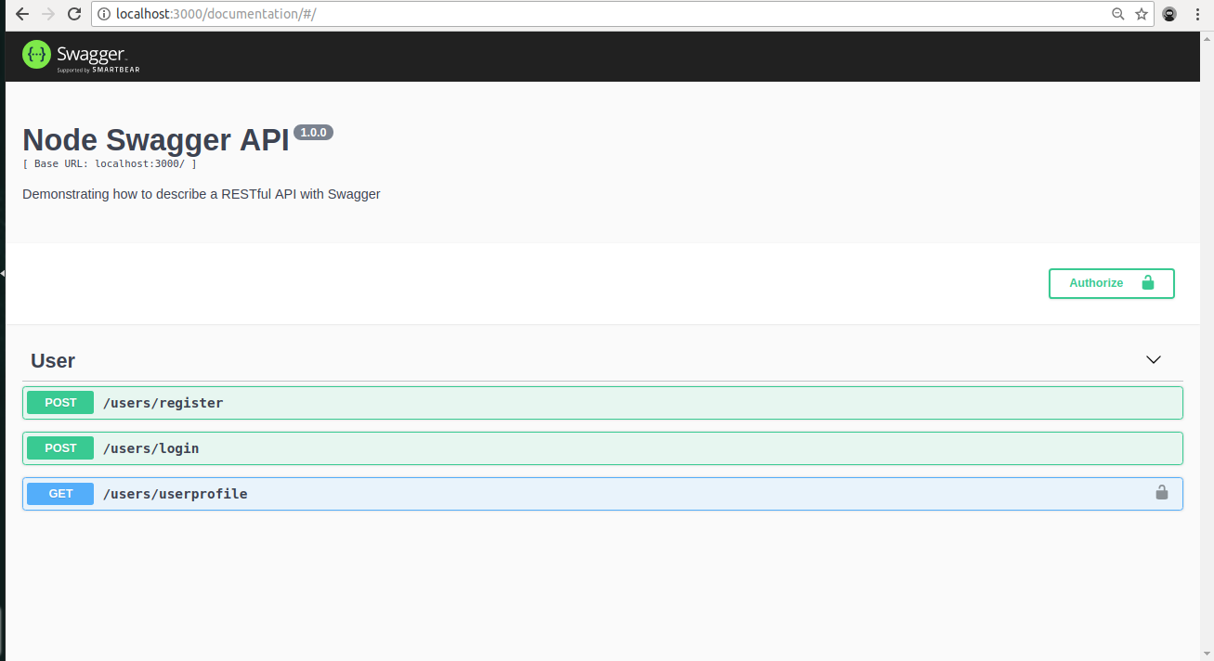
Finally, navigate to
http://localhost:3000/documentation/
in your browser to test out the API endpoints

