Slide 1
Emotion Classification in a Resource Constrained Language
Using Transformer-based Approach
(Authors - Avishek Das, Omar Sharif, Mohammed Moshiul Hoque and Iqbal H. Sarker)
Md Imdadul Haque Emon (18101049) Khondoker Nazia Iqbal (18101006)
Group no : 21

Slide 2
Intro & Problem Statement
Lack of Bengali Language Processing (BLP) tools
Scarcity of benchmark corpus
Complicated language structure
Limited resources

Slide 3
Aim & Proposal
Developing a Bengali emotion corpus (BEmoC)
Classifying text into six basic emotions
Implementing various ML, DNN and Transformer-based approach
Proposing a benchmark system to classify emotion in Bengali Text

Slide 4
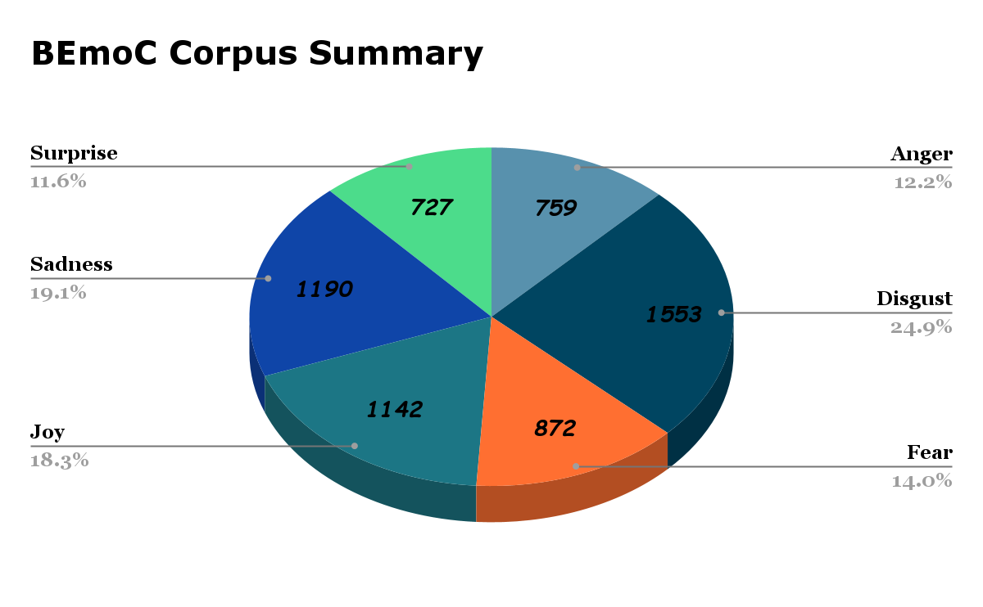
Data Collection & Preprocessing
Data Source:
Social Media & Blogs: 3889 texts
News portal: 270 texts
Offline sources: 2084 texts
Preprocessing:
Removed non-Bengali words and punctuation marks
Discarded less than 3 words data
Labeling each text by voting and correcting them by an expert

Slide 5
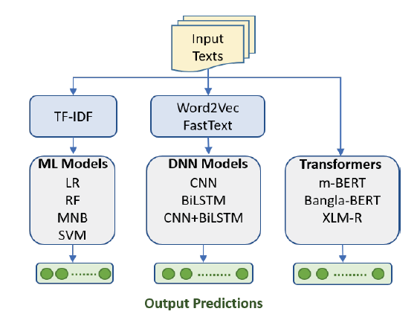
Methodology & Implemented Models

Slide 6
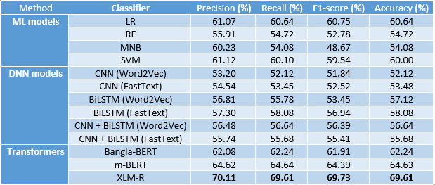
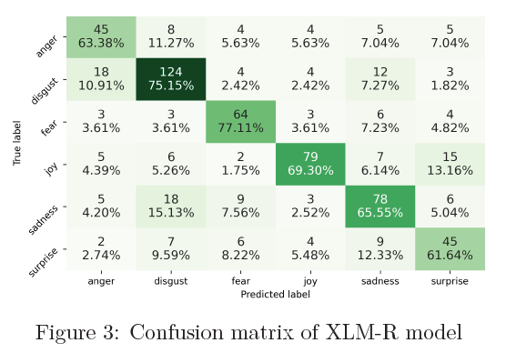
Performance & Error Analysis
Accuracy Scores of Different Approaches
Confusion matrix of XLM-R model

Slide 7
Conclusion
Successfully developed a corpus for Bengali text classification
Co-hen’s Kappa score for the corpus is 0.91
XLM-R achieved the highest f1-score of 69.61%
More emotions can be added in future to extend the corpus

