Slide 1
Homework-13:Retargeting & Audience Building
Prepared by Nazia

Slide 2
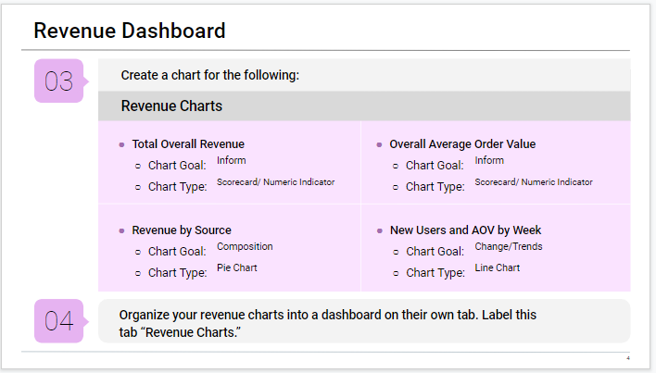
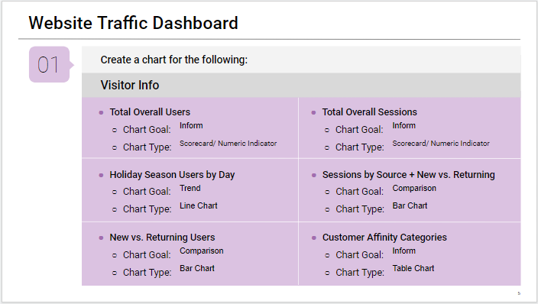
Activity: Revenue & Website Traffic Dashboard
Link: https://docs.google.com/spreadsheets/d/1C2No8pRf1aRhTEL_IHItdvWrRMmvD7XTN9Fj1sqOh8w/edit?usp=sharing

Slide 3
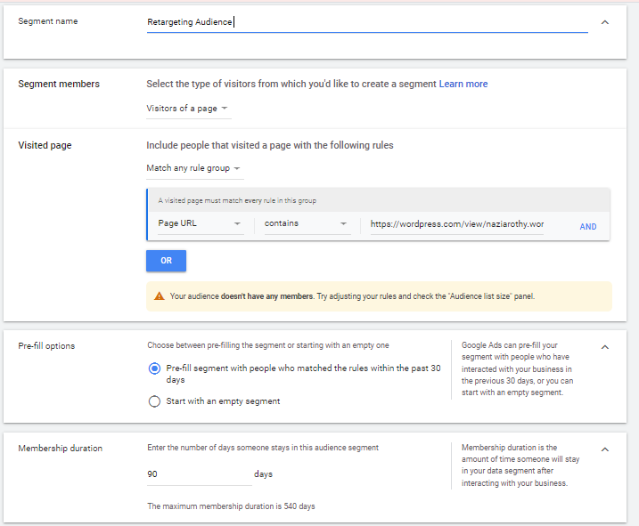
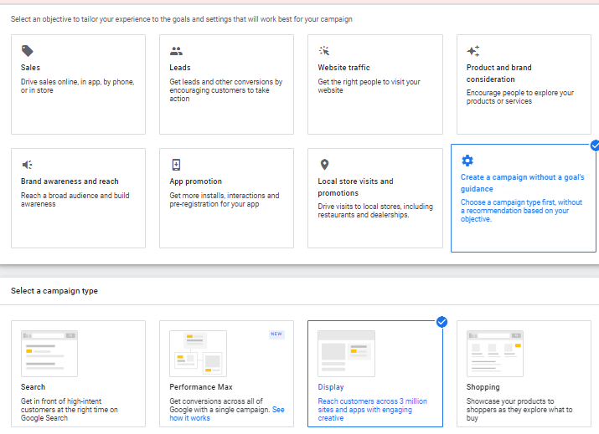
Relevant Screenshots Of Retargeting Audience For Prairie Adventure Tour-Google Ads

Slide 4
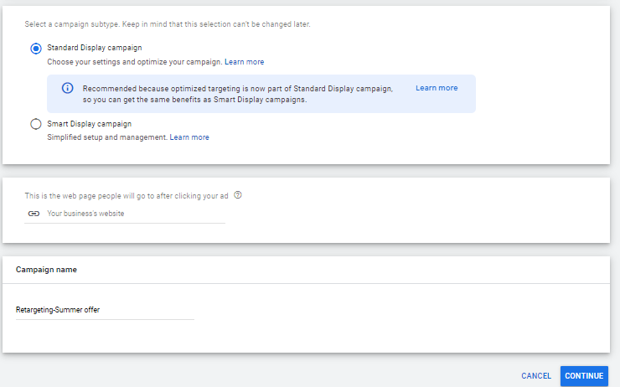
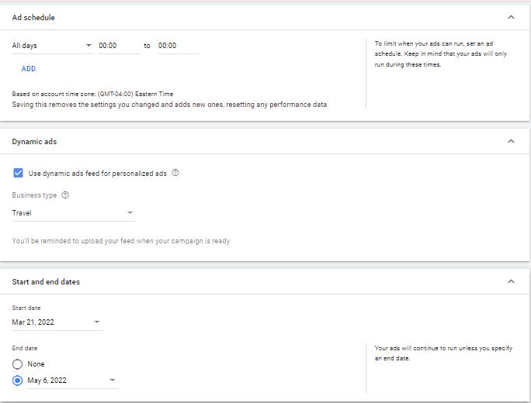
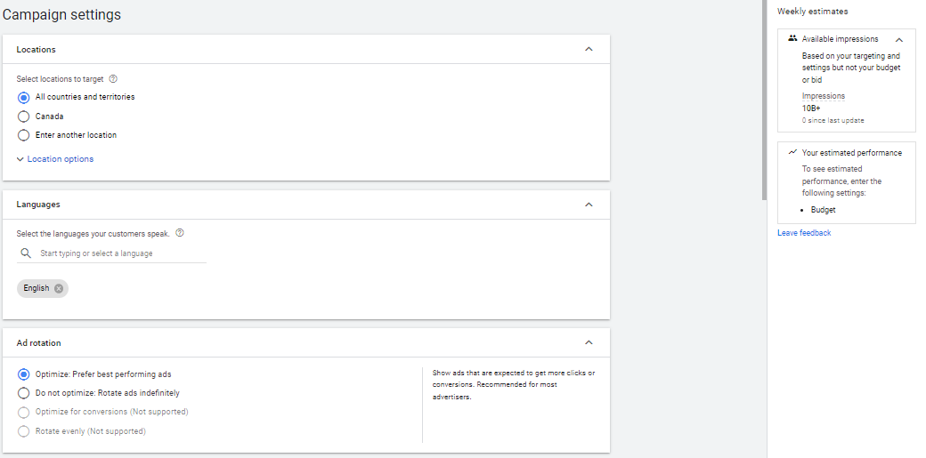
Retargeting Audience For Prairie Adventure Tour-Google Ads(Cont.)

Slide 5
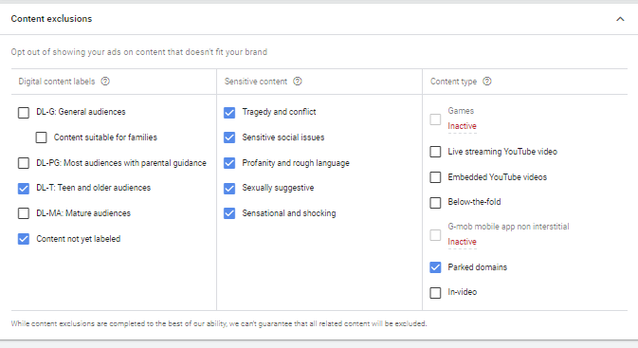
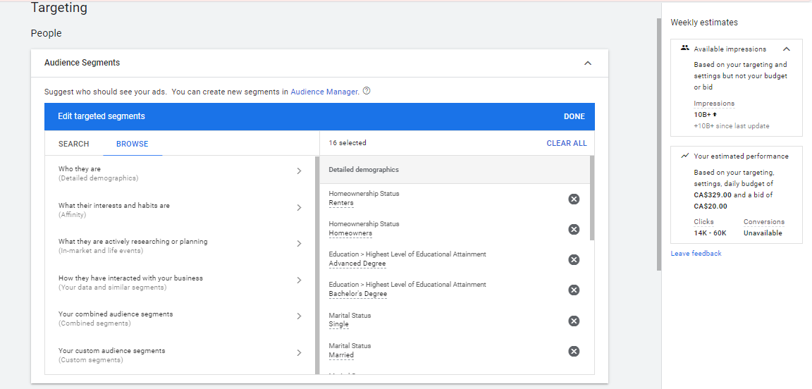
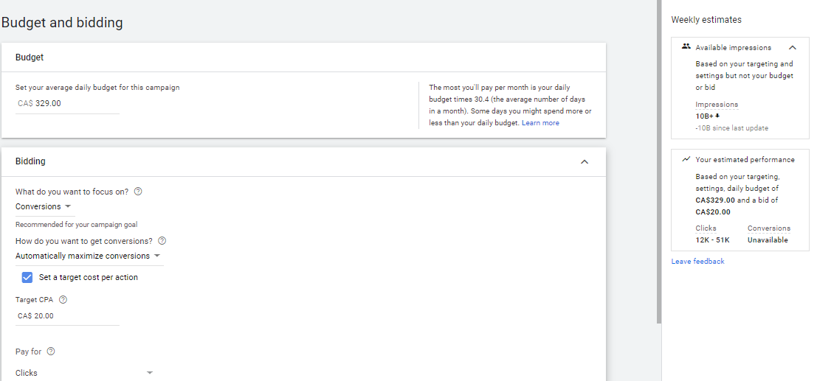
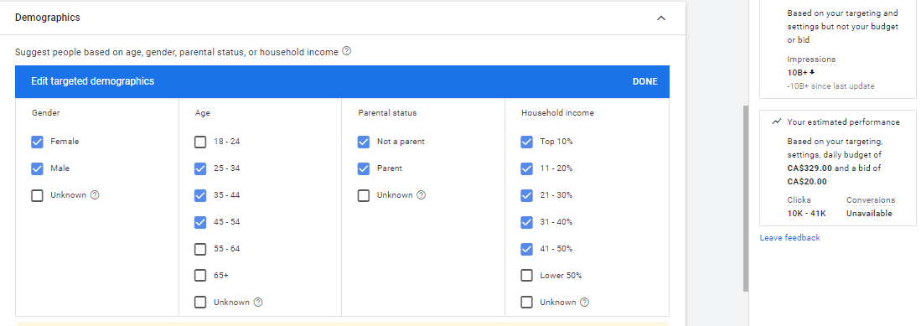
Retargeting Audience For Prairie Adventure Tour-Google Ads(Cont.)

Slide 6
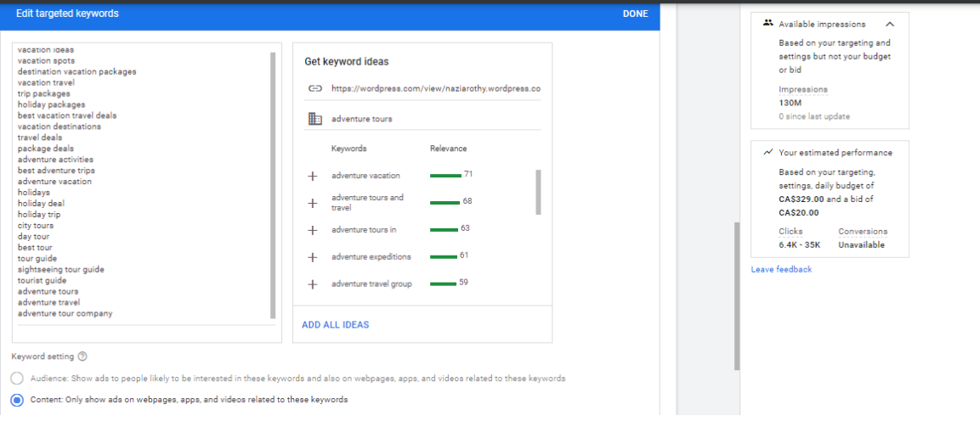
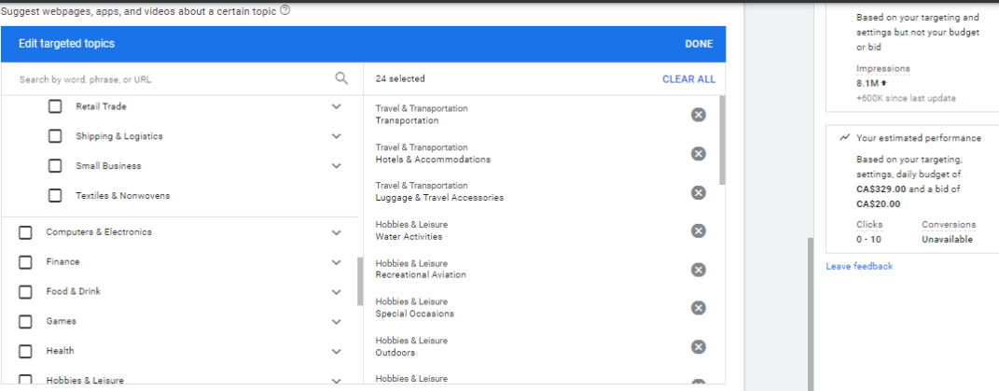
Retargeting Audience For Prairie Adventure Tour-Google Ads(Cont.)

Slide 7
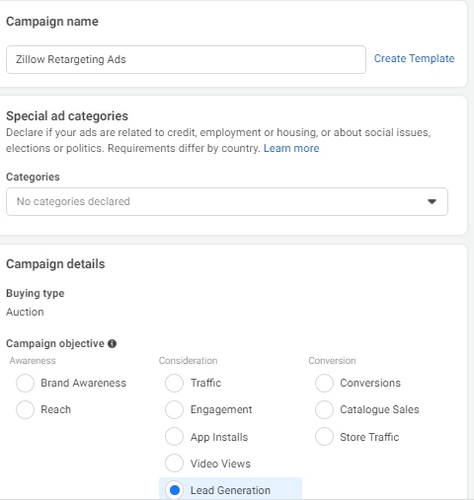
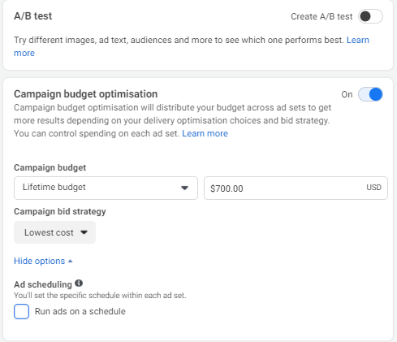
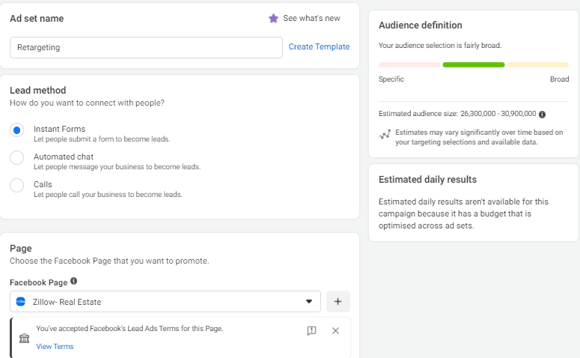
Relevant Screenshots Of Retargeting Audience For Zillow-Facebook Ads

Slide 8
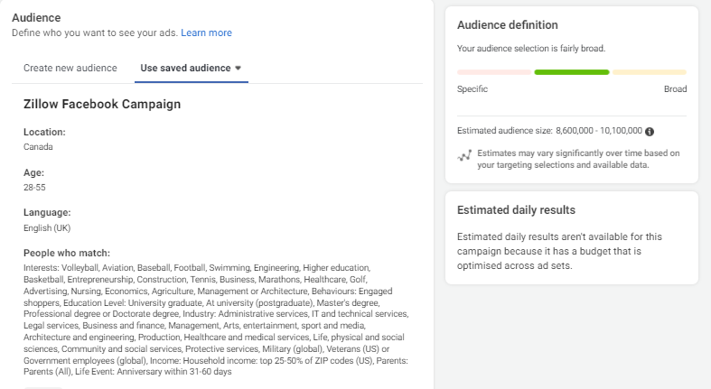
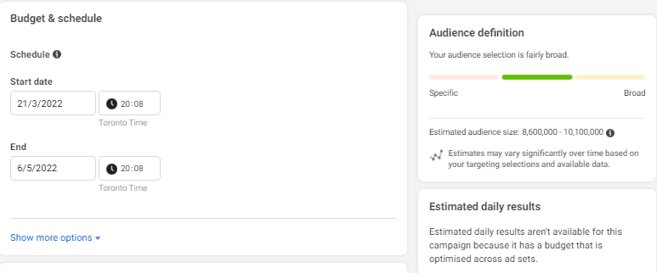
Retargeting Audience For Zillow-Facebook Ads (Cont.)

Slide 9
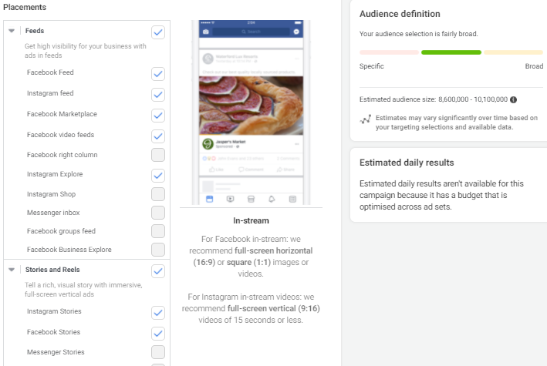
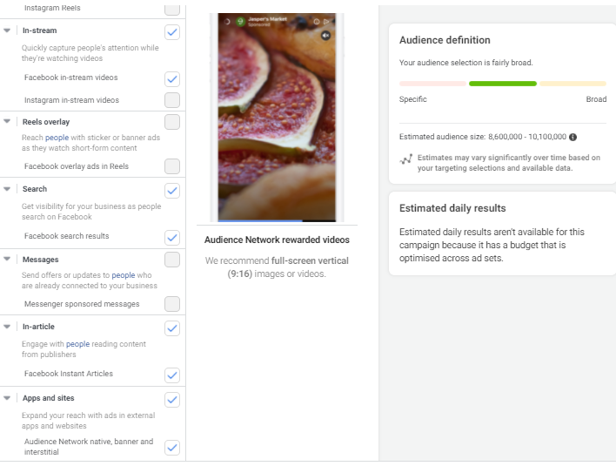
Retargeting Audience For Zillow-Facebook Ads (Cont.)

Slide 10
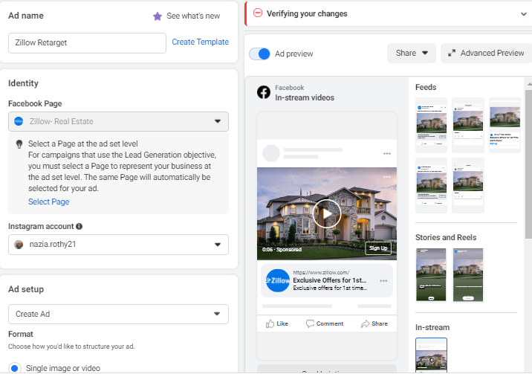
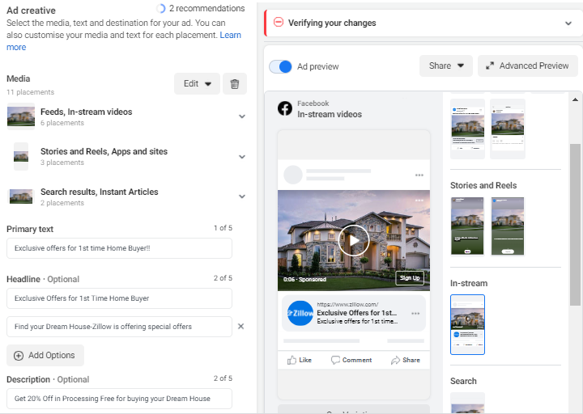
Retargeting Audience For Zillow-Facebook Ads (Cont.)

Slide 11
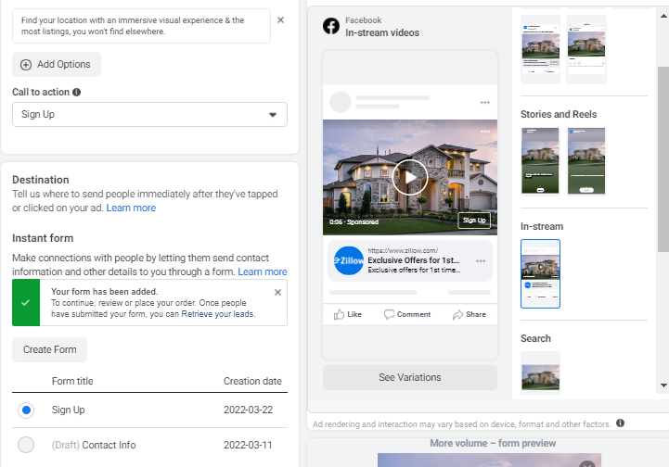
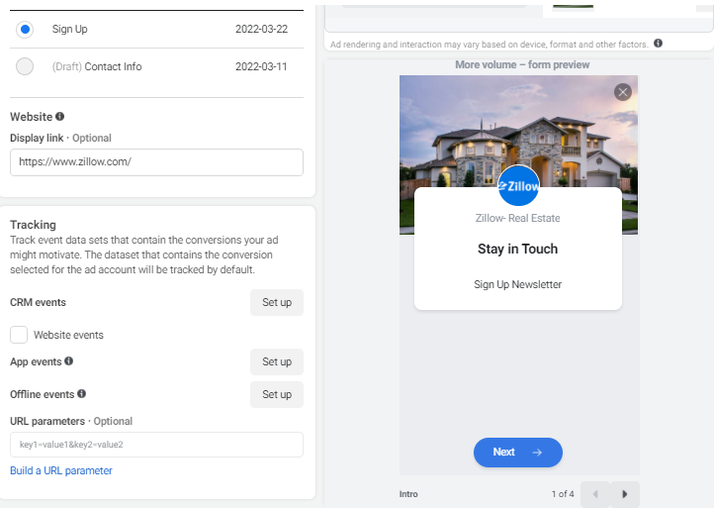
Retargeting Audience For Zillow-Facebook Ads (Cont.)

Slide 12
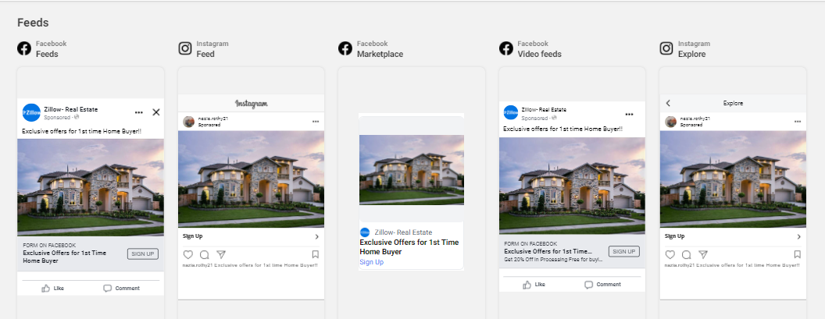
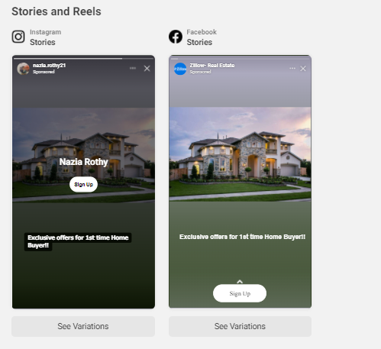
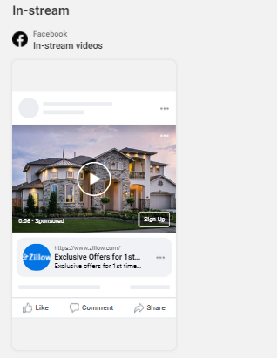
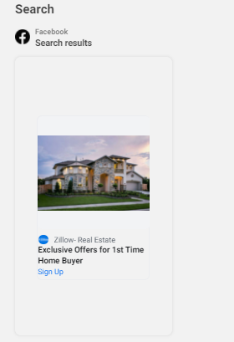
Retargeting Audience For Zillow-Facebook Ads (Cont.)
Campaign Preview

Slide 13
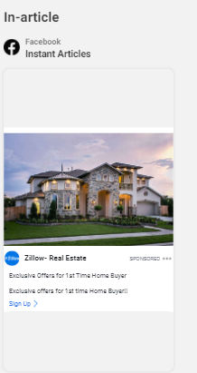
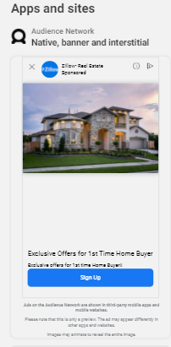
Retargeting Audience For Zillow-Facebook Ads (Cont.)
Campaign Preview

Slide 14
Thank You

