Slide 1
OOP LAB PROJECT
Submitted To: Mousumi Akter
Lecturer
United International University
Submitted By: Nazia Parvin Urmi
Id: 011161201
Sec: NF

Slide 2
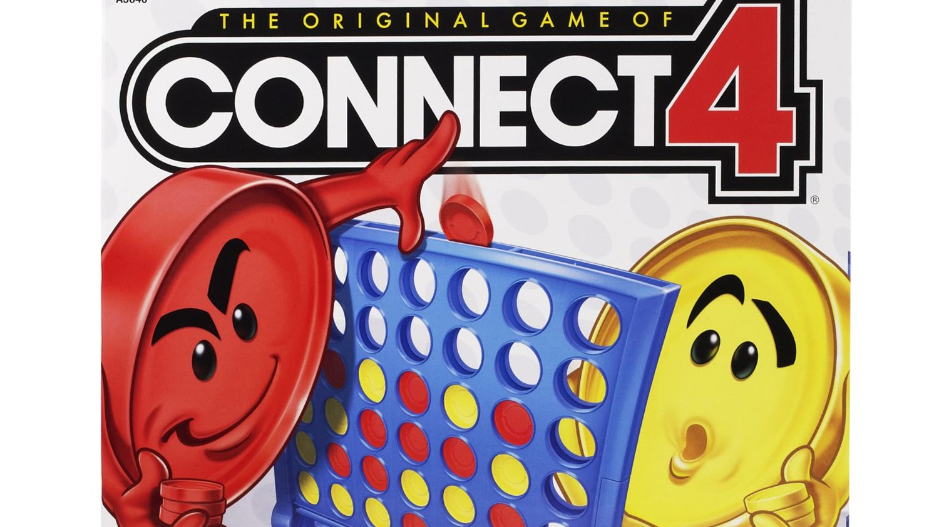
THE GAME OF CONNECT4

Slide 3
Information
NetBeans IDE 8.2
Graphical user Interface[GUI]
Two players game

Slide 4
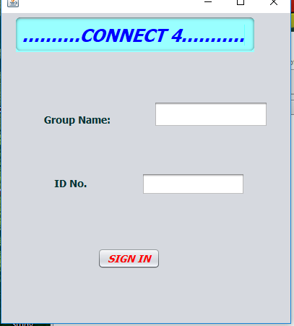
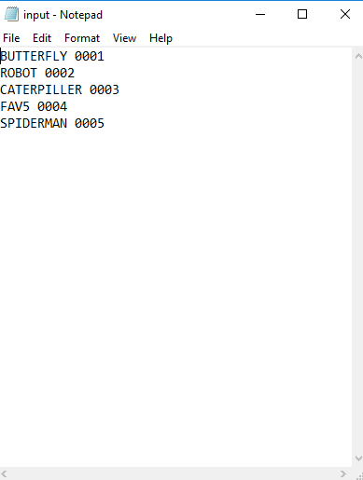
1st page :

Slide 5
How to play:
The group whom is in my input file , only those are able to play this game.
Clicking sign in button , the game will start.
Player 1 has black color and player 2 has green color.
The group of one exact color in 4 match in any direction(left/up/cornerwise) will be the winner.
If the game is draw , the game is over.

Slide 6
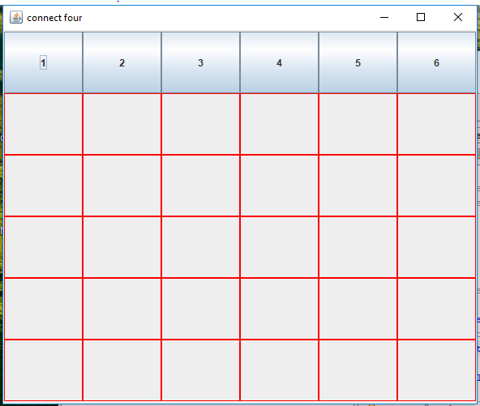
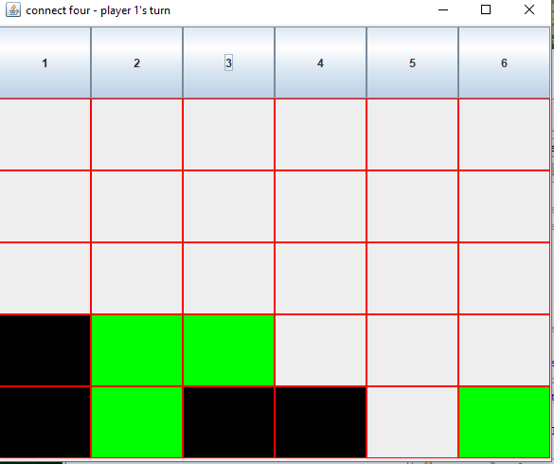
GAME PAGE

Slide 7
FUTURE IMPLEMENTS
Everyone can play this game.
Players will choose the color as they want.
The game will continue after they win.

Slide 8
THANK YOU

