Slide 1
Stadium Reservation System and Management
Team 7
Group Members
1. Nazia Tamanna 1320125042
2. Hasanur Rahman 1411418042
3. Annoor Ayesha Siddika 1411306042
4. Hashmir Rahsan 1320826042
5. S.M. Saffat Oali 1320880042
6. Zareen Tasnim 1511908042

Slide 2
Introduction
This project is web-based system.
Online stadium ticket reservation system is basically made for providing the customers with adequate service, anywhere and anytime.

Slide 3
Purpose
To establish an efficient way to promote stadium management
To minimize the number of staff
To increase the profit organization control crowd in every event. To establish an efficient way of promoting stadium business.

Slide 4
Goals
Promote entertainment side
Reduce Manpower
Control Crowd

Slide 5
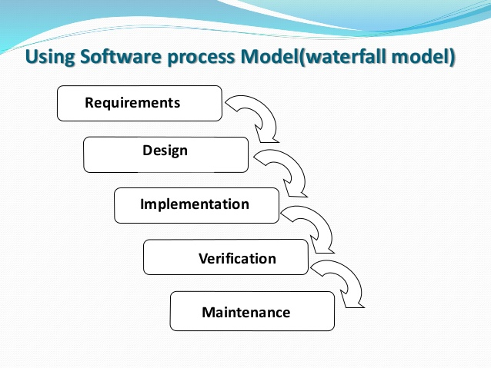
Software Development paradigm

Slide 6
Application’s
User Accounts
Checking Schedules
Booking desired seats

Slide 7
Software Equipments
1.Operating System - Windows 10
2.Server –Apache,MySQL
3.Language- PHP,CSS,HTML,JAVA Script
4.HTML- HTML5
5.Style sheet-CSS 3
Browser-Internet explorer,Mozila firefox
Xampp
Sublime text 3

Slide 8
Limitations
Can’t provide tickets for near future matches.
Can’t buy tickets.
Only can book.

Slide 9
Conclusion
Through this project, anyone can book tickets, choosing seat, lack of early attendance for the match one can see all this information in our website system.

