Slide 1
Using Simulation as an Investigative Methodology in Researching Competencies of Clinical Social Work Practice: A Scoping Review
Submitted by:
Nazifa Khanom
ID: 22166009
Submitted to:
Annajiat Alim Rasel

Slide 2
Introduction
Simulation offers concrete experiential learning opportunities well-suited to assist students in applying knowledge, values and skills into practice making simulation a widely recognized key word in clinical social work education.
There is a burgeoning body of literature suggesting that simulation can be used as a promising research methodology for the studies about practice competencies in medicine and other healthcare fields.
The purpose of this scoping review was to systematically search and summarize the current state of social work literature, in which simulation (e.g., trained actors as standardized clients, virtual reality, staged environments) was used as an investigative methodology in researching practice competencies.

Slide 3
Simulation‑Based Research
Cheng et al. (2014) categorize simulation-based research (SBR) into two types: evaluating teaching and learning, and using simulation as a research methodology. In the medical field, SBR explores practice competencies through simulations, with advantages like standardization and ease of recruitment but challenges including resource intensity and limited longitudinal observation. Reviews caution about the novelty of SBR, emphasizing unknowns in data collection practices, outcome measures, and data analysis. Overall, SBR shows promise but requires careful consideration of its complexities and challenges in various research contexts.

Slide 4
Psychotherapy Process Research
SBR is notably scarce in Psychology and Psychiatry, likely due to the prevalent use of psychotherapy process research (PPR) in these fields, which focuses on actual therapy sessions and client outcomes. PPR, primarily employed by psychologists and psychiatrists, explores treatment mechanisms and client change processes extensively. Social work researchers, facing challenges in engaging with PPR, are turning to simulation as a promising methodology to directly observe and analyze clinical practice, offering a potential avenue for advancing research on social work practice beyond traditional retrospective data methods.

Slide 5
Study Purpose
The purpose of this scoping review was to map out the current state of literature in which simulation was used as an investigative methodology in studying practice competencies of clinical social work.
Scoping review is a methodology particularly suitable for the current study as they seek to explicate the key concepts of SBR as a new area of research and documenting its emerging evidence. Research questions guiding this scoping review were: (1) What are the characteristics of studies of clinical social work competencies that used simulation as a research methodology?; (2) How is simulation-based data used in the studies of practice competencies?; and (3) What benefits and limitations are there in the use of simulation as a research methodology in studying clinical social work practice competencies?

Slide 6
Method
Scoping review is a knowledge synthesis methodology through which researchers “comprehensively summarize and synthesize evidence with the aim of informing practice, programs and policy and providing direction to future research priorities.”
This scoping review was conducted to synthesize the existing knowledge on the use of simulation-based data for research on practice competencies in order to guide future SBR and guide practice. The followed Arksey and O’Malley’s framework consists of the following five stages enhanced by Levac. : (1) identifying research questions, (2) identifying relevant studies, (3) selecting studies based on inclusion and exclusion criteria, (4) charting data, and (5) collating, summarizing and reporting the results. In enhancing the study rigor, we also followed the PRISMA Extension for Scoping Reviews (PRISMA-ScR) guidelines.

Slide 7
Identifying Relevant Studies
The authors searched the table of contents for all articles published since 2010 up to March 25, 2020 in the following relevant social work journals: Clinical Social Work Journal, Research on Social Work Practice, Journal of the Society for Social Work and Research, Journal of Social Work Education, Social Work Education: The International Journal, and Journal of Teaching in Social Work.
This 10-year timeframe was set for the hand search because simulation is a relatively new method and was not common in social work prior to 2010

Slide 8
Selecting Studies,Charting the Data and Results
They excluded studies with the following characteristics: (1) study participation of social workers, social work students or social work supervisors was unclear, (2) the primary study purpose was on the evaluation of simulation-based education or training, including those studies in which competencies were measured (e.g., skills improvement among students as a result of simulation-based learning), and (3) the focus was on macro social work practice competencies (e.g., community organizing, policy-making).
Authors KA and KS developed a data extraction form for a scoping review, charting data on 24 articles related to simulation-based research (SBR) in clinical social work. Categories included publication year, study location, competencies, sample, practice scope, simulation data type, design, rationale, case development, analysis, and methodological strengths/limitations. After an initial search yielded 4,224 articles, 18 met inclusion criteria from 275 full texts, with an additional 6 found through hand-searching, resulting in a final sample of 24 articles for the review. Discrepancies were resolved through team discussions, and the lead author (KA) made final decisions with input from team member KS.

Slide 9
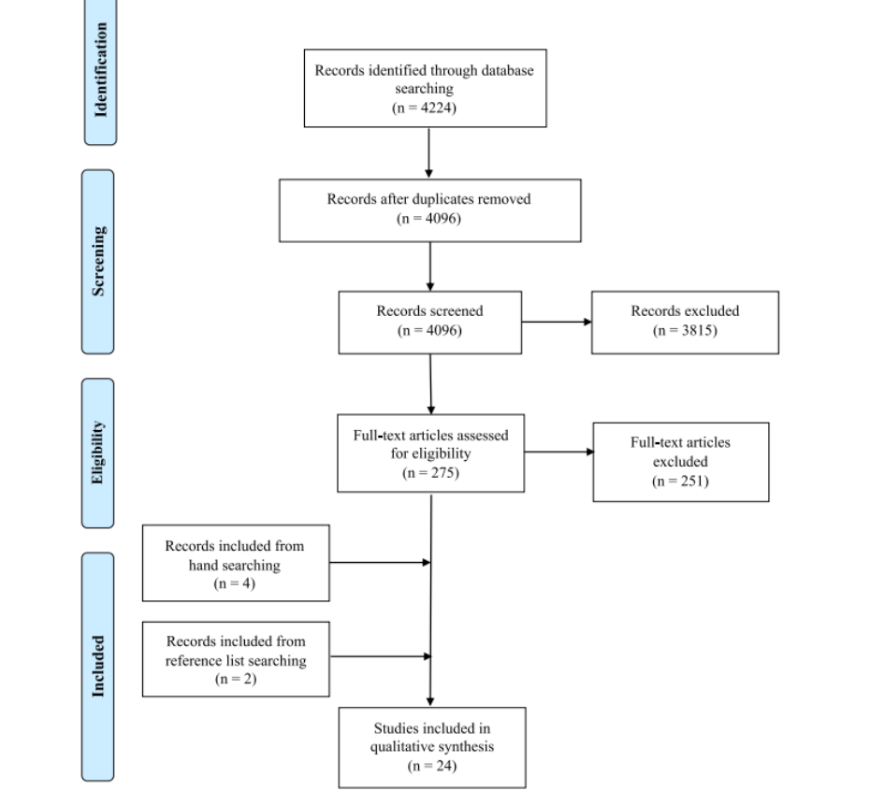
Fig: PRISMA Flowchart of the search and screening process

Slide 10
The Use of Simulation as a Research Methodology
Addressing the second research question on the use of simulation-based data in clinical competencies studies, the review found that 58% of articles provided a rationale for simulation use. Live simulated patients were employed in 54% of studies, while 25% used data from Objective Structured Clinical Examinations (OSCEs), and 17% utilized video-based case vignettes. About 75% of articles described the development of simulated case scenarios, often involving consultation with practitioners and pilot-testing for face validity. In terms of analysis, qualitative methods predominated (n=11), focusing on participants' reflections, while quantitative and mixed methodologies were used less consistently across the articles (n=10 and n=3, respectively).

Slide 11
Strengths and Limitations in Social Work SBR
Addressing the third research question on the benefits and limitations of using simulation as a research methodology in social work, strengths identified include the opportunity for direct observation, standardization of practice situations, and addressing ethical concerns in sensitive research areas. However, limitations include concerns about the simulated nature not fully reflecting real-life practice, the constrained and partial nature of simulation, and its potential inadequacy for studying client outcomes. Researchers also caution about socio-cultural diversity issues in simulated case scenarios, emphasizing the need for careful consideration of applicability to real-life clinical practice.

Slide 12
Discussion & Implications for Clinical Social Work
In summary, the scoping review identified 24 articles focusing on simulation-based research (SBR) in clinical social work competencies. The results indicate that simulation is a relatively new methodology in clinical social work, with a surge in articles published in the last decade. While traditional methods often used written case vignettes, simulation offers a dynamic, immersive approach, especially beneficial for exploring cognitive and affective processes in social work practice. The review suggests potential expansion of competencies studied, emphasizing the ethical fit of simulation for researching sensitive areas and its methodological alignment with examining practice competencies. However, the study notes the need for a clearer rationale, varied data analysis approaches, and increased collaboration between researchers and clinicians in social work SBR.

Slide 13
Limitations
The scoping review acknowledges the potential omission of relevant studies due to time and resource constraints, focusing primarily on peer-reviewed articles available in the university library databases. Exclusions encompass dissertations, books, book chapters, grey literature, and non-English publications.
The review did not assess the quality of each empirical study, as its primary goal was to offer a snapshot of the current literature on simulation-based research in social work, not to critically appraise research quality. Rigor was maintained through multiple independent reviewers in each phase and adherence to the PRISMA-ScR checklist, aiming for consistency, transparency, and bias mitigation.

Slide 14
Conclusion
In conclusion, this scoping review synthesized 24 studies from the social work literature that employed simulation as an investigative methodology for studying clinical social work competencies. Simulation-based research (SBR) emerges as a promising approach for understanding the nuances of clinical competencies and how practitioners integrate knowledge, values, and skills in real-world scenarios. The proximity to practice in SBR findings enhances their relevance, providing valuable insights to support clinical social workers. Despite recognizing both strengths and limitations, continued engagement and investment in SBR are advocated to further advance the literature on clinical social work practice.

