Slide 1
Simulation and Modeling Efforts to Support Decision Making in Healthcare Supply Chain Management
Submitted by: Nazifa Khanom
ID: 22166009
Submitted to: Annajiat Alim Rasel
CSE 718

Slide 2
Introduction
Simulation Modelling(SM) is used in various fields to allow developers and users to represent a system and examine its operations using different possible scenarios and conditions.
The objective of this paper is to present and analyze past simulation and modeling (SM) efforts to support decision making in healthcare SCM, to identify the key challenges associated with SM in healthcare SCM, and to discuss new technologies emerged to meet these challenges.

Slide 3
Motivation and Background
Competition within the healthcare industry is on the rise, and to stay in the market, healthcare organizations face the challenge to reduce operational costs while maintaining, if not improving, the quality of patient care and services provided.
By nature, SCM is a complex, dynamic, and distributed environment. It is also governed by uncertainty and high variability; this is so because it encompasses integrated and interrelated activities undertaken by different and distributed parties (i.e., suppliers, distributors, and consumers).
Efficient management of SC entails making informed decisions based on a holistic view of all elements that affect SCM process. To get there, SC managers in healthcare organizations need to have better visibility into their SCM processes to understand the causes of uncertainty and their impact on these processes

Slide 4
Many researchers argued that SM is a very powerful tool for gaining insight into SCM. In view of these studies, the benefits of SM in SCM include: understanding overall SCM processes and characteristics; capturing SCM dynamics; modeling unexpected events and understanding their impact on SC; and minimizing the risk of changes in the planning of SCM process. Moreover, much research have been undertaken to develop SM tools to support decisions making in SCM.
The application of SM in healthcare SCM is limited in comparison to other sectors, yet it is steadily on the rise. Several studies explored the value of SM to support decision making in healthcare SCM as in other industries. More studies developed SM tools to tackle problems in healthcare SCM.

Slide 5
Methodology
Healthcare SC Design and Management:
The complexity of the SCM problem magnifies with its focus on the healthcare industry. Healthcare SCM is designed to assure a high service level by maximizing the allocation of resources to respond effectively and promptly to the patient care needs.
SCM is set to “enable” the strategy of healthcare organizations maximize patient care and minimize cost. This can be achieved by ensuring product availability, minimizing storage space, reducing material handling time and cost, and minimizing non liquid assets

Slide 6
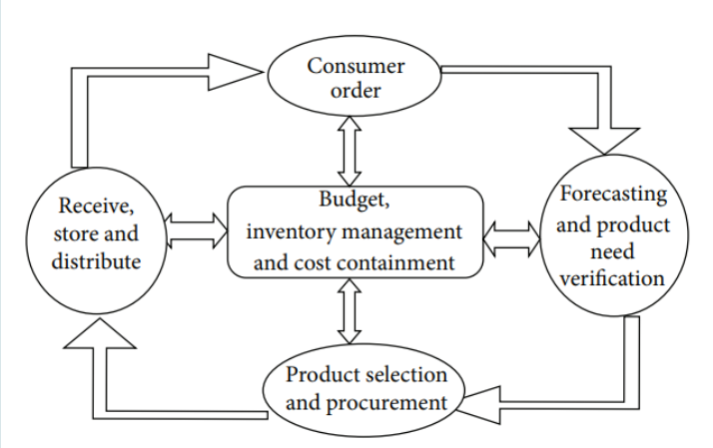
Fig: Modern Healthcare SCM Process

Slide 7
By placing this process focus into perspective, successful SC managers find their competitive advantage by optimizing the balance between the concept of meeting consumers’ demands and the fiscal responsibility.
In the SCM process, the price elasticity of demand plays an important role. In healthcare SC there are many products available to the end user that perform the same or similar functions. The challenge becomes ordering the best product at the best possible price that satisfies the needs of the majority.
Budgetary limitations lead healthcare SC managers to incorporate new functions and policies into their procurement, inventory managements and distribution cycles.
Also, the method includes Strategic and Planning process.

Slide 8
Proposed Simulation Models and its limitations
Simulation models facilitate the design and management of healthcare SC through producing a holistic view of all involved elements and providing “what-if ” analysis tools.
With respect to SCM issues, SM can support decisions concerned with policies, planning processes, inventory management, and suppliers/consumers collaboration agreements.
Swaminathan in proposed a SM-based decision support system (DSS) to support the Drug Distribution Project (DDP) in the state of California, USA.The allocation problem as described was nonlinear, multiobjective, and large in size. Therefore, the proposed DSS utilized a multi-objective optimization model and a heuristic solution to accomplish optimized distribution while taking into account efficiency, effectiveness, and equity of the drug-allocation process

Slide 9
The proposed DSS in this work was proven successful at providing efficient, effective, and fair methods to allocate scarce drugs.
The objective was to minimize wastage and holding cost while maximizing prompt access to the drugs.
The objective functions were to (1) minimize all associated costs including stock-out cost for both finished and raw goods and inventory expiry cost and (2) maximize timely access to the required drugs.
The model also defined a set of transition probabilities to capture changes that may occur in patient classification from one type to another, as well as changes in demand.
The model was implemented using optimization programming language (OPL) to generate an optimal inventory policy to achieve a solution that has many products of high importance at high service level.

Slide 10
The model was set to perform under the following constraints:
(i) demand satisfaction (no stock-out allowed),
(ii) flow persistence between SC members (represented by nodes in the graph),
(iii) storage capacity,
(iv) aggregating all items,
(v) producers supply capacity affecting all potential buyers,
(vi) non-negativity and integrality of decision variables.
The solution of the model involved selecting traveling paths with the minimum cost to distribute inventory

Slide 11
The model included two types. The first type (M1) was an inventory cost-oriented model with an objective function to minimize the total cost of inventory and human resources.
The second type (M2) aimed to provide activities’ schedule that balance the workload over the week days and introduced this objective into M1.
The quality of the obtained solutions was compared considering three criteria: (1) carrying cost; (2) uniform workload distribution; and (3) required working time.
Both models, M1 and M2, are set to perform under several constraints as follows: (i) set time restrictions on manpower to accomplish the required activities; (ii) direct deliveries are restricted to products received within the current period; (iii) demand satisfaction; (iv) respect of storage capacity (weight and volume); (v) no product is received if the supplier does not visit the hospital; (vi) products at CU can only be replenished if unit is visited.

Slide 12
Challenges for SM in Healthcare SCM
The increased interest in SM for healthcare SCM is not without its challenges. In the light of models discussed above, the most challenges faced by simulation and modeling community in healthcare SCM are as follows:
1)Collecting Sufficient Amount of Related Input Data,
2)SM Validation and Verification,
3)Implementation and the cost,
4)Generalization,
5)Growth in Models’ Size and Complexity,
6)Representation of Human Decision Making,
7)Match between SM Techniques and SCM Problems,
8)Expert Modelers,Expert Users,Integration of Existing Models

Slide 13
Promising Technologies to Support SM for Healthcare SCM
To fully exploit the SM opportunities in healthcare SCM, several and different technologies have been tried to meet the challenges presented above. Some of the following technologies may seem irrelevant to SCM in healthcare, yet the popularity and usability advantages offer a potential shift in paradigms that will incorporate SCM with some of them to leverage some potential problems.Some of the most promising technologies:
1)Agent-Based Simulation (ABS),
2)Radio Frequency Identification (RFID),
3)Distributed Simulation (DS),
4)Service-Oriented Architecture (SOA),
5)Cloud Computing (CC)

Slide 14
Conclusion and future scope
Simulation modeling (SM) emerged as a tool to develop specific functional and decision systems that provided flexibility, specificity, and consistency. Healthcare simulation modeling is a way to test changes in a computerized environment that will hopefully put forward ideas for improvements and subsequent implementation.
By offering direct feedback on suggested changes, SM allows healthcare supply chain organizations to analyse different scenarios for decision making while encouraging open communication to further understand the inner workings of a potentially complex system.
As steps are being developed for the success of simulation, it should be viewed not just in the use of current and future technologies but also its application to the clinical environment. As new technologies emerge to mitigate concerns regarding implementation, potential impact, and value added for healthcare SC processes, it then becomes necessary for healthcare organizations to realize the likelihood of simulation modeling to enhance their operations and maximize the benefits.

