Slide 1
Cibo – Online Food Ordering System
Nazima Banu USN: U03CH23S0053 6th Semester, BCA Dayananda Sagar Business Academy 2025 – 2026

Slide 2
INTRODUCTION
Cibo is a web-based online food ordering system
It connects users with restaurants digitally
Provides a simple, fast, and user-friendly ordering experience
Includes user module, admin dashboard, and order tracking system
Designed to improve convenience, efficiency, and digital food ordering experience

Slide 3
Project Scope & Application
Target Audience: Specifically designed for local food joints, cafes, and popular restaurant
Platform Reach: Designed for large restaurant chains and food service businesses adopting digital management systems.
Local & Cloud Deployments: Deployable locally in offline environments or on cloud servers using Supabase.
Integrations: Standardized reports export system ready for monthly accounting and inventory reviews.

Slide 4
Project Objectives
Unified Data Model: Enforce a single parsing layer (normalizeOrder) to sync calculations across all user and admin panels.
Streamlined Actions: Centralize checkout, reordering, and cancellations into a single business service layer.
Centralized Asset Management: Restructure restaurant and menu item images using drop-down visual libraries.
Enhanced User Experience: Integrate responsive cart guards, case-insensitive item reordering, and PDF invoice downloads.

Slide 5
System Overview
Architecture Model: Three-tier architecture consisting of the React user interface, database logic, and a central parsing layer.
Responsive Client Module: Allows customers to browse, cart items, apply discounts, checkout, and track orders.
Control Console: Provides administrators with real-time status management, asset editors, and accounting report exports.
Dual Persistence Layer: Seamless transition between local storage database fallback and online Supabase cloud databases.

Slide 6
User Features
Dynamic Navigation: Automatically filters empty categories out of the active restaurant menu listings.
Safety Guards: Enforces order and item count limits (e.g., maximum 5 per item) with instant system notifications.
Smart Reordering: Translates and copies items from past transaction histories to the cart in a single click.
Digital Invoices: Generates clean, downloadable PDF transaction receipts with detailed cost breakdowns.

Slide 7
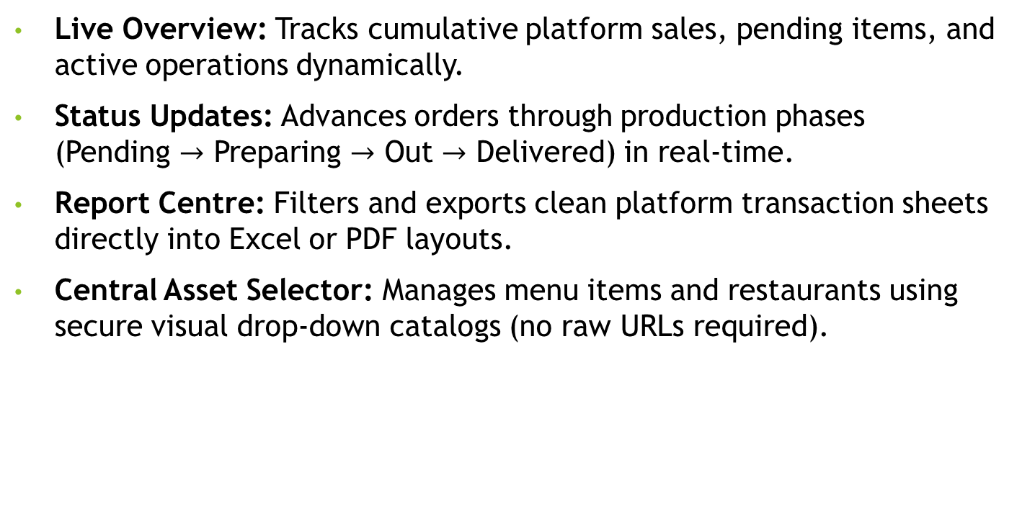
Admin Features
Live Overview: Tracks cumulative platform sales, pending items, and active operations dynamically.
Status Updates: Advances orders through production phases (Pending $→$ Preparing $→$ Out $→$ Delivered) in real-time.
Report Centre: Filters and exports clean platform transaction sheets directly into Excel or PDF layouts.
Central Asset Selector: Manages menu items and restaurants using secure visual drop-down catalogs (no raw URLs required).

Slide 8
Key Technical Integrations
Central Normalizer: Translates multi-source database variables into matching JavaScript objects at runtime.
Separation of Concerns: UI files focus strictly on design rendering, delegating calculations to standalone logic services.
Smart Asset Library: Handles image rendering through secure catalog references, preserving legacy link fallbacks.
Responsive Styling: Enforces a clean, responsive layout across multiple screen sizes using a system-wide Vanilla CSS sheet.

Slide 9
System Workflow Explanation
User browses restaurants and adds items to cart
Cart validates quantity and applies promo codes
processes order and calculates final bill
Order is stored in database / local storage
Admin dashboard receives and manages order
Order status updates reflect in user tracking page
Entire system works with unified data flow architecture

Slide 10
Conclusion
Successful Implementation: Developed a robust React food ordering application using professional Vanilla CSS.
Architecture Integrity: Unified operational actions and data normalization to prevent frontend sync errors.
Future Scope: Ready for online cloud hosting and integration with live SMS notification alerts.

