Slide 1


Week1: Introduction
If statement and for loop.

Slide 2
Remember What is Competitive Programming
Solving Problems using Algorithms
Think fast and code fast
We need to write program to solve the problems

Slide 3
Variables: units of storage
Variables are boxes in the memory of a computer in which we can store stuff.
A variable (or a box) must have a name to identify it.
A variable (or a box) stores values inside. These values can be :
Integers (int)
Floating-point numbers (double)
Characters (char)
Sentences or strings of character (string)

Slide 4
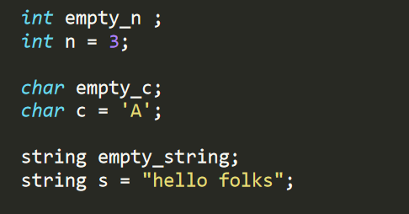
Variable Declaration
To create a storage box we need to declare a variable.
Declaring a variable is equivalent to creating a box, and giving it a name.

Slide 5

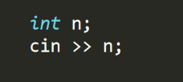
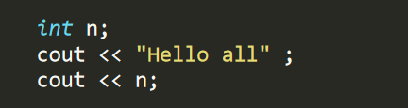
Input and Output in C++
We can make the program anticipate input from console using the following:
We can make the program print stuff to the console using the following:

Slide 6
Let’s start with a problem.

Slide 7

If conditional statment
We basically need arithmetic operations and conditional statements to write any program
We use If statement to handle specific cases.
If statement syntax is:

Slide 8

If conditional statment
{ ==, !=, >, >=, <, <=} are the basic comparision operations.
To put more than one condition we put {and} or {or} between the conditions.
Example: if the denominator equals zero then print “invalid operation“

Slide 9
Given two integers a and b determine if a/b is positive, negative, or state that it is an invalid operation.

Slide 10
Ready for a harder version ?
Instead of the 3 students, assume there are n students, where n will be supplied as an input to the program:
Input:
A number n.
n numbers on the same line.
Output:
A number
Constraints:
n is in the range [1,1000]
The n numbers will be in the range [1,1000]

Slide 11
Let’s think !
How can we input n numbers ?
Of course we will not use (cin >> x) n times because n can be up to 1000 !.
We need some other tool that will make this repetitive task easier.
Yes we have loops in C++ !

Slide 12
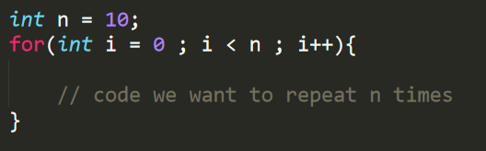
For Loops in C++
For loops allows us to repeat a piece of code any number of times we want !
A for loop has Three components:
Declaration Area
Condition Area
Operation Area
These components are separated by a semicolon ;

Slide 13
Let’s solve the problems now!

Slide 14

Questions ?

