Slide 1

Algorithms Program Week4:
Functions

Slide 2
Recap
So far, we covered most of the basics C++.
We have done 2 contests so far.
It is highly recommended to go over the contest problems and make sure you solve all of them, solutions are available on the program’s repo on github.

Slide 3
Today
How to create functions
Famous built-in functions in C++
Some practice.

Slide 4
Functions
Remember how we always write : int main() ?
A function is a block of commands.
Functions (except for main) are designed to take some information, do something with it and then return some useful information to be used.

Slide 5
How to create a function in c++
A function has 3 Main components, also called its signature:
Return value: The type of variable that is returned by the function
Identifier: The name of the function
Parameters: The types that we should give to the function

Slide 6
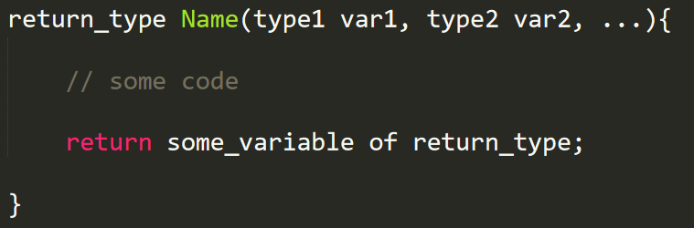
FORMAT OF A FUNCTION

Slide 7
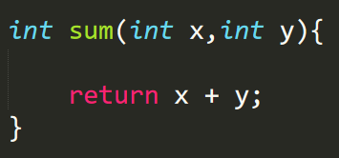
Example of a function:

Slide 8
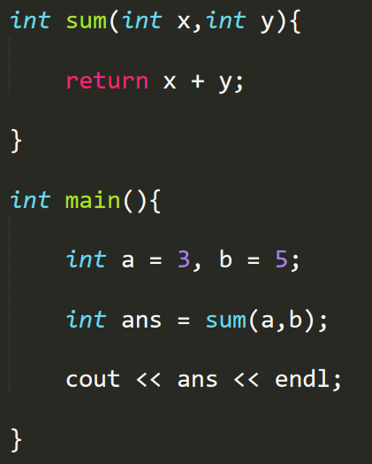
How to use it ?
A function can be called from any other function (either main or non-main function) by typing its name and providing the parameters in parenthesis, in the same order it is defined.

Slide 9
We can create functions and connect functions to each other
WHY and HOW we do that ?

Slide 10
Function as an IDEa
A helper that does some stuff for us

Slide 11
Function in hardware
A sequence of commands inside the memory

Slide 12
Useful built-in functions in c++
Max()
Min()
Sort()
Reverse()
Sqrt()
Pow()
Sin()
Cos()

Slide 13

Now let’s do some example to understand more

