Slide 1

Algorithms Program Week2:
Arrays, Sorting, and Complexity

Slide 2
Announcements
Tomorrow we will have our first contest !
Please make sure you have signed up to these websites:
codeforces.com
a2oj.com

Slide 3

Remember Last Week

Slide 4
Variables: UnIts OF sTORAGE
Variables are like boxes that have names, and in which we can store values (numbers, characters, strings, etc)

Slide 5
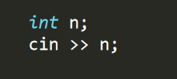
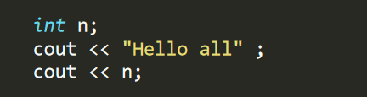
Input & Output in C++
We use cin >> to input values from console
We use cout << to print out to console

Slide 6
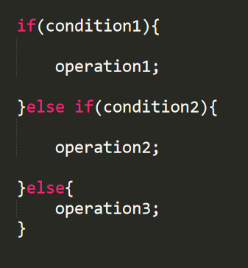
Conditional if else statements
Execute an operation depending on whether a condition holds

Slide 7
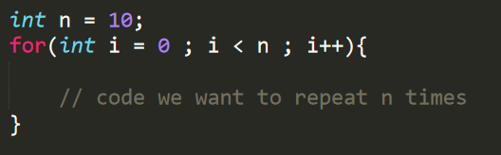
For Loop

Slide 8
Arrays
How about we start with a problem ?

Slide 9

Arrays
Arrays allow us to store many variables without having to define each variable separately
An array is like a hotel, every room has a number (in an array it’s called an index).
When we define an array, we reserve hotel rooms, in which we can store the values of our variables.
Array indexes start from 0.

Slide 10

How much Does an array fit
Typically, an array can fit up to ${10}^{6} to {10}^{7}$ elements.
If you fill the array more than this and submit your code, you get Memory Limit Exceeded verdict

Slide 11
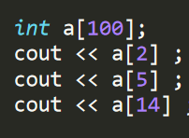
HOW TO ACCESS ELEMENTS OF AN ARRAY ?
USING THE INDEX
This example prints the second, fifth, and 14th element of array a

Slide 12
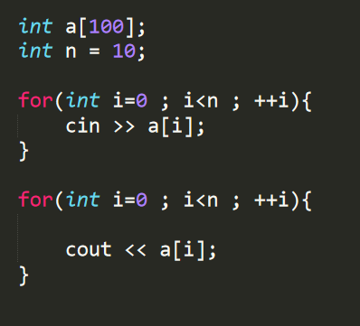
For loops are close friends with arrays
We usually use for loops to input elements of arrays from console, and to print contents of array to console.

Slide 13

Now let’s code the solution !

Slide 14
Can a problem have 2 solutions ? Where one is better than the other ?
YES!

Slide 15
How do we compare algorithms and solutions ?
Using Time Complexity !

Slide 16


Time complexity
The expected time the code or algorithm requires to produce a solution depending on the INPUT SIZE
If input size is N, and we have to use a for loop which iterates N times to find the solution, we say the complexity of the solution is O(n)
If we have about $2n^{2}$ operations we say that the complexity is $O(n^{2})$ !

Slide 17


How to estimate time complexity ?
Ask yourself the following question: How many iterations (loops) or comparisons (if statements) are we doing in terms of the input size
For example, 1 for loop that iterates n times tells us that complexity is $O(n)$
For example, 2 for loops inside each other iterating n times each is $O(n^{2})$
When finding complexity remember these two rules:
Drop constants: $4n\log{n+5 →O(n\log{n)}}$
If you have sum of several functions, take the greatest one and drop others
$n+\log{n} →O\left(n\right)$
$n^{3}+n^{2}+n →O(n^{3})$

Slide 18

Examples:
$n\log{n}+n\sqrt{n}$
$2^{n}+n^{7}+3$
$2^{n}+n!$
$3^{n} n^{2}+2^{n}$
$n\sqrt{n }+m\log{m}$

Slide 19

Sorting numbers
SORTING IS TO ORDER THINGS ACCORDING TO A PREDEFINED ORDER
SORTING NUMBERS IN A NON-DECREASING ORDER
SORTING CHARACTERS ACCORDING TO ALPHABETIC ORDER
THER ARE MANY AND MANY ALGORITHMS FOR SORTING WITH DIFFERENT COMPLEXITIES.
THE FASTES ALGORITHM IS $O(n\log{n)}$ (If you like to discuss let’s talk after the session !)
Sorting is very crucial in solving problems! It is not the main task, but it is essential to reach the final solution
Lucky for us, C++ has a sorting tool that is ready to use without caring about implementation details

Slide 20
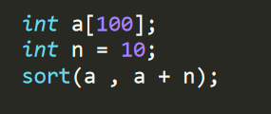
SORT FUNCTION IN C++
We can sort arrays in C++ !
Let’s explore an example

Slide 21
Now, Let’s solve a problem wrapping up all today’s content
Given N numbers (1 <= N <= 1000), where the numbers are (1 <= number <= 1000), find the frequency of each number. In other words, count how many times each number appears, and print it to console.

