Slide 1
USING MICROSOFT ACCESS
Create Queries By Using Logical Operators

Slide 2
What is operators in Microsoft Access?
Operators are used in Access expressions to specify what kind of operation to perform, such as add, multiply, compare, or concatenate
Logical Operator | Meaning
AND | Display result if both conditions are TRUE
OR | Display result if either one of the conditions is TRUE
NOT | Display result if the given conditions is FALSE (Not TRUE)
TRUE | Display result if the given conditions is YES
FALSE | Display result if the given conditions is NO
LIKE | Display result if the given conditions is ALMOST ALIKE

Slide 3
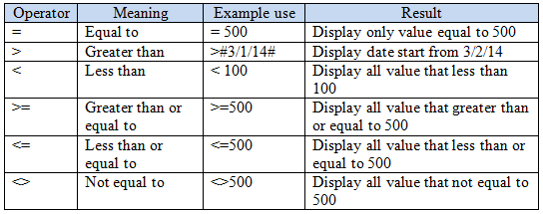
What is operators in Microsoft Access?
Operators are used in Access expressions to specify what kind of operation to perform, such as add, multiply, compare, or concatenate

Slide 4
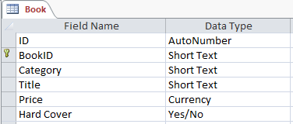
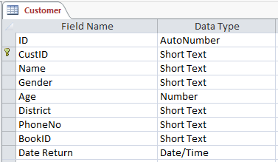
Database Name: Book-Loan

Slide 5
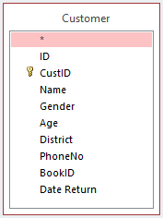
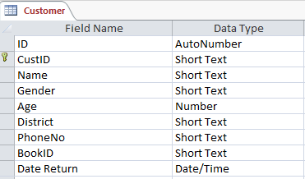
Question? List of female customers from Tutong District
Re-Phrase Question: Female Gender AND Tutong District

Slide 6
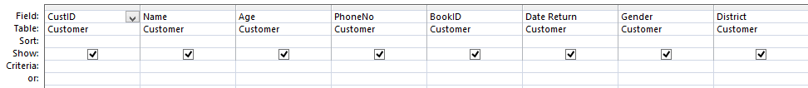


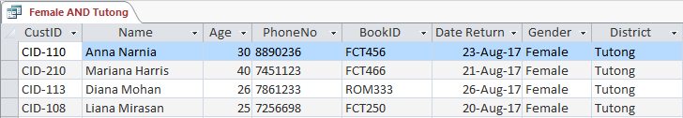
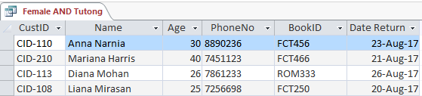
Question? List of female customers from Tutong District
Re-Phrase Question: Female Gender AND Tutong District
If ☑ (checked), repeating content is displayed
If ◻ (unchecked), field name is not displayed

Slide 7
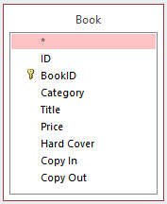
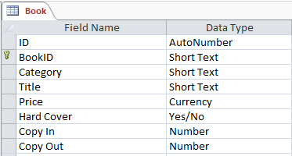
Question? List of fiction book with hard cover
Re-Phrase Question: Fiction Category AND Hard Cover

Slide 8
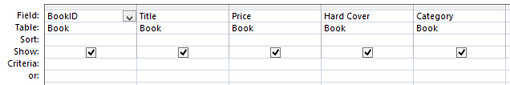




Question? List of fiction book with hard cover
Re-Phrase Question: Fiction Category AND Hard Cover
If ☑ (checked), repeating content is displayed
If ◻ (unchecked), field name is not displayed

Slide 9
Question? List of customers from Tutong or Temburong District
Re-Phrase Question: Customers from Tutong OR Temburong District

Slide 10
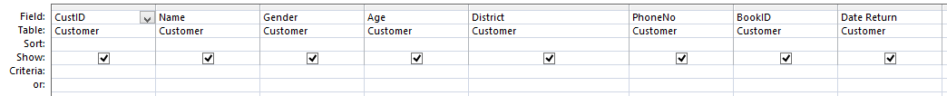
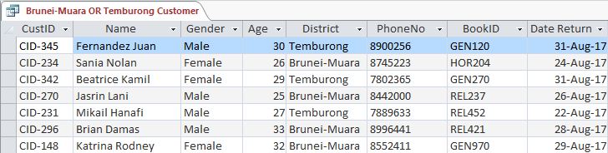
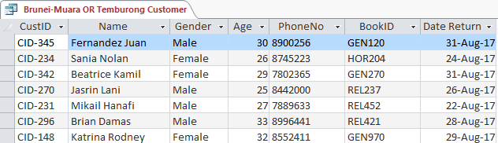
Question? List of customers from Brunei-Muara or Temburong District
Re-Phrase Question: Customers from Brunei-Muara OR Temburong District
If ☑ (checked), repeating content is displayed
If ◻ (unchecked), field name is not displayed

Slide 11
Question? List of customer names starts with J OR M
Re-Phrase Question: Customer names starts with J OR M

Slide 12
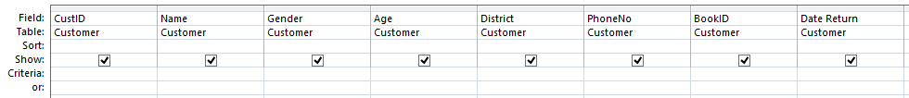
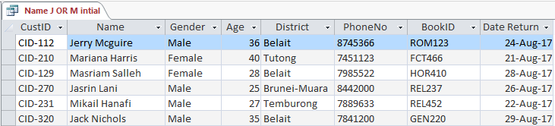
Question? List of customer names starts with J OR M
Re-Phrase Question: Customer names starts with J OR M

Slide 13
Question? Prompt the age of customer
Re-Phrase Question: Asks age of customer by entering the number

Slide 14
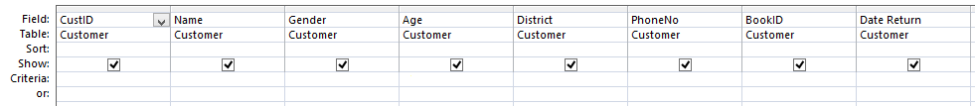
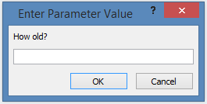
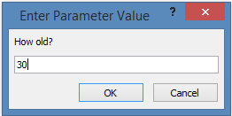

Question? Prompt the age of customer
Re-Phrase Question: Asks age of customer by entering the number

Slide 15
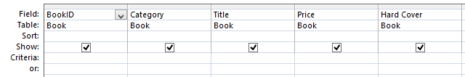
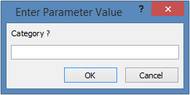
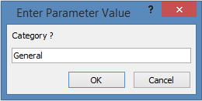
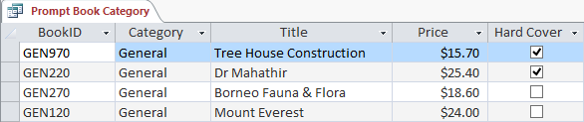
Question? Prompt the category of book
Re-Phrase Question: Asks category of book entering the category

Slide 16
Question? List of books with prices less than 20
Re-Phrase Question: List of books with prices < $20

Slide 17
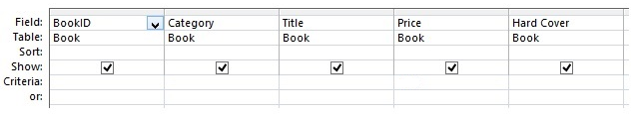
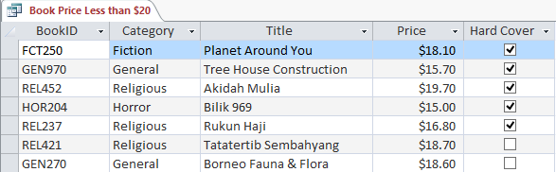
Question? List of books with prices less than 20
Re-Phrase Question: List of books with prices < $20

Slide 18
Question? List of copy of books left for loaning
Re-Phrase Question: Number of copies book left in stock

Slide 19
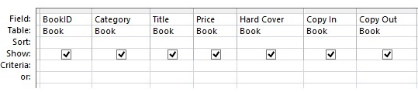
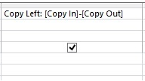
Question? List of copy of books left for loaning
Re-Phrase Question: Number of copies book left in stock
Copy Left: [Copy in]-[Copy Out]

Slide 20
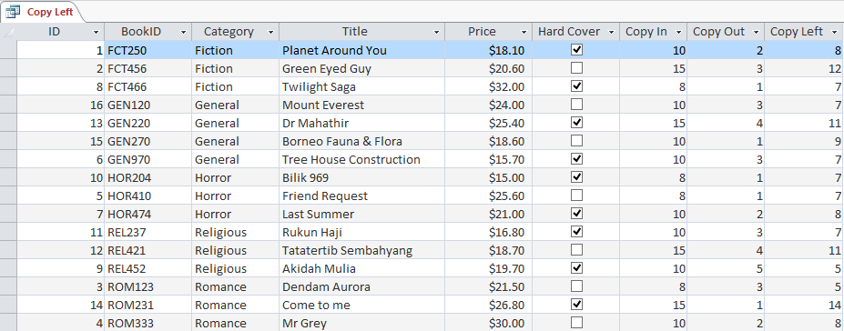
Question? List of copy of books left for loaning
Re-Phrase Question: Number of copies book left in stock

Slide 21
ANY QUESTION ?

