Slide 1
Variasi Mesh
N bola = 1 bola
r = 50 nm
Bahan = Silikon

Slide 2
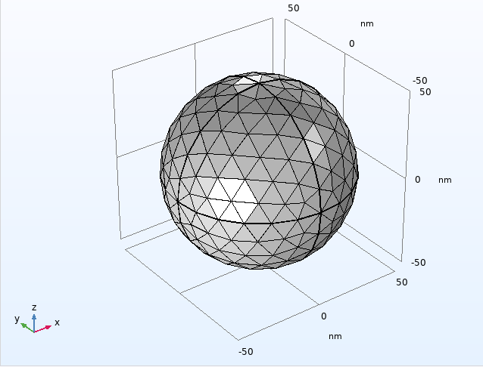
Mesh = 464 (coarse)

Slide 3
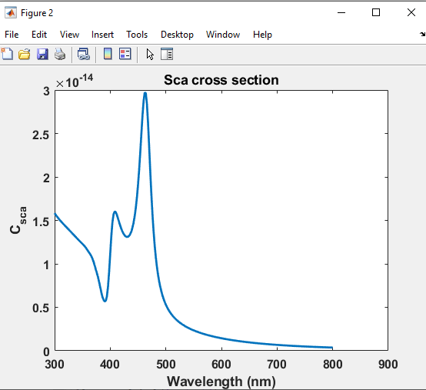
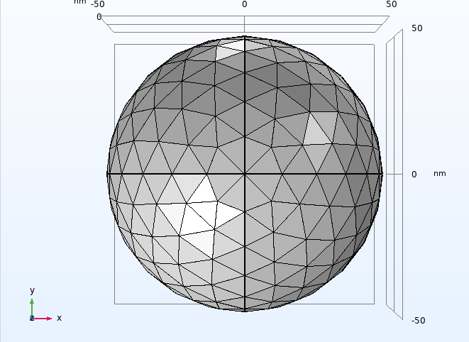
Mesh = 464 (coarse), t = 30 menit

Slide 4
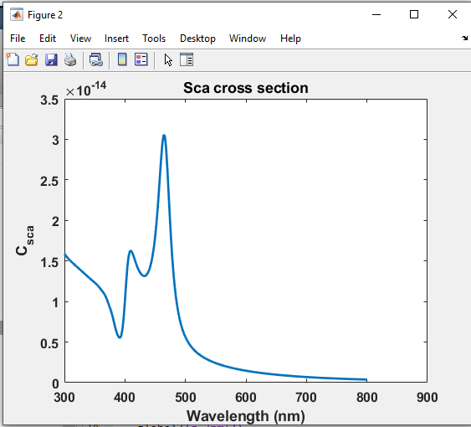
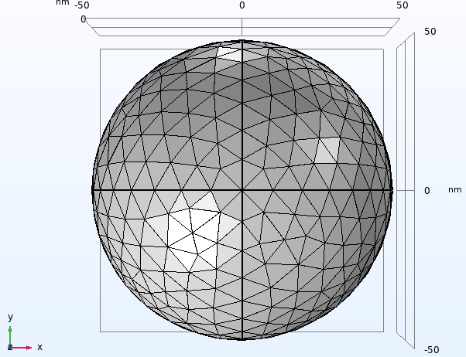
Mesh = 834 (normal), t = 1 jam

Slide 5
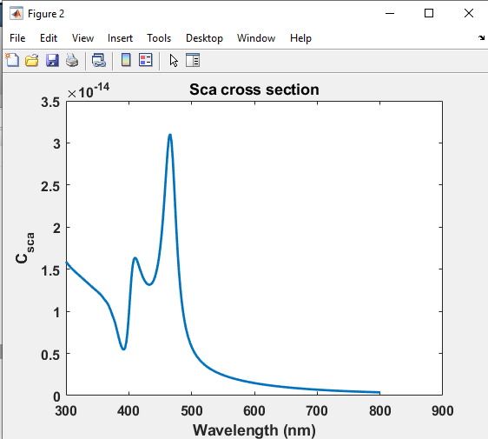
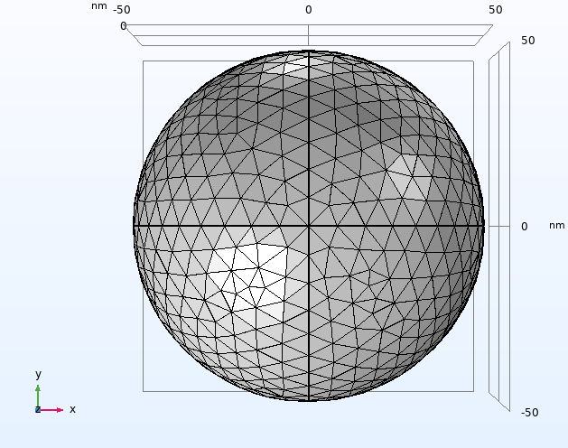
Mesh = 1320 (fine), t = 3-4 jam

Slide 6

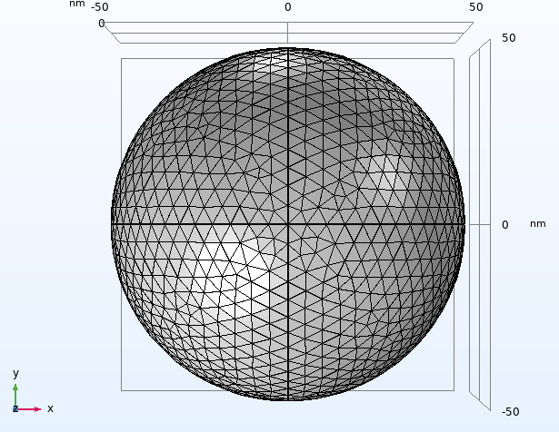
Mesh = 2812 (finer), t = 12 jam

Slide 7
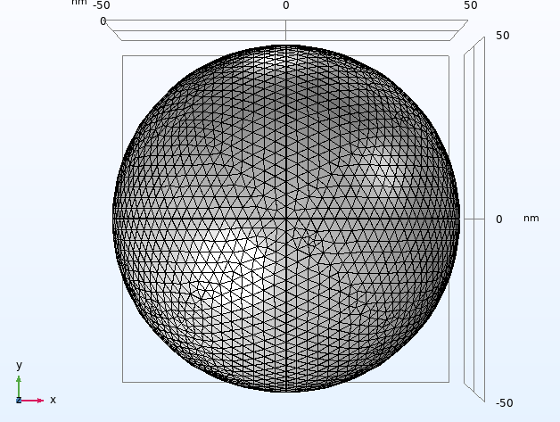
Mesh = 6578 (extra finer), tidak di run

Slide 8
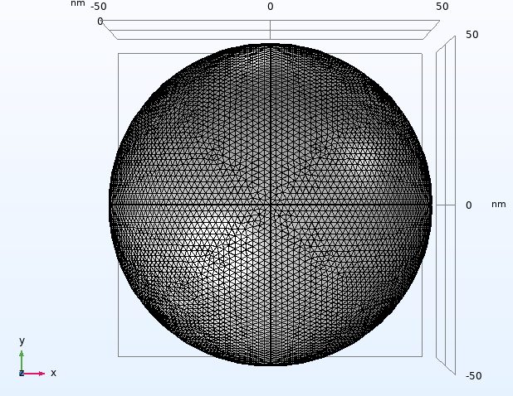
Mesh = 19704 (extremely finer), tidak di run

Slide 9

Statistika Bose-Einstein (partikel tak terbedakan)
Jumlah penyusunan sistem-sistem dalam assembli boson adalah
$$W=\prod_{s=1}^{M}{\frac{\left(g_{s}+n_{s}−1\right)!}{\left(g_{s}−1\right)!n_{s}!}}$$
$$W=W_{1}∙W_{2}∙W_{3}∙W_{4}∙W_{5}$$
Dengan mengambil $n=5$ dan $g=5$
$$W_{1}=\frac{\left(5+1−1\right)!}{\left(5−1\right)!1!}=\frac{5!}{4!}=5$$
$$W_{2}=\frac{\left(5+2−1\right)!}{\left(5−1\right)!2!}=\frac{6!}{3!}=15$$
$$W_{3}=\frac{\left(5+3−1\right)!}{\left(5−1\right)!3!}=35$$

Slide 10

$$W_{4}=\frac{\left(5+4−1\right)!}{\left(5−1\right)!4!}=70$$
$$W_{5}=\frac{\left(5+5−1\right)!}{\left(5−1\right)!5!}=126$$
Sehingga
$$W=W_{1}∙W_{2}∙W_{3}∙W_{4}∙W_{5}$$
$$W=5∙15∙35∙70∙126$$
$$W=23.152.500$$
Terdapat 23 juta lebih jumlah penyusunan sistem dalam assembli.

