Slide 1
Untuk 1 bola, ragam koordinat pusat
Mesh = 1320, r = 50 nm

Slide 2
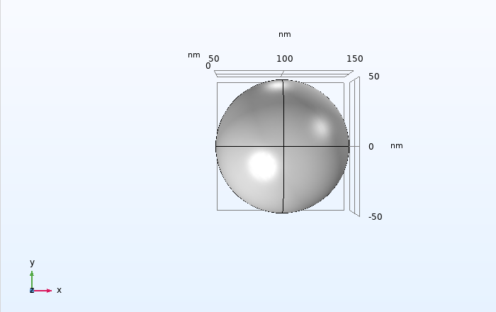
Fine = 1320, x=100nm

Slide 3
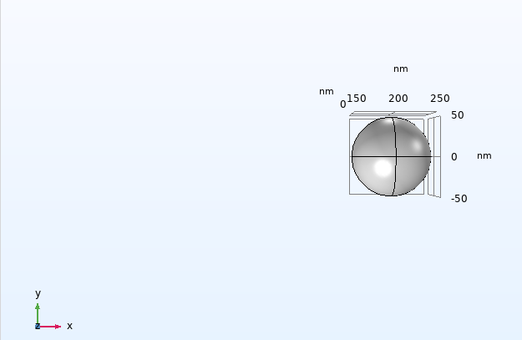
Fine = 1320, x=200nm

Slide 4
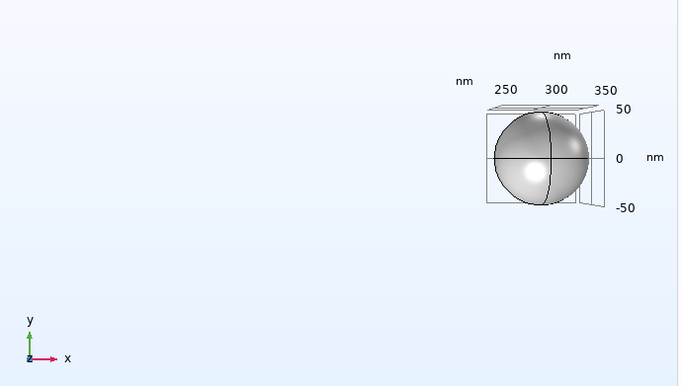
Fine = 1320, x=300nm

Slide 5
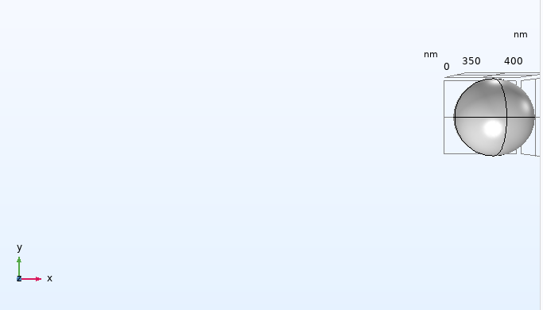
Fine = 1320, x=400nm

Slide 6
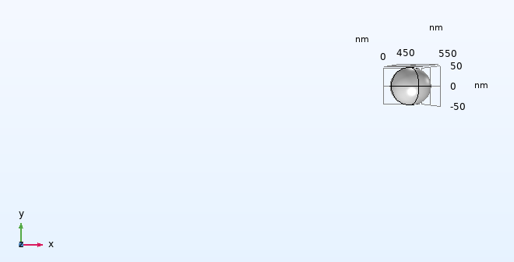
Fine = 1320, x=500nm

