Slide 1
Modelling of the patients survived 1 year using Data Mining Technique
Name : Muhammad Nazman Bin Mohd Nasir
ID No. : 2018249406
Group : CS2425A
Other Members :
1. Syed Anand Najmi Bin Sayed Abu Bashar (2018439602)
2. Muhammad Fikri Bin Abdullah (2018201142)
3. Khairul Irsyad Bin Mohd Hiffni (2019998689)

Slide 2
1.0 Introduction
A hospital in the province of Greenland has been trying to improve its care conditions by looking at historic survival of the patients. They tried looking at their data but could not identify the main factors leading to high survivals. The dataset contains the patient records collected from a hospital in Greenland. The "Survived1year" column is a target variable that has binary entries (0 or 1).
Problem statement
The data set is used to identify if the patients will survive after 1 year of treatment or not. Hence, the target variable is whether the patient survived after one year of treatment or not which will be referred to as ‘y’ as in the data set. This target variable is a binary variable with its respective value :
0 = did not survive after 1 year treatment
1 = survive after 1 year treatment
Objectives
To predict the probabilities of patients survive after 1 year of treatment. In this project, there are several objectives that needed to be achieve :
Construct the best model for each predictive model that we learned which are Decision Tree, Logistic Regression, and Neural Network.
Perform the model scoring on those predictive models.
Compare all three predictive models and choose the best out of that three in predicting the chances of survival of patients after 1 year.
Limitation
The data set is a secondary data that are distributed online.

Slide 3
2.0 DATA DESCRIPTION
Data Name : Patient Survival After One year of Treatment
Data Source : kaggle.com/rsrishav/patient-survival-after-one-year-of-treatment
Data Size : 33013 observations
Variables : variables
Target variable : y (did the patients survived after one year of treatment?)
(y=1) ~ patients survived after one year of treatment
(y=0) ~ patients did not survived after one year of treatment
Input variables : variables
Rejected variable : variable
The rejected variable was rejected because the number of missing values in the variable is more than half the data size. (More than 50% total observations)

Slide 4
2.0 DATA DESCRIPTION
Data :
Data :
Variable Name | Role | Variable Type | Description
Survived1year Or y | Target | Binary | 1 = patients survived after 1 year 0 = patients did not survive after 1 year
IDPatientCare_Situation | Input | Numerical | Care situation of a patient during treatment
Diagnosed_ Condition | Input | Numerical | The diagnosed condition of the patient
ID_Patient | Input | Numerical | Patient identifier number
Treatmentwithdrugs | Input | Categorical | Class of drugs used during treatment
Patient_Age | Input | Numerical | Age of the patient
PatientBodyMass_Index | Input | Numerical | A calculated value based on the patient’s weight, height, etc.
Patient_Smoker | Input | Binary | If the patient was a smoker or not
Variable Name | Role | Variable Type | Description
PatientRuralUrban | Input | Binary | If the patient stayed in Rural or Urban part of the country
A | Input | Binary | The previous condition of patient was A or not
B | Input | Binary | The previous condition of patient was B or not
C | Input | Binary | The previous condition of patient was C or not
D | Input | Binary | The previous condition of patient was D or not
E | Input | Binary | The previous condition of patient was E or not
F | Input | Binary | The previous condition of patient was F or not
Z | Input | Binary | The previous condition of patient was Z or not
*Notes : the unknown data is treated as missing values

Slide 5
2.0 DATA DESCRIPTION
Data:
Variable Name | Role | Variable Type | Description
PreviousCondition | Input | Categorical | Condition of the patient before the start of the treatment ( This variable is splitted into 8 columns - A, B, C, D, E, F, Z and Numberofprevcond. A, B, C, D, E, F and Z are the previous conditions of the patient. Suppose for one patient, if the entry in column A is 1, it means that the previous condition of the patient was A. If the patient didn't have that condition, it is 0 and same for other conditions. If a patient has previous condition as A and C , columns A and C will have entries as 1 and 1 respectively while the other column B, D, E, F, Z will have entries 0, 0, 0, 0, 0 respectively. The column Numberofprev_cond will have entry as 2 i.e. 1 + 0 + 1 + 0 + 0 + 0 + 0 + 0 = 2 in this case. )
*Notes : the unknown data is treated as missing values

Slide 6

3.0 DATA EXPLORATION AND MANAGEMENT
3.1 DATA EXPLORATION
In data exploration, we explore our data to find out whether there are any typo errors, missing values, skewed data or outliers. So, we use Multiplot node to connect it to our data source and run it.
After using multiplot node, we found out that:
A has 2356 missing values
B has 2356 missing values
C has 2356 missing values
D has 2356 missing values
E has 2356 missing values
F has 2356 missing values
Z has 2356 missing values
Number_of_prev_cond has 2356 missing values
Patient_Rural_Urban has 1000 missing values
Patient_smoker has 1000 missing values
Survived_1_year has 1000 missing values
Treated_with_drugs has 1008 missing values

Slide 7
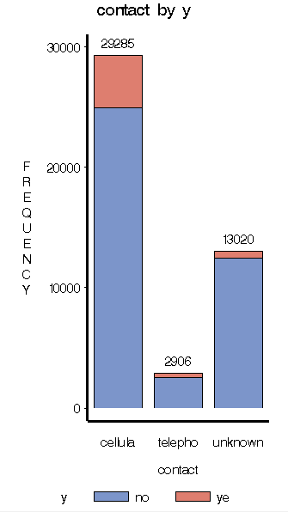
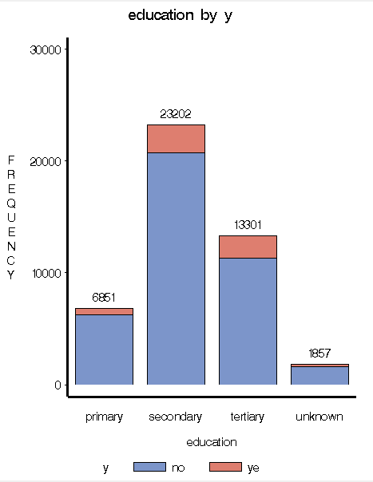
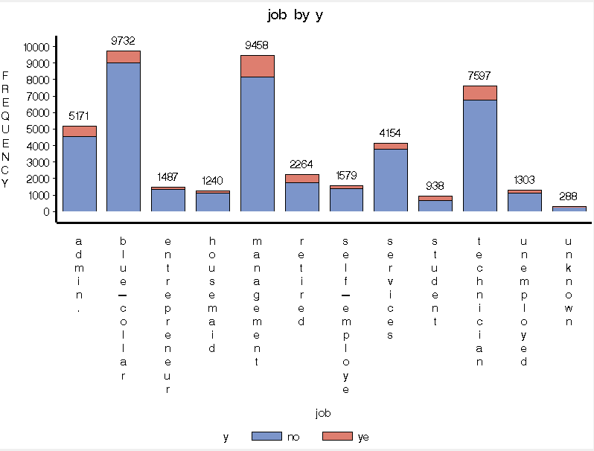
3.0 DATA EXPLORATION AND MANAGEMENT
3.1 DATA EXPLORATION
In data exploration, we explore our data to find out whether there are any typo errors, missing values, skewed data or outliers. So, we use Multiplot node to connect it to our data source and run it.
From the results, there are 3 variable with missing values denoted as unknown which can be seen in train graph. In the contact variable, there are 13020 unknown contact, in the education variable, there are 1857 unknown education and in the job variable, there are 288 unknown job.

Slide 8
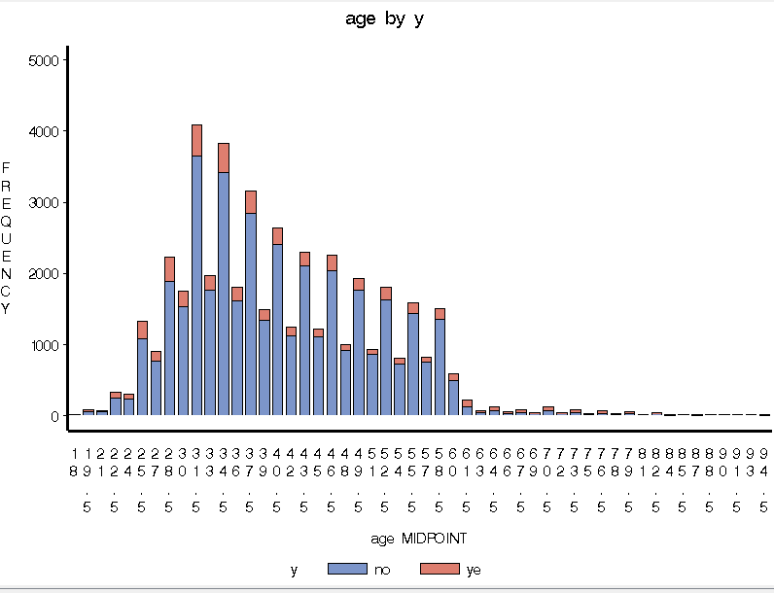
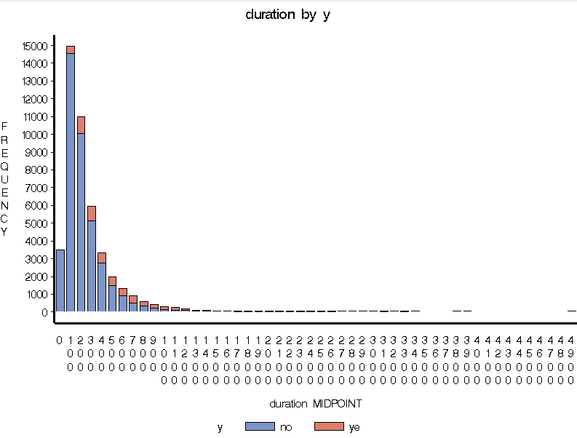
3.0 DATA EXPLORATION AND MANAGEMENT
3.1 DATA EXPLORATION
Additionally, there are 2 graphs which are skewed in shape which are under age and duration variable. We can see from the train graphs below.

Slide 9
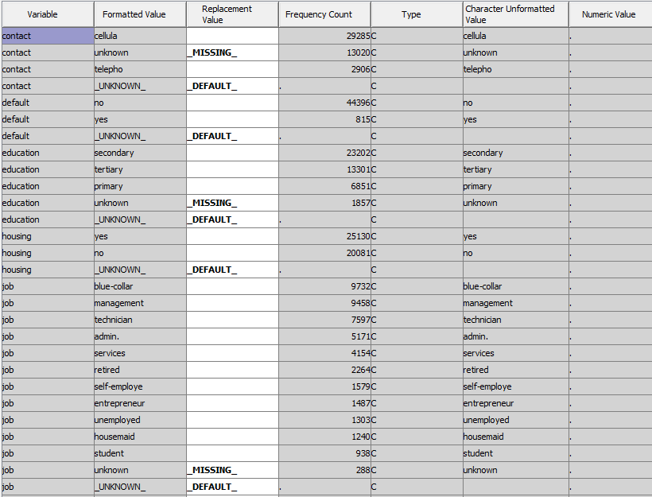
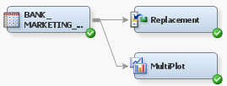
3.0 DATA EXPLORATION AND MANAGEMENT
3.2 DATA MANAGEMENT
In order to handle the problem, there are 3 nodes that were used:
Replacement node,
Impute node and,
Transform Variables node.
Replacement node
To treat the unknown input as missing values, we connect the replacement node to data source, in the properties panel, click the ellipses that represent the value of Replacement Editor under Class Variables.
Using the keyword _MISSING_ , we replace the unknown input to missing values by inserting keyword into the column Replacement Value next to the unknown.
*For interval variables, we did
some filtering to some of
the variables that are age,
balance, campaign, duration,
pdays and previous. All this are
done under Replacement Editor
in the Interval variables class.

Slide 10
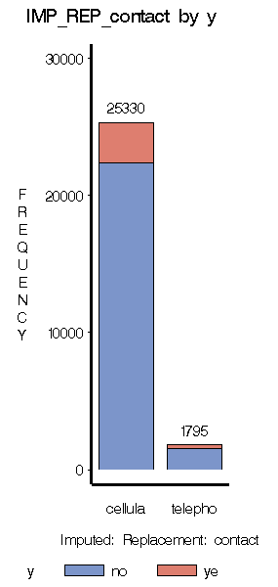
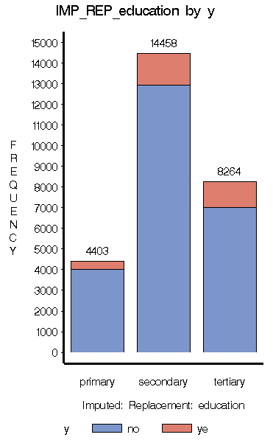
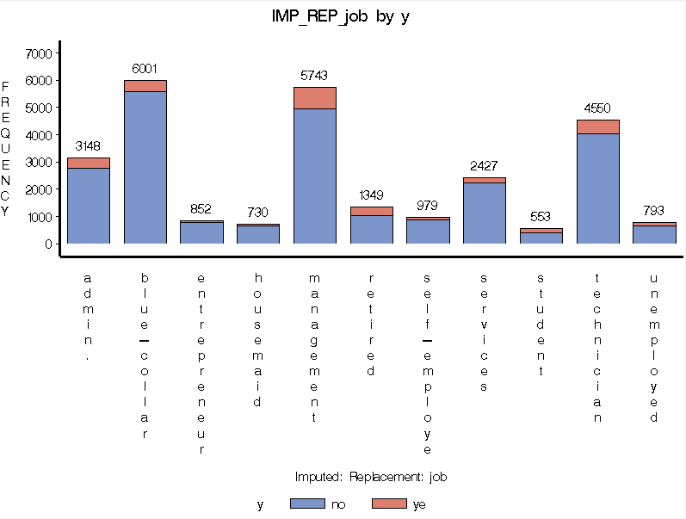
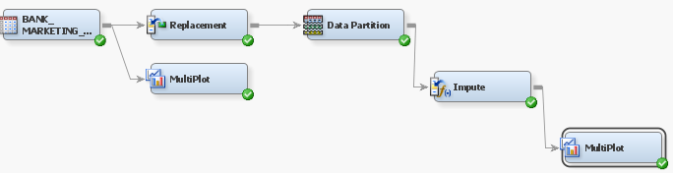
3.0 DATA EXPLORATION AND MANAGEMENT
3.2 DATA MANAGEMENT
Impute node
After replacing the unknown to missing values, we add impute node to deal with the missing values. If the variable is numerical (interval) variable, the missing value is imputed using mean. If the variable is categorical variable, then the missing value is imputed using mode
Hence, we connect the impute node after replacement node (based in figure below, impute node is connected after data partition node. Data partition node is used to partition data into training data set and validation data set) and also connect the Multiplot node to the impute node then run it.
We can see in the result from Multiplot node in train graph. Since the missing values are only in categorical variable, they were imputed using mode. In contact variable, the missing value is imputed into cellular, in education variable, missing value is imputed into secondary and in the job variable, missing value is imputed into blue-collar.

Slide 11
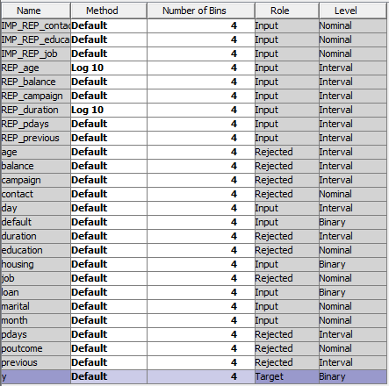
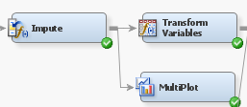
3.0 DATA EXPLORATION AND MANAGEMENT
3.2 DATA MANAGEMENT
Transform Variables node
In order to handle the skewness of the graph, we transform the variable using Transform Variables node.
We connect the Transform Variables node to Impute node. In the properties panel, click the ellipses that represents the value of Variables. Then change the method for REP_age and REP_duration variables to Log 10.

Slide 12
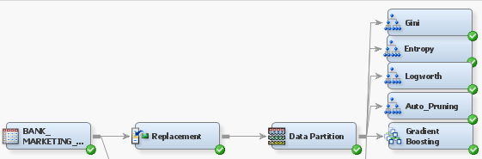
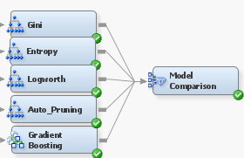
4.0 Building Predictive Model
First we need to partition the data into training data set and validation data. Using the Data Partition node, we partition the data as 60% training data set and 40% validation data set. After that, we can start in constructing the predictive model.
4.1 DECISION TREE MODEL
4.1.1 MODEL ASSESSMENT
We construct 5 Decision Tree (DT) node that are Gini, Entropy, Logworth(Chi-Square), Auto Pruning and Gradient Boosting. Then, we connect all 5 to Model Comparison node and run it.
This way, we can assess which model are the best model in the decision tree. From the results after running the Model Comparison node, we can evaluate the results of fit statistics to determine underfit, overfit and the best model.
In order to determine underfit model, the model perform well in validation data but poorly in training data.
For overfit model, it can be examined through the gap in the accuracy / error measures between training and validation results. Large gaps may indicate the existence of overfitting.

Slide 13
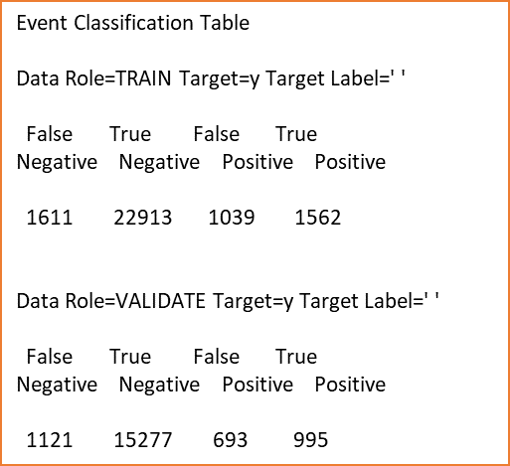
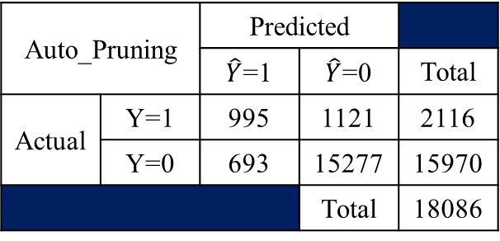
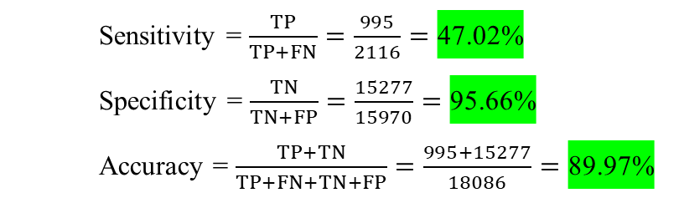
4.1 DECISION TREE MODEL
4.1.1 MODEL ASSESSMENT
The result of the fit statistics is as follows :
Underfit model : No underfit model.
Overfit model : Decision Tree Gini is the overfit model since it has the largest gap in overall gap.
Best model : Decision Tree Auto_Pruning is the best model because it has the least average squared error and the largest ROC index
BEST MODEL
Auto_Pruning
Confusion Matrix for Auto_Pruning.
*The value must be taken from Data Role=VALIDATE
Auto_Pruning |  | Predicted
 |  | $\hat{Y}$=1 | $\hat{Y}$=0 | Total
Actual | Y=1 | 995 | 1121 | 2116
 | Y=0 | 693 | 15277 | 15970
 |  |  | Total | 18086
Sensitivity = $\frac{TP}{TP+FN}=\frac{995}{2116}=\text{47.02\%}$
Specificity = $\frac{TN}{TN+FP}=\frac{15277}{15970}=\text{95.66\%}$
Accuracy = $\frac{TP+TN}{TP+FN+TN+FP}=\frac{995+15277}{18086}=\text{89.97\%}$
The model is better in predicting negative targets, P(Y=0), rather than positive targets, P(Y=1) because the value of specificity (95.66%) is higher than sensitivity(47.02%) and the accuracy is 89.97%

Slide 14
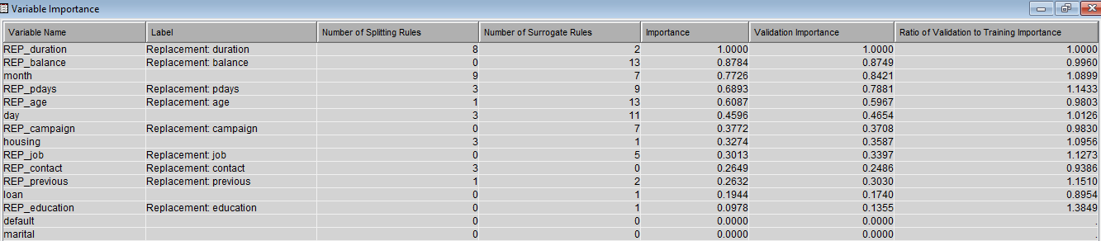
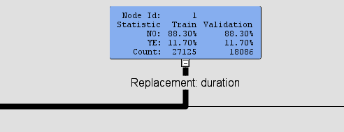
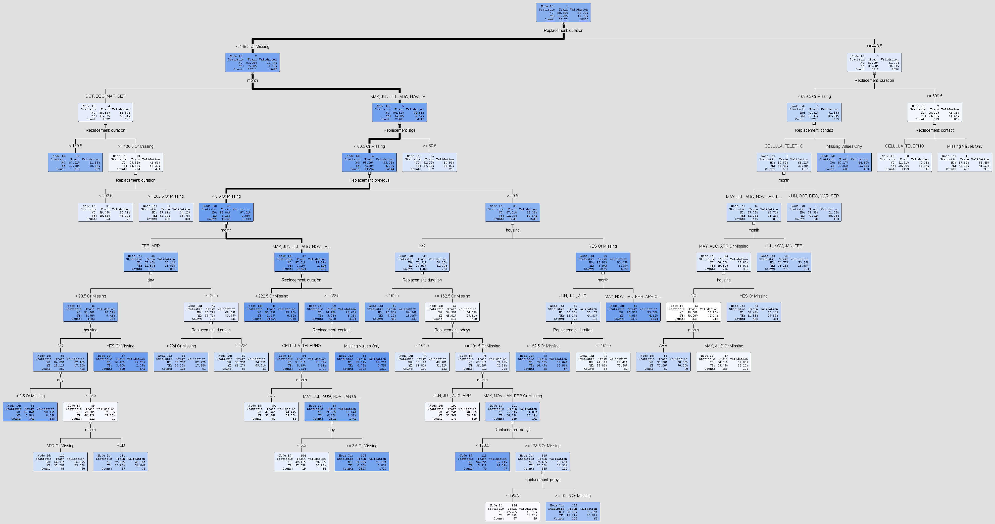
4.1 DECISION TREE MODEL
Variable Importance
4.1.2 MODEL SCORING
Based on Variable Importance and Decision Tree :
There are 32 rules represented by the number of leaves on the decision tree.
Depth= 10
And there are 27125 observations used in growing the tree.
There are 8 input variables that are used in growing decision tree.
The most important variable is REP_duration.
month variable is being used 9 times while REP_duration is being used 8 times in growing the decision tree. In addition, REP_pdays, day, housing and REP_contact are used 3 times in growing the decision tree. The rest that are REP_age and REP_previous are being used once in the decision tree as the split.
Decision Tree (Auto_Pruning)

Slide 15
ENGLISH RULE:
*------------------------------------------------------------*
Node = 9
*------------------------------------------------------------*
if Replacement: duration < 699.5 AND Replacement: duration >= 448.5 or MISSING
AND Replacement: contact equals Missing
then
Tree Node Identifier = 9
Number of Observations = 608
Predicted: y=ye = 0.13
Predicted: y=no = 0.87
*------------------------------------------------------------*
Node = 10
*------------------------------------------------------------*
if Replacement: duration >= 699.5
AND Replacement: contact IS ONE OF: CELLULA, TELEPHO
then
Tree Node Identifier = 10
Number of Observations = 1193
Predicted: y=ye = 0.58
Predicted: y=no = 0.42
*------------------------------------------------------------*
Node = 11
*------------------------------------------------------------*
if Replacement: duration >= 699.5
AND Replacement: contact equals Missing
then
Tree Node Identifier = 11
Number of Observations = 420
Predicted: y=ye = 0.42
Predicted: y=no = 0.58
*------------------------------------------------------------*
Node = 12
*------------------------------------------------------------*
if month IS ONE OF: OCT, DEC, MAR, SEP
AND Replacement: duration < 130.5
then
Tree Node Identifier = 12
Number of Observations = 318
Predicted: y=ye = 0.13
Predicted: y=no = 0.87
*------------------------------------------------------------*
Node = 15
*------------------------------------------------------------*
if month IS ONE OF: MAY, JUN, JUL, AUG, NOV, JAN, FEB, APR or MISSING
AND Replacement: duration < 448.5 or MISSING
AND Replacement: age >= 60.5
then
Tree Node Identifier = 15
Number of Observations = 387
Predicted: y=ye = 0.38
Predicted: y=no = 0.62
*------------------------------------------------------------*
Node = 17
*------------------------------------------------------------*
if month IS ONE OF: JUN, OCT, DEC, MAR, SEP
AND Replacement: duration < 699.5 AND Replacement: duration >= 448.5 or MISSING
AND Replacement: contact IS ONE OF: CELLULA, TELEPHO
then
Tree Node Identifier = 17
Number of Observations = 142
Predicted: y=ye = 0.70
Predicted: y=no = 0.30
*------------------------------------------------------------*
Node = 26
*------------------------------------------------------------*
if month IS ONE OF: OCT, DEC, MAR, SEP
AND Replacement: duration < 202.5 AND Replacement: duration >= 130.5
then
Tree Node Identifier = 26
Number of Observations = 254
Predicted: y=ye = 0.41
Predicted: y=no = 0.59
*------------------------------------------------------------*
Node = 27
*------------------------------------------------------------*
if month IS ONE OF: OCT, DEC, MAR, SEP
AND Replacement: duration < 448.5 AND Replacement: duration >= 202.5 or MISSING
then
Tree Node Identifier = 27
Number of Observations = 460
Predicted: y=ye = 0.62
Predicted: y=no = 0.38
*------------------------------------------------------------*
Node = 33
*------------------------------------------------------------*
if month IS ONE OF: JUL, NOV, JAN, FEB
AND Replacement: duration < 699.5 AND Replacement: duration >= 448.5 or MISSING
AND Replacement: contact IS ONE OF: CELLULA, TELEPHO
then
Tree Node Identifier = 33
Number of Observations = 773
Predicted: y=ye = 0.25
Predicted: y=no = 0.75
*------------------------------------------------------------*
Node = 43
*------------------------------------------------------------*
if month IS ONE OF: MAY, AUG, APR or MISSING
AND housing IS ONE OF: YES or MISSING
AND Replacement: duration < 699.5 AND Replacement: duration >= 448.5 or MISSING
AND Replacement: contact IS ONE OF: CELLULA, TELEPHO
then
Tree Node Identifier = 43
Number of Observations = 450
Predicted: y=ye = 0.32
Predicted: y=no = 0.68
*------------------------------------------------------------*
Node = 48
*------------------------------------------------------------*
if month IS ONE OF: MAY, JUN, JUL, AUG, NOV, JAN or MISSING
AND Replacement: previous < 0.5 or MISSING
AND Replacement: duration < 222.5 or MISSING
AND Replacement: age < 60.5 or MISSING
then
Tree Node Identifier = 48
Number of Observations = 11754
Predicted: y=ye = 0.01
Predicted: y=no = 0.99
*------------------------------------------------------------*
Node = 50
*------------------------------------------------------------*
if month IS ONE OF: MAY, JUN, JUL, AUG, NOV, JAN, FEB, APR or MISSING
AND housing IS ONE OF: NO
AND Replacement: previous >= 0.5
AND Replacement: duration < 162.5
AND Replacement: age < 60.5 or MISSING
then
Tree Node Identifier = 50
Number of Observations = 489
Predicted: y=ye = 0.09
Predicted: y=no = 0.91
*------------------------------------------------------------*
Node = 53
*------------------------------------------------------------*
if month IS ONE OF: MAY, NOV, JAN, FEB, APR or MISSING
AND housing IS ONE OF: YES or MISSING
AND Replacement: previous >= 0.5
AND Replacement: duration < 448.5 or MISSING
AND Replacement: age < 60.5 or MISSING
then
Tree Node Identifier = 53
Number of Observations = 2377
Predicted: y=ye = 0.04
Predicted: y=no = 0.96
*------------------------------------------------------------*
Node = 56
*------------------------------------------------------------*
if month IS ONE OF: APR
AND housing IS ONE OF: NO
AND Replacement: duration < 699.5 AND Replacement: duration >= 448.5 or MISSING
AND Replacement: contact IS ONE OF: CELLULA, TELEPHO
then
Tree Node Identifier = 56
Number of Observations = 60
Predicted: y=ye = 0.70
Predicted: y=no = 0.30
*------------------------------------------------------------*
Node = 57
*------------------------------------------------------------*
if month IS ONE OF: MAY, AUG or MISSING
AND housing IS ONE OF: NO
AND Replacement: duration < 699.5 AND Replacement: duration >= 448.5 or MISSING
AND Replacement: contact IS ONE OF: CELLULA, TELEPHO
then
Tree Node Identifier = 57
Number of Observations = 266
Predicted: y=ye = 0.45
Predicted: y=no = 0.55
*------------------------------------------------------------*
Node = 65
*------------------------------------------------------------*
if month IS ONE OF: MAY, JUN, JUL, AUG, NOV, JAN or MISSING
AND Replacement: previous < 0.5 or MISSING
AND Replacement: duration < 448.5 AND Replacement: duration >= 222.5
AND Replacement: contact equals Missing
AND Replacement: age < 60.5 or MISSING
then
Tree Node Identifier = 65
Number of Observations = 1976
Predicted: y=ye = 0.01
Predicted: y=no = 0.99
*------------------------------------------------------------*
Node = 67
*------------------------------------------------------------*
if month IS ONE OF: FEB, APR
AND housing IS ONE OF: YES or MISSING
AND day < 20.5 or MISSING
AND Replacement: previous < 0.5 or MISSING
AND Replacement: duration < 448.5 or MISSING
AND Replacement: age < 60.5 or MISSING
then
Tree Node Identifier = 67
Number of Observations = 820
Predicted: y=ye = 0.04
Predicted: y=no = 0.96
*------------------------------------------------------------*
Node = 68
*------------------------------------------------------------*
if month IS ONE OF: FEB, APR
AND day >= 20.5
AND Replacement: previous < 0.5 or MISSING
AND Replacement: duration < 224 or MISSING
AND Replacement: age < 60.5 or MISSING
then
Tree Node Identifier = 68
Number of Observations = 126
Predicted: y=ye = 0.22
Predicted: y=no = 0.78
*------------------------------------------------------------*
Node = 69
*------------------------------------------------------------*
if month IS ONE OF: FEB, APR
AND day >= 20.5
AND Replacement: previous < 0.5 or MISSING
AND Replacement: duration < 448.5 AND Replacement: duration >= 224
AND Replacement: age < 60.5 or MISSING
then
Tree Node Identifier = 69
Number of Observations = 83
Predicted: y=ye = 0.66
Predicted: y=no = 0.34
*------------------------------------------------------------*
Node = 74
*------------------------------------------------------------*
if month IS ONE OF: MAY, JUN, JUL, AUG, NOV, JAN, FEB, APR or MISSING
AND housing IS ONE OF: NO
AND Replacement: previous >= 0.5
AND Replacement: pdays < 101.5
AND Replacement: duration < 448.5 AND Replacement: duration >= 162.5 or MISSING
AND Replacement: age < 60.5 or MISSING
then
Tree Node Identifier = 74
Number of Observations = 199
Predicted: y=ye = 0.62
Predicted: y=no = 0.38
*------------------------------------------------------------*
Node = 76
*------------------------------------------------------------*
if month IS ONE OF: JUN, JUL, AUG
AND housing IS ONE OF: YES or MISSING
AND Replacement: previous >= 0.5
AND Replacement: duration < 162.5 or MISSING
AND Replacement: age < 60.5 or MISSING
then
Tree Node Identifier = 76
Number of Observations = 86
Predicted: y=ye = 0.10
Predicted: y=no = 0.90
*------------------------------------------------------------*
Node = 77
*------------------------------------------------------------*
if month IS ONE OF: JUN, JUL, AUG
AND housing IS ONE OF: YES or MISSING
AND Replacement: previous >= 0.5
AND Replacement: duration < 448.5 AND Replacement: duration >= 162.5
AND Replacement: age < 60.5 or MISSING
then
Tree Node Identifier = 77
Number of Observations = 86
Predicted: y=ye = 0.56
Predicted: y=no = 0.44
*------------------------------------------------------------*
Node = 84
*------------------------------------------------------------*
if month IS ONE OF: JUN
AND Replacement: previous < 0.5 or MISSING
AND Replacement: duration < 448.5 AND Replacement: duration >= 222.5
AND Replacement: contact IS ONE OF: CELLULA, TELEPHO
AND Replacement: age < 60.5 or MISSING
then
Tree Node Identifier = 84
Number of Observations = 82
Predicted: y=ye = 0.59
Predicted: y=no = 0.41
*------------------------------------------------------------*
Node = 88
*------------------------------------------------------------*
if month IS ONE OF: FEB, APR
AND housing IS ONE OF: NO
AND day < 9.5 or MISSING
AND Replacement: previous < 0.5 or MISSING
AND Replacement: duration < 448.5 or MISSING
AND Replacement: age < 60.5 or MISSING
then
Tree Node Identifier = 88
Number of Observations = 540
Predicted: y=ye = 0.08
Predicted: y=no = 0.92
*------------------------------------------------------------*
Node = 100
*------------------------------------------------------------*
if month IS ONE OF: JUN, JUL, AUG, APR
AND housing IS ONE OF: NO
AND Replacement: previous >= 0.5
AND Replacement: pdays >= 101.5 or MISSING
AND Replacement: duration < 448.5 AND Replacement: duration >= 162.5 or MISSING
AND Replacement: age < 60.5 or MISSING
then
Tree Node Identifier = 100
Number of Observations = 173
Predicted: y=ye = 0.54
Predicted: y=no = 0.46
*------------------------------------------------------------*
Node = 104
*------------------------------------------------------------*
if month IS ONE OF: MAY, JUL, AUG, NOV, JAN or MISSING
AND day < 3.5
AND Replacement: previous < 0.5 or MISSING
AND Replacement: duration < 448.5 AND Replacement: duration >= 222.5
AND Replacement: contact IS ONE OF: CELLULA, TELEPHO
AND Replacement: age < 60.5 or MISSING
then
Tree Node Identifier = 104
Number of Observations = 19
Predicted: y=ye = 0.58
Predicted: y=no = 0.42
*------------------------------------------------------------*
Node = 105
*------------------------------------------------------------*
if month IS ONE OF: MAY, JUL, AUG, NOV, JAN or MISSING
AND day >= 3.5 or MISSING
AND Replacement: previous < 0.5 or MISSING
AND Replacement: duration < 448.5 AND Replacement: duration >= 222.5
AND Replacement: contact IS ONE OF: CELLULA, TELEPHO
AND Replacement: age < 60.5 or MISSING
then
Tree Node Identifier = 105
Number of Observations = 2623
Predicted: y=ye = 0.06
Predicted: y=no = 0.94

Slide 16
ENGLISH RULE:
Based on the English rule :
There are 32 rules which are equal to number of leaves
And 12 rules are used to predict P(Y=1) – has subscribed to a term deposit
And 20 rules are used to predict P(Y=0) – has not subscribed to a term deposit
There are 27125 observations used to grow the decision tree which is equal to the sum of observation in English Rule.
List of profiles/characters that has subscribed to a term deposit, P(Y=1)
*------------------------------------------------------------*
Node = 110
*------------------------------------------------------------*
if month IS ONE OF: APR or MISSING
AND housing IS ONE OF: NO
AND day < 20.5 AND day >= 9.5
AND Replacement: previous < 0.5 or MISSING
AND Replacement: duration < 448.5 or MISSING
AND Replacement: age < 60.5 or MISSING
then
Tree Node Identifier = 110
Number of Observations = 85
Predicted: y=ye = 0.35
Predicted: y=no = 0.65
*------------------------------------------------------------*
Node = 111
*------------------------------------------------------------*
if month IS ONE OF: FEB
AND housing IS ONE OF: NO
AND day < 20.5 AND day >= 9.5
AND Replacement: previous < 0.5 or MISSING
AND Replacement: duration < 448.5 or MISSING
AND Replacement: age < 60.5 or MISSING
then
Tree Node Identifier = 111
Number of Observations = 37
Predicted: y=ye = 0.73
Predicted: y=no = 0.27
*------------------------------------------------------------*
Node = 118
*------------------------------------------------------------*
if month IS ONE OF: MAY, NOV, JAN, FEB or MISSING
AND housing IS ONE OF: NO
AND Replacement: previous >= 0.5
AND Replacement: pdays < 178.5 AND Replacement: pdays >= 101.5
AND Replacement: duration < 448.5 AND Replacement: duration >= 162.5 or MISSING
AND Replacement: age < 60.5 or MISSING
then
Tree Node Identifier = 118
Number of Observations = 70
Predicted: y=ye = 0.06
Predicted: y=no = 0.94
*------------------------------------------------------------*
Node = 134
*------------------------------------------------------------*
if month IS ONE OF: MAY, NOV, JAN, FEB or MISSING
AND housing IS ONE OF: NO
AND Replacement: previous >= 0.5
AND Replacement: pdays < 195.5 AND Replacement: pdays >= 178.5
AND Replacement: duration < 448.5 AND Replacement: duration >= 162.5 or MISSING
AND Replacement: age < 60.5 or MISSING
then
Tree Node Identifier = 134
Number of Observations = 67
Predicted: y=ye = 0.52
Predicted: y=no = 0.48
*------------------------------------------------------------*
Node = 135
*------------------------------------------------------------*
if month IS ONE OF: MAY, NOV, JAN, FEB or MISSING
AND housing IS ONE OF: NO
AND Replacement: previous >= 0.5
AND Replacement: pdays >= 195.5 or MISSING
AND Replacement: duration < 448.5 AND Replacement: duration >= 162.5 or MISSING
AND Replacement: age < 60.5 or MISSING
then
Tree Node Identifier = 135
Number of Observations = 102
Predicted: y=ye = 0.20
Predicted: y=no = 0.80
if Replacement: duration >= 699.5 AND Replacement: contact IS ONE OF: CELLULA, TELEPHO
if month IS ONE OF: JUN, OCT, DEC, MAR, SEP AND Replacement: duration < 699.5 AND Replacement: duration >= 448.5 or MISSING AND Replacement: contact IS ONE OF: CELLULA, TELEPHO
if month IS ONE OF: OCT, DEC, MAR, SEP AND Replacement: duration < 448.5 AND Replacement: duration >= 202.5 or MISSING
if month IS ONE OF: APR AND housing IS ONE OF: NO AND Replacement: duration < 699.5 AND Replacement: duration >= 448.5 or MISSING AND Replacement: contact IS ONE OF: CELLULA, TELEPHO
if month IS ONE OF: FEB, APR AND day >= 20.5 AND Replacement: previous < 0.5 or MISSING AND Replacement: duration < 448.5 AND Replacement: duration >= 224 AND Replacement: age < 60.5 or MISSING
if month IS ONE OF: MAY, JUN, JUL, AUG, NOV, JAN, FEB, APR or MISSING AND housing IS ONE OF: NO AND Replacement: previous >= 0.5 AND Replacement: pdays < 101.5 AND Replacement: duration < 448.5 AND Replacement: duration >= 162.5 or MISSING AND Replacement: age < 60.5 or MISSING
if month IS ONE OF: JUN, JUL, AUG AND housing IS ONE OF: YES or MISSING AND Replacement: previous >= 0.5 AND Replacement: duration < 448.5 AND Replacement: duration >= 162.5 AND Replacement: age < 60.5 or MISSING
if month IS ONE OF: JUN AND Replacement: previous < 0.5 or MISSING AND Replacement: duration < 448.5 AND Replacement: duration >= 222.5 AND Replacement: contact IS ONE OF: CELLULA, TELEPHO AND Replacement: age < 60.5 or MISSING
if month IS ONE OF: JUN, JUL, AUG, APR AND housing IS ONE OF: NO AND Replacement: previous >= 0.5 AND Replacement: pdays >= 101.5 or MISSING AND Replacement: duration < 448.5 AND Replacement: duration >= 162.5 or MISSING AND Replacement: age < 60.5 or MISSING
if month IS ONE OF: MAY, JUL, AUG, NOV, JAN or MISSING AND day < 3.5 AND Replacement: previous < 0.5 or MISSING AND Replacement: duration < 448.5 AND Replacement: duration >= 222.5 AND Replacement: contact IS ONE OF: CELLULA, TELEPHO AND Replacement: age < 60.5 or MISSING
if month IS ONE OF: FEB AND housing IS ONE OF: NO AND day < 20.5 AND day >= 9.5 AND Replacement: previous < 0.5 or MISSING AND Replacement: duration < 448.5 or MISSING AND Replacement: age < 60.5 or MISSING
if month IS ONE OF: MAY, NOV, JAN, FEB or MISSING AND housing IS ONE OF: NO AND Replacement: previous >= 0.5 AND Replacement: pdays < 195.5 AND Replacement: pdays >= 178.5 AND Replacement: duration < 448.5 AND Replacement: duration >= 162.5 or MISSING AND Replacement: age < 60.5 or MISSING

Slide 17
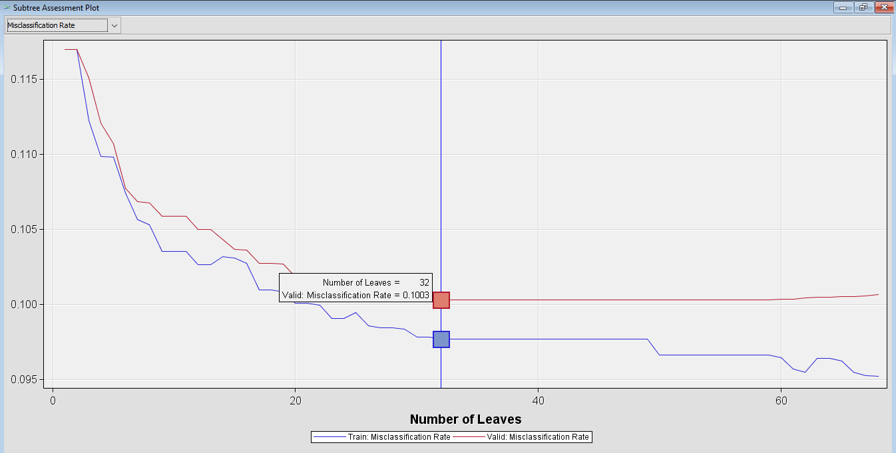

Subtree Assessment Plot (Misclassification rate)
The plot shows the misclassification rate corresponding to each subtree as the data is sequentially split. The use of this plot is to find the optimal decision tree. We need to assess the performances of a leaf tree by looking at the lowest value of misclassification rate (0.1003) on valid data set.
Therefore the optimal tree is with 32 number of leaves.
Overall Conclusion
There are 8 input variables that contributes in predicting the target (y – has the client subscribed to a term deposit )
The most important variable that is used first to split is REP_duration.
There are 32 rules in which
12 profiles are used to predict P(Y=1) – has subscribed to a term deposit
And 20 profiles are used to predict P(Y=0) – has not subscribed to a term deposit.
There are 27125 observations used in growing the decision tree.

Slide 18
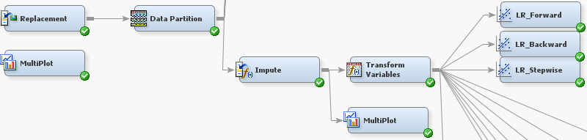
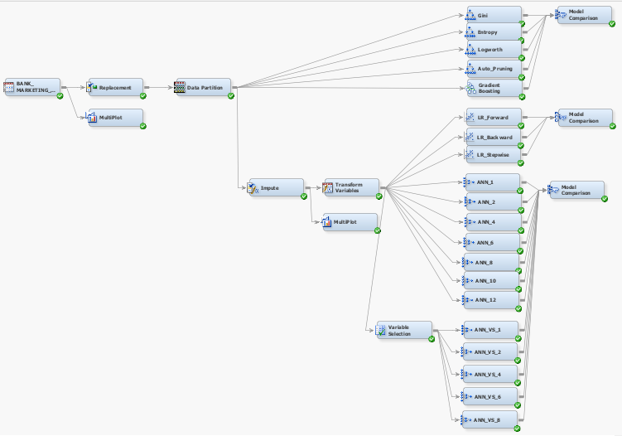
4.2 LOGISTICS REGRESSION MODEL
4.2.1 MODEL ASSESSMENT
Before finding the best model in Logistic Regression (LR), we need to impute the missing values and transform the variable that are skewed. So we connect the Impute node and Transform Variables node after Data Partition. After that, we connect 3 Logistic Regression node which are Forward, Backward and Stepwise. At the end, we connect the Model Comparison node and run it.
BEST MODEL
LR_Forward
Underfit Model : No underfit model.
Overfit Model : No overfit model since absolute gap is the same for all three models
Best Model : LR_Forward is chosen as the best model because it is easier to construct

Slide 19
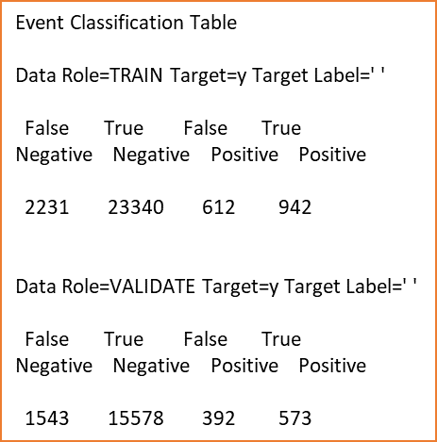
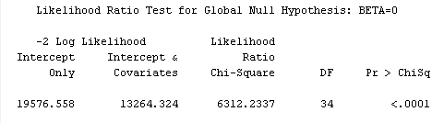
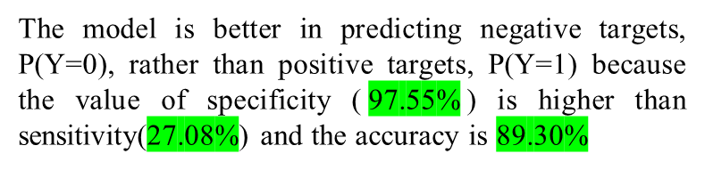
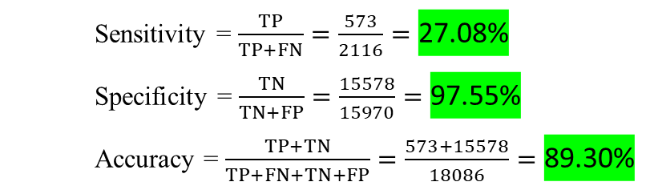

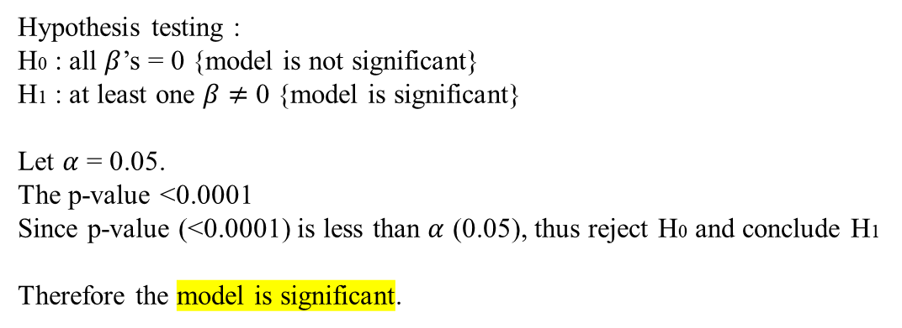
Confusion Matrix for LR_Forward.
*The value must be taken from Data Role=VALIDATE
LR_Forward |  | Predicted
 |  | $\hat{Y}$=1 | $\hat{Y}$=0 | Total
Actual | Y=1 | 573 | 1543 | 2116
 | Y=0 | 392 | 15578 | 15970
 |  |  | Total | 18086
Sensitivity = $\frac{TP}{TP+FN}=\frac{573}{2116}=\text{27.08\%}$
Specificity = $\frac{TN}{TN+FP}=\frac{15578}{15970}=\text{97.55\%}$
Accuracy = $\frac{TP+TN}{TP+FN+TN+FP}=\frac{573+15578}{18086}=\text{89.30\%}$
The model is better in predicting negative targets, P(Y=0), rather than positive targets, P(Y=1) because the value of specificity ($\text{97.5}\text{5}\text{\%}$) is higher than sensitivity($\text{27.08\%}$) and the accuracy is $\text{89.30\%}$
4.1.2 MODEL SCORING
To test for the significant of the model.
Hypothesis testing :
H0 : all $β$’s = 0 {model is not significant}
H1 : at least one $β$ $≠$ 0 {model is significant}
Let $α$ = 0.05.
The p-value <0.0001
Since p-value (<0.0001) is less than $α$ (0.05), thus reject H0 and conclude H1
Therefore the model is significant.

Slide 20
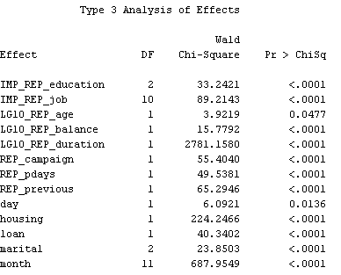
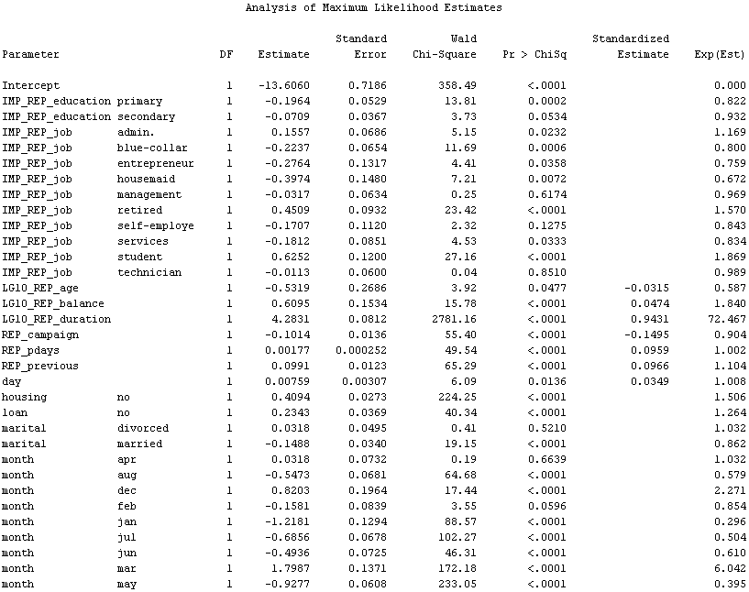
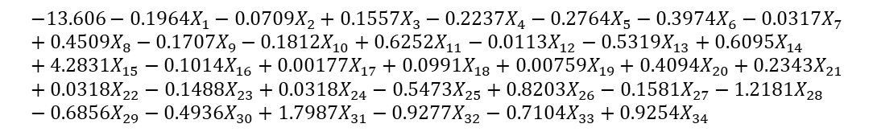

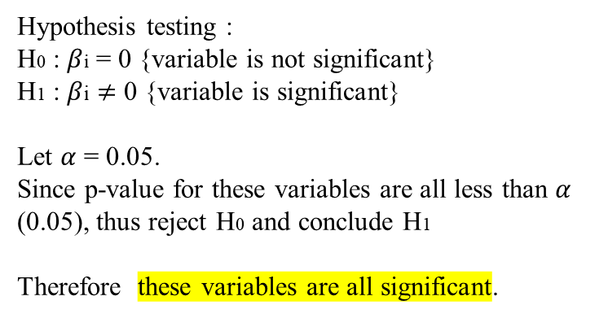
To test for the significant of the variables.
Estimated equation of predicted positive targets, P(Y=1)
Let say:
X1
X2
X3
X4
X5
.
.
.
.
.
.
.
.
.
.
.
.
.
.
.
.
.
.
.
.
.
.
.
.
.
.
.
X32
X33
X34
Hypothesis testing :
H0 : $β$i = 0 {variable is not significant}
H1 : $β$i $≠$ 0 {variable is significant}
Let $α$ = 0.05.
Since p-value for these variables are all less than $α$ (0.05), thus reject H0 and conclude H1
Therefore these variables are all significant.
P(Y=1) = $\frac{1}{1+e^{−logit}}$
logit =
$$−13.606−0.1964X_{1}−0.0709X_{2}+0.1557X_{3}−0.2237X_{4}−0.2764X_{5}−0.3974X_{6}−0.0317X_{7}+0.4509X_{8}−0.1707X_{9}−0.1812X_{10}+0.6252X_{11}−0.0113X_{12}−0.5319X_{13}+0.6095X_{14}+4.2831X_{15}−0.1014X_{16}+0.00177X_{17}+0.0991X_{18}+0.00759X_{19}+0.4094X_{20}+0.2343X_{21}+0.0318X_{22}−0.1488X_{23}+0.0318X_{24}−0.5473X_{25}+0.8203X_{26}−0.1581X_{27}−1.2181X_{28}−0.6856X_{29}−0.4936X_{30}+1.7987X_{31}−0.9277X_{32}−0.7104X_{33}+0.9254X_{34}$$

Slide 21
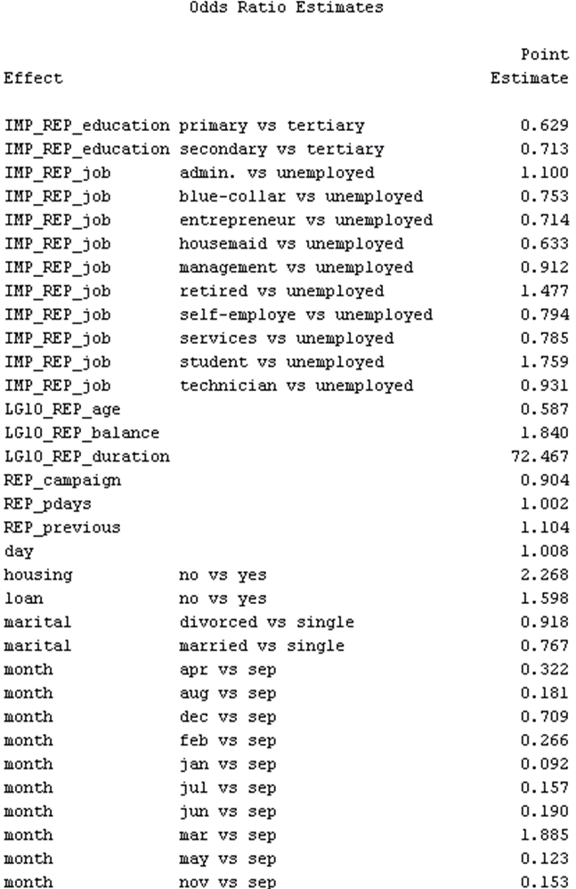
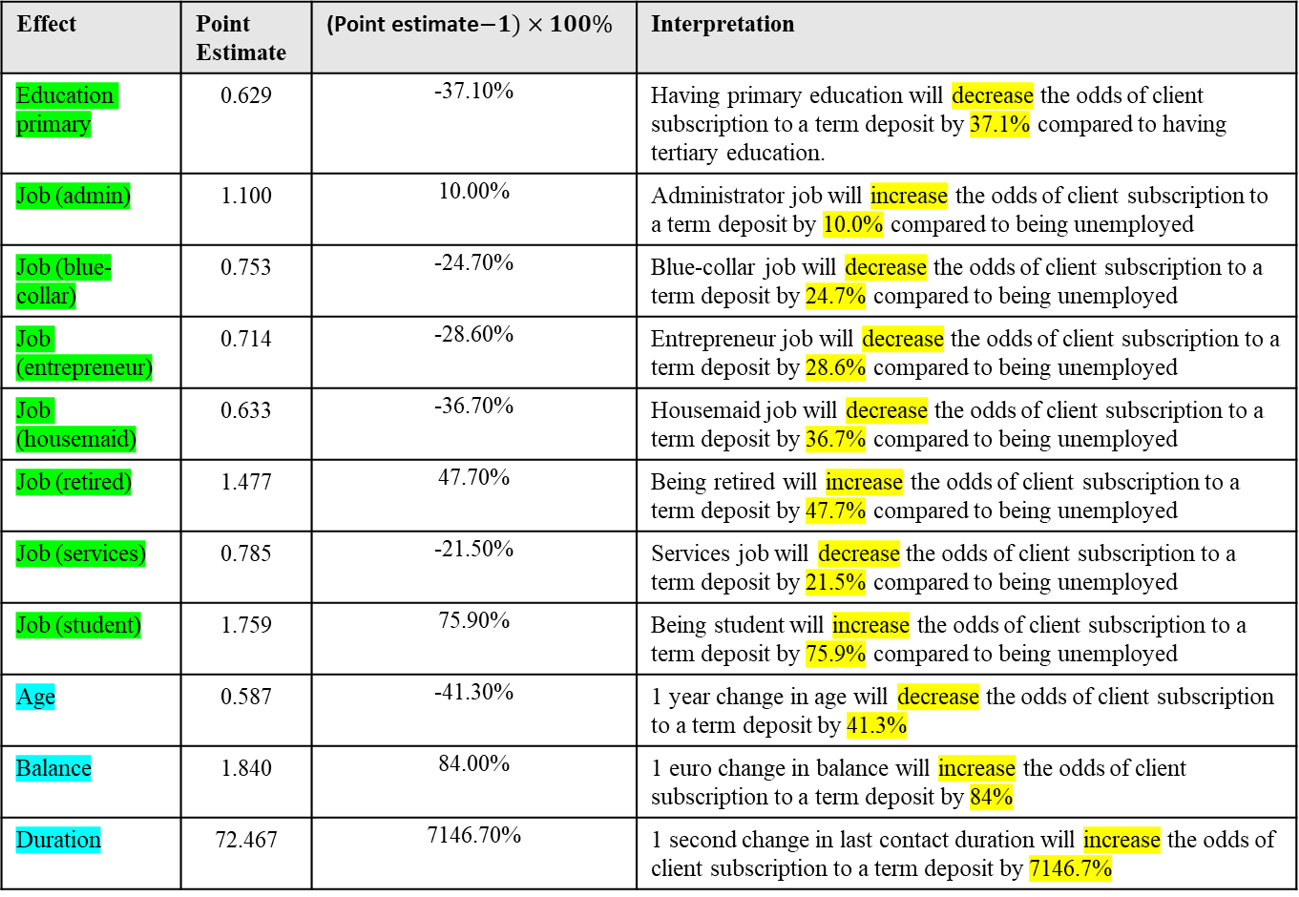
To explain odds ratio
* Yellow highlight indicate significant category
Effect | Point Estimate | (Point estimate$−1)×100\%$ | Interpretation
Education primary | 0.629 | -37.10% | Having primary education will decrease the odds of client subscription to a term deposit by 37.1% compared to having tertiary education.
Job (admin) | 1.100 | 10.00% | Administrator job will increase the odds of client subscription to a term deposit by 10.0% compared to being unemployed
Job (blue-collar) | 0.753 | -24.70% | Blue-collar job will decrease the odds of client subscription to a term deposit by 24.7% compared to being unemployed
Job (entrepreneur) | 0.714 | -28.60% | Entrepreneur job will decrease the odds of client subscription to a term deposit by 28.6% compared to being unemployed
Job (housemaid) | 0.633 | -36.70% | Housemaid job will decrease the odds of client subscription to a term deposit by 36.7% compared to being unemployed
Job (retired) | 1.477 | 47.70% | Being retired will increase the odds of client subscription to a term deposit by 47.7% compared to being unemployed
Job (services) | 0.785 | -21.50% | Services job will decrease the odds of client subscription to a term deposit by 21.5% compared to being unemployed
Job (student) | 1.759 | 75.90% | Being student will increase the odds of client subscription to a term deposit by 75.9% compared to being unemployed
Age | 0.587 | -41.30% | 1 year change in age will decrease the odds of client subscription to a term deposit by 41.3%
Balance | 1.840 | 84.00% | 1 euro change in balance will increase the odds of client subscription to a term deposit by 84%
Duration | 72.467 | 7146.70% | 1 second change in last contact duration will increase the odds of client subscription to a term deposit by 7146.7%
*Green is qualitative
*Turqoise is quantitative

Slide 22
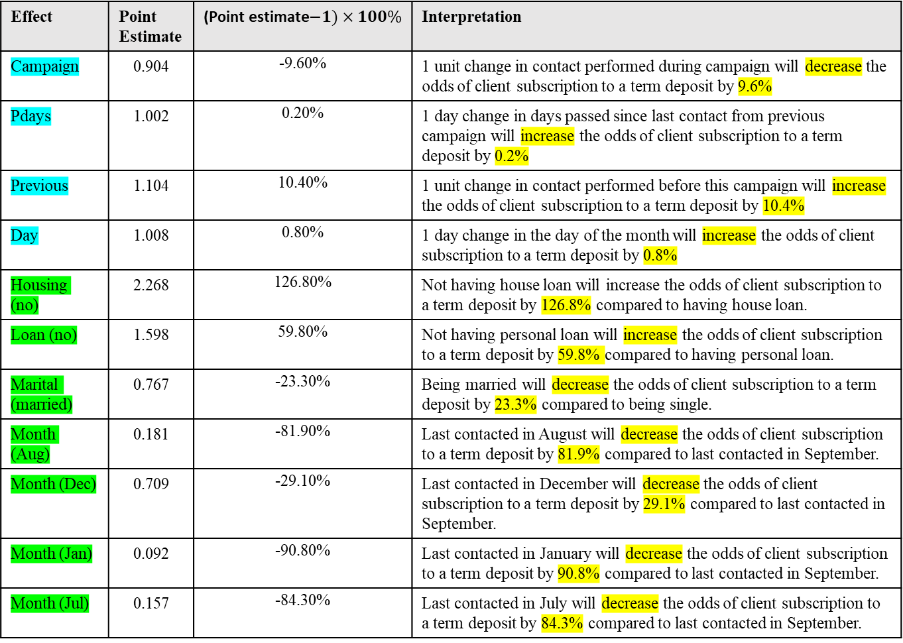
To explain odds ratio
* Yellow highlight indicate significant category
Effect | Point Estimate | (Point estimate$−1)×100\%$ | Interpretation
Campaign | 0.904 | -9.60% | 1 unit change in contact performed during campaign will decrease the odds of client subscription to a term deposit by 9.6%
Pdays | 1.002 | 0.20% | 1 day change in days passed since last contact from previous campaign will increase the odds of client subscription to a term deposit by 0.2%
Previous | 1.104 | 10.40% | 1 unit change in contact performed before this campaign will increase the odds of client subscription to a term deposit by 10.4%
Day | 1.008 | 0.80% | 1 day change in the day of the month will increase the odds of client subscription to a term deposit by 0.8%
Housing (no) | 2.268 | 126.80% | Not having house loan will increase the odds of client subscription to a term deposit by 126.8% compared to having house loan.
Loan (no) | 1.598 | 59.80% | Not having personal loan will increase the odds of client subscription to a term deposit by 59.8% compared to having personal loan.
Marital (married) | 0.767 | -23.30% | Being married will decrease the odds of client subscription to a term deposit by 23.3% compared to being single.
Month (Aug) | 0.181 | -81.90% | Last contacted in August will decrease the odds of client subscription to a term deposit by 81.9% compared to last contacted in September.
Month (Dec) | 0.709 | -29.10% | Last contacted in December will decrease the odds of client subscription to a term deposit by 29.1% compared to last contacted in September.
Month (Jan) | 0.092 | -90.80% | Last contacted in January will decrease the odds of client subscription to a term deposit by 90.8% compared to last contacted in September.
Month (Jul) | 0.157 | -84.30% | Last contacted in July will decrease the odds of client subscription to a term deposit by 84.3% compared to last contacted in September.
*Green is qualitative
*Turqoise is quantitative

Slide 23
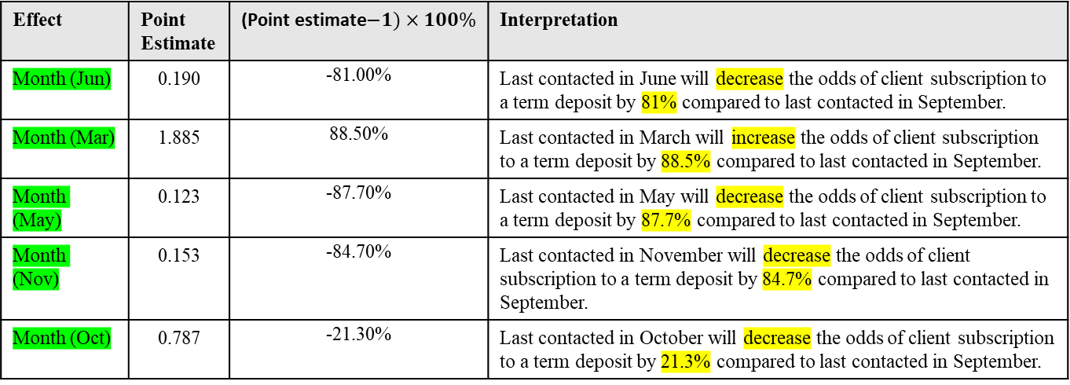
To explain odds ratio
* Yellow highlight indicate significant category
Effect | Point Estimate | (Point estimate$−1)×100\%$ | Interpretation
Month (Jun) | 0.190 | -81.00% | Last contacted in June will decrease the odds of client subscription to a term deposit by 81% compared to last contacted in September.
Month (Mar) | 1.885 | 88.50% | Last contacted in March will increase the odds of client subscription to a term deposit by 88.5% compared to last contacted in September.
Month (May) | 0.123 | -87.70% | Last contacted in May will decrease the odds of client subscription to a term deposit by 87.7% compared to last contacted in September.
Month (Nov) | 0.153 | -84.70% | Last contacted in November will decrease the odds of client subscription to a term deposit by 84.7% compared to last contacted in September.
Month (Oct) | 0.787 | -21.30% | Last contacted in October will decrease the odds of client subscription to a term deposit by 21.3% compared to last contacted in September.
*For other effects that did not mentioned, there is no interpretation/explanation for the odds ratio since the category is not significant (p-value > 0.05).
*Green is qualitative
*Turqoise is quantitative

Slide 24
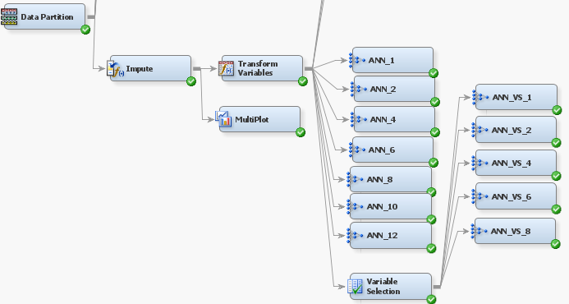
4.3 NEURAL NETWORK MODEL
4.3.1 MODEL ASSESSMENT
For Artificial Neural Network (ANN), it was the same as Logistic Regression as to we need to impute the missing values and transform the variable that are skewed. So we connect the Impute node and Transform Variables node after Data Partition.
Next, we divide two part, ANN nodes that are connected to Variable Selection node and ANN nodes that are not connected to Variable Selection node.
For without Variable selection node, we create ANN nodes with 1,2,4,6,8,10 and 12 hidden units. For with Variable selection node, we create ANN nodes with 1,2,4,6 and 8 hidden units. All the ANN nodes have the Direct Connection property turn to Yes.
After that, all the ANN nodes are then connected to model comparison and run it.

Slide 25
Underfit Model : No underfit model.
Overfit Model : ANN_10 is the overfit model
Best Model : ANN_12 is the best model
BEST MODEL
ANN_12

Slide 26
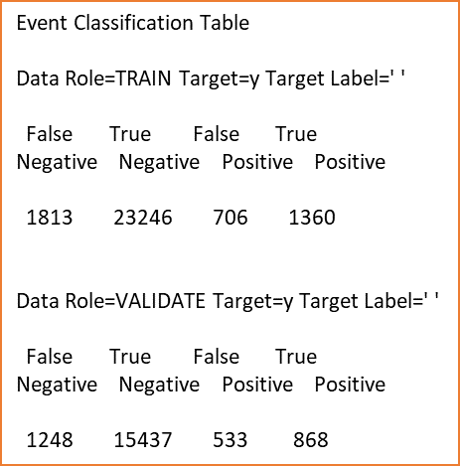
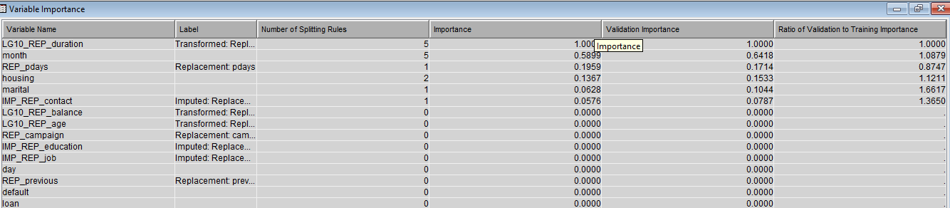
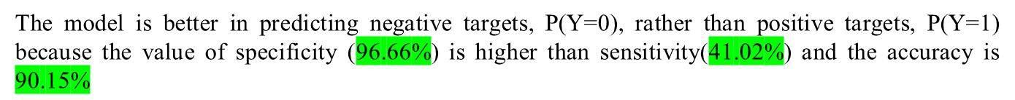
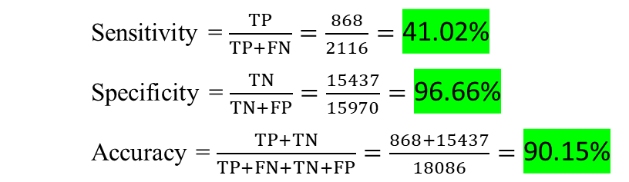

Confusion Matrix for ANN_12.
*The value must be taken from Data Role=VALIDATE
ANN_12 |  | Predicted
 |  | $\hat{Y}$=1 | $\hat{Y}$=0 | Total
Actual | Y=1 | 868 | 1248 | 2116
 | Y=0 | 533 | 15437 | 15970
 |  |  | Total | 18086
Sensitivity = $\frac{TP}{TP+FN}=\frac{868}{2116}=\text{41.02\%}$
Specificity = $\frac{TN}{TN+FP}=\frac{15437}{15970}=\text{96.66\%}$
Accuracy = $\frac{TP+TN}{TP+FN+TN+FP}=\frac{868+15437}{18086}=\text{90.15\%}$
The model is better in predicting negative targets, P(Y=0), rather than positive targets, P(Y=1) because the value of specificity ($\text{96.66\%}$) is higher than sensitivity($\text{41.02}\text{\%}$) and the accuracy is $\text{90.15}\text{\%}$
Variable Importance for ANN_12.
Based on the variable importance, the variable LG10_REP_duration is the most important variable.

Slide 27
5.0 BEST MODEL
From all the three predictive models, we got the best model from each of them that are :
Decision Tree - Auto_Pruning
Logistics Regression - LR_Forward
Neural Network - ANN_12
Underfit Model : No underfit model.
Overfit Model : ANN_12 is the overfit model
Best Model : Auto_Pruning is the best model
CONCLUSION
Auto_Pruning from the decision tree is the best model

Slide 28
APPENDIX
Full Diagram
Decision Tree
Logistics Regression
Neural Network

