Slide 1


Slide 2


Slide 3



Slide 4


Slide 5


Slide 6
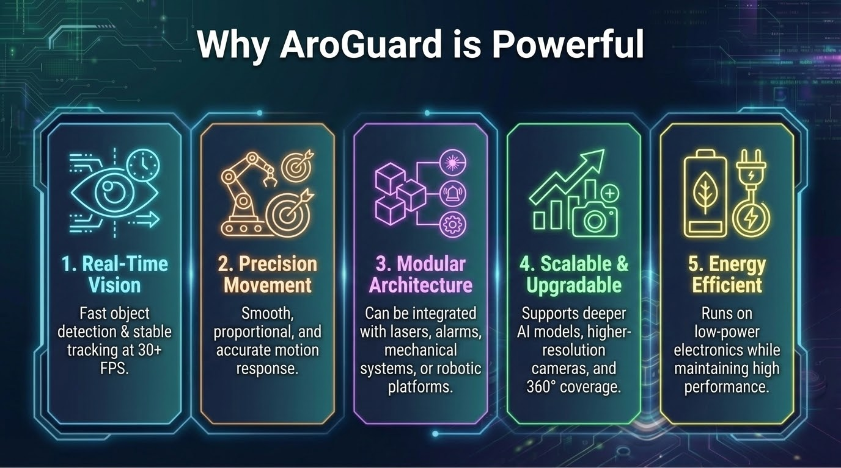

Slide 7


Slide 8


Slide 9

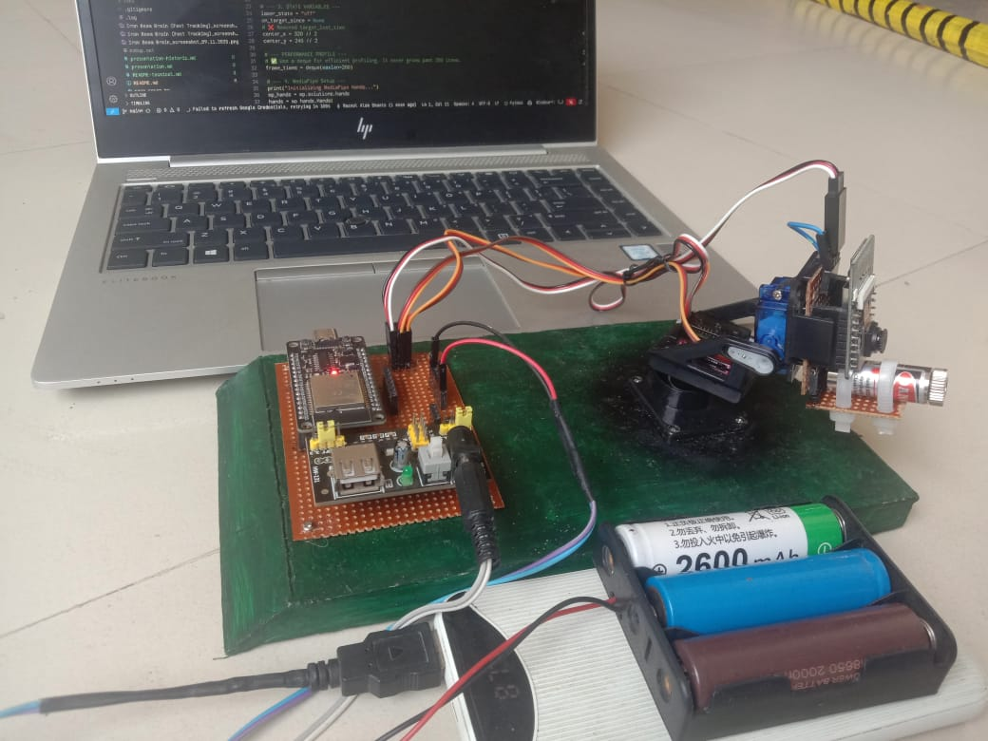
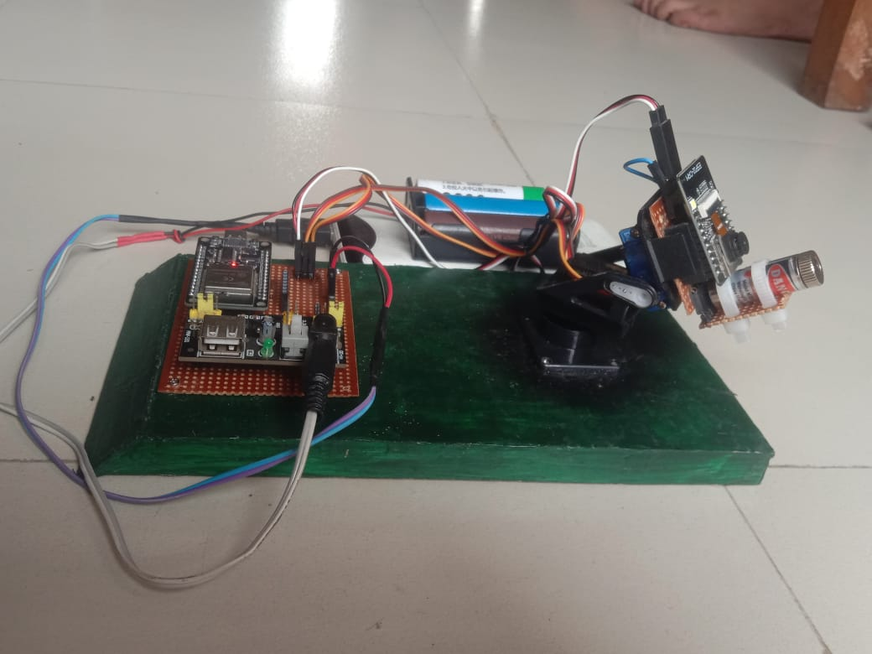
AroGuard In Action

Slide 10


