Slide 1
Implementation of Different Scheduling Algorithm
SPL-1, Mid Term Presentation
Nazmul Hasan Rupu
BSSE 1135
Surervisor: Professor Dr. Mahbubul Alam Joarder

Slide 2
What is CPU Scheduling?
CPU Scheduling is a process of determining which process will own CPU for execution while another process is on hold. The main task of CPU scheduling is to make sure that whenever the CPU remains idle, the OS at least select one of the processes available in the ready queue for execution. The selection process will be carried out by the CPU scheduler. It selects one of the processes in memory that are ready for execution.

Slide 3
Different Type of Scheduling Algorithm
First-Come First-Serve Scheduling, FCFS
Shortest-Job-First Scheduling, SJF (Preemptive)
Shortest-Job-First Scheduling, SJF (Non-preemptive)
Priority Scheduling
Round Robin Scheduling
Banker’s Algorithm

Slide 4
Important Concepts that I Learnt
Arrival Time : Time at which the process arrives in the ready queue.
Completion Time : Time at which process completes its execution.
Burst Time : Time required by a process for CPU execution.
Turn Around Time : Time Difference between completion time and arrival time.
Turn Around Time = Completion Time – Arrival Time
Waiting Time(W.T) : Time Difference between turn around time and burst time.
Waiting Time = Turn Around Time – Burst Time

Slide 5
First Come First Serve (FCFS):
Simplest scheduling algorithm that schedules according to arrival times of processes. First come first serve scheduling algorithm states that the process that requests the CPU first is allocated the CPU first. It is implemented by using the FIFO queue. When a process enters the ready queue, its PCB is linked onto the tail of the queue. When the CPU is free, it is allocated to the process at the head of the queue. The running process is then removed from the queue. FCFS is a non-preemptive scheduling algorithm

Slide 6
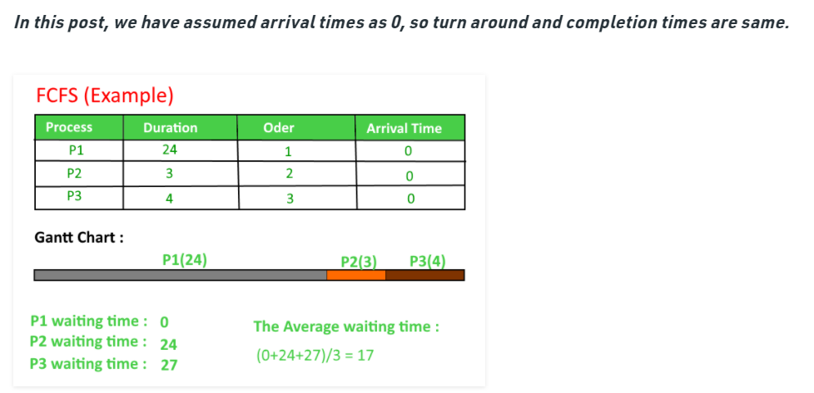
Example

Slide 7
Shortest Job First (SJF):
Process which have the shortest burst time are scheduled first.If two processes have the same bust time then FCFS is used to break the tie. It is a non-preemptive scheduling algorithm.

Slide 8
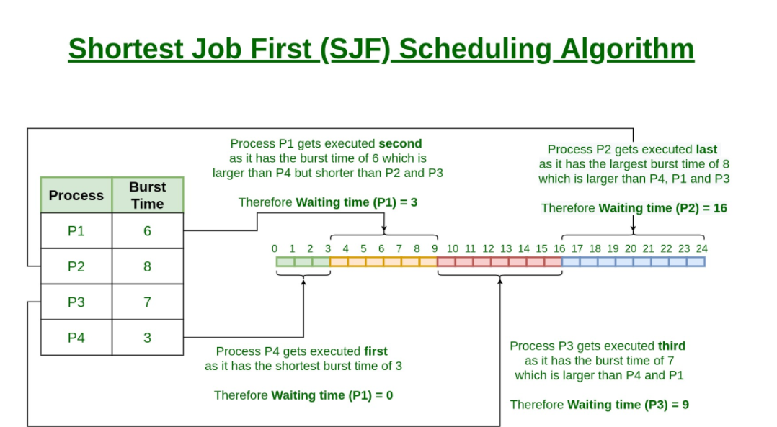
Example

Slide 9
Round Robin Scheduling:
Each process is assigned a fixed time(Time Quantum/Time Slice) in cyclic way.It is designed especially for the time-sharing system. The ready queue is treated as a circular queue. The CPU scheduler goes around the ready queue, allocating the CPU to each process for a time interval of up to 1-time quantum. To implement Round Robin scheduling, we keep the ready queue as a FIFO queue of processes. New processes are added to the tail of the ready queue. The CPU scheduler picks the first process from the ready queue, sets a timer to interrupt after 1-time quantum, and dispatches the process.

Slide 10
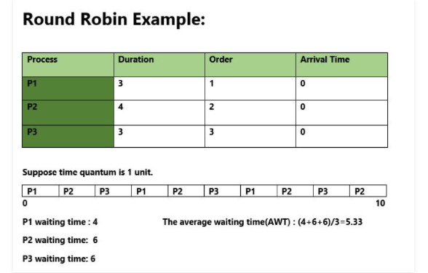
Example

Slide 11
Priority Based scheduling :
In this scheduling, processes are scheduled according to their priorities, i.e., highest priority process is scheduled first. If priorities of two processes match, then schedule according to arrival time. Here starvation of process is possible.

Slide 12
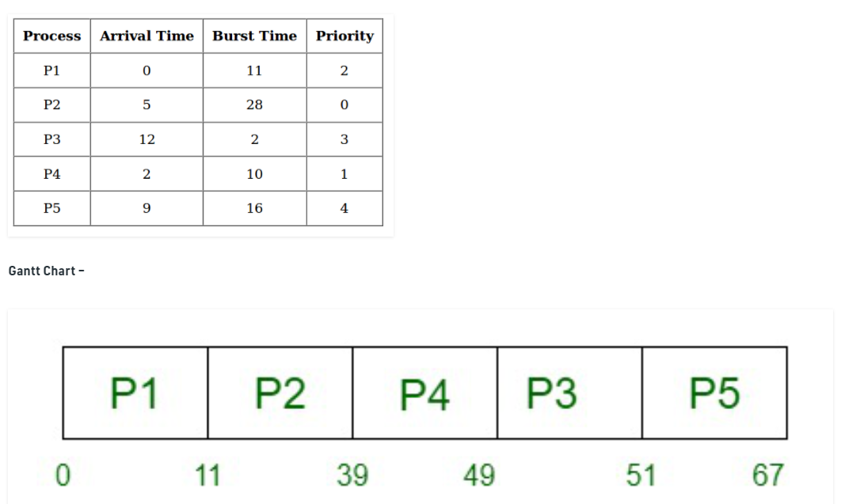
Example

Slide 13
Banker’s Algorithm in Operating System
The banker’s algorithm is a resource allocation and deadlock avoidance algorithm that tests for safety by simulating the allocation for predetermined maximum possible amounts of all resources, then makes an “s-state” check to test for possible activities, before deciding whether allocation should be allowed to continue.
Example : https://www.geeksforgeeks.org/bankers-algorithm-in-operating-system-2/

Slide 14
Thank you
git- link : github.com/Nazmul-Hasan-Rupu/SPL-1

