Slide 1

Project name
NLP based Natural Language Queries| February 2022
Natural Language Queries
-NLP based Question Answering Task.
Z
Supervisor:
Dr. Md. Mostofa Akbar, BUET.
Dr. Iqbal Hossain, University of Arizona.
Salman Rakin, M.Sc. Student
Notes:
We designed this template so that each member of the project team has a set of slides with its own theme. Members, here’s how you add a new slide to just your set:
Mark where you want to add the slide: Select an existing one in the Thumbnails pane, click the New Slide button, then choose a layout. The new slide gets the same theme as the other slides in your set.
Careful! Don’t annoy your fellow presenters by accidentally changing their themes. That can happen if you choose a different theme from the Design tab, which changes all of the slides in the presentation to that look.

Slide 2
OUTLINE
NLP based Natural Language Queries| February 2022
Natural Language Queries (NLQ).
Natural Language Question Answering (NL QA).
NLQ to SQL.
Machine Learning Approach for NQL to SQL.
System Architecture for Translating NQL to SQL.
Python Packages for NLP & NLQ.
List of Papers as Reference.
Salman Rakin, M.Sc. Student

Slide 3
Natural Language Queries (NLQ)
NLP based Natural Language Queries| February 2022
Natural Language Query interfaces allow the end-users to access the desired information without the need to know any specialized
Query language
Data storage
Schema details
Enable the business analysts to access domain-specific knowledge without having to learn specialized query languages such as SQL, SPARQL
The state-of-the-art QA system.
The fully automated interpretation of NLQ is AI-hard (Yampolskiy,2013)
Salman Rakin, M.Sc. Student

Slide 4
Natural Language Queries (NLQ)
NLP based Natural Language Queries| February 2022
Real Life Example:
Power BI (Business Intelligence) Natural Language Query.
Domain Specific Knowledge.
Specified Data Source.
Relational Model.
Ex:- “Show the total sales in Arizona last month from client A”
Salman Rakin, M.Sc. Student

Slide 5
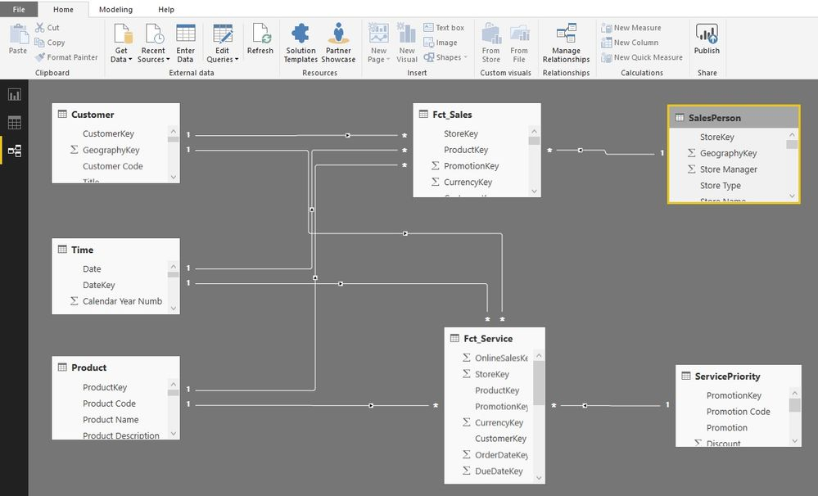
Natural Language Queries (NLQ)
NLP based Natural Language Queries| February 2022
Salman Rakin, M.Sc. Student

Slide 6
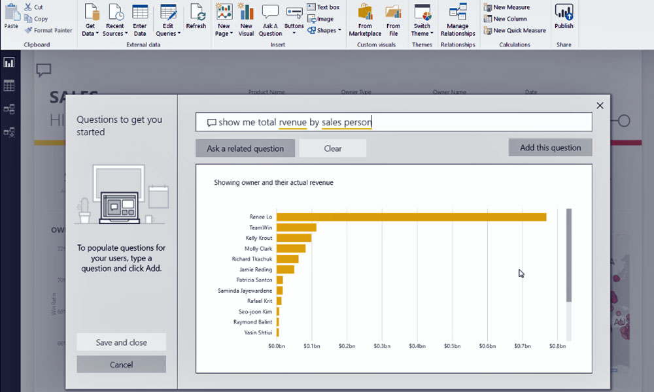
Natural Language Queries (NLQ)
NLP based Natural Language Queries| February 2022
Salman Rakin, M.Sc. Student

Slide 7
Natural Language Question Answering (NL QA)
NLP based Natural Language Queries| February 2022
NL QA in general refers to a large body of works segmented by the backend data store and resources used to answer the question.
Natural Language Interfaces to databases (NLIDB)
NL question answering over structured data like databases.
Machine learning based systems
Seq2SQL using reinforcement learning.
Rule Based Reasoning
ATHENA implementation outperforms over ontology reasoning.
Salman Rakin, M.Sc. Student

Slide 8
NQL to SQL
NLP based Natural Language Queries| February 2022
Natural Language Query
Generated SQL
NLIDB (Intermediate Representation Language )
Give me the addresses of clients where age is greater than or equal to 26 and name is "Hanane"
Select
CLIENT.ADDRESS
from client where
CLIENT.AGE >= 26
and CLIENT.NAME
= 'hanane'
Salman Rakin, M.Sc. Student

Slide 9
NQL to SQL
NLP based Natural Language Queries| February 2022
Drawbacks of the NLIDB Model:
NLIDB are designed for a particular database model (Relational, Relational-Object, Object, XML,etc.)
Syntax rules describing the terminal symbols are domain-dependent.
NLDBI don‘t improve the waiting time for translating the questions already processed.
Salman Rakin, M.Sc. Student

Slide 10
Steps for NQL to SQL
NLP based Natural Language Queries| February 2022
The proposed system is based on intermediate representation language approach:
NLQ Analysis Operations (Linguistic Component)
Intermediate XML Logical Query (IXLQ) translated into Database Query (Database Knowledge Component)
Auto Generator of Syntactic Rules (AGSR) improves knowledge base through experience. (Module of Natural Language Query Definition-MNLQD)
Salman Rakin, M.Sc. Student

Slide 11
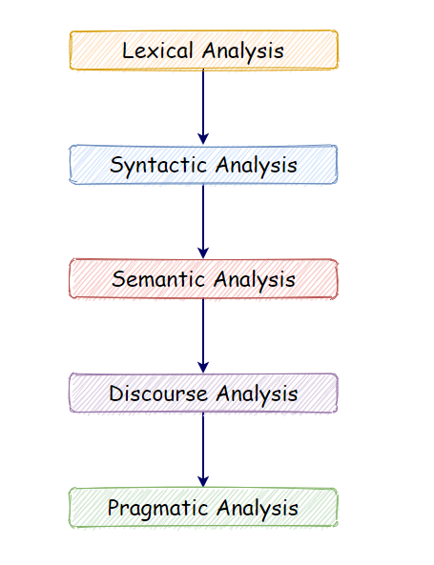
Linguistic Module
NLP based Natural Language Queries| February 2022
NLQ ⊆ NLP
The Linguistic Module NLQ Analysis Operations including text analysis, tokenization, lemmatizatione, tagging, dependency parsing:
Morphological Analysis
Syntactic Analysis
Semantic Analysis
Salman Rakin, M.Sc. Student

Slide 12
Linguistic Module (Morphological Analysis)
NLP based Natural Language Queries| February 2022
Divides the input sentence in primitive units called tokens. And return information about each token.
Token analyzing: this function is used to split the input sentence in primitive units called tokens, which is considered as a single logical unit.
Spelling checker: this function ensures that each token is in the system dictionary, if this is not the case, then spell checking is performed or a new word is added to the system vocabulary.
Salman Rakin, M.Sc. Student

Slide 13
Linguistic Module (Morphological Analysis)
NLP based Natural Language Queries| February 2022
c) Ambiguity reduction: Minimizes the ambiguity in a sentence to simplify the task of the next analysis by replacing several words or symbols with canonical internal words. (Stemming)
d) Tagger: Determines the grammatical category of each token. (Speech Tagging)
e) Morpheme: This function is used to determine the morpheme of each token. (Named Entity Tagging)
Salman Rakin, M.Sc. Student

Slide 14
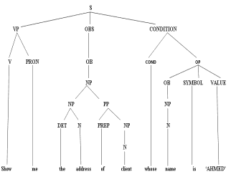
Linguistic Module (Syntactic Analysis)
NLP based Natural Language Queries| February 2022
Returns the parse tree that shows how words relate to each other.
Syntactic rules described by an Extended Context Free Grammar (ECFG).
Show me the address of client whose name is "AHMED".
Salman Rakin, M.Sc. Student

Slide 15
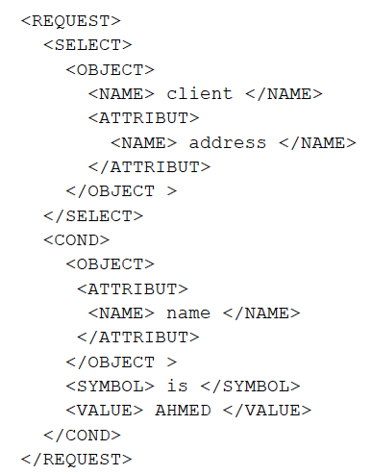
Linguistic Module (Semantic Analysis)
NLP based Natural Language Queries| February 2022
The goal of the semantic analysis is to assign a logical meaning to the parse tree using some semantic rules.
Logical Query (IXLQ)
Show me the address of client whose name is "AHMED".
Salman Rakin, M.Sc. Student

Slide 16
System Architecture (Database Knowledge Component)
NLP based Natural Language Queries| February 2022
The component has two tasks :
First, it translates the logical query (i.e. IXLQ) into database query, by mapping each element of the logical query to its corresponding clause in the database query.
Displays the answers returned by the DBMS in tabular form.
The system generates SQL query for relational database and Xpath for xml database.
Salman Rakin, M.Sc. Student

Slide 17
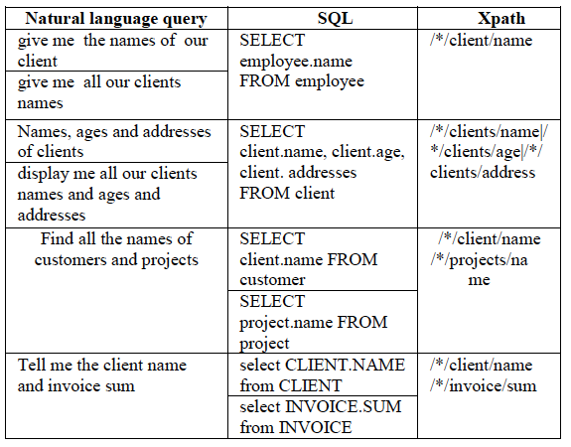
System Architecture (Database Knowledge Component)
NLP based Natural Language Queries| February 2022
Salman Rakin, M.Sc. Student

Slide 18
Python Packages for NLP,NLQ
NLP based Natural Language Queries| February 2022
NLTK+ CoreNLP
Linguistic processing modules for the NLQ
NLTK+ sqlite3/pymysql
Convert the natural language query to complex SQL query and than fire that query on the database.
Quepy
A Python framework to transform natural language questions to queries.
Salman Rakin, M.Sc. Student

Slide 19
Python Packages for NLP,NLQ
NLP based Natural Language Queries| February 2022
OpenNLP
You have to train the machine using the corpus. That model predicts the columns, functions, criteria etc.
NLSQL
A Python framework to transform natural language questions to queries.
Stanza+CoreNLP
Coreference Resolution Support added.
Salman Rakin, M.Sc. Student

Slide 20
List of Papers as Reference
NLP based Natural Language Queries| February 2022
Hanane Bais, Mustapha Machkour, Lahcen Koutti. Querying database using a generic natural language Interface based on machine learning. March 2016.
Jaydeep Sen, Tanaya Babtiwale, Kanishk Saxena, Yash Butala, Sumit Bhatia, Karthik Sankaranarayanan. Schema Aware Semantic Reasoning for Interpreting Natural Language Queries in Enterprise Settings. December 2020.
Peng Qi, Yuhao Zhang, Yuhui Zhang, Jason Bolton, Christopher D. Manning. Stanza: A Python Natural Language Processing Toolkit for Many Human Languages. July 2020.
Rajarshi Das, Manzil Zaheer, Dung Thai, Ameya Godbole, Ethan Perez,Jay-Yoon Lee, Lizhen Tan, Lazaros Polymenakos, Andrew McCallum. Case-Based Reasoning for Natural Language Queries over Knowledge Bases. Novemer 2021.
Salman Rakin, M.Sc. Student

Slide 21
List of Papers as Reference
NLP based Natural Language Queries| February 2022
Kyle Richardson, Jonas Kuhn. Function Assistant: A Tool for NL Querying of APIs. September 2017.
Dezhao Song,Frank Schilder, Charese Smiley, Chris Brew. Natural Language Question Answering and Analytics for Diverse and Interlinked Datasets. June 2015.
Po-Sen Huang, ChenglongWang, Rishabh Singh, Wen-tau Yih, Xiaodong He.Natural Language to Structured Query Generation via Meta-Learning. June 2018.
Nandan Sukthankar, Sanket Maharnawar, Pranay Deshmukh, Yashodhara Haribhakta, Vibhavari Kamble. nQuery - A Natural Language Statement to SQL Query Generator. August 2017.
Ashish Palakurthi, Ruthu S. M., Arjun R. Akula,Radhika Mamidi. Classification of Attributes in a Natural Language Query into Different SQL Clauses. September 2015.
Salman Rakin, M.Sc. Student

Slide 22
List of Papers as Reference
NLP based Natural Language Queries| February 2022
Fred Popowich, Milan Mosny, David Lindberg. Interactive Natural Language Query Construction for Report Generation. May 2012.
Victor Zhong, Caiming Xiong, Richard Socher. SEQ2SQL: GENERATING STRUCTURED QUERIES FROM NATURAL LANGUAGE USING REINFORCEMENT LEARNING. November 2017.
Xingdi Yuan, Marc-Alexandre Cote, Jie Fu, Zhouhan Lin, Christopher Pal,Yoshua Bengio, Adam Trischler. Interactive Language Learning by Question Answering. November 2019.
Salman Rakin, M.Sc. Student

Slide 23

NLP based Natural Language Queries| February 2022
Salman Rakin, M.Sc. Student

