Slide 1
Thesis-11
Seven moment invariant analysis-2

Slide 2
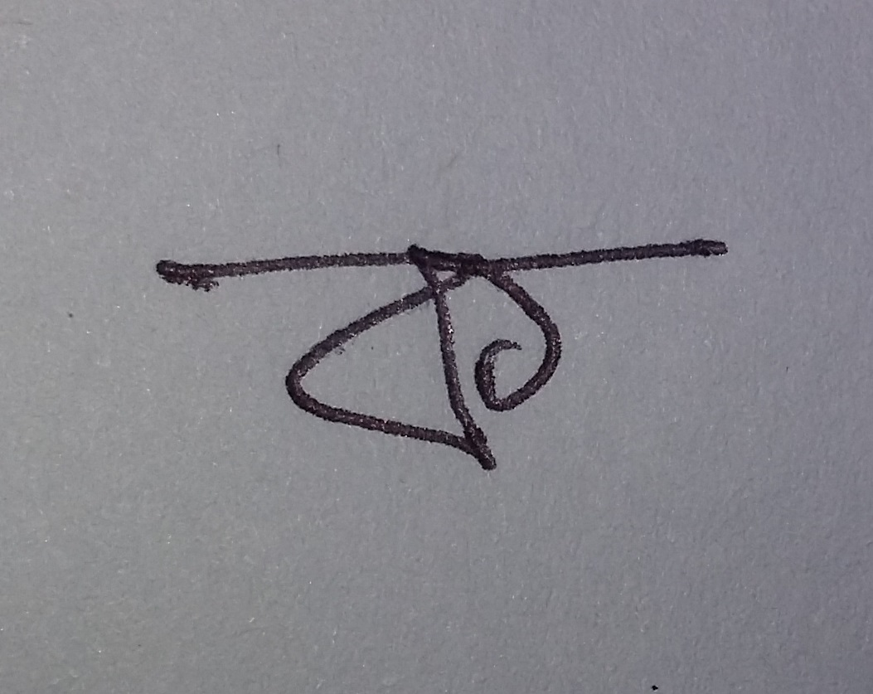
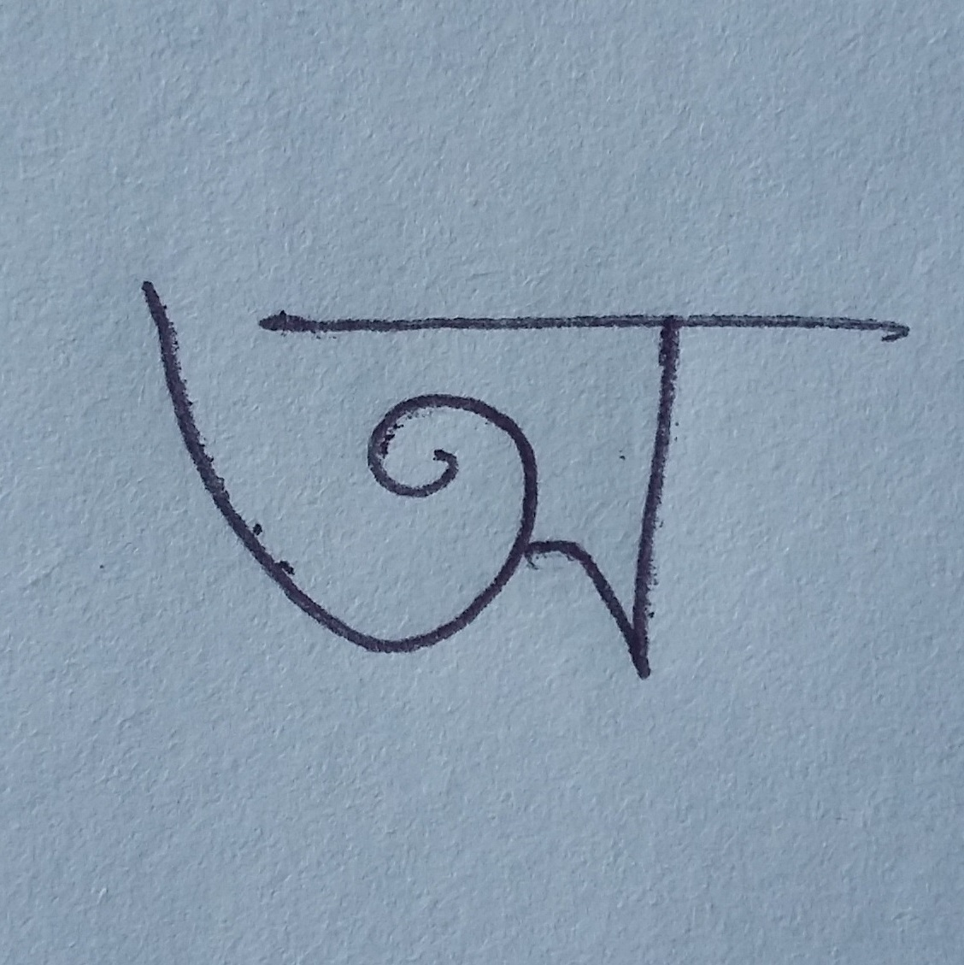
Experimented images (Ko_2.jpg, O_1.jpg)

Slide 3
Values of seven moment for “Ko_2.jpg”
ko_2.jpg | Moments | Original | Half sized | 90 degree | 180 degree | avg
 | m_1 | 0.17827743 | 0.17827743 | 0.17827743 | 0.17827743 | 0.17827743
 | m_2 | 1.4509E-07 | 1.4509E-07 | 1.4509E-07 | 1.4509E-07 | 1.4509E-07
 | m_3 | 4.06307E-08 | 4.06307E-08 | 4.06307E-08 | 4.06307E-08 | 4.06307E-08
 | m_4 | 1.41609E-07 | 1.41609E-07 | 1.41609E-07 | 1.41609E-07 | 1.41609E-07
 | m_5 | 1.1E-14 | 1.1E-14 | 1.1E-14 | 1.1E-14 | 1.1E-14
 | m_6 | 5.3862E-11 | 5.3862E-11 | 5.3862E-11 | 5.3862E-11 | 5.3862E-11
 | m_7 | -1E-15 | -1E-15 | -1E-15 | -1E-15 | -1E-15

Slide 4
Values of seven moment for “o_1.jpg”
O_1.jpg | Moments | Original | Half sized | 90 degree | 180 degree | avg
 | m_1 | 0.175463523 | 0.175463523 | 0.175463523 | 0.175463523 | 0.175463523
 | m_2 | 8.65273E-08 | 8.65273E-08 | 8.65273E-08 | 8.65273E-08 | 8.65273E-08
 | m_3 | 1.99464E-08 | 1.99464E-08 | 1.99464E-08 | 1.99464E-08 | 1.99464E-08
 | m_4 | 2.25377E-07 | 2.25377E-07 | 2.25377E-07 | 2.25377E-07 | 2.25377E-07
 | m_5 | -1.4E-14 | -1.4E-14 | -1.4E-14 | -1.4E-14 | -1.4E-14
 | m_6 | -4.0403E-11 | -4.0403E-11 | -4.0403E-11 | -4.0403E-11 | -4.0403E-11
 | m_7 | 5E-15 | 5E-15 | 5E-15 | 5E-15 | 5E-15

Slide 5
Charts of “ko_2.jpg” and “o_1.jpg”

Slide 6
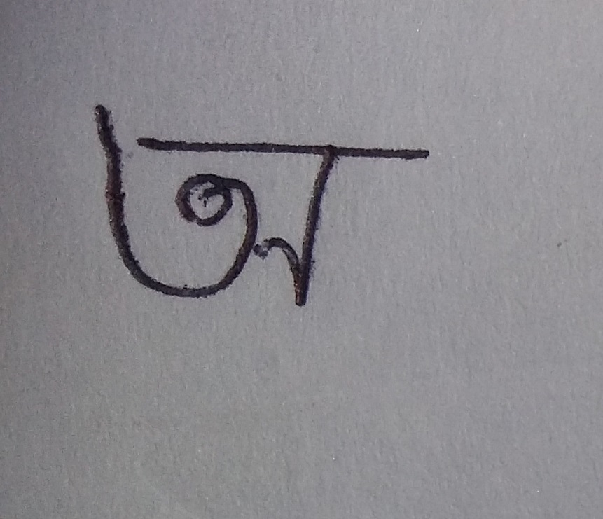
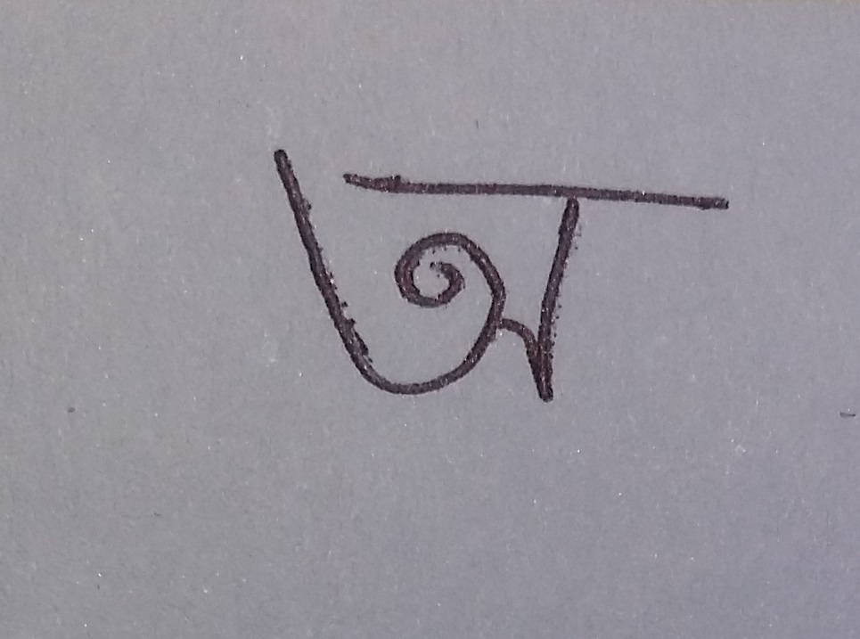
“O_11.jpg” and “O_12.jpg”

Slide 7
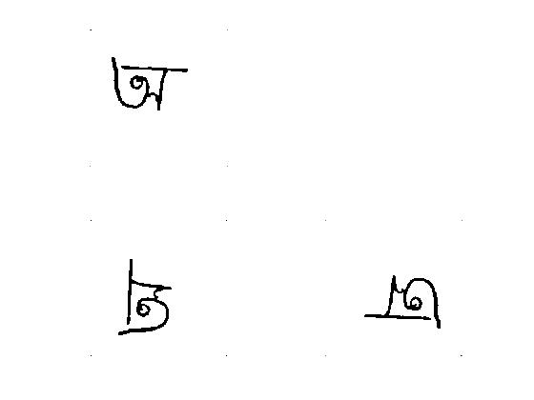
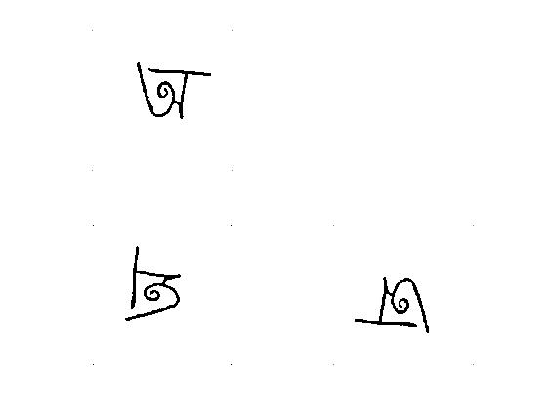
Results of “o_11.jpg” and “o_12.jpg”

Slide 8
Seven moments of “o_11.jpg” and “o_12.jpg”
 | o_11.jpg |  |  |  |  | o_12.jpg
Actions | Original | Half sized | 90 degree | 180 degree | Avg | Original | Half sized | 90 degree | 180 degree | Avg
m_1 | 0.179474837 | 0.180298673 | 0.179474837 | 0.179474837 | 0.179680796 | 0.178649775 | 0.179083917 | 0.178649775 | 0.178649775 | 0.178758311
m_2 | 2.02005E-06 | 2.48676E-06 | 2.02005E-06 | 2.02005E-06 | 2.13673E-06 | 1.12E-07 | 1.10E-07 | 1.12E-07 | 1.12E-07 | 1.11563E-07
m_3 | 2.08653E-07 | 2.30878E-07 | 2.08653E-07 | 2.08653E-07 | 2.14209E-07 | 2.19E-08 | 1.80E-08 | 2.19E-08 | 2.19E-08 | 2.09534E-08
m_4 | 4.11284E-06 | 4.88456E-06 | 4.11284E-06 | 4.11284E-06 | 4.30577E-06 | 1.06E-06 | 1.23E-06 | 1.06E-06 | 1.06E-06 | 1.1008E-06
m_5 | -3.05605E-12 | -4.08087E-12 | -3.05605E-12 | -3.05605E-12 | -3.31225E-12 | 3.90E-14 | 2.57E-14 | 3.90E-14 | 3.90E-14 | 3.56956E-14
m_6 | -5.49812E-09 | -7.22824E-09 | -5.49812E-09 | -5.49812E-09 | -5.93065E-09 | -3.05E-10 | -3.62E-10 | -3.05E-10 | -3.05E-10 | -3.19108E-10
m_7 | 2.27522E-12 | 3.20205E-12 | 2.27522E-12 | 2.27522E-12 | 2.50693E-12 | -1.56E-13 | -1.82E-13 | -1.56E-13 | -1.56E-13 | -1.62539E-13

Slide 9
Avg moments of o_1 & o_2

Slide 10
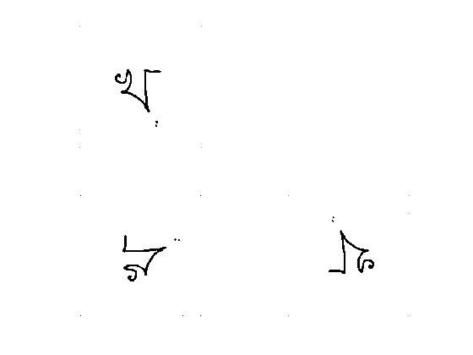
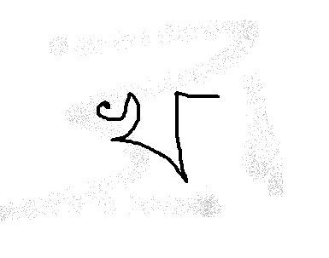
“kho_11.jpg” in original form and result

Slide 11
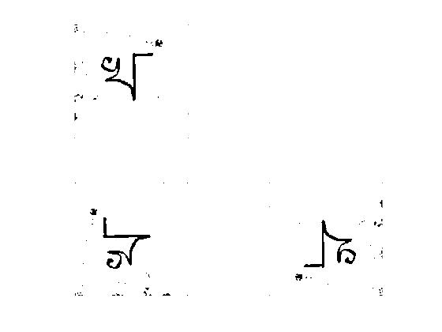
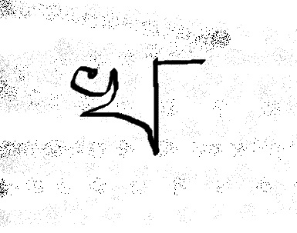
“kho_12.jpg” in original form and result

Slide 12
Values of “Kho_11.jpg” and ”Kho_12.jpg”
 | kho_11.jpg |  |  |  |  | kho_12.jpg
Actions | Original | Half sized | 90 degree | 180 degree | Avg | Original | Half sized | 90 degree | 180 degree | Avg | Difference
m_1 | 0.173645423 | 0.174290392 | 0.173645423 | 0.173645423 | 0.173806666 | 0.177479183 | 0.178311588 | 0.177479183 | 0.177479183 | 0.177687284 | 0.003880619
m_2 | 1.10118E-08 | 2.19793E-08 | 1.10118E-08 | 1.10118E-08 | 1.37537E-08 | 1.49E-07 | 6.99E-08 | 1.49E-07 | 1.49E-07 | 1.2915E-07 | 1.15396E-07
m_3 | 3.60089E-09 | 4.7651E-09 | 3.60089E-09 | 3.60089E-09 | 3.89194E-09 | 6.36E-08 | 6.57E-08 | 6.36E-08 | 6.36E-08 | 6.41323E-08 | 6.02404E-08
m_4 | 4.47103E-08 | 5.82148E-08 | 4.47103E-08 | 4.47103E-08 | 4.80864E-08 | 1.25E-06 | 1.46E-06 | 1.25E-06 | 1.25E-06 | 1.30284E-06 | 1.25475E-06
m_5 | -5.35752E-16 | -8.45315E-16 | -5.35752E-16 | -5.35752E-16 | -6.13143E-16 | 3.33E-13 | 4.34E-13 | 3.33E-13 | 3.33E-13 | 3.58219E-13 | 3.58832E-13
m_6 | -2.63517E-13 | -4.00467E-12 | -2.63517E-13 | -2.63517E-13 | -1.1988E-12 | 3.71E-10 | 2.69E-10 | 3.71E-10 | 3.71E-10 | 3.45167E-10 | 3.46366E-10
m_7 | -1.86561E-16 | 4.7491E-16 | -1.86561E-16 | -1.86561E-16 | -2.1193E-17 | 1.16E-13 | 1.28E-13 | 1.16E-13 | 1.16E-13 | 1.18947E-13 | 1.18968E-13

Slide 13
Chart of moments of “kho_11.jpg” and “kho_12.jpg”

Slide 14
Conclusion
If we calculate the moment of two same characters, we found small difference between the average of their moment values.
For single image of a character we found almost similar average values which define whether we translated the image the seven moment invariant does not change the values a lot and they are similar in almost 3 digits after decimal points.
If we calculate the moment of two different characters, we found small difference between the average of their moment values.
The moment values are so small fraction. As a result it is so difficult to classify two different characters using seven moment invariants.

