Slide 1
Thesis-9
Zernike moment analysis-3

Slide 2
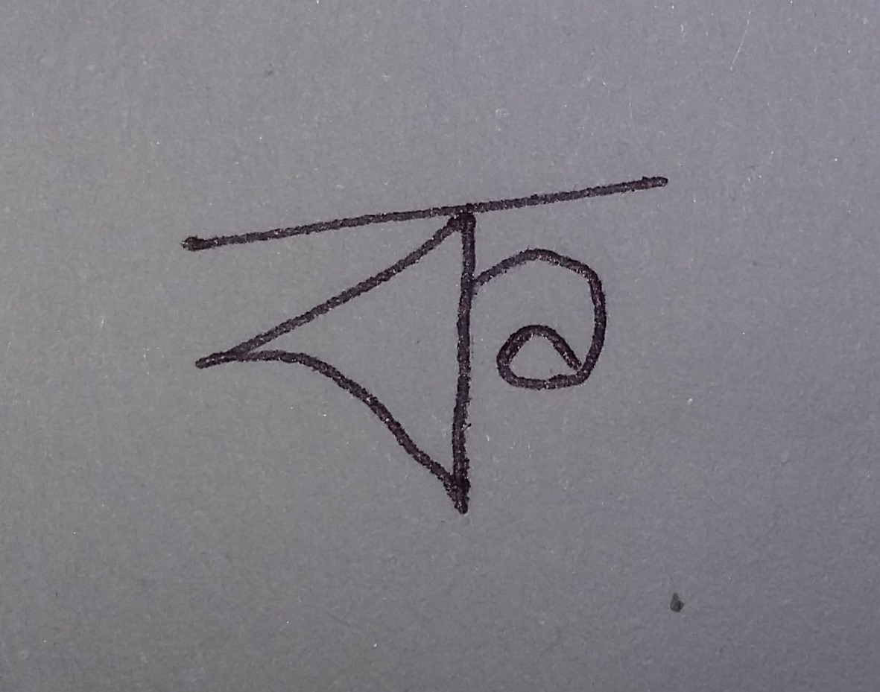
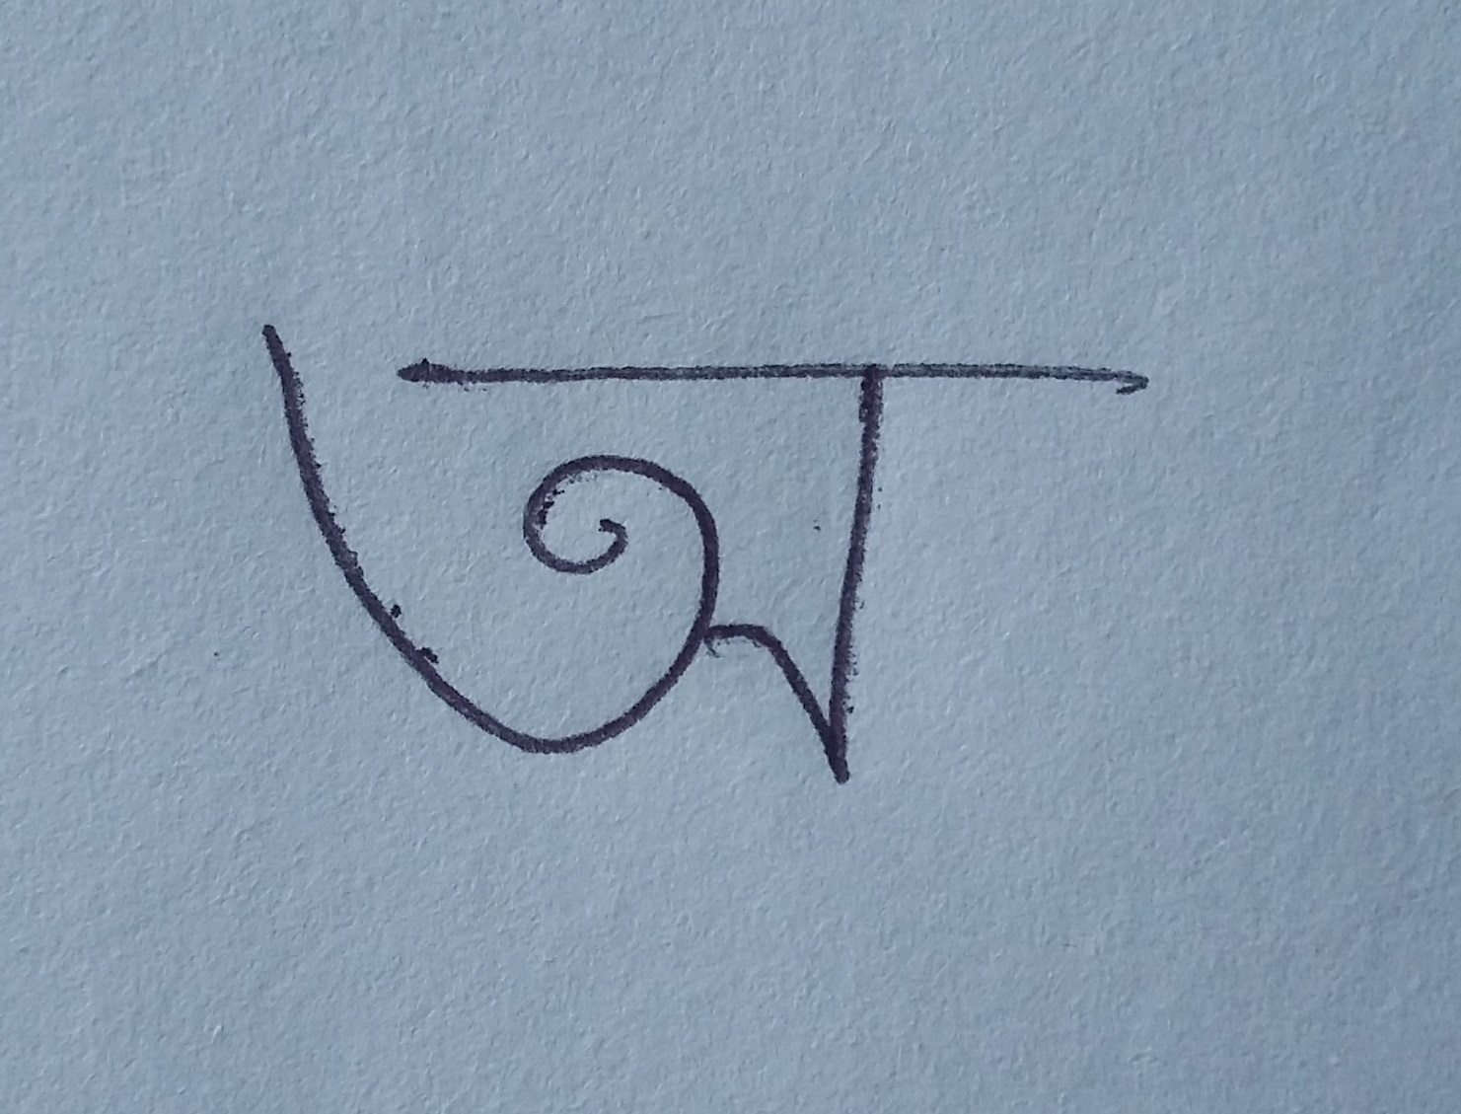
‘ko’ & ‘o’ written by person-1

Slide 3
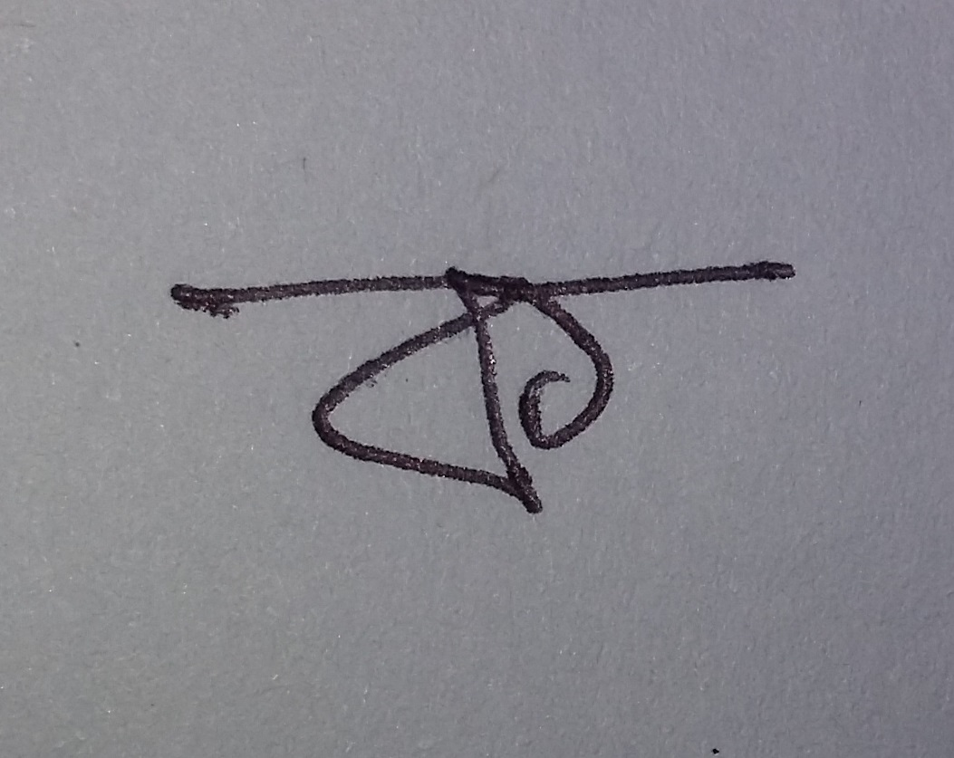
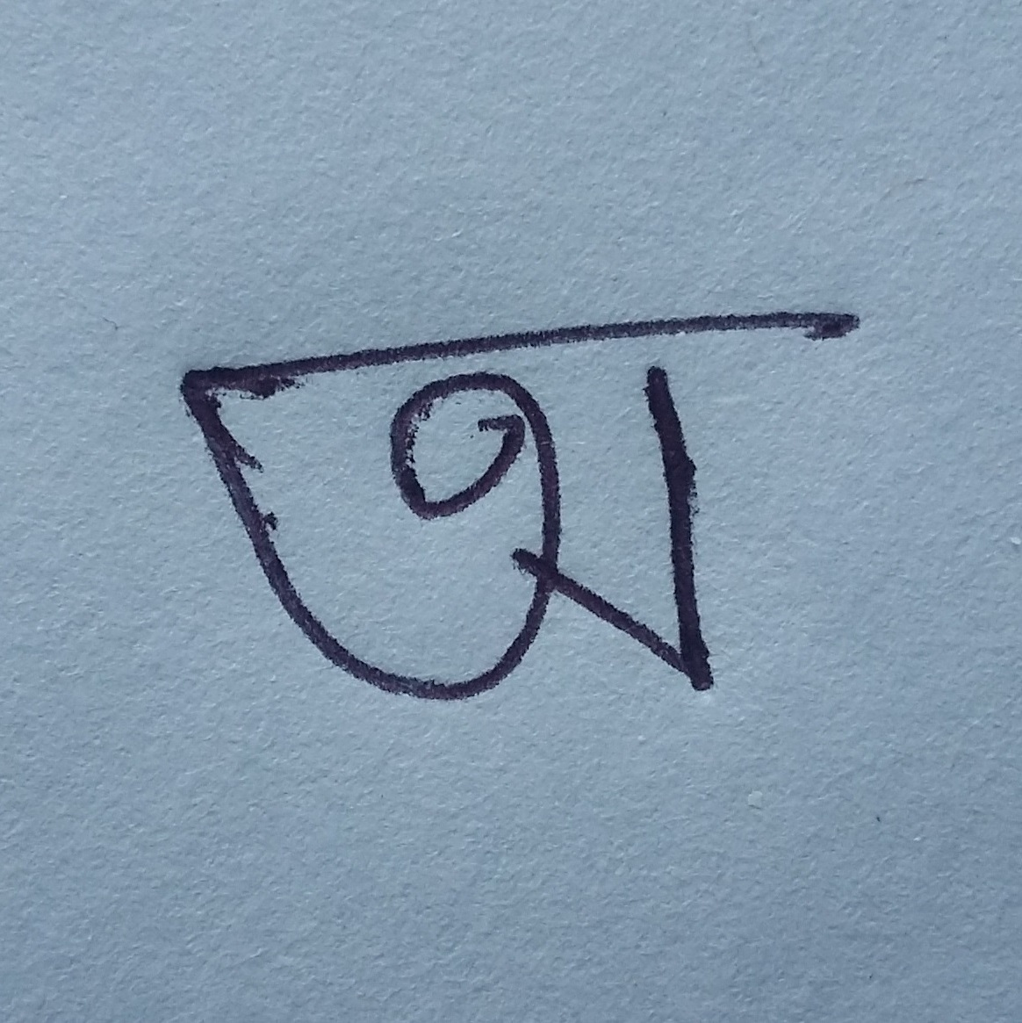
‘ko’ & ‘o’ written by person-2

Slide 4
Data in different angle of ‘ko’ & ‘o’ written by person-1
Order |  | Ko_1 |  |  |  |  | o_1
Z_1 | Z_2 | Original | Nine | Ninety | NintyFive | Average | Original | Nine | Ninety | NintyFive | Average | Def of Avg(Person-1)
0 | 0 | 0.004233378 | 0.002731471 | 0.004233378 | 0.003294442 | 0.003623167 | 0.005359591 | 0.003593101 | 0.004233378 | 0.004200867 | 0.004346734 | 0.000723567
1 | 1 | 0.00015095 | 0.000128986 | 0.00015095 | 0.00012479 | 0.000138919 | 0.00259957 | 0.001527704 | 0.00015095 | 0.001904683 | 0.001545727 | 0.001406808
2 | 0 | 0.012592536 | 0.008849738 | 0.012592536 | 0.010337223 | 0.011093008 | 0.011556318 | 0.009301202 | 0.012592536 | 0.010246908 | 0.010924241 | 0.000168768
2 | 2 | 0.003020997 | 0.001545514 | 0.003020997 | 0.001984444 | 0.002392988 | 0.002986524 | 0.001521272 | 0.003020997 | 0.001995025 | 0.002380955 | 1.20333E-05
3 | 1 | 0.002434929 | 0.000921774 | 0.002434929 | 0.001436825 | 0.001807114 | 0.005955712 | 0.004406901 | 0.002434929 | 0.005142671 | 0.004485053 | 0.002677939
3 | 3 | 0.00217806 | 0.001659892 | 0.00217806 | 0.002266779 | 0.002070698 | 0.001563293 | 0.001126639 | 0.00217806 | 0.001695564 | 0.001640889 | 0.000429809
4 | 0 | 0.01081608 | 0.011339515 | 0.01081608 | 0.011805535 | 0.011194303 | 0.007348317 | 0.009042867 | 0.01081608 | 0.008752415 | 0.00898992 | 0.002204383
4 | 2 | 0.008191971 | 0.005235849 | 0.008191971 | 0.006271035 | 0.006972706 | 0.008756127 | 0.005549033 | 0.008191971 | 0.006771235 | 0.007317092 | 0.000344385
4 | 4 | 0.000785541 | 0.00033799 | 0.000785541 | 0.000452701 | 0.000590443 | 0.000904425 | 0.000357335 | 0.000785541 | 0.000509036 | 0.000639085 | 4.86412E-05
5 | 1 | 0.002617196 | 0.002431052 | 0.002617196 | 0.002907873 | 0.002643329 | 0.00591277 | 0.004877934 | 0.002617196 | 0.005364242 | 0.004693036 | 0.002049706
5 | 3 | 0.00355134 | 0.002001739 | 0.00355134 | 0.002192168 | 0.002824146 | 0.004179032 | 0.002383036 | 0.00355134 | 0.002544436 | 0.003164461 | 0.000340314
5 | 5 | 0.001215326 | 0.000442543 | 0.001215326 | 0.000637657 | 0.000877713 | 0.001074754 | 0.00036675 | 0.001215326 | 0.000560921 | 0.000804438 | 7.32751E-05
6 | 0 | 0.005810235 | 0.00633382 | 0.005810235 | 0.005890593 | 0.005961221 | 0.00529166 | 0.003612817 | 0.005810235 | 0.003934154 | 0.004662216 | 0.001299004
6 | 2 | 0.01080379 | 0.008735477 | 0.01080379 | 0.009708334 | 0.010012848 | 0.009156937 | 0.008557618 | 0.01080379 | 0.009179556 | 0.009424475 | 0.000588373
6 | 4 | 0.002935692 | 0.000230813 | 0.002935692 | 0.000831863 | 0.001733515 | 0.00295447 | 0.001559741 | 0.002935692 | 0.002034038 | 0.002370985 | 0.00063747
6 | 6 | 0.002095272 | 0.000647831 | 0.002095272 | 0.000994039 | 0.001458103 | 0.000555365 | 0.00016568 | 0.002095272 | 0.000262051 | 0.000769592 | 0.000688511
7 | 1 | 0.004389992 | 0.00241533 | 0.004389992 | 0.003456534 | 0.003662962 | 0.012833766 | 0.006260052 | 0.004389992 | 0.008513659 | 0.007999367 | 0.004336405
7 | 3 | 0.005080813 | 0.003639957 | 0.005080813 | 0.004641229 | 0.004610703 | 0.007852274 | 0.005813484 | 0.005080813 | 0.007688841 | 0.006608853 | 0.00199815
7 | 5 | 0.001568088 | 0.000865028 | 0.001568088 | 0.00086287 | 0.001216018 | 0.004450603 | 0.0019349 | 0.001568088 | 0.002744893 | 0.002674621 | 0.001458602
7 | 7 | 0.001794283 | 0.003330969 | 0.001794283 | 0.000569562 | 0.001872274 | 0.002085052 | 0.003835601 | 0.001794283 | 0.001252697 | 0.002241908 | 0.000369634
8 | 0 | 0.009702704 | 0.00660663 | 0.009702704 | 0.008099395 | 0.008527858 | 0.007840721 | 0.005924688 | 0.009702704 | 0.00723291 | 0.007675256 | 0.000852603
8 | 2 | 0.00565809 | 0.008656001 | 0.00565809 | 0.008196655 | 0.007042209 | 0.005925611 | 0.006935557 | 0.00565809 | 0.006151558 | 0.006167704 | 0.000874505
8 | 4 | 0.008215501 | 0.003876942 | 0.008215501 | 0.005612609 | 0.006480139 | 0.003176748 | 0.002793309 | 0.008215501 | 0.003145761 | 0.00433283 | 0.002147309
8 | 6 | 0.003313475 | 0.002271232 | 0.003313475 | 0.002804394 | 0.002925644 | 0.002287041 | 0.000910464 | 0.003313475 | 0.001312222 | 0.001955801 | 0.000969844
8 | 8 | 0.001589467 | 0.00038273 | 0.001589467 | 0.000648485 | 0.001052537 | 0.000419591 | 9.64486E-05 | 0.001589467 | 0.000168946 | 0.000568613 | 0.000483924

Slide 5
Data in different angle of ‘ko’ & ‘o’ written by person-2
 |  | Ko_2 |  |  |  |  | o_2
Z_1 | Z_2 | Original | Nine | Ninety | NintyFive | Average | Original | Nine | Ninety | NintyFive | Average | Def of Avg(Person-2)
0 | 0 | 0.002071509 | 0.001254258 | 0.002071509 | 0.001591266 | 0.001747136 | 0.003158241 | 0.002038992 | 0.002071509 | 0.002480643 | 0.002437346 | 0.00069021
1 | 1 | 0.002256363 | 0.001152456 | 0.002256363 | 0.001610834 | 0.001819004 | 0.003156823 | 0.001791756 | 0.002256363 | 0.002286858 | 0.00237295 | 0.000553946
2 | 0 | 0.0045921 | 0.003756038 | 0.0045921 | 0.003933341 | 0.004218395 | 0.007049536 | 0.005369788 | 0.0045921 | 0.006186001 | 0.005799357 | 0.001580962
2 | 2 | 0.002655167 | 0.001400236 | 0.002655167 | 0.001751756 | 0.002115581 | 0.003241022 | 0.001640441 | 0.002655167 | 0.002153002 | 0.002422408 | 0.000306827
3 | 1 | 0.005702302 | 0.004120762 | 0.005702302 | 0.004667374 | 0.005048185 | 0.007095242 | 0.005134874 | 0.005702302 | 0.006096149 | 0.006007142 | 0.000958957
3 | 3 | 0.000705713 | 0.001280774 | 0.000705713 | 0.001422941 | 0.001028785 | 0.001566786 | 0.001346907 | 0.000705713 | 0.00188251 | 0.001375479 | 0.000346694
4 | 0 | 0.003003053 | 0.003503799 | 0.003003053 | 0.003349263 | 0.003214792 | 0.004841012 | 0.00544716 | 0.003003053 | 0.005484522 | 0.004693937 | 0.001479145
4 | 2 | 0.008678063 | 0.005127846 | 0.008678063 | 0.006458687 | 0.007235665 | 0.00875097 | 0.005696195 | 0.008678063 | 0.006878896 | 0.007501031 | 0.000265367
4 | 4 | 0.00121209 | 0.000646281 | 0.00121209 | 0.000676243 | 0.000936676 | 0.001562903 | 0.000612588 | 0.00121209 | 0.000871691 | 0.001064818 | 0.000128142
5 | 1 | 0.004143075 | 0.00469137 | 0.004143075 | 0.004814479 | 0.004448 | 0.003702673 | 0.004934763 | 0.004143075 | 0.004802401 | 0.004395728 | 5.22715E-05
5 | 3 | 0.001756205 | 0.00040111 | 0.001756205 | 0.000255462 | 0.001042246 | 0.004969308 | 0.002127581 | 0.001756205 | 0.002440447 | 0.002823385 | 0.00178114
5 | 5 | 0.000826026 | 0.000151569 | 0.000826026 | 0.000423575 | 0.000556799 | 0.001416467 | 0.000476494 | 0.000826026 | 0.000733525 | 0.000863128 | 0.000306329
6 | 0 | 0.003882375 | 0.001849261 | 0.003882375 | 0.002201682 | 0.002953924 | 0.007682041 | 0.003736418 | 0.003882375 | 0.004768791 | 0.005017406 | 0.002063483
6 | 2 | 0.011063107 | 0.009165585 | 0.011063107 | 0.010169087 | 0.010365221 | 0.006666215 | 0.007688961 | 0.011063107 | 0.007767185 | 0.008296367 | 0.002068854
6 | 4 | 0.004845523 | 0.002169457 | 0.004845523 | 0.003120256 | 0.00374519 | 0.005575275 | 0.00282966 | 0.004845523 | 0.003695851 | 0.004236577 | 0.000491388
6 | 6 | 0.000262501 | 0.000323697 | 0.000262501 | 0.000124229 | 0.000243232 | 0.000404336 | 0.000128135 | 0.000262501 | 0.000181987 | 0.00024424 | 1.00806E-06
7 | 1 | 0.002031528 | 0.00171667 | 0.002031528 | 0.000780473 | 0.00164005 | 0.012668668 | 0.004740828 | 0.002031528 | 0.00693528 | 0.006594076 | 0.004954026
7 | 3 | 0.005111755 | 0.004199802 | 0.005111755 | 0.005413888 | 0.0049593 | 0.010908303 | 0.007217068 | 0.005111755 | 0.009385311 | 0.008155609 | 0.003196309
7 | 5 | 0.004035224 | 0.001766051 | 0.004035224 | 0.002339276 | 0.003043944 | 0.005939657 | 0.002527064 | 0.004035224 | 0.003617777 | 0.00402993 | 0.000985987
7 | 7 | 0.002281319 | 0.003685061 | 0.002281319 | 0.001225766 | 0.002368366 | 0.002238338 | 0.003635149 | 0.002281319 | 0.001099871 | 0.002313669 | 5.46968E-05
8 | 0 | 0.008778747 | 0.004371299 | 0.008778747 | 0.006287872 | 0.007054166 | 0.012176176 | 0.007928348 | 0.008778747 | 0.010178386 | 0.009765414 | 0.002711248
8 | 2 | 0.005544022 | 0.008891049 | 0.005544022 | 0.007982469 | 0.00699039 | 0.008509088 | 0.003712855 | 0.005544022 | 0.00393251 | 0.005424619 | 0.001565772
8 | 4 | 0.007506485 | 0.005045573 | 0.007506485 | 0.006199228 | 0.006564443 | 0.007423411 | 0.005748775 | 0.007506485 | 0.006531918 | 0.006802647 | 0.000238204
8 | 6 | 0.001111035 | 0.000562417 | 0.001111035 | 0.000634698 | 0.000854797 | 0.001341187 | 0.000624505 | 0.001111035 | 0.000784585 | 0.000965328 | 0.000110531
8 | 8 | 0.000185082 | 0.000419033 | 0.000185082 | 7.33519E-05 | 0.000215637 | 0.000536467 | 0.000122202 | 0.000185082 | 0.000214743 | 0.000264623 | 4.89864E-05

Slide 6
Difference of average Zernike moment values between ‘k_2.jpg’ and ‘o_2.jpg’ written by Person-1

Slide 7
Difference of average Zernike values between ‘k_2.jpg’ and ‘o_2.jpg’ written by Person-2

Slide 8
Conclusion
From the analysis of the data we can see that, for individual character Zernike moment gives a big difference of values.

