Slide 1
Thesis

Slide 2
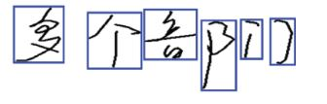
Why geometric modeling
Segmentation and recognition process segmented and recognize a text.
To evaluate candidate S&R 3 things are combined:
character recognition scores
geometric context
linguistic context.

Slide 3

Take a look at Chinese Text

Slide 4

Distinct outline
Chinese text has distinct outline feature. Like different size, position and aspect ratio.

Slide 5
Classification of G.M
Geometric Model
Class Independent
Class Dependent
Unary class dependent G.M (ucg)
Binary class dependent G.M (bcg)
Unary class independent G.M (uig)
Binary class independent G.M (big)

Slide 6
Which one they used
UCG
Unary geometric model (for single character geometry)
BCG
Binary geometric model (for between character geometry)

Slide 7
Why they used them
To check
Whether candidate pattern valid character or not
Whether a single gap is a between character gap or not

Slide 8
How they used
They extract features for unary and binary geometry from the bounding boxes.
They cluster the character classes empirically into six super classes using the EM algorithm.

Slide 9
Extract features for unary and binary geometry
For geometric modeling of single character, 1 candidate character pattern can be extracted by 42 geometric features. Those 42 features can be categorized into 3
10 scaler features related to the bounding box of the character
4 scaler feature related to the vertical center of the text line.
28 profile based feature.

Slide 10
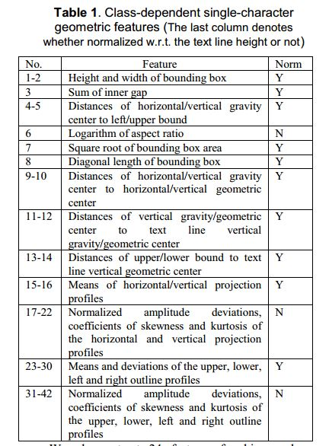
Extract features for unary and binary geometry

