Slide 1
Thesis
Nazmul Arefin

Slide 2
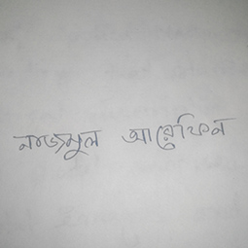
Original Image

Slide 3
Resized (255x255)

Slide 4
RGB to GRAYSCAL
im = imread('name.jpg');
IM = rgb2gray(im);

Slide 5
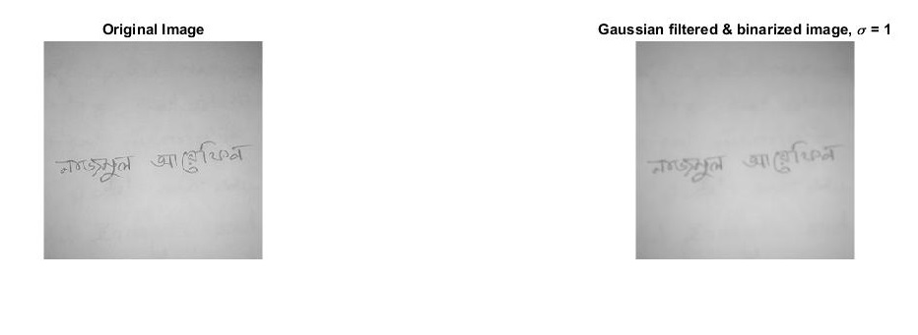
Gaussian applied ( σ = 1)

Slide 6
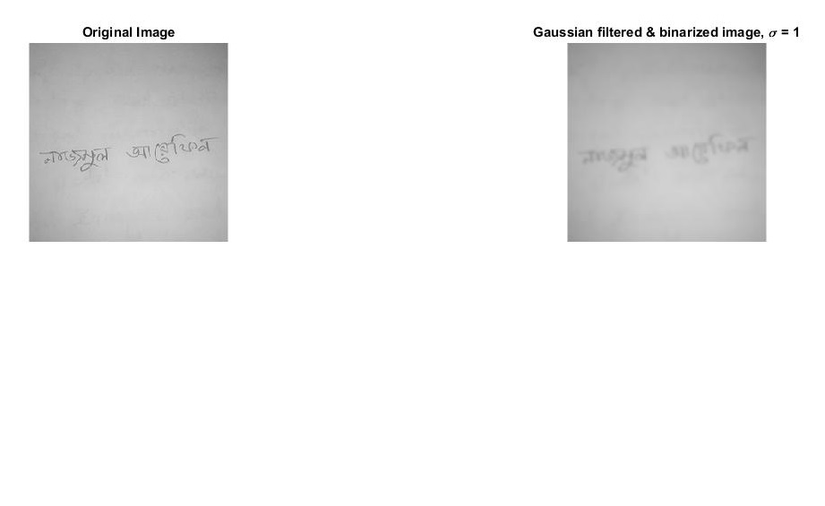
Gaussian applied ( σ = 2)

Slide 7
Gaussian & Binarized
im = imread('name.jpg');
IM = rgb2gray(im);
% imshow(IM);
[m,n] = size(IM);
M = mean(IM);
% t = graythresh(IM);
Iblur = imgaussfilt(IM, 2);
B = Iblur;
for i = 1:m
for j = 1:n
if(IM(i,j) >= 170)
B(i,j) = 255;
else
B(i,j) = 0;
end
end
end
p_edge = edge(IM, 'Sobel');
bw = bwareaopen(imfill(p_edge, 'holes'),5);
subplot(2,2,1)
imshow(IM)
title('Original Image');
subplot(2,2,2)
imshow(B)
title('Gaussian filtered & binarized image, \sigma = 1')

Slide 8
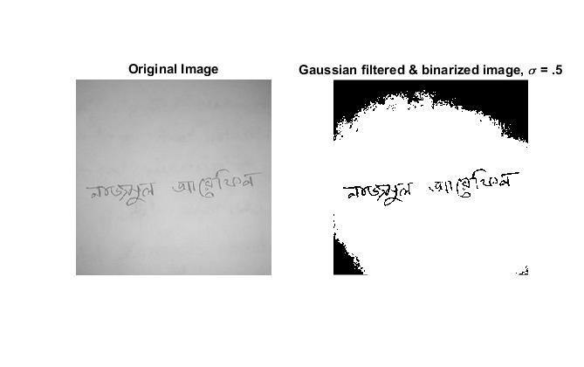
Gaussian & Binarized
Threshold = 170
Gaussian = .5

Slide 9
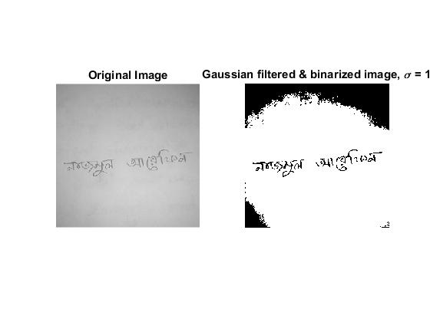
Gaussian & Binarized

Slide 10

Gaussian & Binarized

Slide 11
Edge detected by sobel (code used)
p_edge = edge(IM, 'Sobel');
bw = bwareaopen(imfill(p_edge, 'holes'),5);

Slide 12
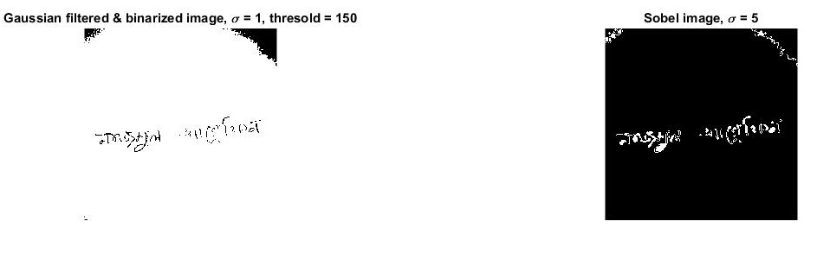
Edge detected by sobel

Slide 13
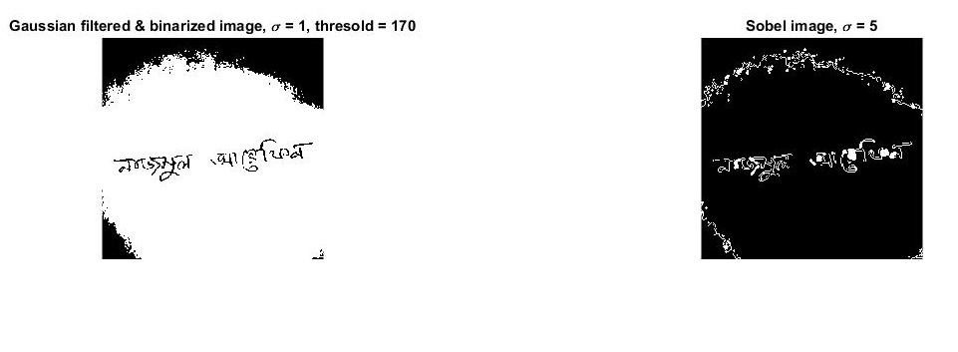
Edge detected by sobel

Slide 14
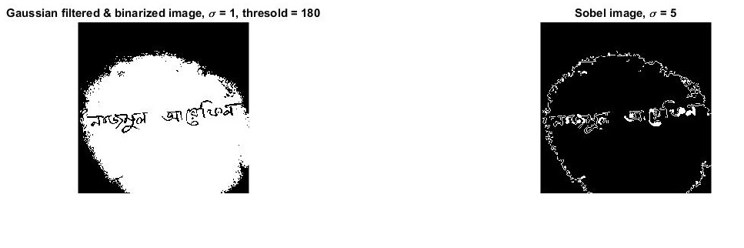
Edge detected by sobel

Slide 15
Thanks

